Slide 1
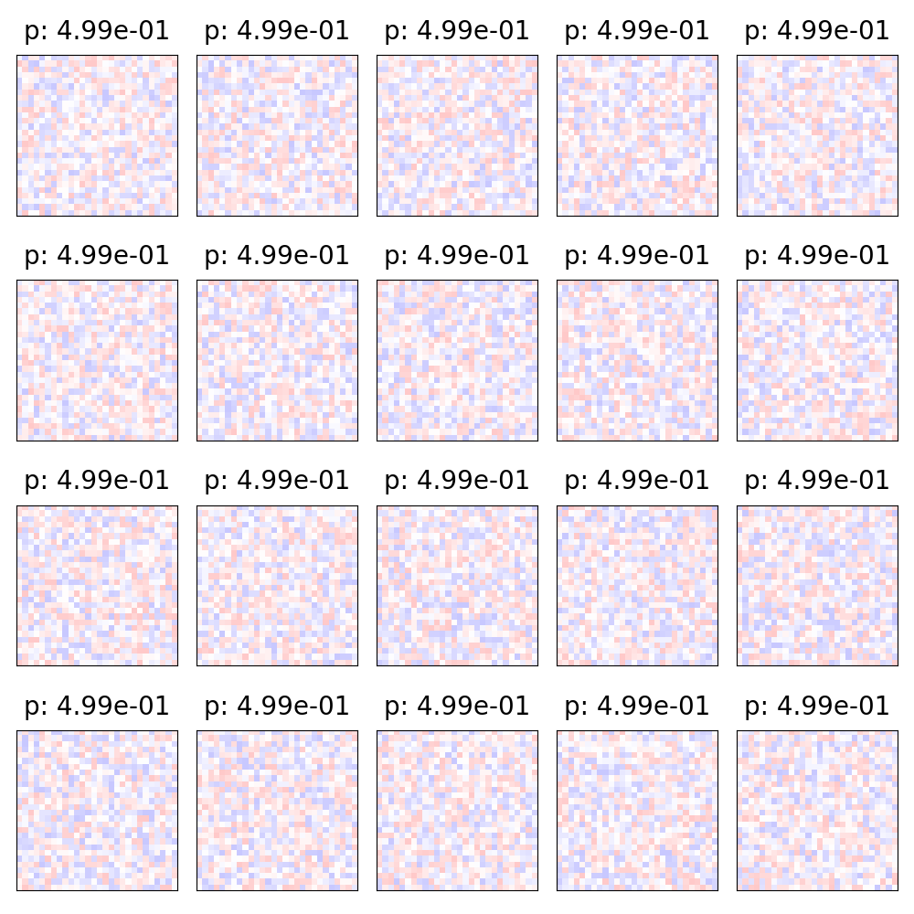
Unit 1
Unit 2
Unit 3
Unit 4
Unit 5
Unit 6
Unit 7
Unit 8
Unit 9
Unit 10
Unit 11
Unit 12
Unit 13
Unit 14
Unit 15
Unit 16
Unit 17
Unit 18
Unit 19
Unit 20

