Slide 1
CLQGA: Circuit learning quantum genetic algorithm
A genetic algorithm that designs quantum circuits that have less of a barren plateau issue

Slide 2
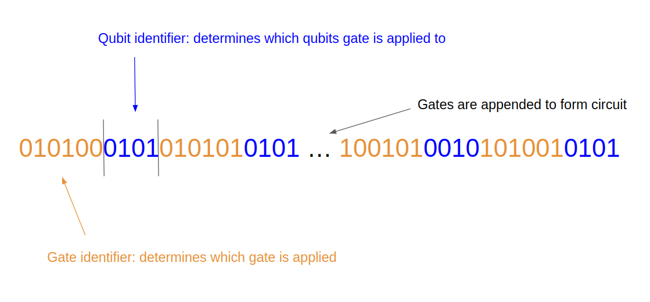
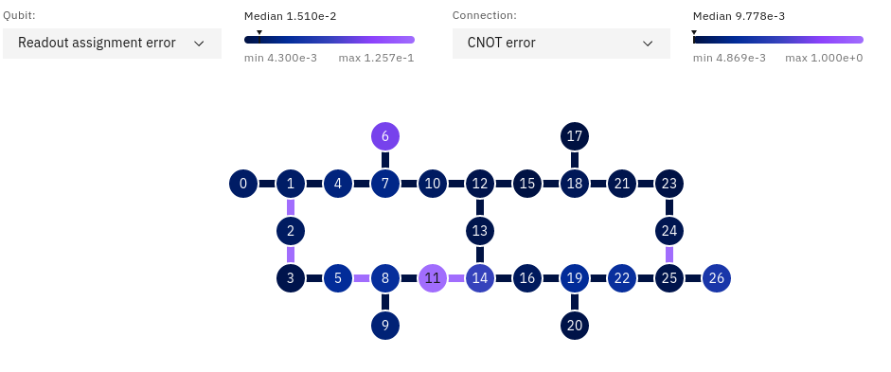
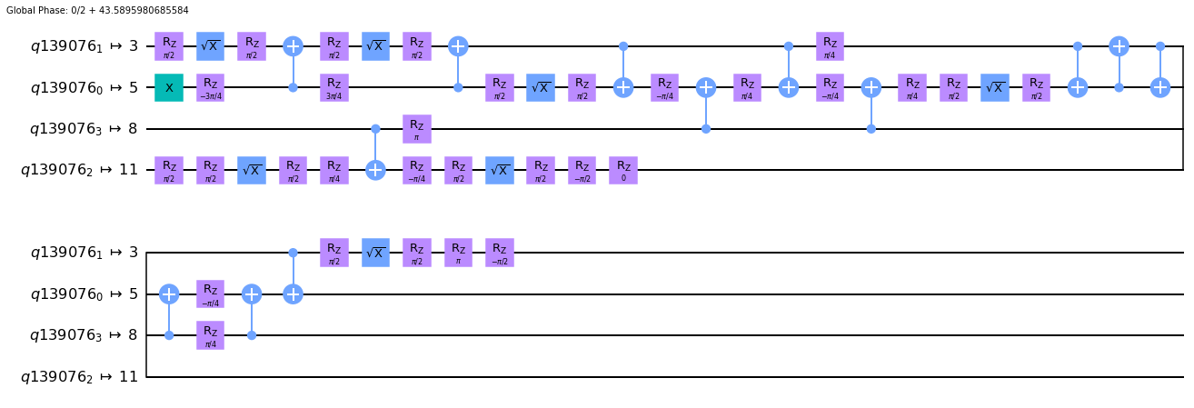
Individual chromosome
IBM chip layout
configured quantum circuit

Slide 3
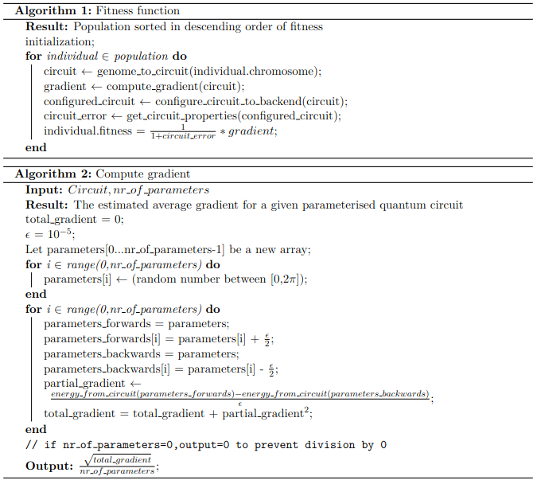
Implementation
Selection - Xenakis
Combination - Modified uniform Crossover
Mutation - Xenakis
Fitness - pointwise estimated average gradient

Slide 4
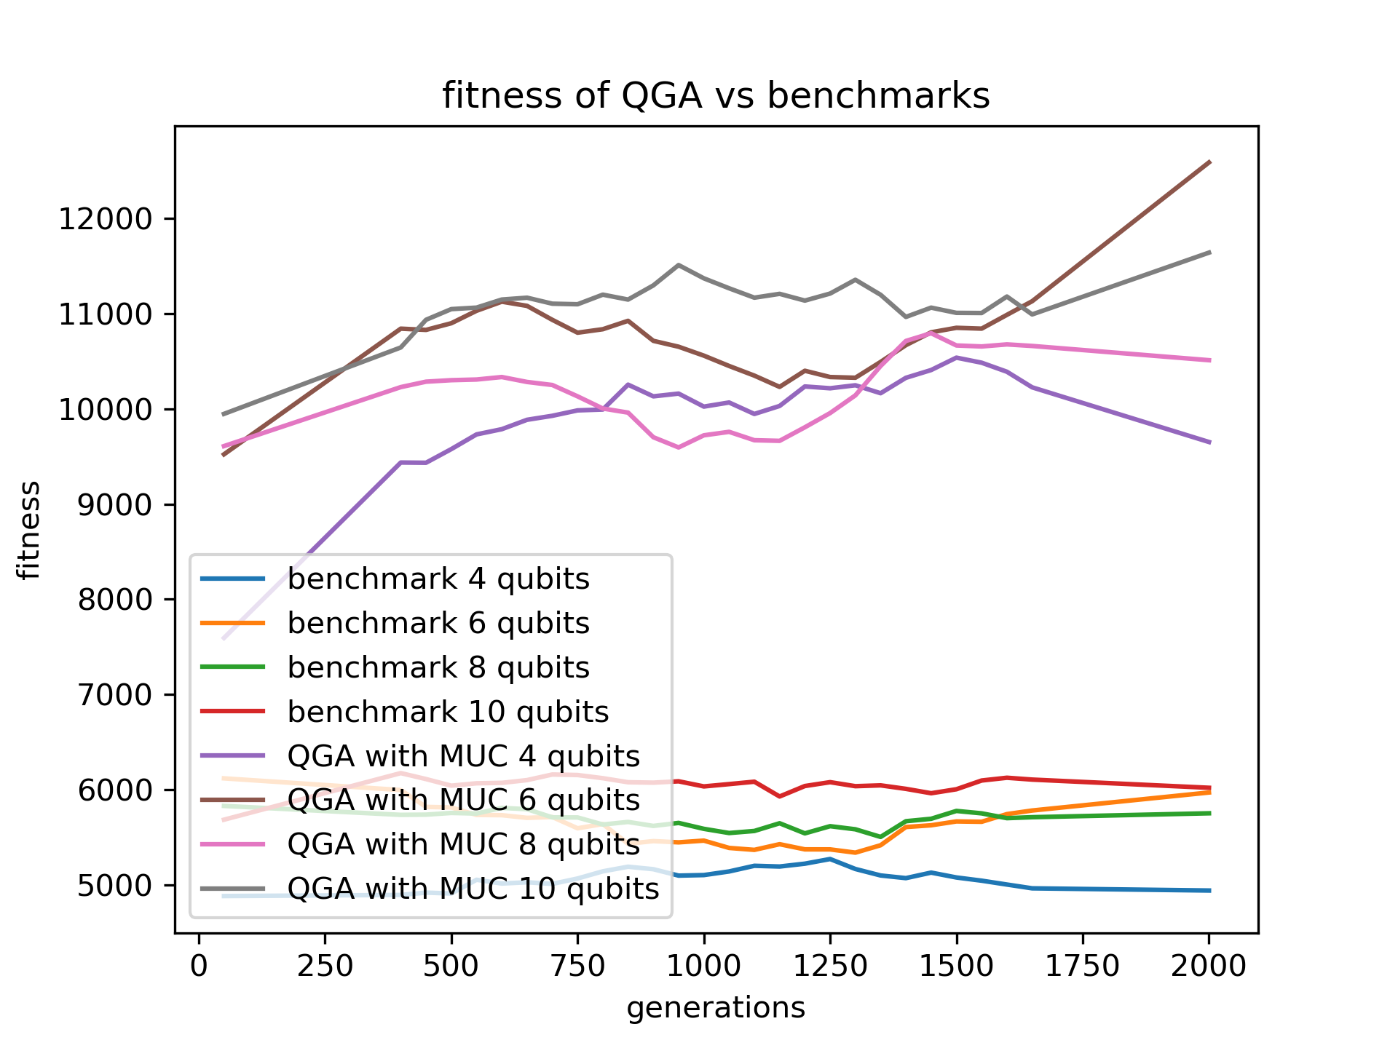
Fitness

Slide 5
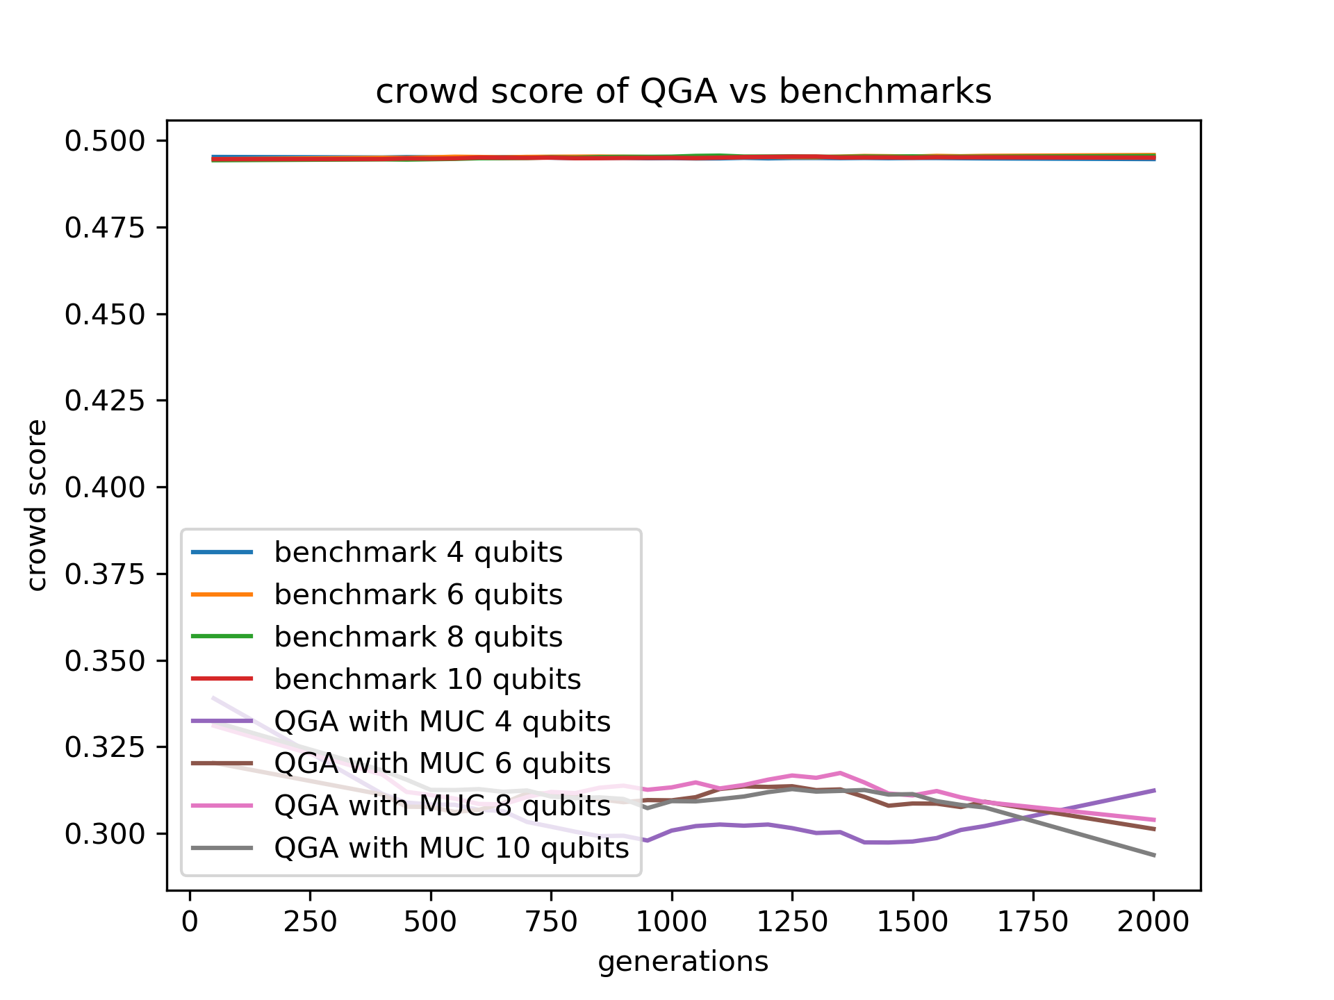
Crowd score

Slide 6
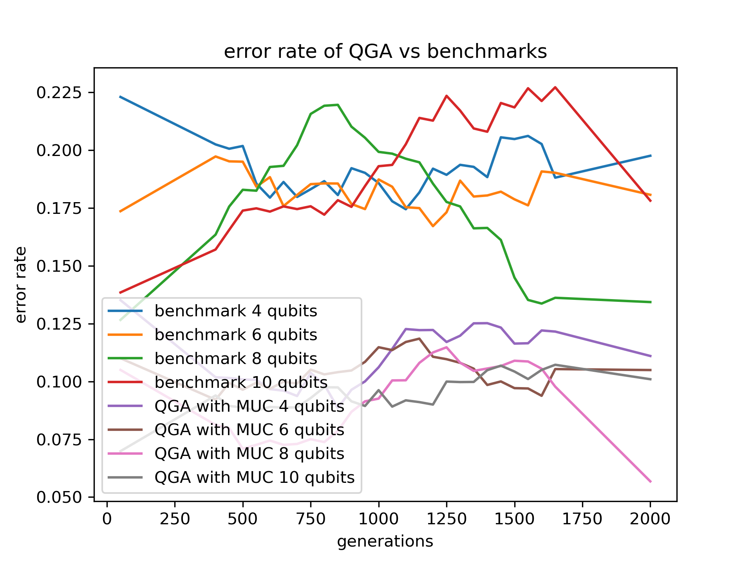
Error rate

Slide 7
Final thoughts
Comparison to “standard” ansatzes like the Hardware efficient ansatz
Run the ansatzes in a VQE on a real IBM device
Analytically analyse the landscapes of the ansatzes

