Slide 1
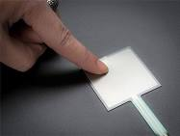
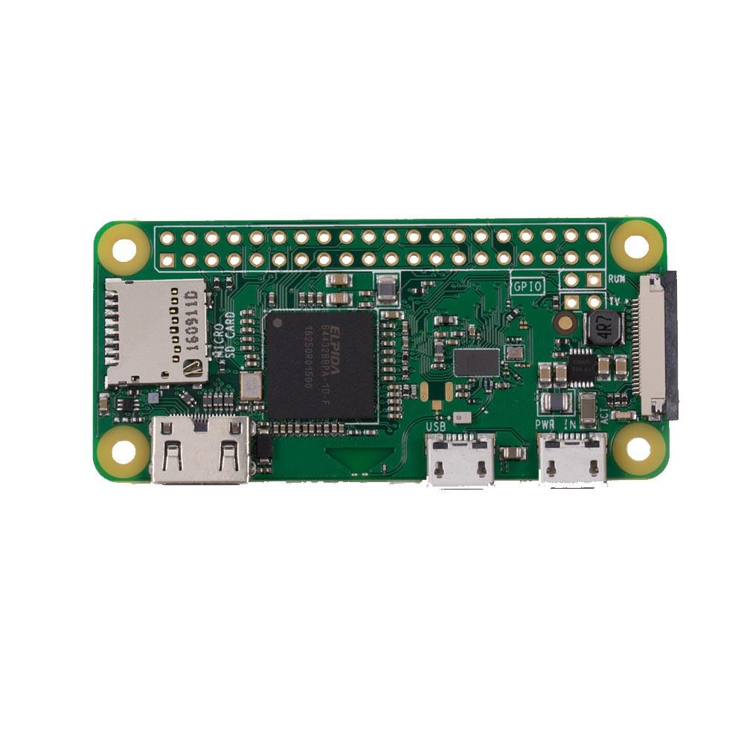

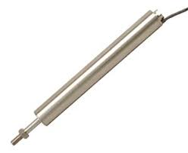
Database
Pressure Sensor
ADC
Raspberry Pi
Zero W
Displacement
Sensor

