Slide 1
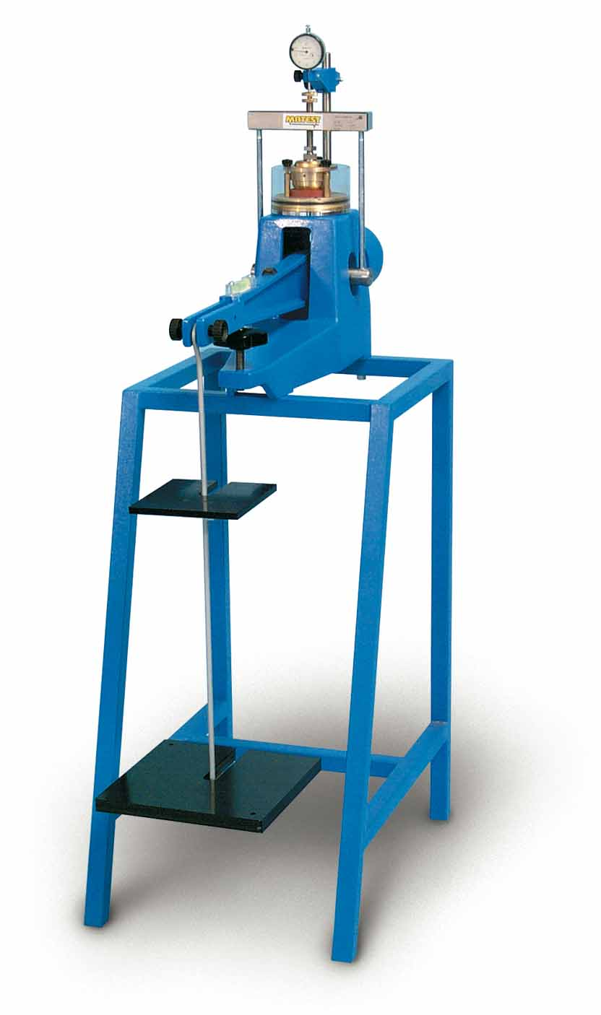
Civil Engineering Internet of Things
Modernize the engineering labs at UMD
Soil Consolidation test
  Soil sample is placed in oedometer
  Lever is loaded with progressively heavier weights
  Gauge measures displacement over
  9 days
Current process requires measurements
to be hand recorded
Goal is to automate the process

Slide 2
Objectives
Improve test accuracy
Give students easy access to the data
Automate data collection with regularly time measurements

Slide 3
Project Description
Automate data collection
  Use strain gauge to determine weight on lever arm
  Use dial indicator to measure linear displacement of soil sample
Time stamp data with a Raspberry Pi connect to eduroam
Log to a database students can access anywhere on campus

Slide 4
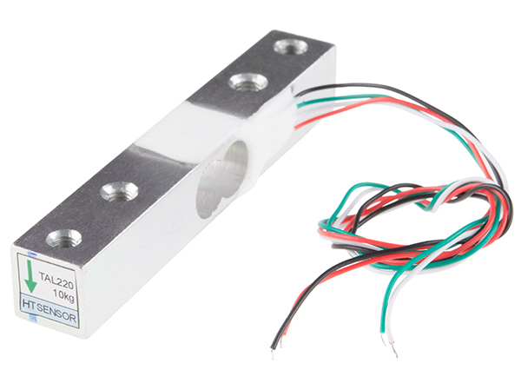

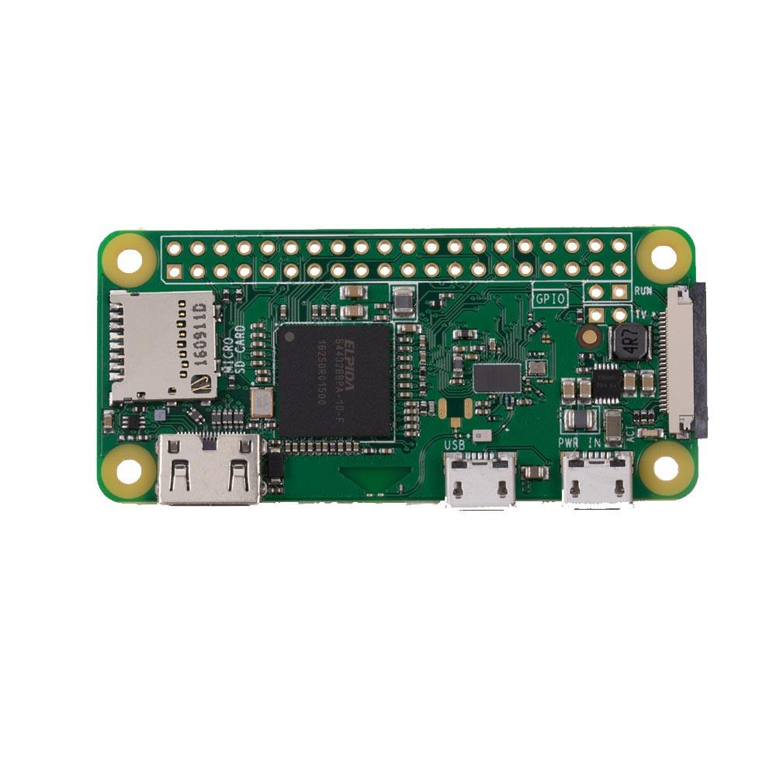

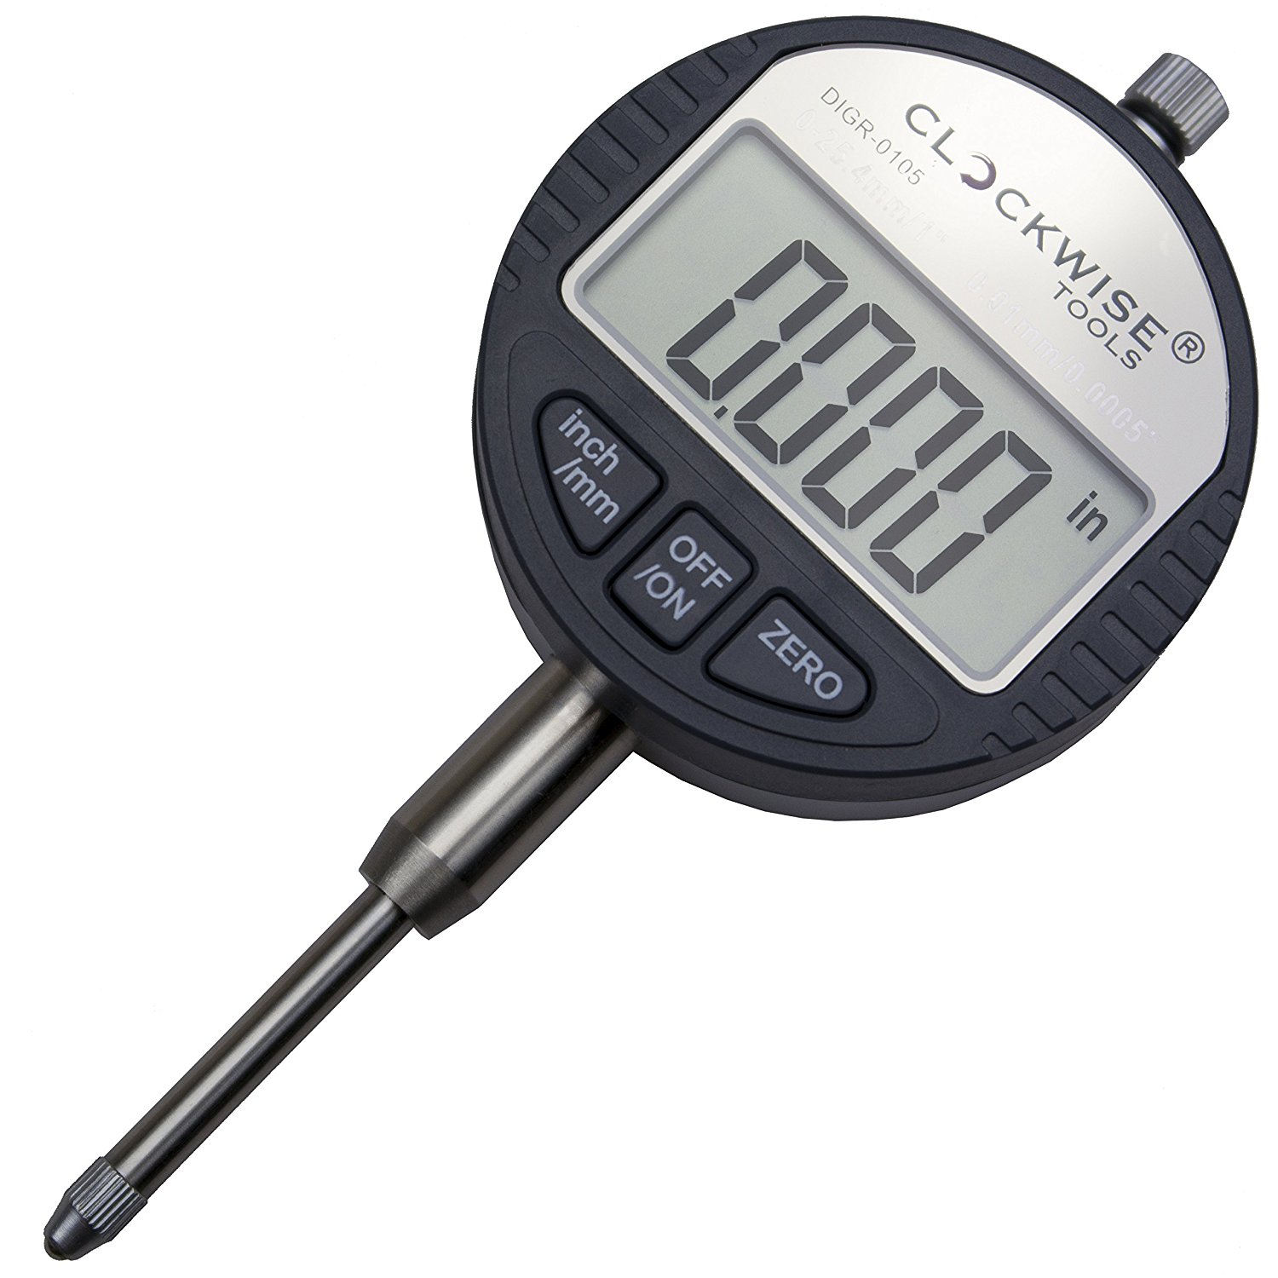
Sensor Block Diagram
Load Cell
Raspberry Pi Zero W
Database
Dial Indicator

