Slide 1

Macroeconomics: Institutions, Instability, and the Financial System
Carlin & Soskice
Chapter 14:
Fiscal Policy
These slides are authored by Hillary Wee,
UCL, Cambridge

Slide 2
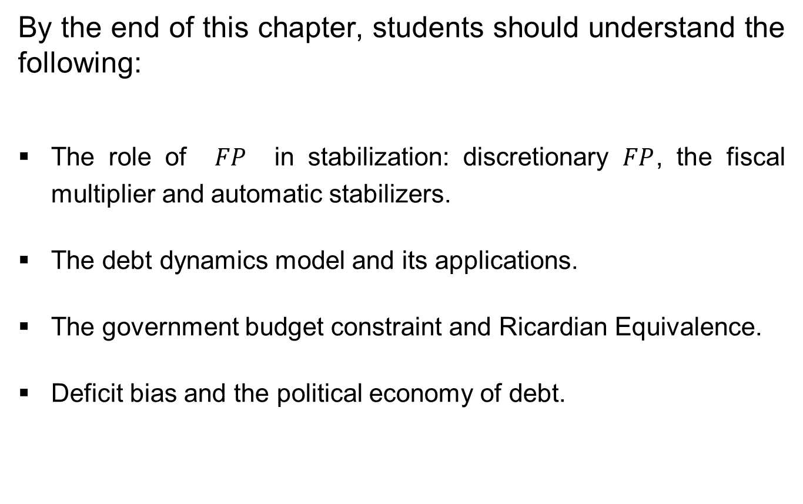
Objectives:
Chapter 14: Fiscal Policy
By the end of this chapter, students should understand the following:
The role of $FP$ in stabilization: discretionary $FP$, the fiscal multiplier and automatic stabilizers.
The debt dynamics model and its applications.
The government budget constraint and Ricardian Equivalence.
Deficit bias and the political economy of debt.

Slide 3
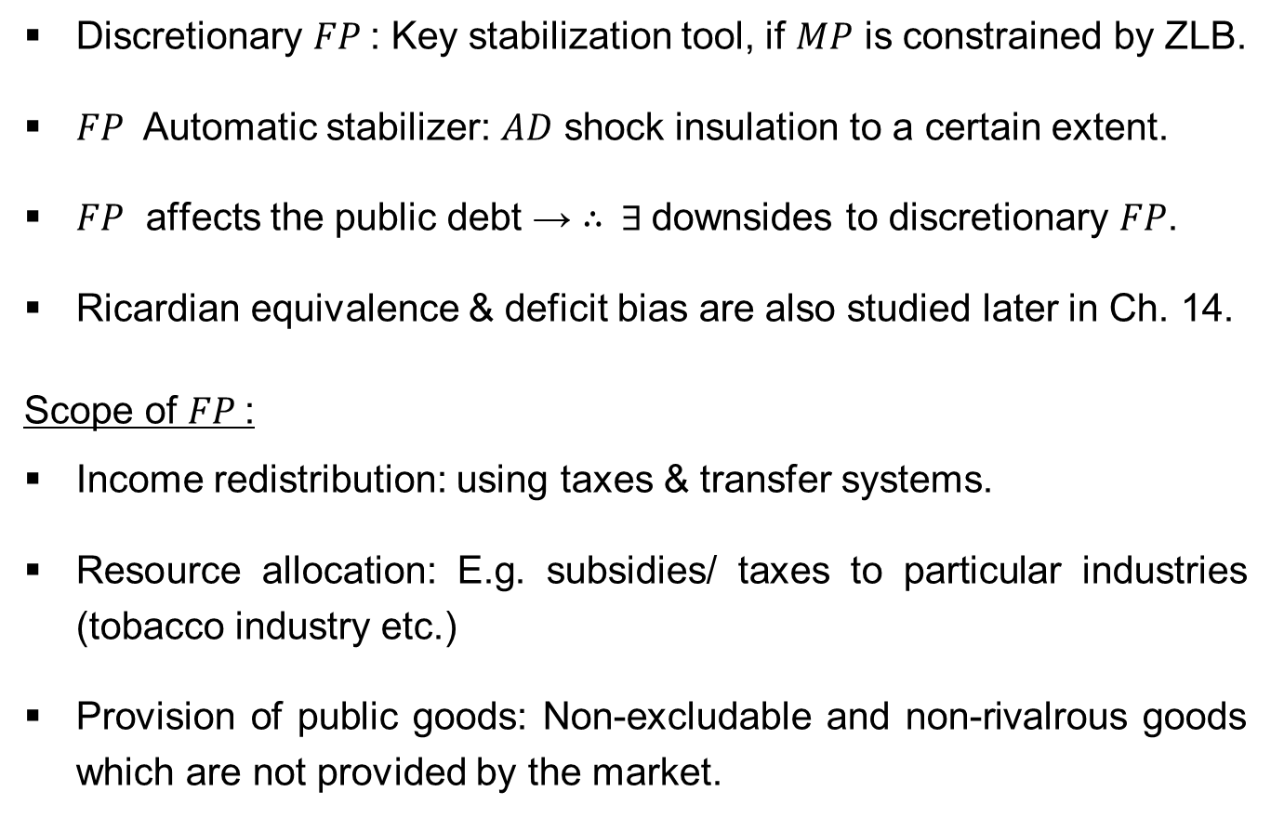
Overview:
Fiscal Policy
Discretionary $FP$: Key stabilization tool, if $MP$ is constrained by ZLB.
$FP$ Automatic stabilizer: $AD$ shock insulation to a certain extent.
$FP$ affects the public debt → ∴ $∃$ downsides to discretionary $FP$.
Ricardian equivalence & deficit bias are also studied later in Ch. 14.
Scope of $FP$:
Income redistribution: using taxes & transfer systems.
Resource allocation: E.g. subsidies/ taxes to particular industries (tobacco industry etc.)
Provision of public goods: Non-excludable and non-rivalrous goods which are not provided by the market.

Slide 4

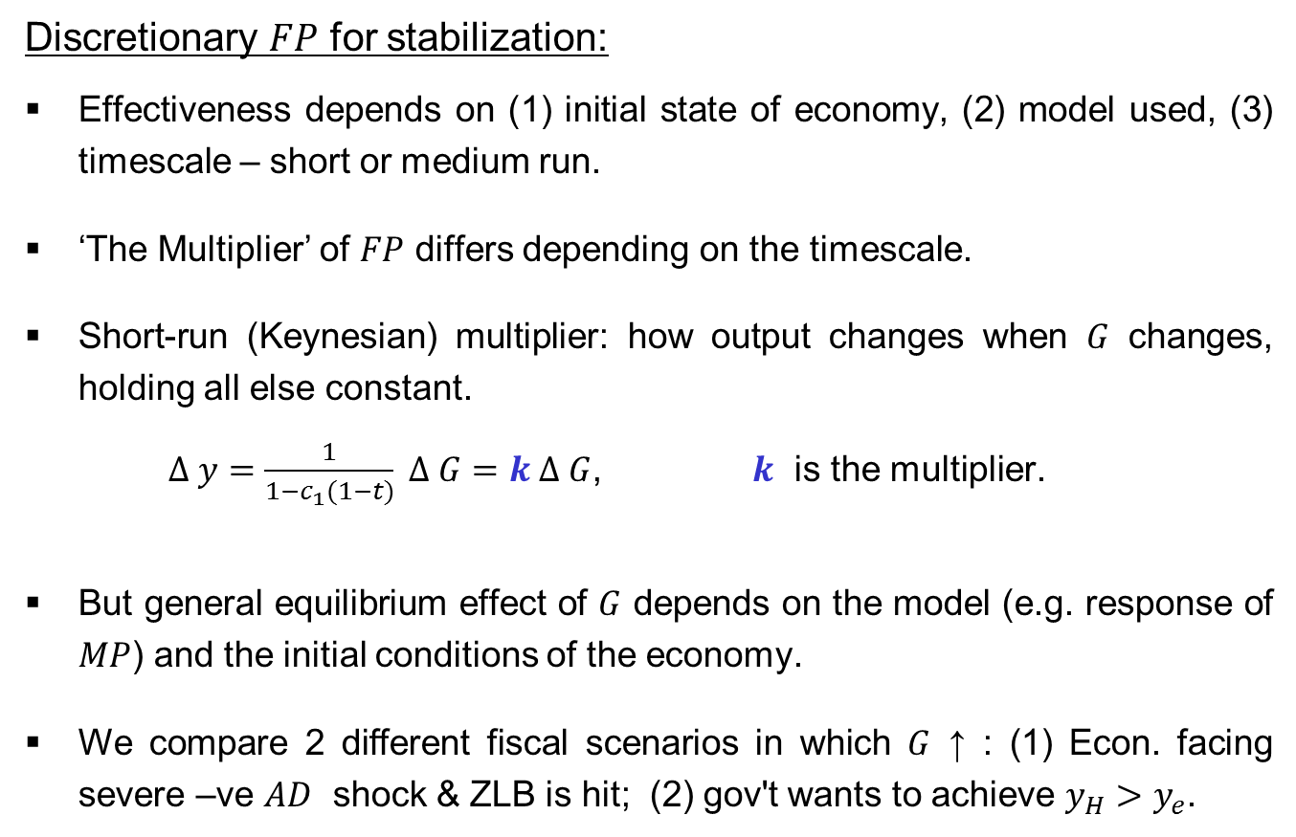
Stabilization:
Discretionary $FP$
Discretionary $FP$ for stabilization:
Effectiveness depends on (1) initial state of economy, (2) model used, (3) timescale – short or medium run.
‘The Multiplier’ of $FP$ differs depending on the timescale.
Short-run (Keynesian) multiplier: how output changes when $G$ changes, holding all else constant.
$Δ y=\frac{1}{1−c_{1}(1−t)} Δ G=k Δ G$, $k$ is the multiplier.
But general equilibrium effect of $G$ depends on the model (e.g. response of $MP$) and the initial conditions of the economy.
We compare 2 different fiscal scenarios in which $G$ ↑ : (1) Econ. facing severe –ve $AD$ shock & ZLB is hit; (2) gov't wants to achieve $y_{H}>y_{e}$.

Slide 5
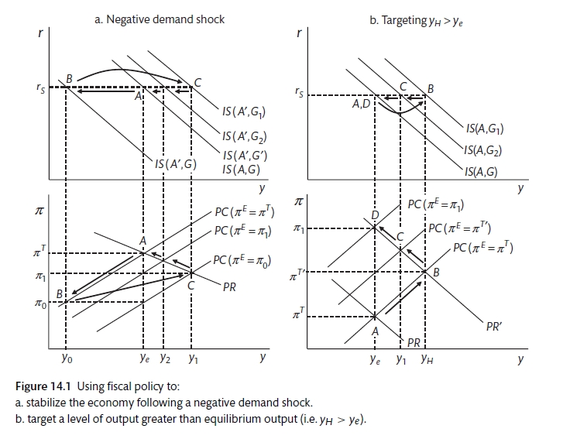

Stabilization:
Discretionary $FP$
Scenario 1: Using $FP$ for stabilization in a severe recession (Fig 14.1 a.)

Slide 6
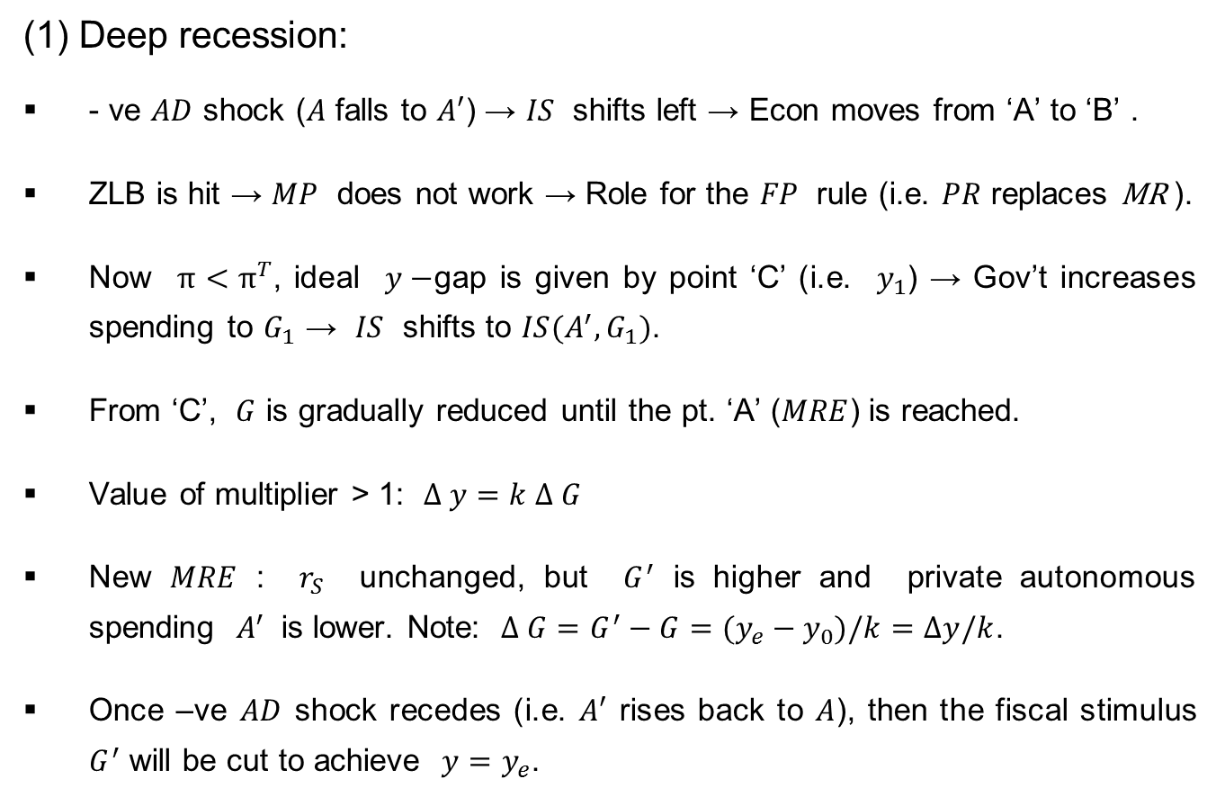
Stabilization:
Discretionary $FP$
(1) Deep recession:
- ve $AD$ shock ($A$ falls to $A′$) → $IS$ shifts left → Econ moves from ‘A’ to ‘B’ .
ZLB is hit → $MP$ does not work → Role for the $FP$ rule (i.e. $PR$ replaces MR ).
Now $π<π^{T}$, ideal $y−$gap is given by point ‘C’ (i.e. $y_{1}$) → Gov’t increases spending to $G_{1}$ → $IS$ shifts to $IS(A^{′},G_{1})$.
From ‘C’, $G$ is gradually reduced until the pt. ‘A’ ($MRE$) is reached.
Value of multiplier > 1: $Δ y=k Δ G$
New $MRE$ : $r_{S}$ unchanged, but $G^{′}$ is higher and private autonomous spending $A^{′}$ is lower. Note: $Δ G=G^{′}−G=(y_{e}−y_{0})/k=Δy/k$.
Once –ve $AD$ shock recedes (i.e. $A′$ rises back to $A$), then the fiscal stimulus $G^{′}$ will be cut to achieve ${y=y}_{e}$.

Slide 7

Stabilization:
Discretionary $FP$
2. Using $FP$ to target an above equilibrium level of output (Fig 14.1 b.)

Slide 8
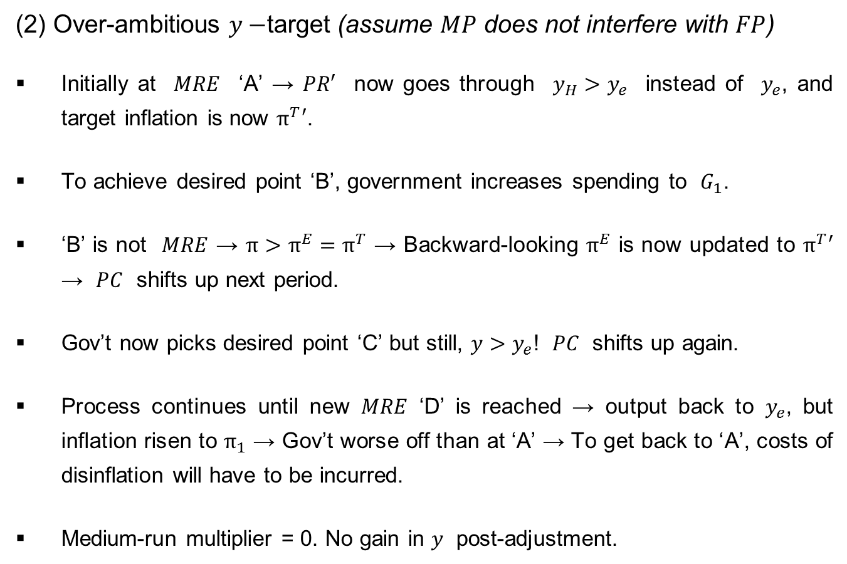
Stabilization:
Discretionary $FP$
(2) Over-ambitious $y−$target (assume $MP$ does not interfere with $FP$)
Initially at $MRE$ ‘A’ → $PR′$ now goes through $y_{H}>y_{e}$ instead of $y_{e}$, and target inflation is now $π^{T}′$.
To achieve desired point ‘B’, government increases spending to $G_{1}$.
‘B’ is not $MRE$ → $π>π^{E}=π^{T}$ → Backward-looking $π^{E}$ is now updated to $π^{T}′$ → $PC$ shifts up next period.
Gov’t now picks desired point ‘C’ but still, $y>y_{e}$! $PC$ shifts up again.
Process continues until new $MRE$ ‘D’ is reached → output back to $y_{e}$, but inflation risen to $π_{1}$ → Gov’t worse off than at ‘A’ → To get back to ‘A’, costs of disinflation will have to be incurred.
Medium-run multiplier = 0. No gain in $y$ post-adjustment.

Slide 9
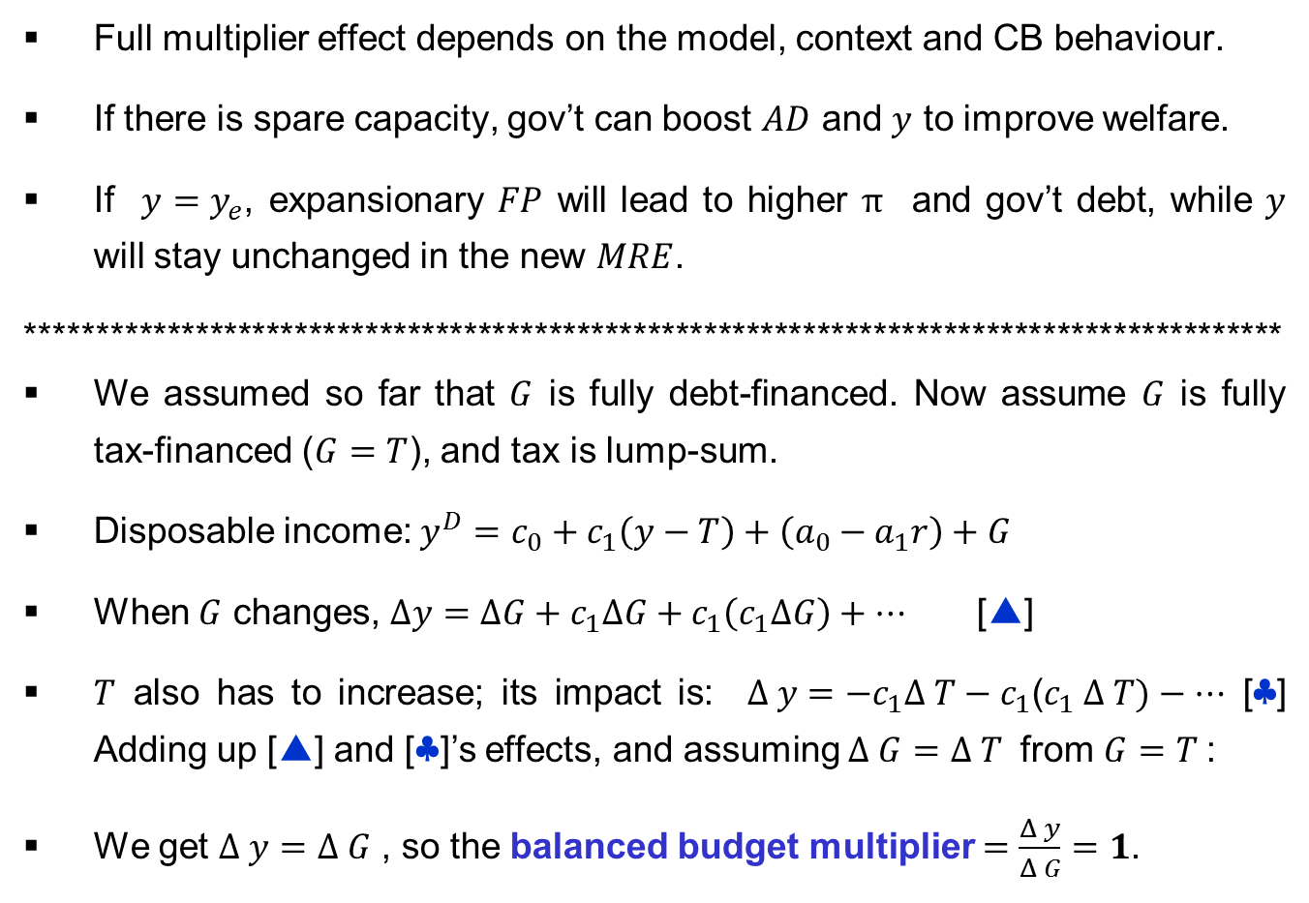
Stabilization:
The Fiscal Multiplier
Full multiplier effect depends on the model, context and CB behaviour.
If there is spare capacity, gov’t can boost $AD$ and $y$ to improve welfare.
If ${y=y}_{e}$, expansionary $FP$ will lead to higher $π$ and gov’t debt, while $y$ will stay unchanged in the new $MRE$.
*****************************************************************************************
We assumed so far that $G$ is fully debt-financed. Now assume $G$ is fully tax-financed ($G=T$), and tax is lump-sum.
Disposable income: $y^{D}=c_{0}+c_{1}\left(y−T\right)+\left(a_{0}−a_{1}r\right)+G$
When $G$ changes, $Δy=ΔG+c_{1}ΔG+c_{1}\left(c_{1}ΔG\right)+…$ [▲]
$T$ also has to increase; its impact is: $Δ y=−c_{1}Δ T−c_{1}$($c_{1} Δ T)−…$ [♣] Adding up [▲] and [♣]’s effects, and assuming $Δ G=$ $Δ T$ from $G=T$:
We get $Δ y=$ $Δ G$ , so the balanced budget multiplier $=\frac{Δ y}{Δ G}=1$.

Slide 10
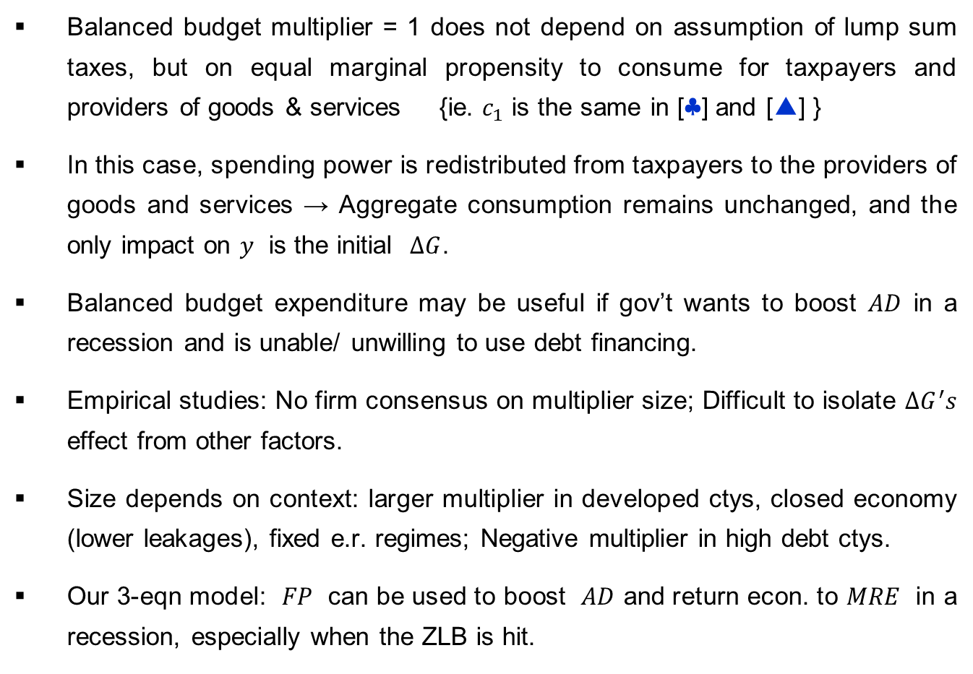
Stabilization:
The Fiscal Multiplier
Balanced budget multiplier = 1 does not depend on assumption of lump sum taxes, but on equal marginal propensity to consume for taxpayers and providers of goods & services {ie. $c_{1}$ is the same in [♣] and [▲] }
In this case, spending power is redistributed from taxpayers to the providers of goods and services → Aggregate consumption remains unchanged, and the only impact on $y$ is the initial $ΔG$.
Balanced budget expenditure may be useful if gov’t wants to boost $AD$ in a recession and is unable/ unwilling to use debt financing.
Empirical studies: No firm consensus on multiplier size; Difficult to isolate $ΔG^{′}s$ effect from other factors.
Size depends on context: larger multiplier in developed ctys, closed economy (lower leakages), fixed e.r. regimes; Negative multiplier in high debt ctys.
Our 3-eqn model: $FP$ can be used to boost $AD$ and return econ. to $MRE$ in a recession, especially when the ZLB is hit.

Slide 11
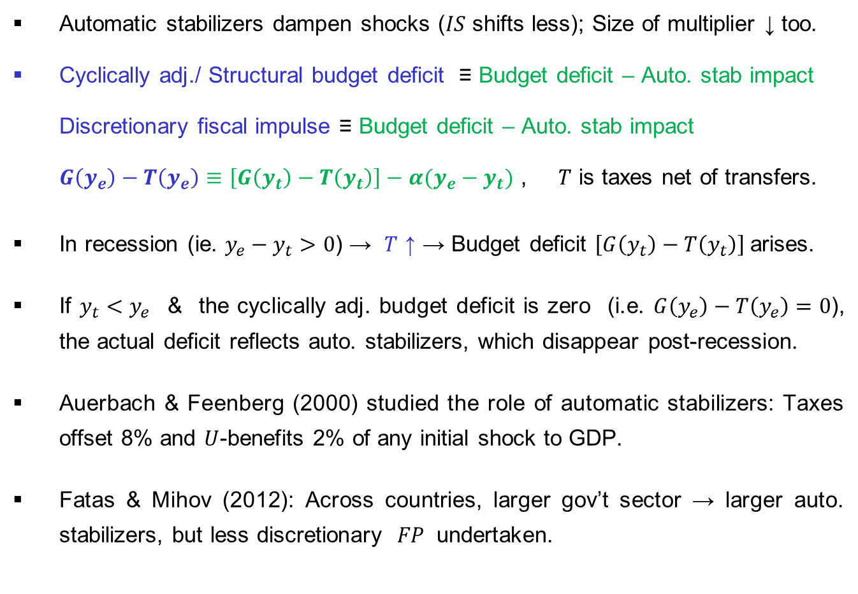
Stabilization:
Automatic Stabilizers
Automatic stabilizers dampen shocks ($IS$ shifts less); Size of multiplier ↓ too.
Cyclically adj./ Structural budget deficit ≡ Budget deficit – Auto. stab impact
Discretionary fiscal impulse ≡ Budget deficit – Auto. stab impact
$G\left(y_{e}\right)−T\left(y_{e}\right)≡\left[G\left(y_{t}\right)−T\left(y_{t}\right)\right]−α(y_{e}−y_{t})$ , $T$ is taxes net of transfers.
In recession (ie. $y_{e}−y_{t}>0$) → $T$ ↑ → Budget deficit $\left[G\left(y_{t}\right)−T\left(y_{t}\right)\right]$arises.
If $y_{t}<y_{e}$ & the cyclically adj. budget deficit is zero (i.e. $G\left(y_{e}\right)−T\left(y_{e}\right)=0$), the actual deficit reflects auto. stabilizers, which disappear post-recession.
Auerbach & Feenberg (2000) studied the role of automatic stabilizers: Taxes offset 8% and $U$-benefits 2% of any initial shock to GDP.
Fatas & Mihov (2012): Across countries, larger gov’t sector → larger auto. stabilizers, but less discretionary $FP$ undertaken.

Slide 12
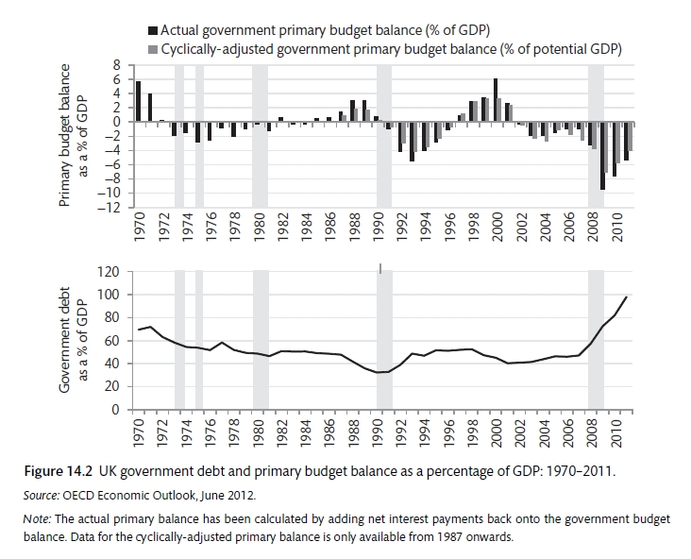

Stabilization:
Automatic Stabilizers
UK: Primary deficit worsen during & after recessions (grey shaded areas).
Usually deficits ↑ → Debt/ GDP ↑; Also, from 1970s debt/ GDP ↓ → role of $π$.

Slide 13
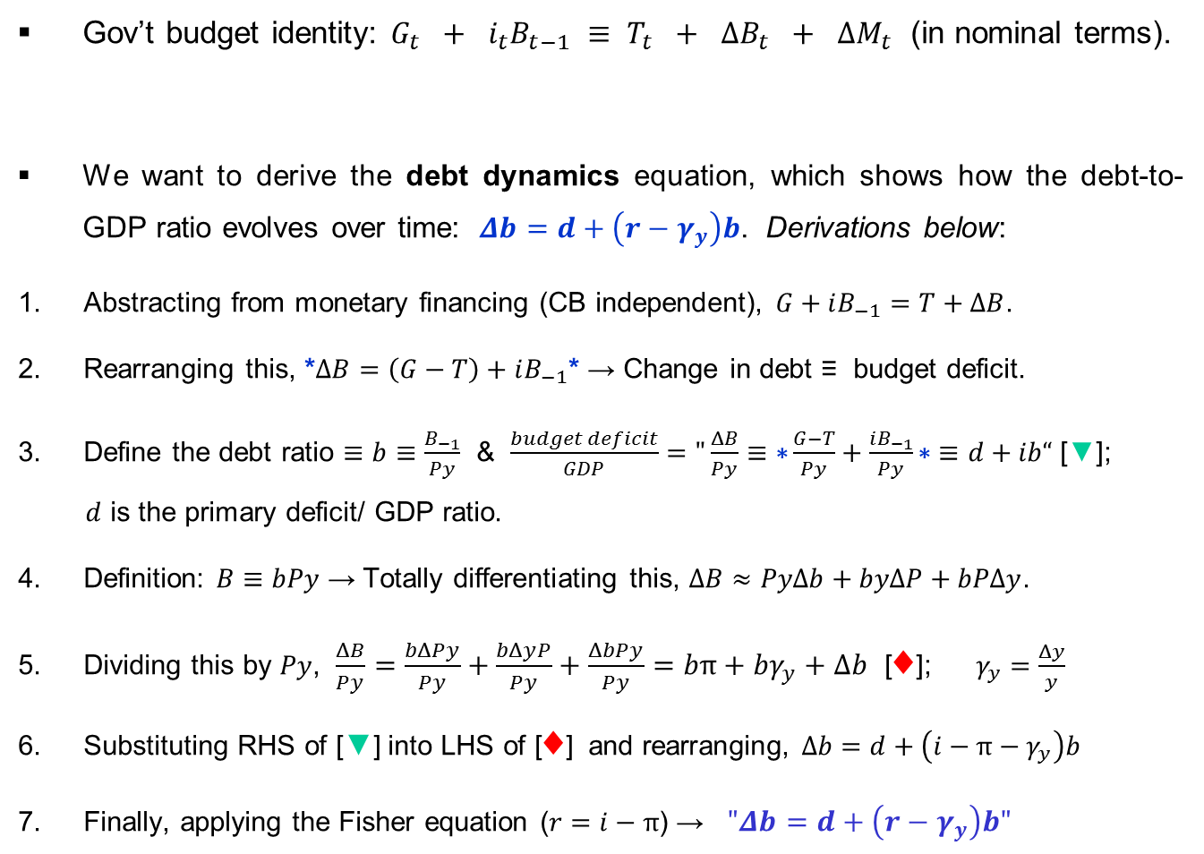
Modelling:
Debt Dynamics
Gov’t budget identity: $G_{t} + i_{t}B_{t−1} ≡ T_{t} + ΔB_{t} + ΔM_{t}$ (in nominal terms).
We want to derive the debt dynamics equation, which shows how the debt-to-GDP ratio evolves over time: $Δb=d+\left(r−γ_{y}\right)b$. Derivations below:
Abstracting from monetary financing (CB independent),$G+iB_{−1}=T+ΔB$.
Rearranging this, *$ΔB=\left(G−T\right)+iB_{−1}$* → Change in debt ≡ budget deficit.
Define the debt ratio $≡b≡\frac{B_{−1}}{Py}$ & $\frac{budget deficit}{GDP}="\frac{ΔB}{Py}≡\text{∗}\frac{G−T}{Py}+\frac{iB_{−1}}{Py}\text{∗}≡d+ib“$ [$▼$];
$d$ is the primary deficit/ GDP ratio.
Definition: $B≡bPy$ → Totally differentiating this, $ΔB≈PyΔb+byΔP+bPΔy$.
Dividing this by $Py$, $\frac{ΔB}{Py}=\frac{bΔPy}{Py}+\frac{bΔyP}{Py}+\frac{ΔbPy}{Py}=bπ+bγ_{y}+Δb$ [♦]; $γ_{y}=\frac{Δy}{y}$
Substituting RHS of [$▼$] into LHS of [♦] and rearranging, $Δb=d+\left(i−π−γ_{y}\right)b$
Finally, applying the Fisher equation ($r=i−π$) → $"Δb=d+\left(r−γ_{y}\right)b"$
gov't exp.
interest
tax revenue
new bonds
new money

Slide 14
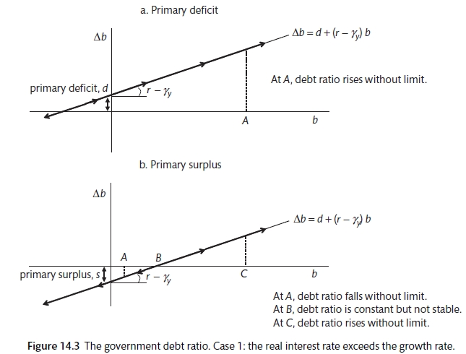

Modelling:
Debt Dynamics
$Δb=d+\left(r−γ_{y}\right)b$ : 2 cases → (i) $r>γ_{y}$ and (ii) $r<γ_{y}$.
Case 1: $r>γ_{y}$ (real int. rate above growth rate)

Slide 15
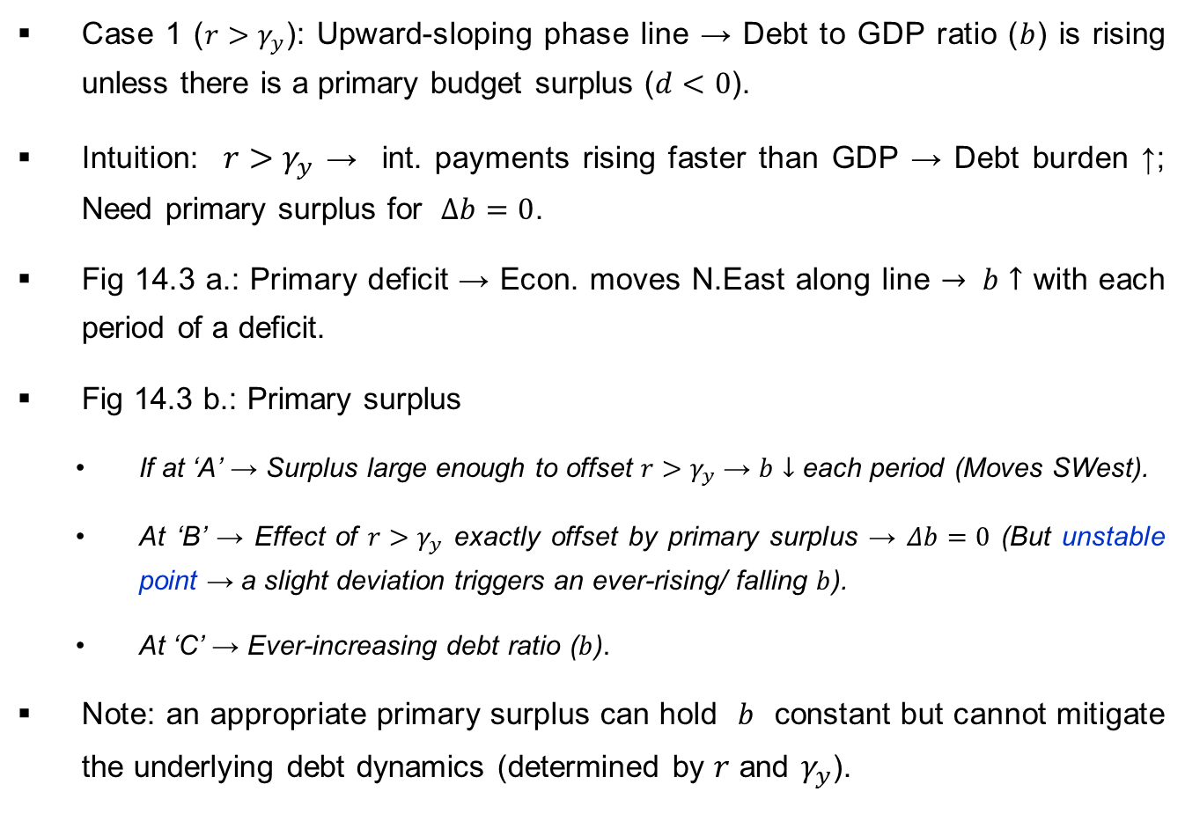
Modelling:
Debt Dynamics
Case 1 ($r>γ_{y}$): Upward-sloping phase line → Debt to GDP ratio ($b$) is rising unless there is a primary budget surplus ($d<0$).
Intuition: $r>γ_{y}$ → int. payments rising faster than GDP → Debt burden ↑; Need primary surplus for $Δb=0$.
Fig 14.3 a.: Primary deficit → Econ. moves N.East along line $→ b↑$ with each period of a deficit.
Fig 14.3 b.: Primary surplus
If at ‘A’ → Surplus large enough to offset $r>γ_{y}$ → $b↓$ each period (Moves SWest).
At ‘B’ → Effect of $r>γ_{y}$ exactly offset by primary surplus → $Δb=0$ (But unstable point → a slight deviation triggers an ever-rising/ falling $b$).
At ‘C’ → Ever-increasing debt ratio ($b$).
Note: an appropriate primary surplus can hold $b$ constant but cannot mitigate the underlying debt dynamics (determined by $r$ and $γ_{y}$).

Slide 16
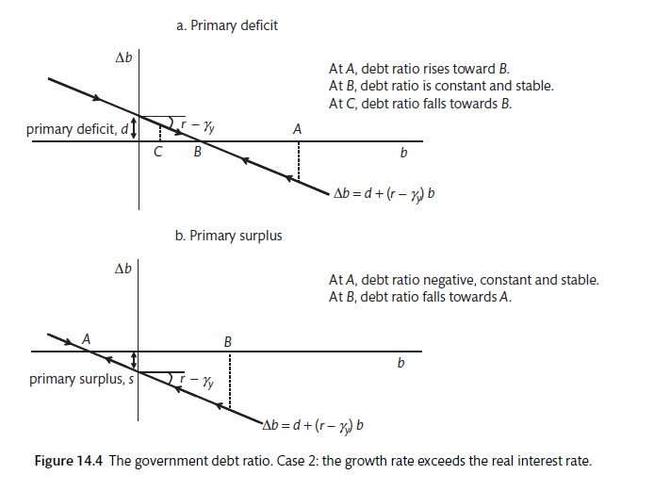

Modelling:
Debt Dynamics
Case 2: $r<γ_{y}$ (real int. rate below growth rate)

Slide 17
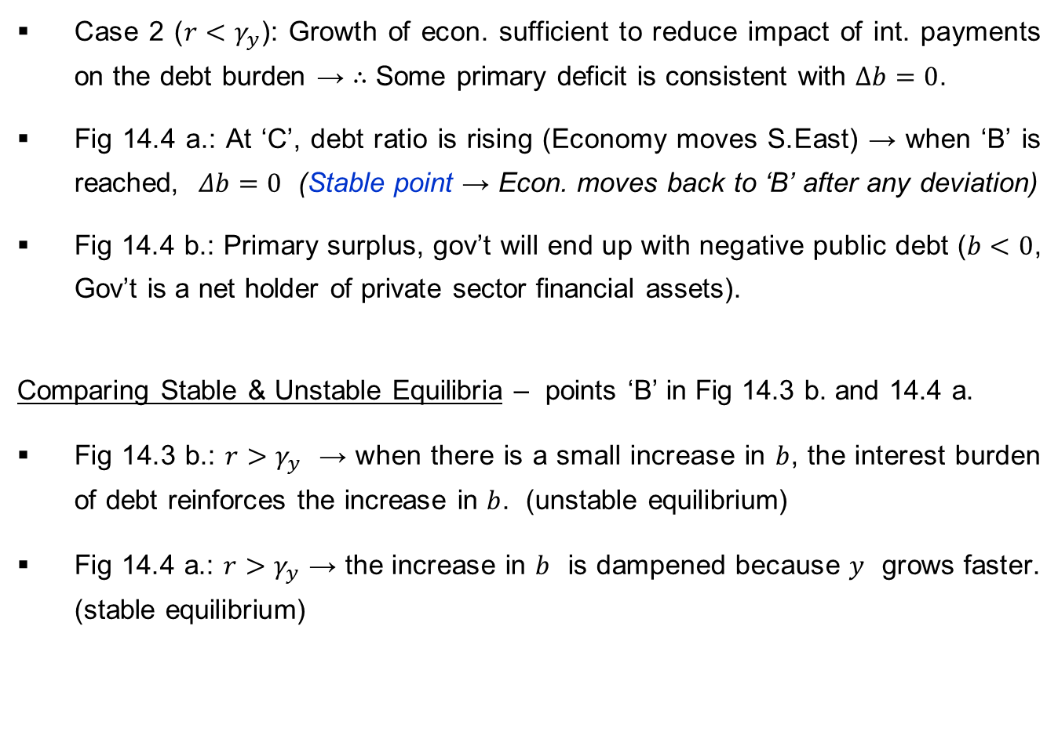
Modelling:
Debt Dynamics
Case 2 ($r<γ_{y}$): Growth of econ. sufficient to reduce impact of int. payments on the debt burden → ∴ Some primary deficit is consistent with $Δb=0$.
Fig 14.4 a.: At ‘C’, debt ratio is rising (Economy moves S.East) → when ‘B’ is reached, $Δb=0$ (Stable point → Econ. moves back to ‘B’ after any deviation)
Fig 14.4 b.: Primary surplus, gov’t will end up with negative public debt ($b<0$, Gov’t is a net holder of private sector financial assets).
Comparing Stable & Unstable Equilibria – points ‘B’ in Fig 14.3 b. and 14.4 a.
Fig 14.3 b.: $r>γ_{y}$ → when there is a small increase in $b$, the interest burden of debt reinforces the increase in $b$. (unstable equilibrium)
Fig 14.4 a.: $r>γ_{y}$ → the increase in $b$ is dampened because $y$ grows faster. (stable equilibrium)

Slide 18
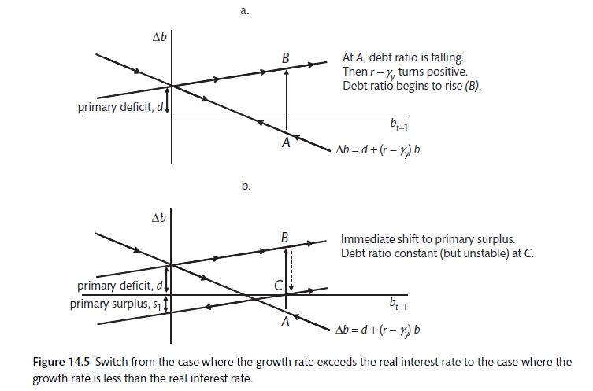

Modelling:
Debt Dynamics
Scenario analysis – Fig. 14.5 a. (below):
Initially at ‘A’, primary deficit ($d>0$) and $r<γ_{y}$.
But shock to $r$ and/or $γ_{y}$ → now, $r<γ_{y}$ → New upward-sloping phase line →
Economy jumps to ‘B’ → $b$ rises without limit unless $r$, $γ_{y}$ or $d$ changes.

Slide 19

Modelling:
Debt Dynamics
Fig 14.5 b. (below): $FP$ shifts.
Same as before, but as soon as $r<γ_{y}$ occurs, gov't tightens $FP$ (↑ $T$ and/ or ↓ $G$) → If tightening is instantaneous, econ. moves from ‘A’ to ‘C’ and $b$ will be constant (but unstable).

Slide 20
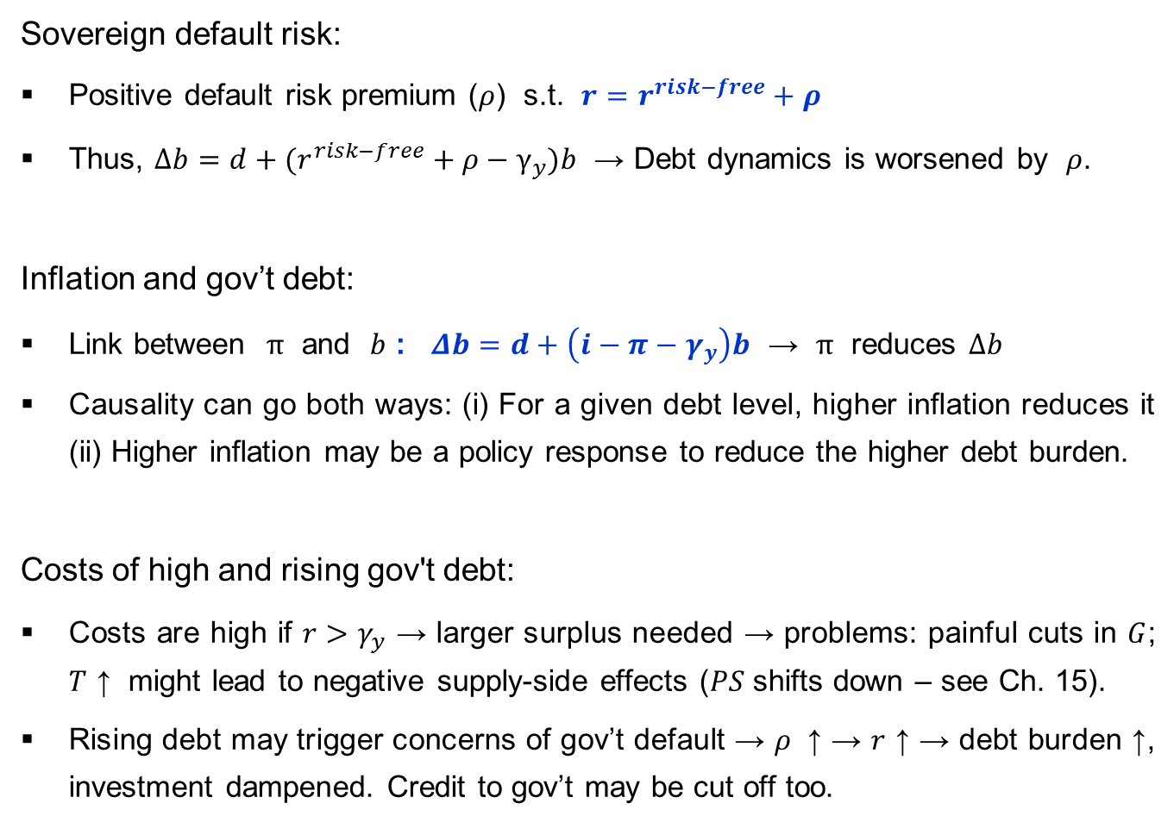
Modelling:
Debt Dynamics
Sovereign default risk:
Positive default risk premium ($ρ$) s.t. $r=r^{risk−free}+ρ$
Thus, $Δb=d+(r^{risk−free}+ρ−γ_{y})b$ → Debt dynamics is worsened by $ρ$.
Inflation and gov’t debt:
Link between $π$ and $b$ : $Δb=d+\left(i−π−γ_{y}\right)b$ → $π$ reduces $Δb$
Causality can go both ways: (i) For a given debt level, higher inflation reduces it (ii) Higher inflation may be a policy response to reduce the higher debt burden.
Costs of high and rising gov't debt:
Costs are high if $r>γ_{y}$ → larger surplus needed → problems: painful cuts in $G$; $T$ ↑ might lead to negative supply-side effects ($PS$ shifts down – see Ch. 15).
Rising debt may trigger concerns of gov’t default → $ρ$ ↑ → $r$ ↑ → debt burden ↑, investment dampened. Credit to gov’t may be cut off too.

Slide 21
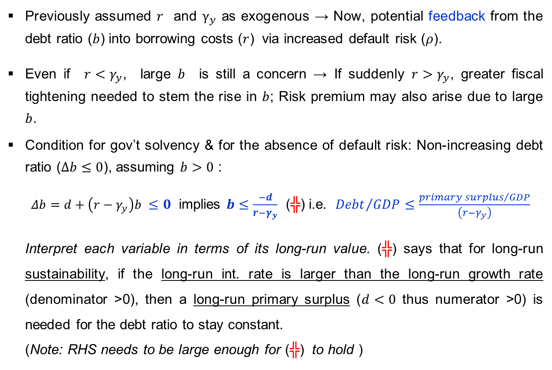
Modelling:
Debt Dynamics
Previously assumed $r$ and $γ_{y}$ as exogenous → Now, potential feedback from the debt ratio ($b$) into borrowing costs ($r$) via increased default risk ($ρ$).
Even if $r<γ_{y}$, large $b$ is still a concern → If suddenly $r>γ_{y}$, greater fiscal tightening needed to stem the rise in $b$; Risk premium may also arise due to large $b$.
Condition for gov’t solvency & for the absence of default risk: Non-increasing debt ratio ($Δb≤0$), assuming $b>0$ :
$Δb=d+\left(r−γ_{y}\right)b ≤0$ implies $b≤\frac{−d}{r−γ_{y}}$ (╬) i.e. ${Debt}/{GDP}≤\frac{{primary surplus}/{GDP}}{\left(r−γ_{y}\right)}$
Interpret each variable in terms of its long-run value. (╬) says that for long-run sustainability, if the long-run int. rate is larger than the long-run growth rate (denominator >0), then a long-run primary surplus ($d<0$ thus numerator >0) is needed for the debt ratio to stay constant.
(Note: RHS needs to be large enough for (╬) to hold )

Slide 22
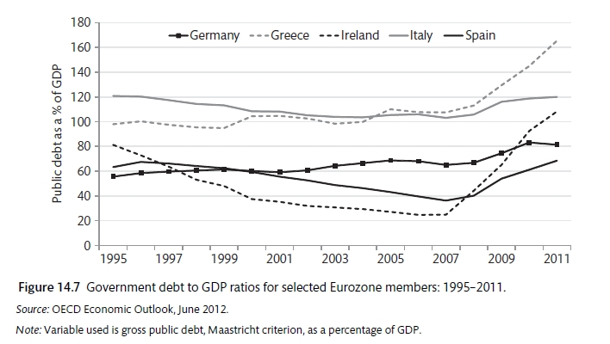


Application:
Debt Dynamics
Eurozone sovereign debt crisis: $Δb>0$ btw 2008-11. We can explain this using $Δb=d+(r^{risk−free}+ρ−γ_{y})b$ → For $Δb>0$, we simply need RHS>0.
$d>0$ from bailing out banks; $γ_{y}$ ↓ from collapsed $AD$ due to the global fin. crisis; $ρ$ ↑ from fears of default in the periphery.
Even gov’ts with low & stable $b$ are vulnerable to $r>γ_{y}$.
E.g. debt explosion in Ireland (25% in 2007 to 108% by 2011)

Slide 23
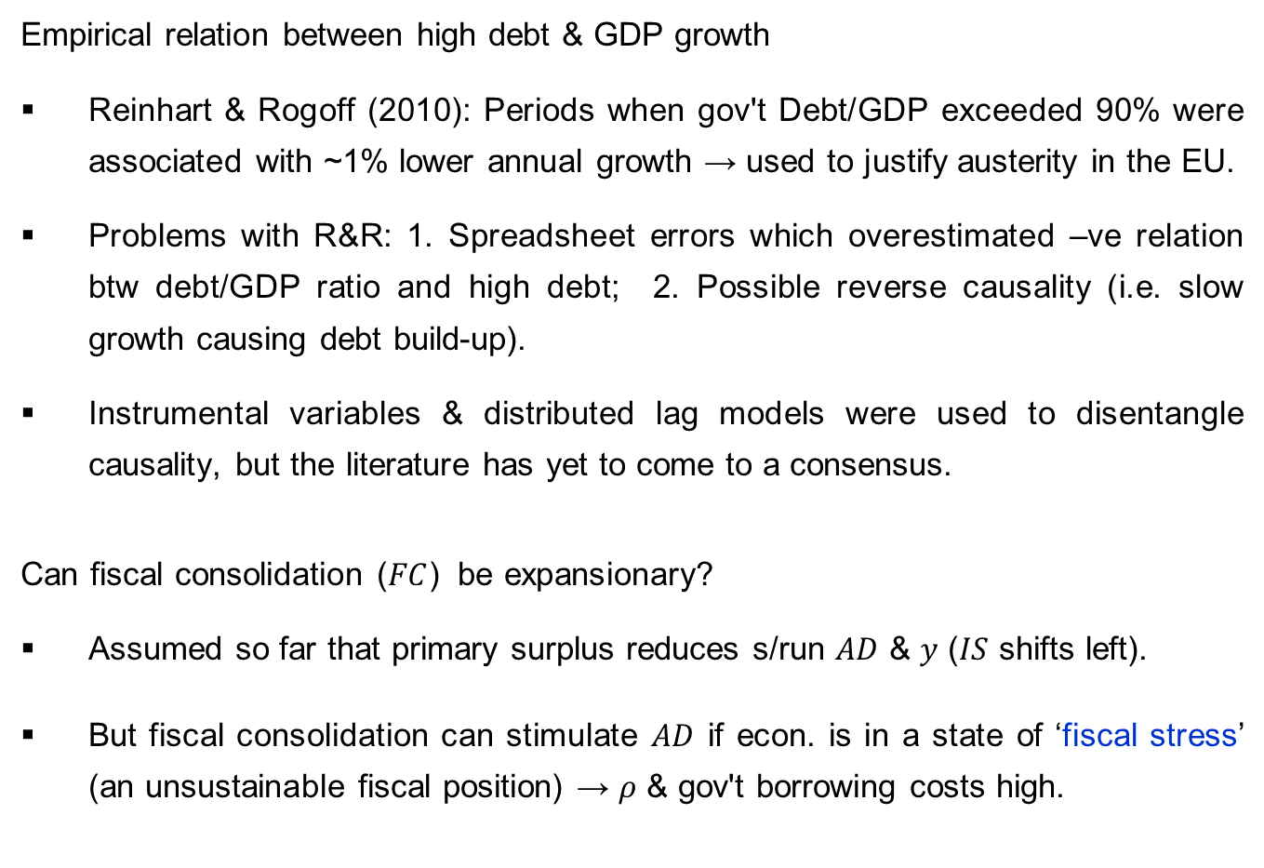
Application:
Debt Dynamics
Empirical relation between high debt & GDP growth
Reinhart & Rogoff (2010): Periods when gov't Debt/GDP exceeded 90% were associated with ~1% lower annual growth → used to justify austerity in the EU.
Problems with R&R: 1. Spreadsheet errors which overestimated –ve relation btw debt/GDP ratio and high debt; 2. Possible reverse causality (i.e. slow growth causing debt build-up).
Instrumental variables & distributed lag models were used to disentangle causality, but the literature has yet to come to a consensus.
Can fiscal consolidation ($FC$) be expansionary?
Assumed so far that primary surplus reduces s/run $AD$ & $y$ ($IS$ shifts left).
But fiscal consolidation can stimulate $AD$ if econ. is in a state of ‘fiscal stress’ (an unsustainable fiscal position) → $ρ$ & gov't borrowing costs high.

Slide 24
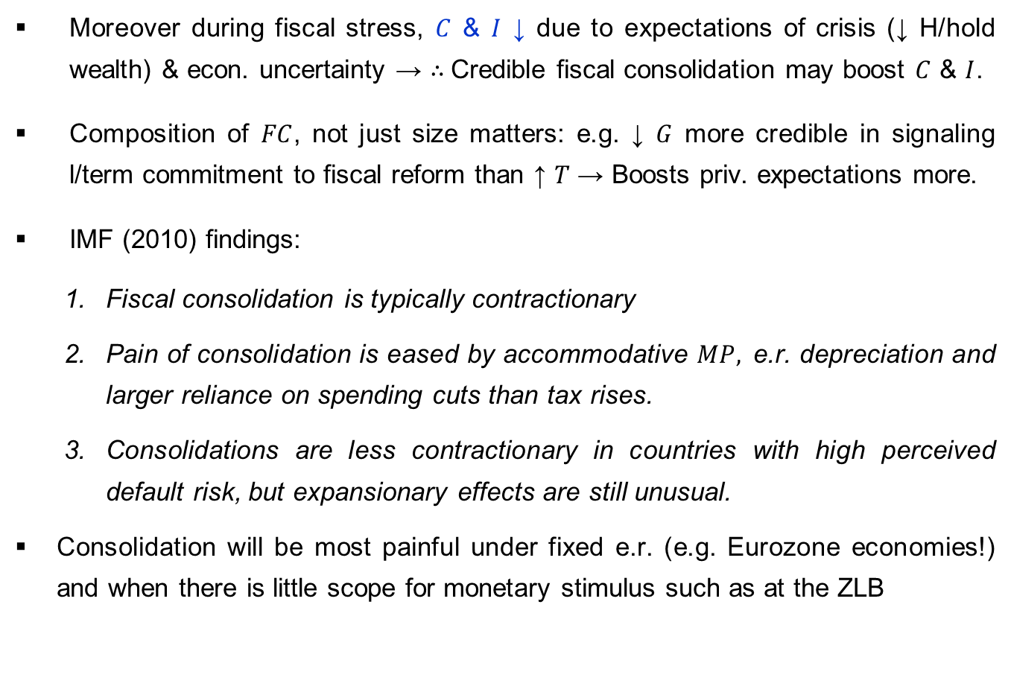
Application:
Debt Dynamics
Moreover during fiscal stress, $C$ & $I$ ↓ due to expectations of crisis (↓ H/hold wealth) & econ. uncertainty → ∴ Credible fiscal consolidation may boost $C$ & $I$.
Composition of $FC$, not just size matters: e.g. ↓ $G$ more credible in signaling l/term commitment to fiscal reform than ↑ $T$ → Boosts priv. expectations more.
IMF (2010) findings:
Fiscal consolidation is typically contractionary
Pain of consolidation is eased by accommodative $MP,$e.r. depreciation and larger reliance on spending cuts than tax rises.
Consolidations are less contractionary in countries with high perceived default risk, but expansionary effects are still unusual.
Consolidation will be most painful under fixed e.r. (e.g. Eurozone economies!) and when there is little scope for monetary stimulus such as at the ZLB

Slide 25
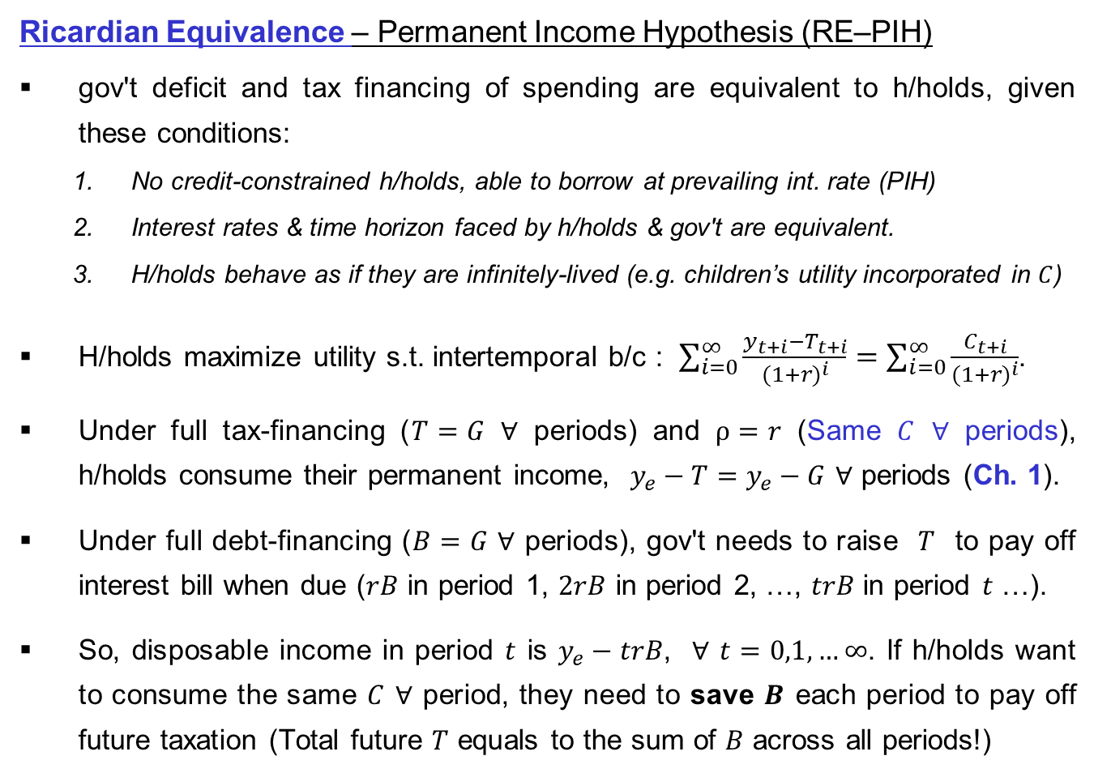
Modelling:
Ricardian Equivalence
Ricardian Equivalence – Permanent Income Hypothesis (RE–PIH)
gov't deficit and tax financing of spending are equivalent to h/holds, given these conditions:
No credit-constrained h/holds, able to borrow at prevailing int. rate (PIH)
Interest rates & time horizon faced by h/holds & gov't are equivalent.
H/holds behave as if they are infinitely-lived (e.g. children’s utility incorporated in $C$)
H/holds maximize utility s.t. intertemporal b/c : $\sum_{i=0}^{∞}{\frac{y_{t+i}−T_{t+i}}{{(1+r)}^{i}}}=\sum_{i=0}^{∞}{\frac{C_{t+i}}{{(1+r)}^{i}}}$.
Under full tax-financing ($T=G$ $∀$ periods) and $ρ=r$ (Same $C$ $∀$ periods), h/holds consume their permanent income, $y_{e}−T=y_{e}−G$ $∀$ periods (Ch. 1).
Under full debt-financing ($B=G$ $∀$ periods), gov't needs to raise $T$ to pay off interest bill when due ($rB$ in period 1, $2rB$ in period 2, …, $trB$ in period $t$ …).
So, disposable income in period $t$ is $y_{e}−trB$, $∀$ $t=0,1, …∞$. If h/holds want to consume the same $C$ $∀$ period, they need to save $B$ each period to pay off future taxation (Total future $T$ equals to the sum of $B$ across all periods!)

Slide 26
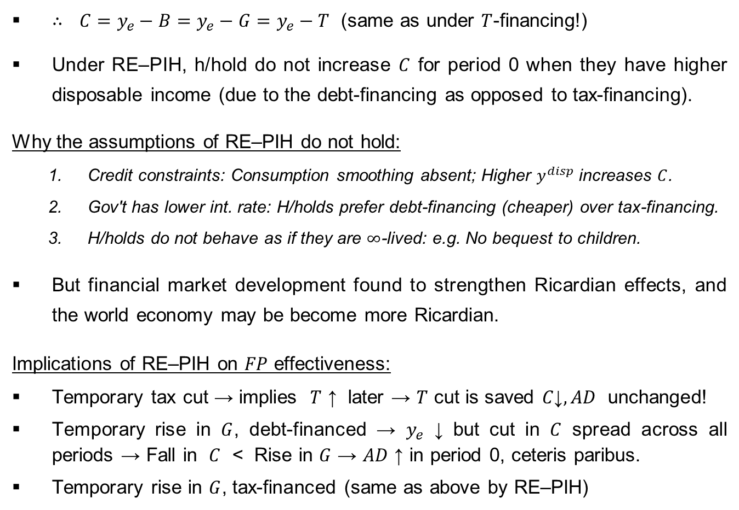
Modelling:
Ricardian Equivalence
∴ $C=y_{e}−B=y_{e}−G=y_{e}−T$ (same as under $T$-financing!)
Under RE–PIH, h/hold do not increase $C$ for period 0 when they have higher disposable income (due to the debt-financing as opposed to tax-financing).
Why the assumptions of RE–PIH do not hold:
Credit constraints: Consumption smoothing absent; Higher $y^{disp}$ increases $C$.
Gov't has lower int. rate: H/holds prefer debt-financing (cheaper) over tax-financing.
H/holds do not behave as if they are $∞$-lived: e.g. No bequest to children.
But financial market development found to strengthen Ricardian effects, and the world economy may be become more Ricardian.
Implications of RE–PIH on $FP$ effectiveness:
Temporary tax cut → implies $T$ ↑ later → $T$ cut is saved $C\text{↓}, AD$ unchanged!
Temporary rise in $G$, debt-financed → $y_{e}$ ↓ but cut in $C$ spread across all periods → Fall in $C$ < Rise in $G$ → $AD$ ↑ in period 0, ceteris paribus.
Temporary rise in $G$, tax-financed (same as above by RE–PIH)

Slide 27
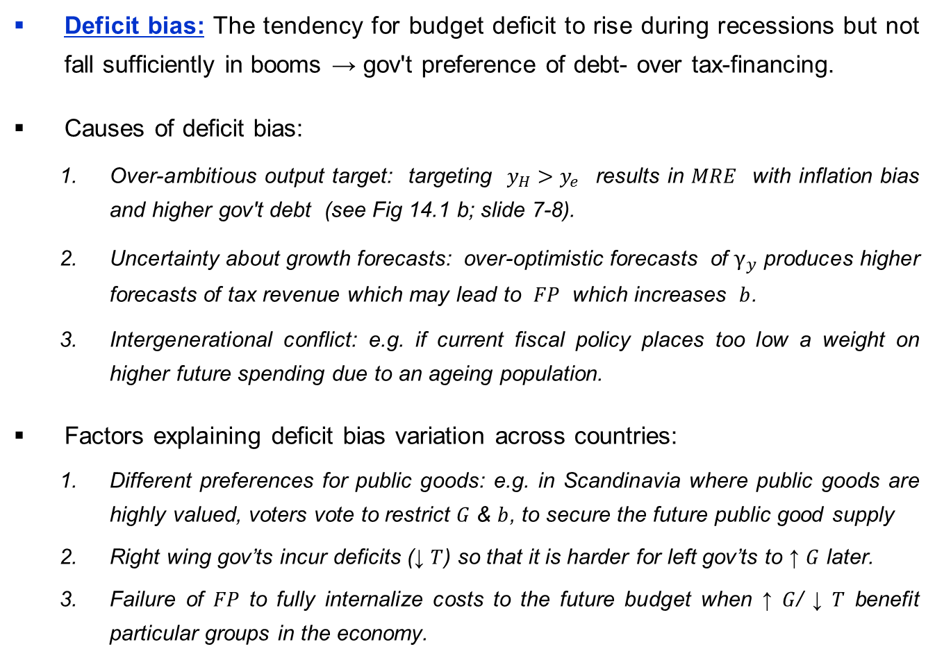
Application:
Deficit Bias
Deficit bias: The tendency for budget deficit to rise during recessions but not fall sufficiently in booms → gov't preference of debt- over tax-financing.
Causes of deficit bias:
Over-ambitious output target: targeting $y_{H}>y_{e}$ results in $MRE$ with inflation bias and higher gov't debt (see Fig 14.1 b; slide 7-8).
Uncertainty about growth forecasts: over-optimistic forecasts of $γ_{y}$ produces higher forecasts of tax revenue which may lead to $FP$ which increases $b$.
Intergenerational conflict: e.g. if current fiscal policy places too low a weight on higher future spending due to an ageing population.
Factors explaining deficit bias variation across countries:
Different preferences for public goods: e.g. in Scandinavia where public goods are highly valued, voters vote to restrict $G$ & $b$, to secure the future public good supply
Right wing gov’ts incur deficits (↓ $T$) so that it is harder for left gov’ts to ↑ $G$ later.
Failure of $FP$ to fully internalize costs to the future budget when ↑ $G$/ ↓ $T$ benefit particular groups in the economy.

Slide 28
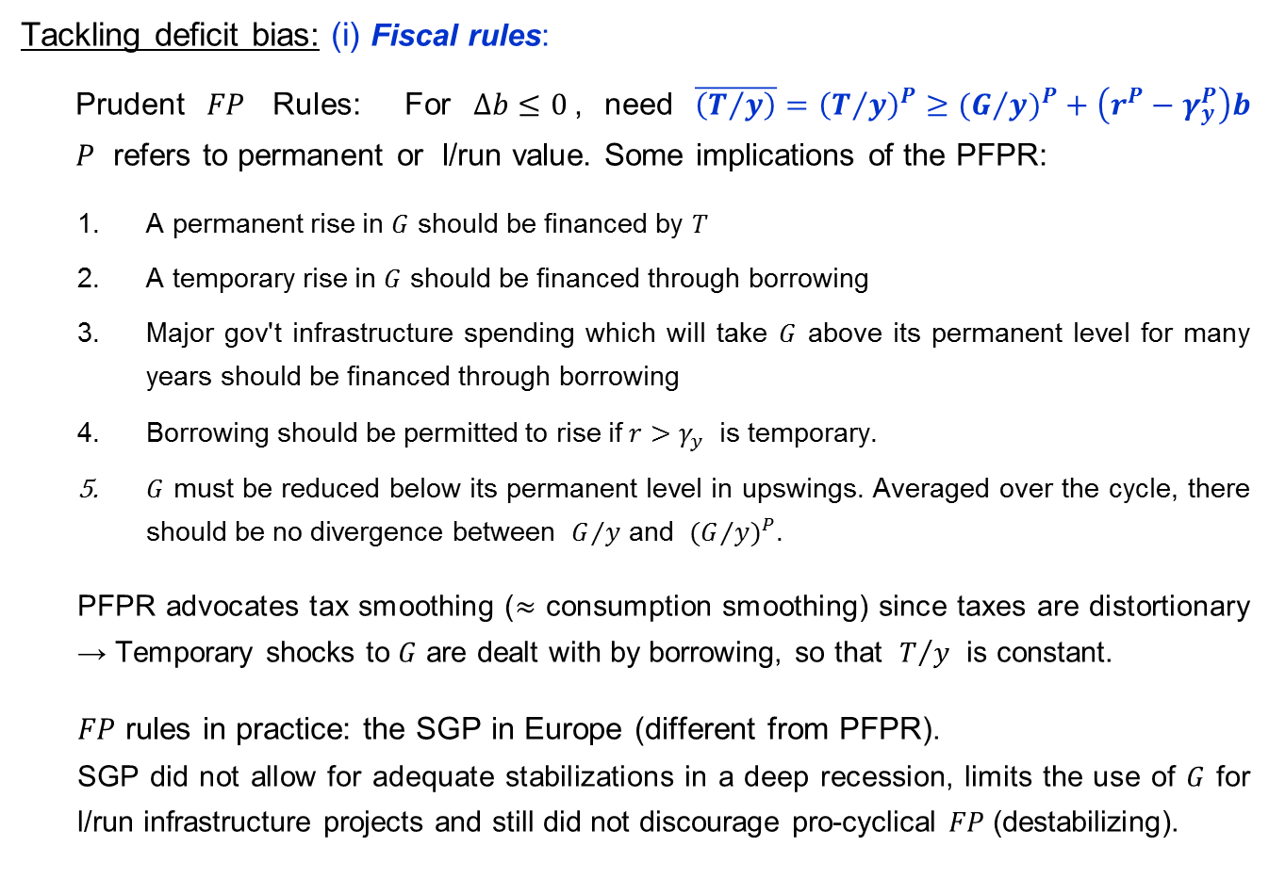
Application:
Deficit Bias
Tackling deficit bias: (i) Fiscal rules:
Prudent $FP$ Rules: For $Δb≤0$, need $\overline{\left(T/y\right)}={\left(T/y\right)}^{P}≥{{(G}/y)}^{P}+\left(r^{P}−γ_{y}^{P}\right)b$ $P$ refers to permanent or l/run value. Some implications of the PFPR:
A permanent rise in $G$ should be financed by $T$
A temporary rise in $G$ should be financed through borrowing
Major gov't infrastructure spending which will take $G$ above its permanent level for many years should be financed through borrowing
Borrowing should be permitted to rise if $r>γ_{y}$ is temporary.
$G$ must be reduced below its permanent level in upswings. Averaged over the cycle, there should be no divergence between $G/y$ and ${{(G}/y)}^{P}$.
PFPR advocates tax smoothing ($≈$ consumption smoothing) since taxes are distortionary → Temporary shocks to $G$ are dealt with by borrowing, so that $T/y$ is constant.
$FP$ rules in practice: the SGP in Europe (different from PFPR).
SGP did not allow for adequate stabilizations in a deep recession, limits the use of $G$ for l/run infrastructure projects and still did not discourage pro-cyclical $FP$ (destabilizing).

Slide 29
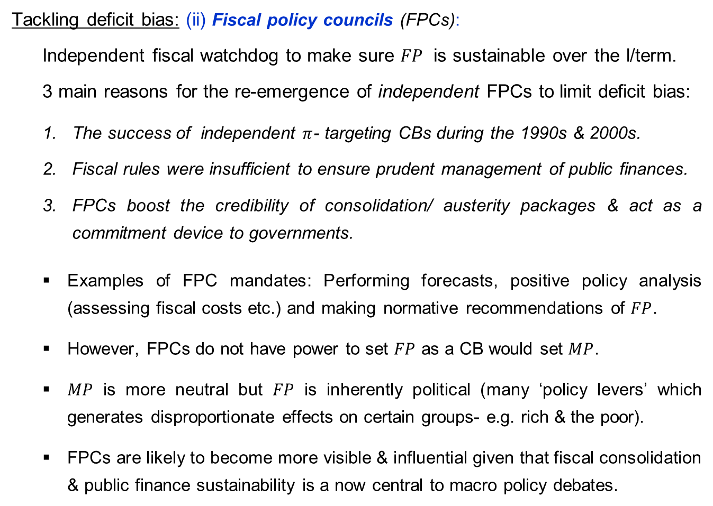
Application:
Deficit Bias
Tackling deficit bias: (ii) Fiscal policy councils (FPCs):
Independent fiscal watchdog to make sure $FP$ is sustainable over the l/term.
3 main reasons for the re-emergence of independent FPCs to limit deficit bias:
The success of independent $π$- targeting CBs during the 1990s & 2000s.
Fiscal rules were insufficient to ensure prudent management of public finances.
FPCs boost the credibility of consolidation/ austerity packages & act as a commitment device to governments.
Examples of FPC mandates: Performing forecasts, positive policy analysis (assessing fiscal costs etc.) and making normative recommendations of $FP$.
However, FPCs do not have power to set $FP$ as a CB would set $MP$.
$MP$ is more neutral but $FP$ is inherently political (many ‘policy levers’ which generates disproportionate effects on certain groups- e.g. rich & the poor).
FPCs are likely to become more visible & influential given that fiscal consolidation & public finance sustainability is a now central to macro policy debates.

Slide 30
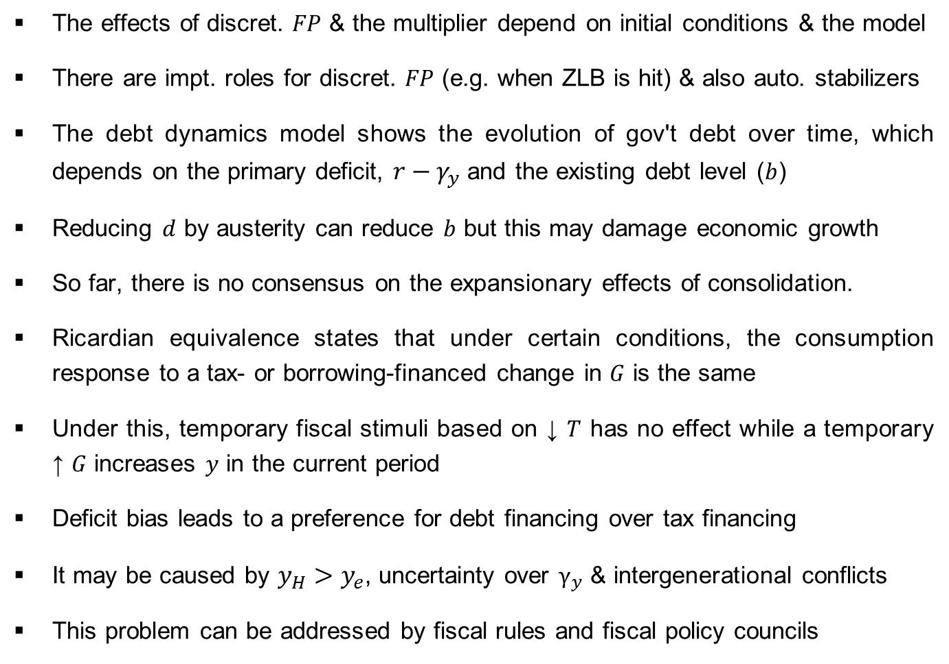
Summary:
Chapter 14: Fiscal Policy
The effects of discret. $FP$ & the multiplier depend on initial conditions & the model
There are impt. roles for discret. $FP$ (e.g. when ZLB is hit) & also auto. stabilizers
The debt dynamics model shows the evolution of gov't debt over time, which depends on the primary deficit, $r−γ_{y}$ and the existing debt level ($b$)
Reducing $d$ by austerity can reduce $b$ but this may damage economic growth
So far, there is no consensus on the expansionary effects of consolidation.
Ricardian equivalence states that under certain conditions, the consumption response to a tax- or borrowing-financed change in $G$ is the same
Under this, temporary fiscal stimuli based on ↓ $T$ has no effect while a temporary ↑ $G$ increases $y$ in the current period
Deficit bias leads to a preference for debt financing over tax financing
It may be caused by $y_{H}>y_{e}$, uncertainty over $γ_{y}$ & intergenerational conflicts
This problem can be addressed by fiscal rules and fiscal policy councils

