Slide 1
Git training
EPAM Java Junior Program
Péter Veres
peter_veres2@epam.com

Slide 2
Git
Git is based on basic computer science. If it's too hard for you, perhaps you're in the wrong industry.

Slide 3
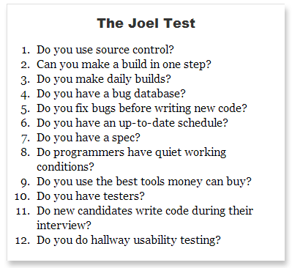
How to measure the quality of a software team?
Git introduction
Notes:
http://www.joelonsoftware.com/articles/fog0000000043.html

Slide 4
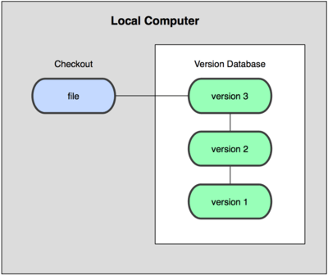
About version control
Git introduction
Local database

Slide 5

About version control
Git introduction
Centralized Version Control Systems

Slide 6
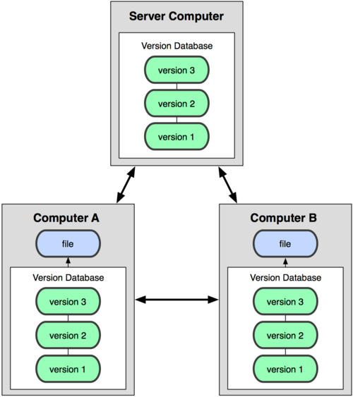
About version control
Git introduction
Distributed Version Control Systems

Slide 7
Short story of git
Git introduction
Linux
Before 2002 patch emailing system
BitKeeper between 2002 and 2005
Git from April of 2005
git:
“I’m an egotistical bastard, and I name all my projects after myself. First Linux, now git.” – Linus

Slide 8
What is git?
Git introduction
distributed revision control and source code management system
git != SVN + Magic
Stupid content tracker
Content-addressable
Snapshots
New tree
Blobs
Pointers
No diff! (like SVN)
There may be a lot of things that Git is not good at, but these things are what Git is very good at.

Slide 9
Essentials
Git introduction
Non-linear development
Distributed development
Efficiency
Example Ruby on Rails
9 MB
13 in git
115 MB in SVN
Efficient network operations

Slide 10
Prerequisites
Git introduction
MysysGit
http://msysgit.github.io/
Registration
github.com
git.epam.com
Import public keys
https://git.epam.com/help/ssh
P4 Merge: Visual Merge Tool (Perforce)
Select P4Merge only
http://www.perforce.com/product/components/perforce-visual-merge-and-diff-tools

Slide 11
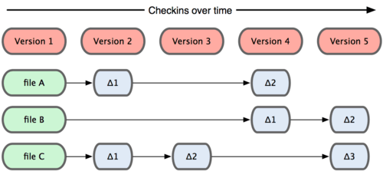
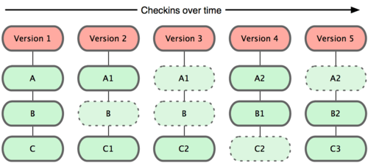
Basics - snapshots
Git BASICS

Slide 12
Configuring git
Git configuration
Three levels of configuration
System
/etc/gitconfig
Global
~/.gitconfig
Local
.git/config
Notes:
git config --list
git config --list --system
git config --list --global
git config --list --local
git config --global merge.tool p4merge
git config --global mergetool.p4merge.path "C:/Program Files/Perforce/p4merge.exe„
Set your editor:
# git config --global core.editor "'C:/Program Files (x86)/Notepad++/notepad++.exe' -multiInst -notabbar -nosession -noPlugin"
[core]
editor = 'C:/Program Files (x86)/Notepad++/notepad++.exe' -multiInst -notabbar -nosession –noPlugin

Slide 13
Exercise #1
Configuring git
Notes:
Task
Add user.name and user.email to global
git config --global user.name "John Doe"
$ git config --global user.email johndoe@example.com

Slide 14
Versioning with git
Git basics
Working directory
single checkout of one version of the project
Staging area/Index
stores information about what will go into your next commit. It is a simple file.
Repository
where Git stores the metadata and object database for your project, .git directory
Notes:
Stop here and show something!

Slide 15

Basics – the tree states
Git BASICS

Slide 16
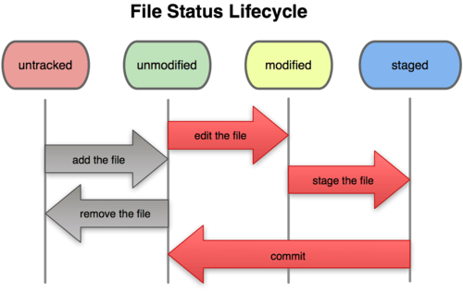
Basics – file status lifecycle
Git BASICS

Slide 17
Exercise #2
Versioning with git
Notes:
git init
git status
git add .
git commit –m
git log
git log --pretty=oneline
git show
git diff
.gitignore
git clean
git rm
git rm --staged
Task:
Test the command above

Slide 18
Object database
Git objects
Git Object Database, which is kept in the Git Directory
Each object is compressed (with Zlib) and referenced by the SHA-1 value (40 chars) of its contents plus a small header.
Types
Blob
Tree
Commit
…

Slide 19
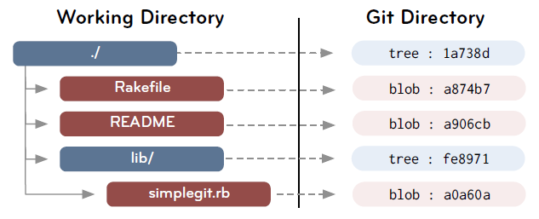
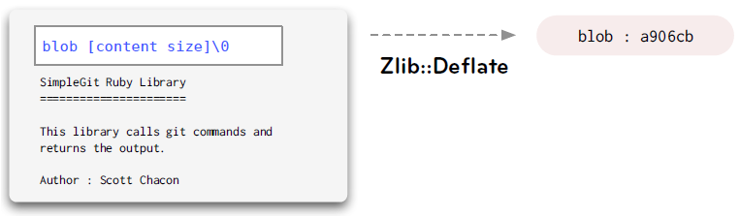
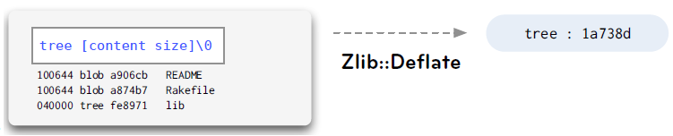
Blob, tree
Git objects

Slide 20
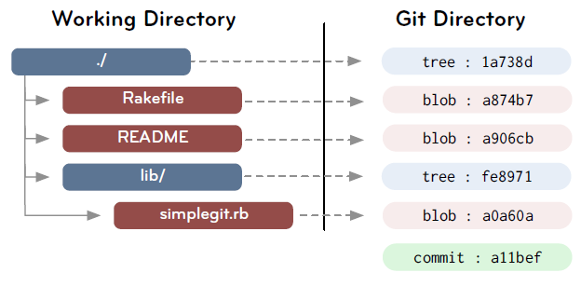
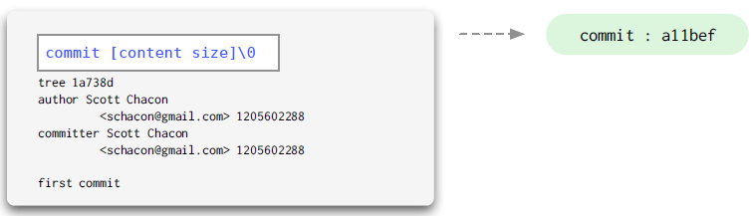
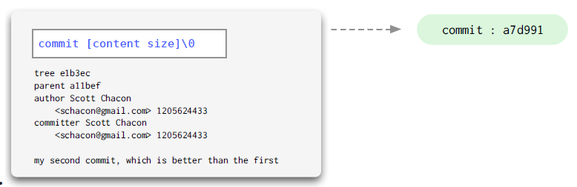
Commit
Git objects
Points to a tree
Keeps author, committer, message, parent commits

Slide 21
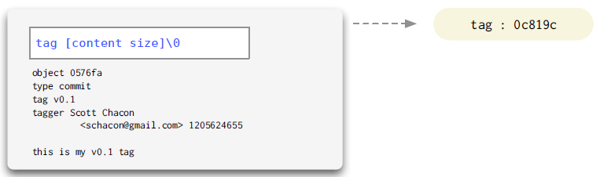
Tag
Git objects
We’ll talk about it later…

Slide 22
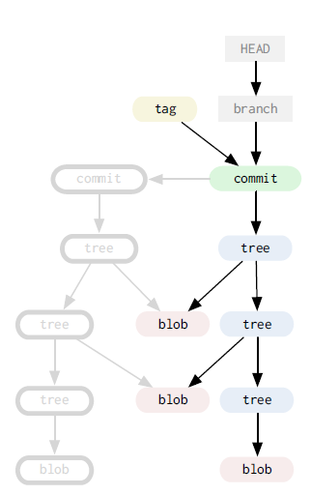
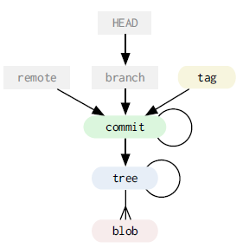
Data model
Git objects
Grey: “cheap” objects
Color: immutable

Slide 23
Data model
Git objects
DAG
Objects are immutable
References can constantly change

Slide 24
Exercise #3
git cat-file
Notes:
Create commit
git cat-file
commit
tree (git cat-file master{tree})
File
Task
Find the previous commit
Revert the previous content of the file with git cat-file

Slide 25
Ancestry References
git
^ (caret)
git show HEAD^: 1st parent of the commit
git show HEAD^2: 2nd parent of the commit
~ (tilde)
git show HEAD~: 1st parent of the commit
git show HEAD~2: 1st parent of the 1st parent

Slide 26
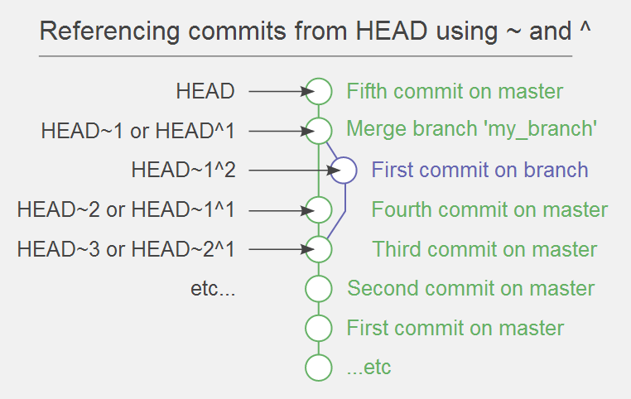
Ancestry References
git
Example
Notes:
http://www.paulboxley.com/blog/2011/06/git-caret-and-tilde

Slide 27
Exercise #2
Ancestry references
Notes:
Try ^ and ~
Create file and test

Slide 28
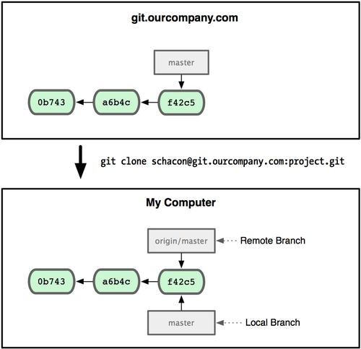
Git remotes
Git remotes
Remote branches

Slide 29
Git remotes
Git remotes
We’ll talk about branches later
git remote add:
Remote branches are in .git/refs/remotes
Remote branches are tracked by local branch
Remote branch can be fetched/rebased/merged
Local branch can be commited/pushed
Remote branch can be checkouted, but HEAD will be detached state
You can commit to a detached HEAD, but it will be detached
Notes:
remote repositories
git remote
git fetch
git push – push should be fast forwarded, non-fastforwarded is not recommended (--force)
git push -u
git pull
git pull --rebase
git rebase

Slide 30
Git on the Server
Git in the Server
Git on the server
Protocols
Local
SSH – anonymous access not supported
git – own protocol, no authentication
http(s)
Web-based hosting services for software development projects that use the Git revision control system
Examples
github.com
bitbucket
git.epam.com (gitlab)
…

Slide 31
Pull request
Git in the Server
Not the part of the git
Pull requests are between branches, not commits!

Slide 32
Exercise #4
Git remotes
Notes:
Tasks
Find a project, push it to your repo (create another remote)
Find a project from my projects, fork it, create commit, and add pull request

Slide 33
Git Branching
Git branching
What is a branch?
A branch is a new pointer (40 bytes)
Commands
git branch
git checkout
git merge
Notes:
- git branch iss53 git; checkout iss53 / OR git checkout -b iss53
- git commit -a -m 'added a new footer [issue 53]'
- show a fast-forward
- show an automatic merge
- show a conflict
- git branch -v
- git branch --merged
git branch --no-merged
git branch -d OR –D
git branch –a
git branch –r
git branch –m rename

Slide 34
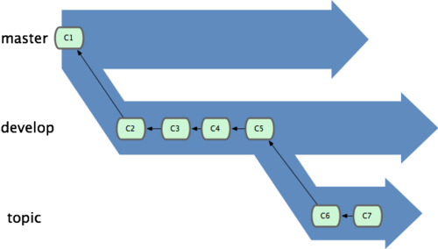
Git Branching
Git branching
Branch management
Master branch
Development branches
Topic branches

Slide 35
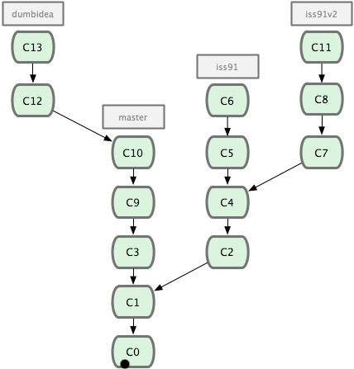
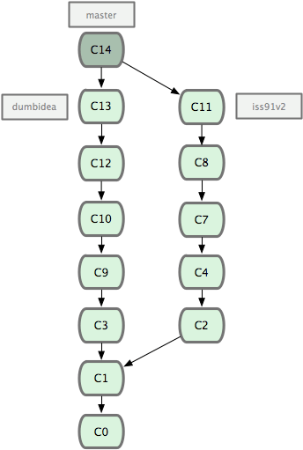
Git Branching
Git branching
Notes:
Iss91 is dropped away

Slide 36
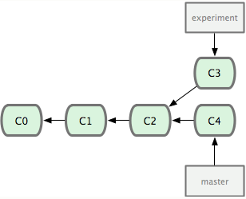
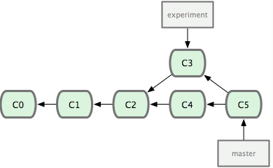
Merging
Git branching
Fast-forward merge
Non-fast forward merge
Merge with conflicts
2-way merge vs 3-way merge
Which merge tool should be used?

Slide 37
Exercise #5
Git Branching

Slide 38
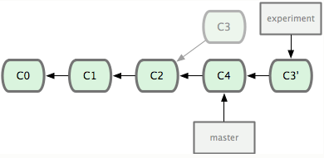
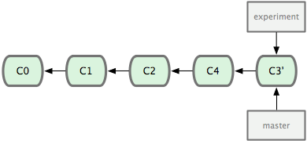
Rebasing
Git REbasing
rewinding head
replay your work on top of it

Slide 39
Perils of Rebasing
Git REbasing
Do not rebase commits that you have pushed to a public repository.
Notes:
Show this example: http://git-scm.com/book/en/Git-Branching-Rebasing

Slide 40
Exercise #4
Git Rebasing
Notes:
TODO: rebase

Slide 41
Remote branches
Git remotes #2
git remote add:
Remote branches are in .git/refs/remotes
Remote branches are tracked by local branch
Remote branch can be fetched/rebased/merged
Local branch can be committed/pushed
→ local and remote branches are independent
→ but remote branches can be tracked by a local branch
Push branch:
git push [remote] [branch]
git push [remote] [branch_local]:[branch_remote]
git push [remote] :[branch_remote] – this removes the remote branch

Slide 42
Exercise #4
Git Remote Branching
Notes:
create a remote repo
git remote add origin …

Slide 43
Rebase vs merge
Git branching
Rebase
Pros:
Code history is flat and readable
Manipulate a single commit is easy (eg. revert)
Cons:
Can hide context
Does not work very well with pull requests
Rewriting history
You will need a force push on remote branches → BREAKAGE

Slide 44
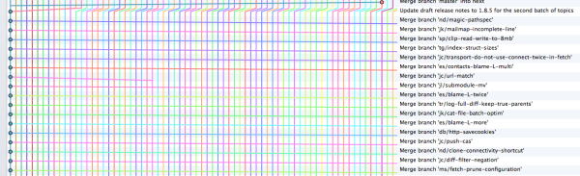
Rebase vs merge
Git branching
Merge
Pros:
Traceability
Cons:
History can become intensely polluted by lots of merge commits

Slide 45
Rebase vs merge
Git branching
Guideline
Do not rebase commits that you have pushed to a public repository.

Slide 46
Undoing things
git
Change your last commit
git commit –-amend
Revert: reverts the specified commit with a new commit
git revert HEAD
Reset: resets the head to the specified commit
Soft: Does not touch the index file nor the working tree at all
Mixed: Resets the index but not the working tree (default)
Hard: Resets the index and working tree.
Un-modifying a modified file
git checkout – filename
git checkout . – restore working copy
Notes:
reset:
Create and commit a file
Edit and commit file
Create tag
Show mixed, soft and hard reset

Slide 47
Exercise #6
Undoing things
Notes:
git init
git status
git add .
git commit –m
git log
git log --pretty=oneline
git show
git diff
.gitignore
git reset
git checkout
git rm
git rm --staged
//TODO: task for the attendees

Slide 48
Stashing
git
don’t want to do a commit of half-done work
you can get back to this point later
play with the change on different branches
branch can be created from a stash
Notes:
git stash
git stash apply

Slide 49
Exercise #7
Git stashing

Slide 50
Tagging
git
Tag specific points in the history
Types
Lightweight
Like a branch, but cannot be changed
Annotated
Object in the git database (name, e-mail, date)
Branch can be created from a tag
Commands
git tag [tag]
git tag –a [tag] –m message
git push [remote] [tagname]
Notes:
- git tag –l

Slide 51
Exercise #8
Git tagging
Notes:
TODO: task

Slide 52
Housekeeping
git
git fsck --unreachable
git prune
Removing unreachable objects (eg. Created by git add)
git gc
Compressing file revisions (packing files)
Removing unreachable objects (eg. Created by git add)
git push
Packing also called during pushing
Notes:
fsck:
git add
git fsck --unreachable
git reset HEAD –hard
git prune

Slide 53
.git dir
Git internals
hooks/ - client-side hooks
info/ - global ignored patterns
logs/
objects/ - stores the database
info, packs – packed files
refs/ - pointer into commit objects
heads – last commit hashs of the branches
tags
remotes / <remote_name> / <branch_name>
HEAD – branch currently checked out (pointer to a file in refs/…)
config – project specific config
Remotes
index – staging area

Slide 54
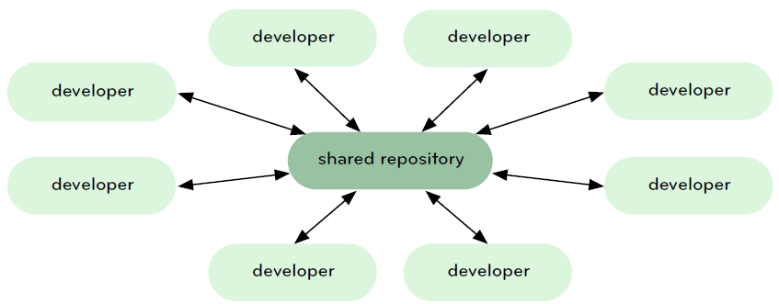
Central repository workflow
Git workflows
Notes:
https://www.kernel.org/pub/software/scm/git/docs/everyday.html

Slide 55
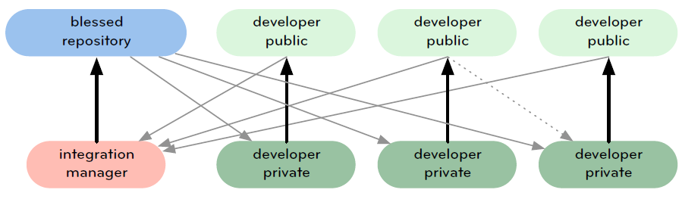
Integration-manager workflow
Git workflows

Slide 56
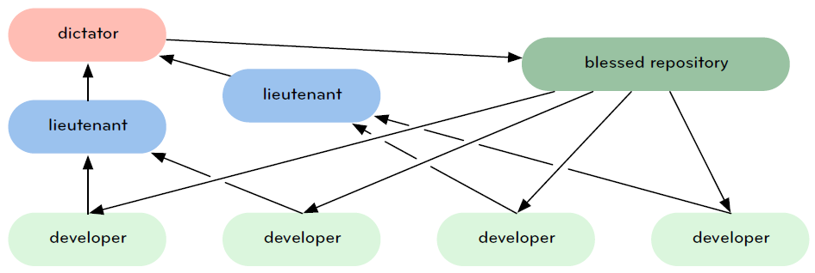
Dictator and Lieutenants Workflow
Git workflows

Slide 57
Commands
Git internals
Commands
Plumbing commands
Porcelain commends (eg. commit, push, etc.)

Slide 58
Major git commands
Git workflows
git-show-branch(1)
to see where you are.
git-log(1)
to see what happened.
git-checkout(1) and git-branch(1)
to switch branches.
git-add(1)
to manage the staging area
git-diff(1) and git-status(1)
to see what you are in the middle of doing.

Slide 59
Major git commands
Git workflows
git-commit(1)
to advance the current branch.
git-reset(1) and git-checkout(1) (with pathname parameters)
to undo changes.
git-merge(1)
to merge between local branches.
git-rebase(1)
to maintain topic branches.
git-tag(1)
to mark known point.

Slide 60
Major git commands
Git workflows
git-clone(1)
from the upstream to prime your local repository.
git-pull(1) and git-fetch(1)
from "origin" to keep up-to-date with the upstream.
git-push(1)
to update remote

Slide 61
Git Drawbacks
Git
Revision number is a hash (40 chars)
very long
Not predictable
Partial checkout not supported
Versioning is always from the root
„Add” before „commit”
No diffs
Do not store big files with git
Initial cloning is slower (commits, branches, …)
Lock not supported (local operations)

Slide 62
Questions

Slide 63
Home work
https://try.github.io/levels/1/challenges/1
Read git book
git man – read and learn git commands

Slide 64
Thank you!

