Slide 1
The SPRAINED study
The effect of a specialist paramedic primary care rotation on appropriate non-conveyance decisions: a controlled interrupted time series analysis Richard Pilbery Andrew Hodge Professor Tracey Young

Slide 2
Conflicts of interest
Richard Pilbery
YAS employee, not involved in rotating pilot
Andrew Hodge
YAS employee, involved with pilot, not involved in data analysis
Prof. Young
Time funded by NIHR ARC

Slide 3
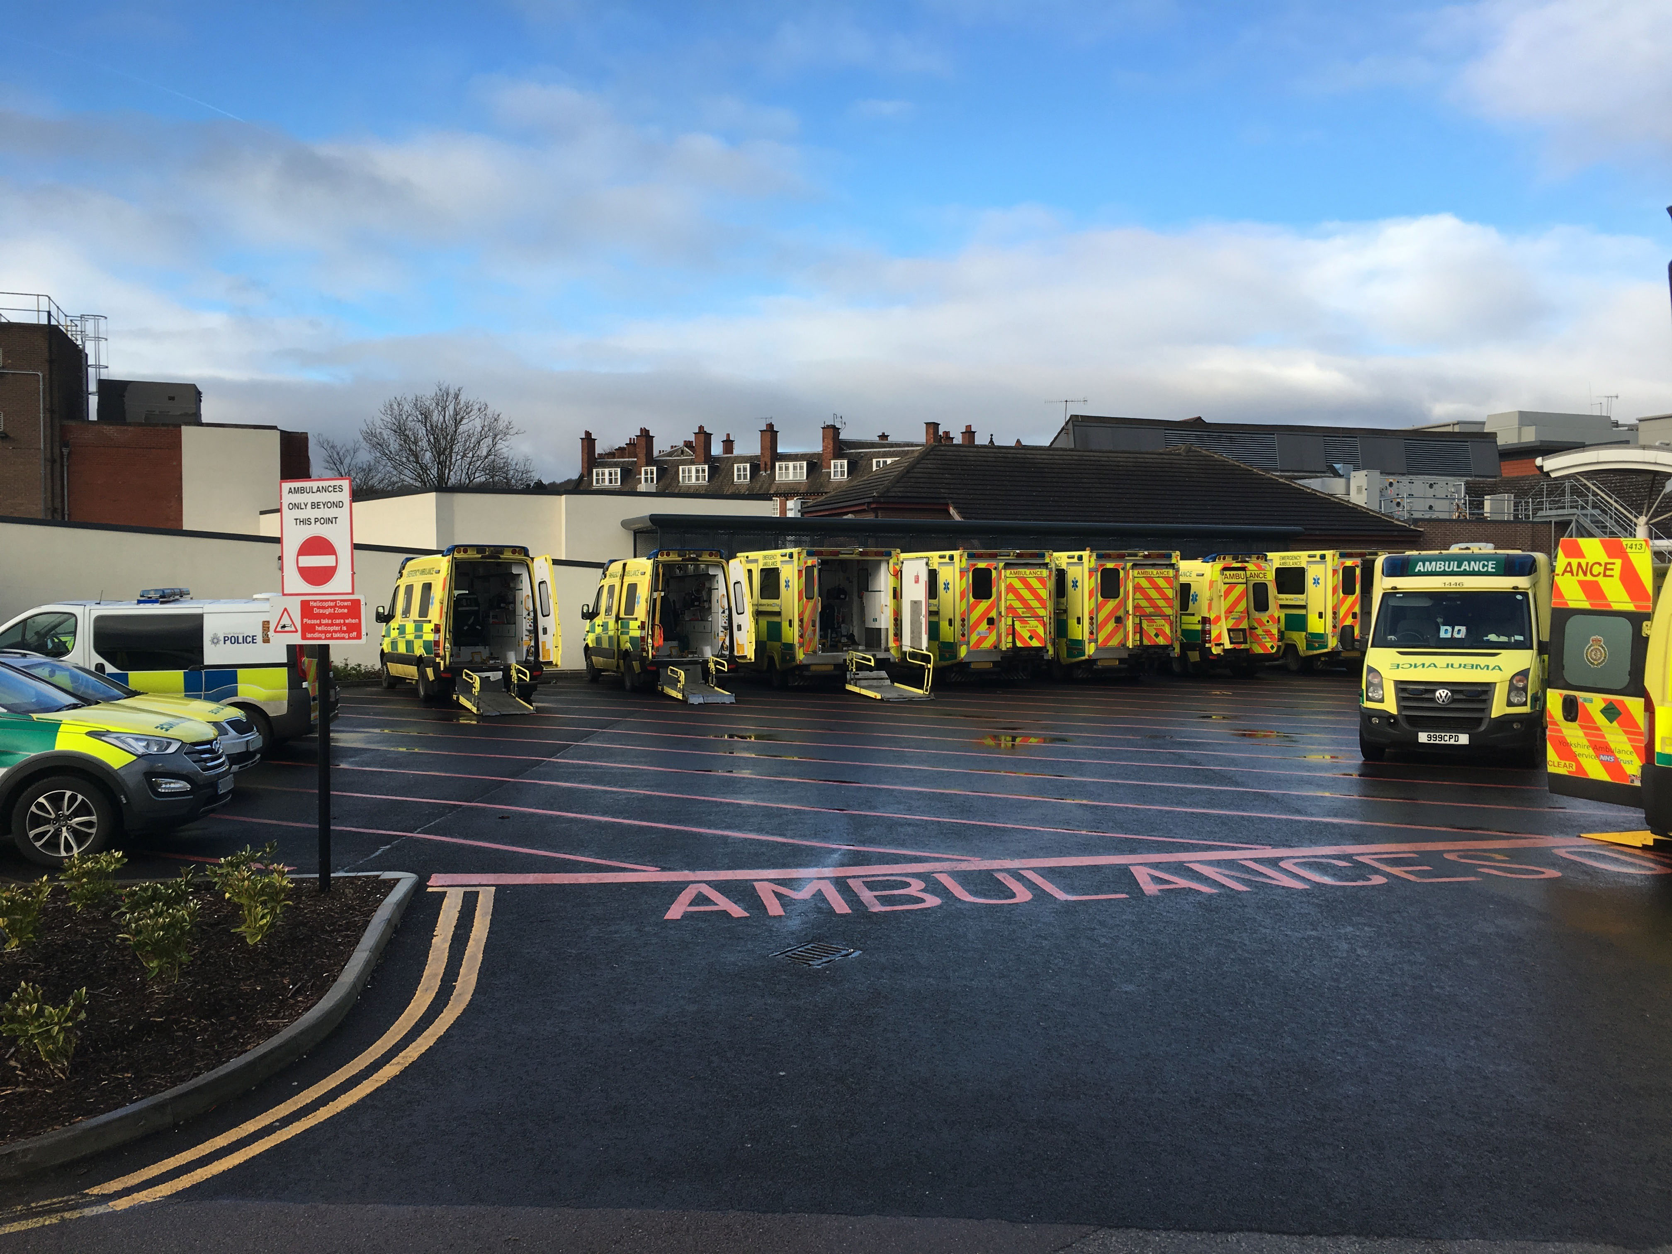
The Challenge

Slide 4
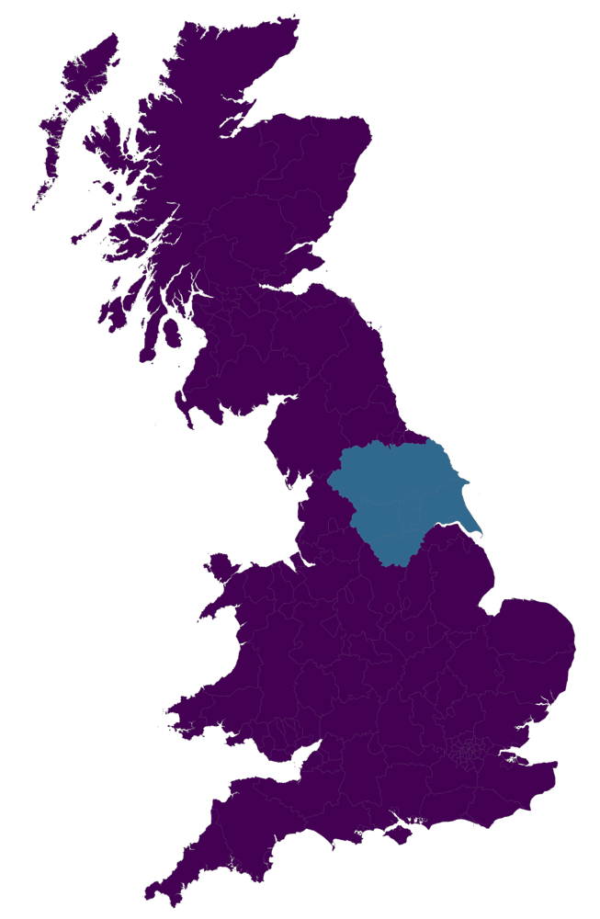
Yorkshire
6000 square miles (~15,500 sq km)
Population: 5 million
YAS responds to ~800,000 incidents each year

Slide 5
Opportunity
Rotating paramedics pilot
Funded by Health Education England
Opportunity for SP development

Slide 6
Aims and objectives
Aim: Evaluate whether primary care placement appropriately increases level and trend of non-conveyance
Primary objective: Determine change and trend in proportion of appropriate non-conveyance decisions
Secondary objective: Compare cost-effectiveness of GP placement SPs vs control

Slide 7
Primary outcome analysis
Before/After design
Controlled Interrupted Time Series
24 months (12 months either side of primary care placement)

Slide 8
Secondary outcome analysis
Salary costs ✅
Education costs ❌
Unit costs
Bootstrapping
item | cost
999 call | £7.33
Ambulance: see and treat | £209.38
Ambulance: see, treat and convey | £257.34
ED attendance | £135.00

Slide 9
Matching
Patient
Location
Paramedics

Slide 10
Results
Data from 1st June 2017 to 31st December 2019
7349 cases
Missing data
1785 : No working impression
15 : No age
8 : No postcode
6 : No sex
4 : No IMD/rural urban class/LTC
5537/7349 (75.3%) eligible
5198/5537 (93.9%) utilised by matching algorithm

Slide 11
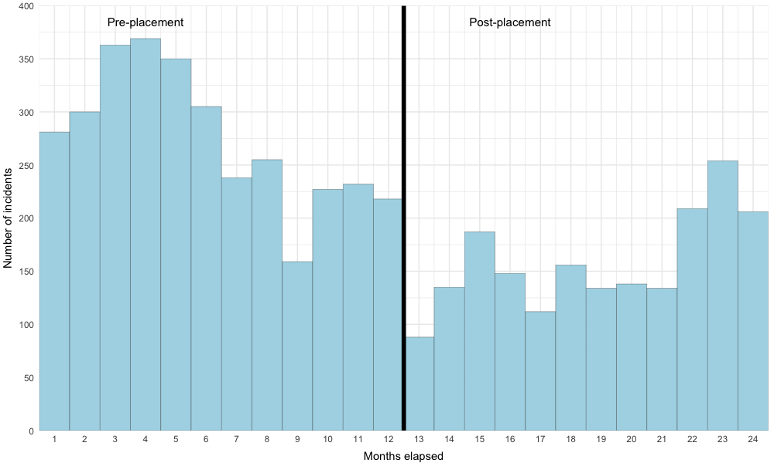
Monthly totals of incidents attended by rotating SPs

Slide 12
Rotating SP daily activity
Activity | Pre-placement n | Pre-placement % | Post-placement n | Post-placement %
EOC | 48 | 3.4 | 179 | 11.9
GP | 0 | 0 | 270 | 18
OPS | 1202 | 84.4 | 910 | 60.6
STUDY | 174 | 12.2 | 143 | 9.5
Total | 1424 | 100 | 1502 | 100

Slide 13
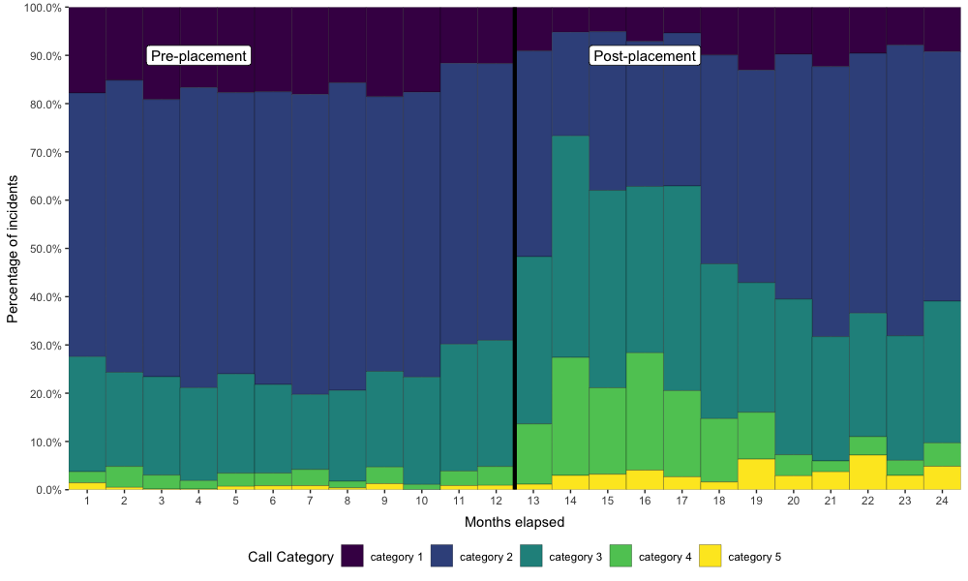
AMPDS call category pre- and post-placement

Slide 14
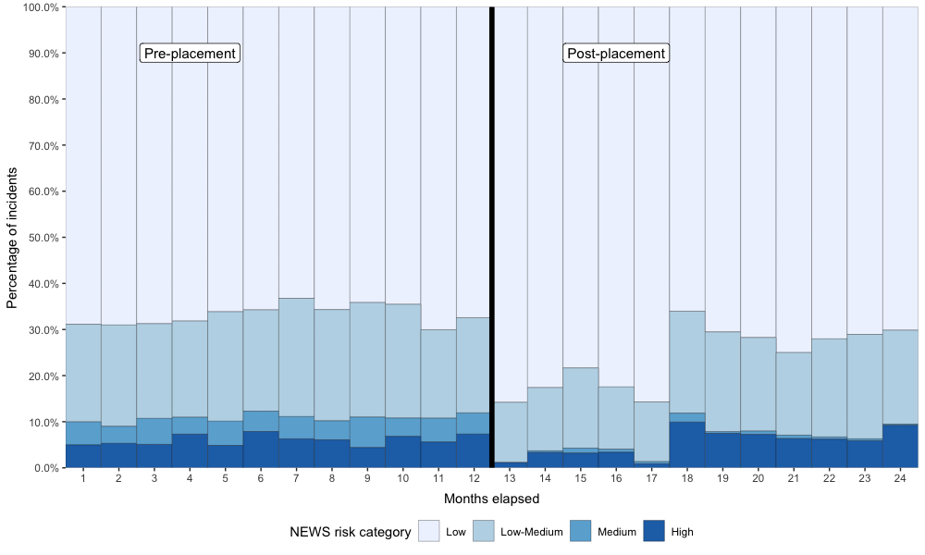
NEWS risk category pre- and post-placement

Slide 15
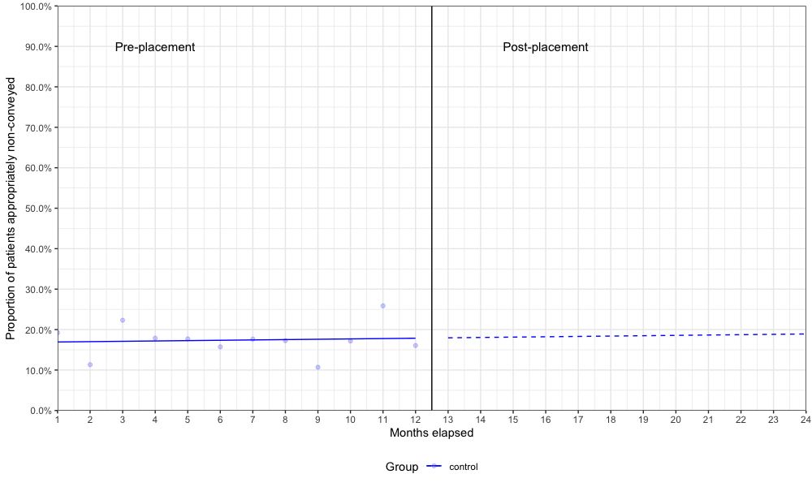
CITS model: Control group

Slide 16
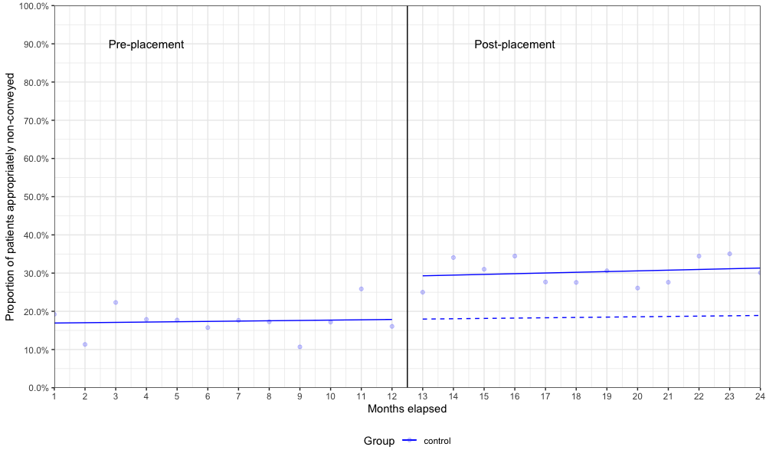
CITS model: Control group

Slide 17
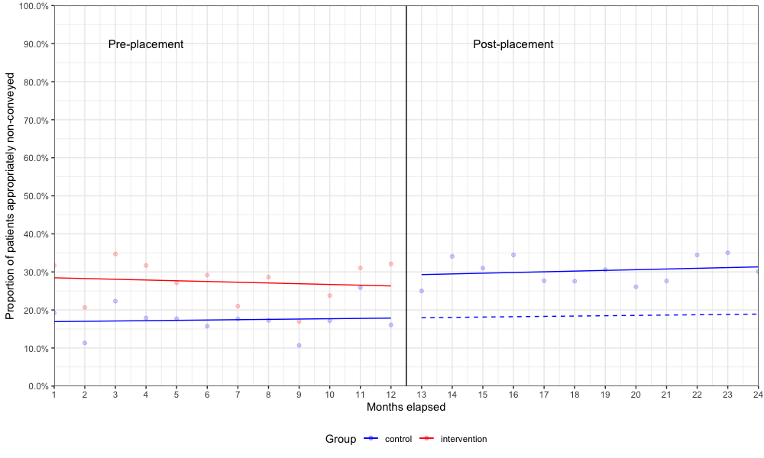
CITS model: Rotating SP group

Slide 18
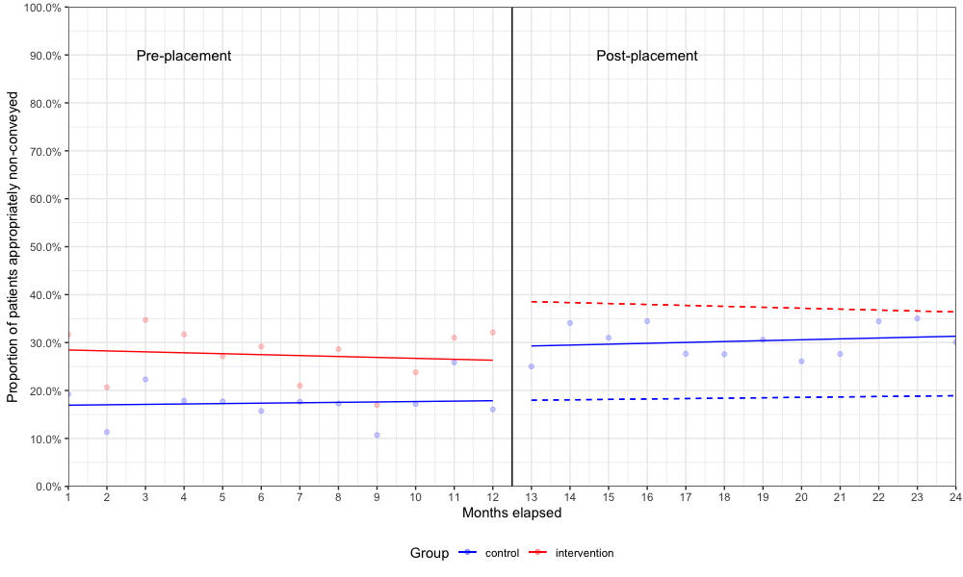
CITS model: Rotating SP group

Slide 19
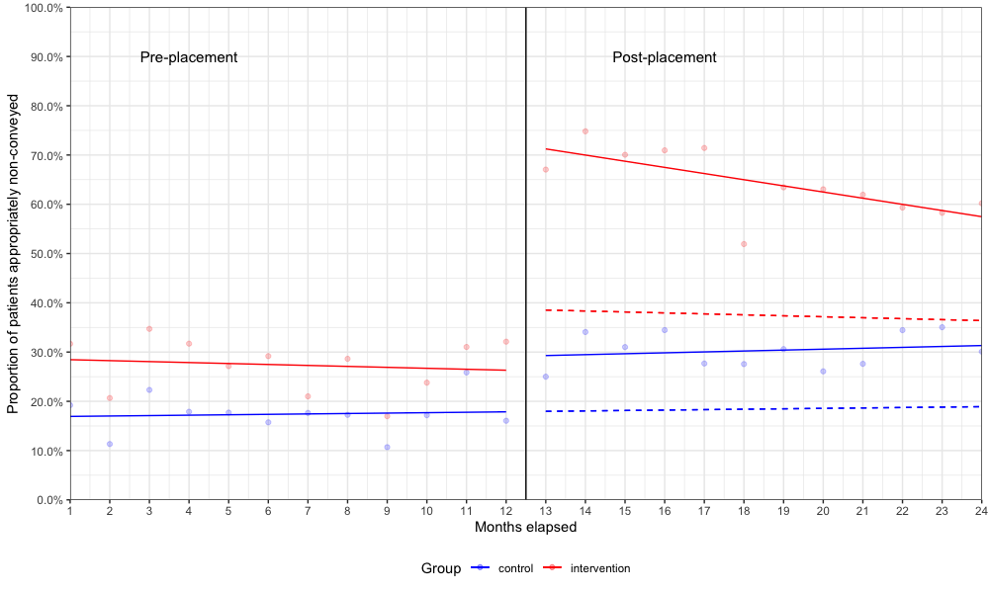
Final fitted CITS model

Slide 20
Segmented regression analysis
 | Coefficient (%) | 95% CI | P value
Initial control group level | 16.8 | 10.9 to 22.8 | <0.001
Pre-placement control group trend | 0.1 | -0.7 to 0.9 | 0.831
Difference in level between control and rotating SP | 11.8 | 3.4 to 20.2 | 0.007
Rotating SP trend relative to control | -0.3 | -1.4 to 0.9 | 0.622
Post-placement change in control level | 11.2 | 3.3 to 19.2 | 0.007
Post-placement change in control trend | 0.1 | -1.0 to 1.2 | 0.862
Post-placement rotating SP change in level relative to control | 35.0 | 23.8 to 46.2 | <0.001
Post-placement rotating SP change in trend relative to control | -1.2 | -2.8 to 0.5 | 0.156

Slide 21
Let's talk money...
Mean cost per appropriate non-conveyance
Rotating SP: £509.42 (95% bootstrapped CI £485.94–£535.41)
Control: £1124.41 (95% bootstrapped CI £1041.89–£1218.31)
Mean saving of £615 per appropriate non-conveyance
95% bootstrapped CI £545.31–£686.69
Cost-effectiveness ratio
£1758.89 per percentage increase in appropriate non-conveyance
95% bootstrapped CI £1477.76–£2133.08

Slide 22
Limitations
Routine observational data vs RCT
Re-contact to 999 only
Patient re-identification
Missing working impressions
Determining paramedic roles

Slide 23
Conclusion
Clinically important and statistically significant increase in appropriate non-conveyance rates
Persisted for the 12-month period following the rotation
Demonstrated cost savings compared to usual care

Slide 24
Questions?
Pre-print URL: bit.ly/SPRAINED

