Slide 1

Portfolio Management System
Amber House Team 4
LittleBankXA
July 31, 2025

Slide 2




Team Members
Sharon Shang Guan
Kelvin Chang
Richard Wang
Anthony Wang
Database & Backend
System Architecture & Frontend
API Integration &Backend
Frontend & Testing

Slide 3

Project Introduction
Goal
Develop a financial portfolio management web app.
▶ Manage stocks and bonds portfolios.
▶ RESTful API backend; responsive web frontend.
▶ Real-time asset tracking, trade simulation, interactive charts.

Slide 4

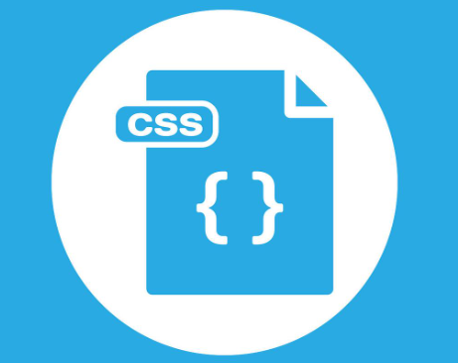
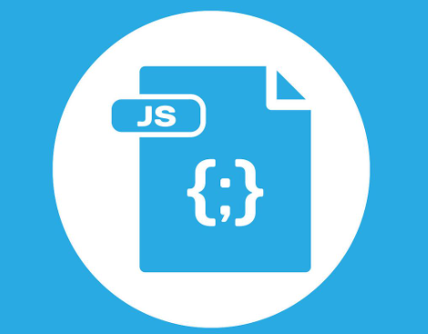
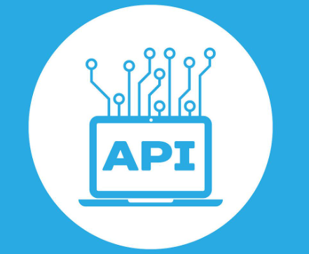
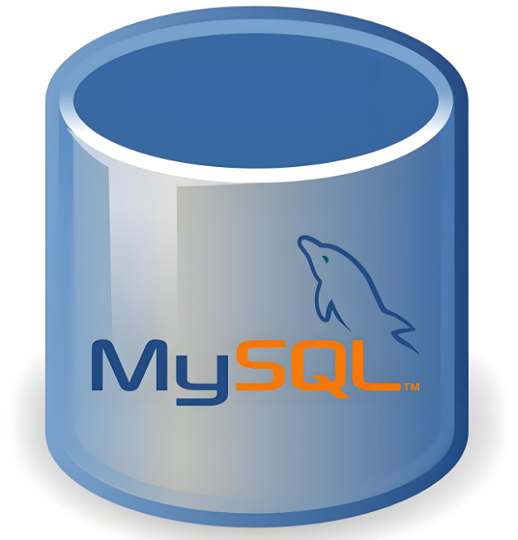
System Flow
1. Frontend: HTML/CSS/JS interface.
2. API Requests: Fetch API calls.
3. Backend: Node.js (Express.js) processes requests.
4. Database: MySQL CRUD operations.
5. External Data: Yahoo Finance API integration.
6. Response: JSON data updates UI dynamically.

Slide 5
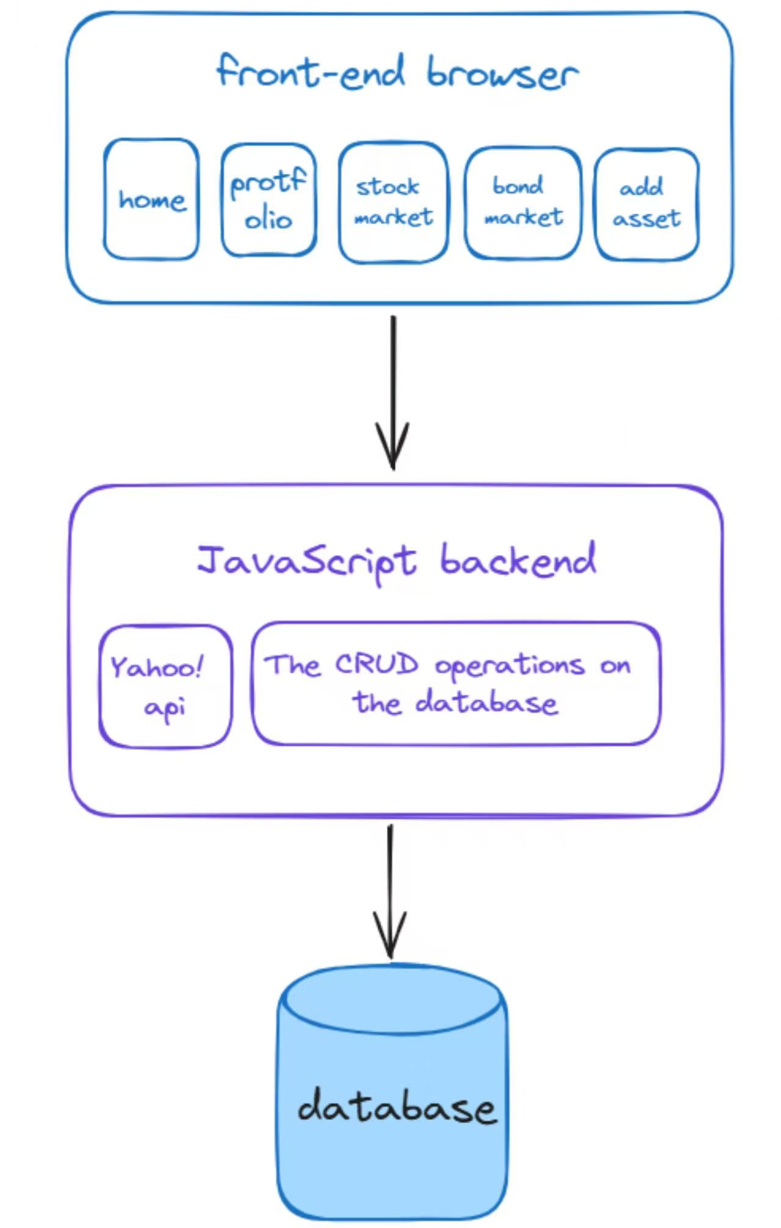
System Architecture
Three-Tier Architecture
▶ Presentation Layer: HTML/CSS/JavaScript
▶ Application Layer: Node.js, Express.js, REST API
▶ Data Layer: MySQL database

Slide 6
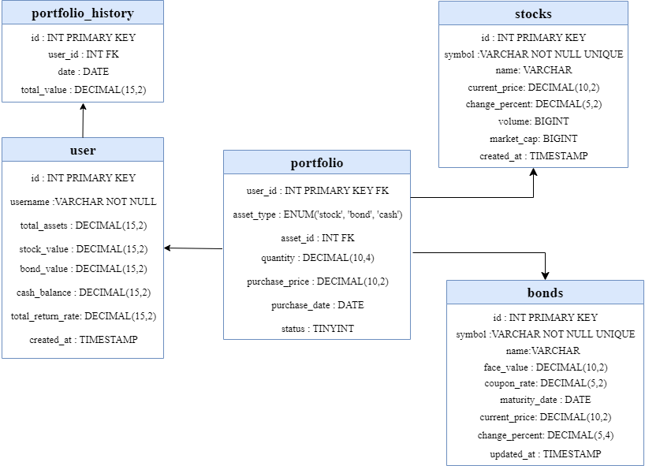
Database Design

Slide 7
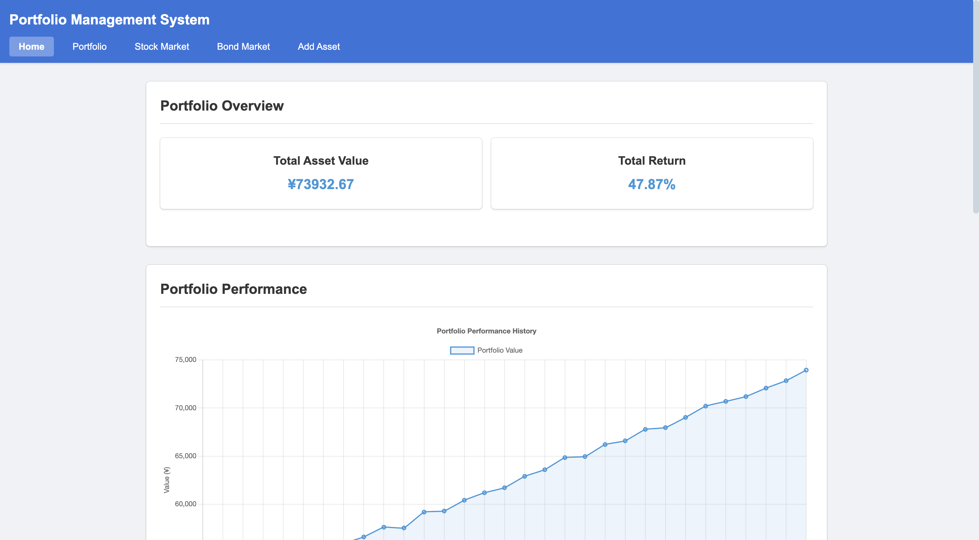
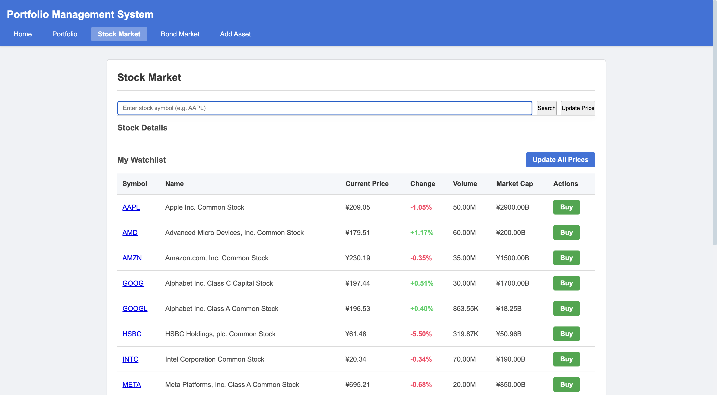
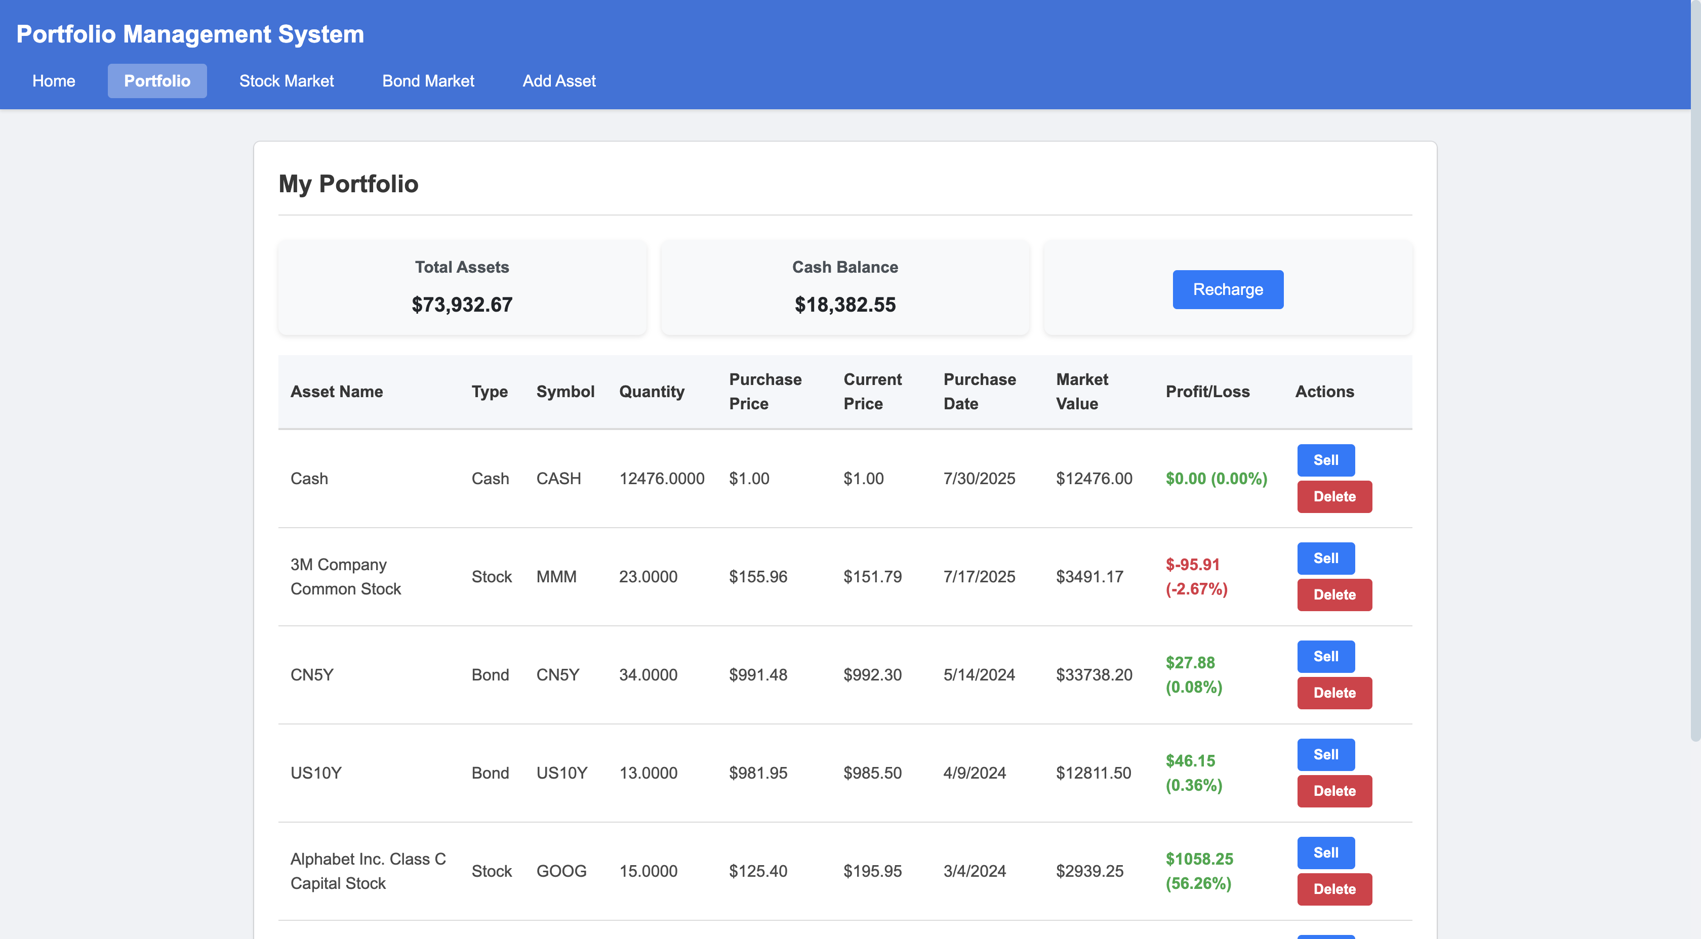
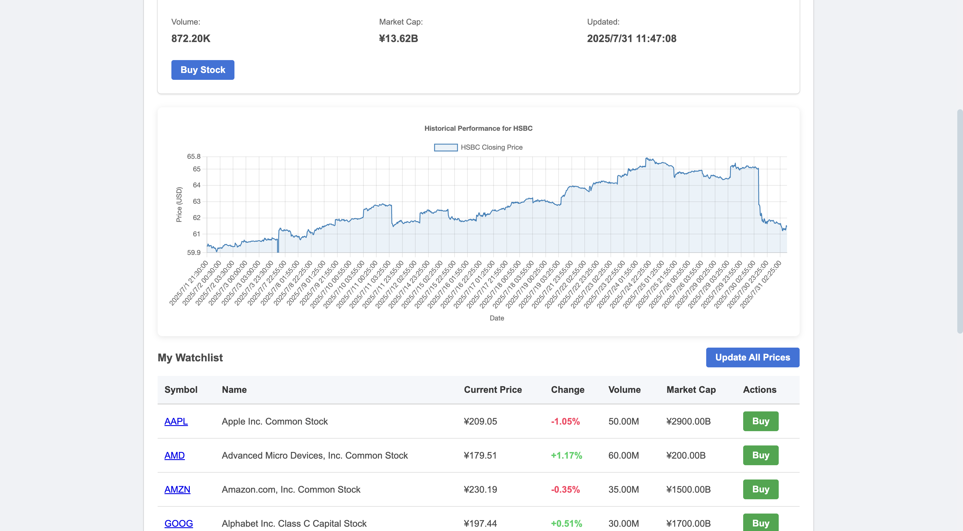
Application Screenshots
Portfolio Detail View
Historical Chart
Dashboard Overview
Stock Market Page

Slide 8
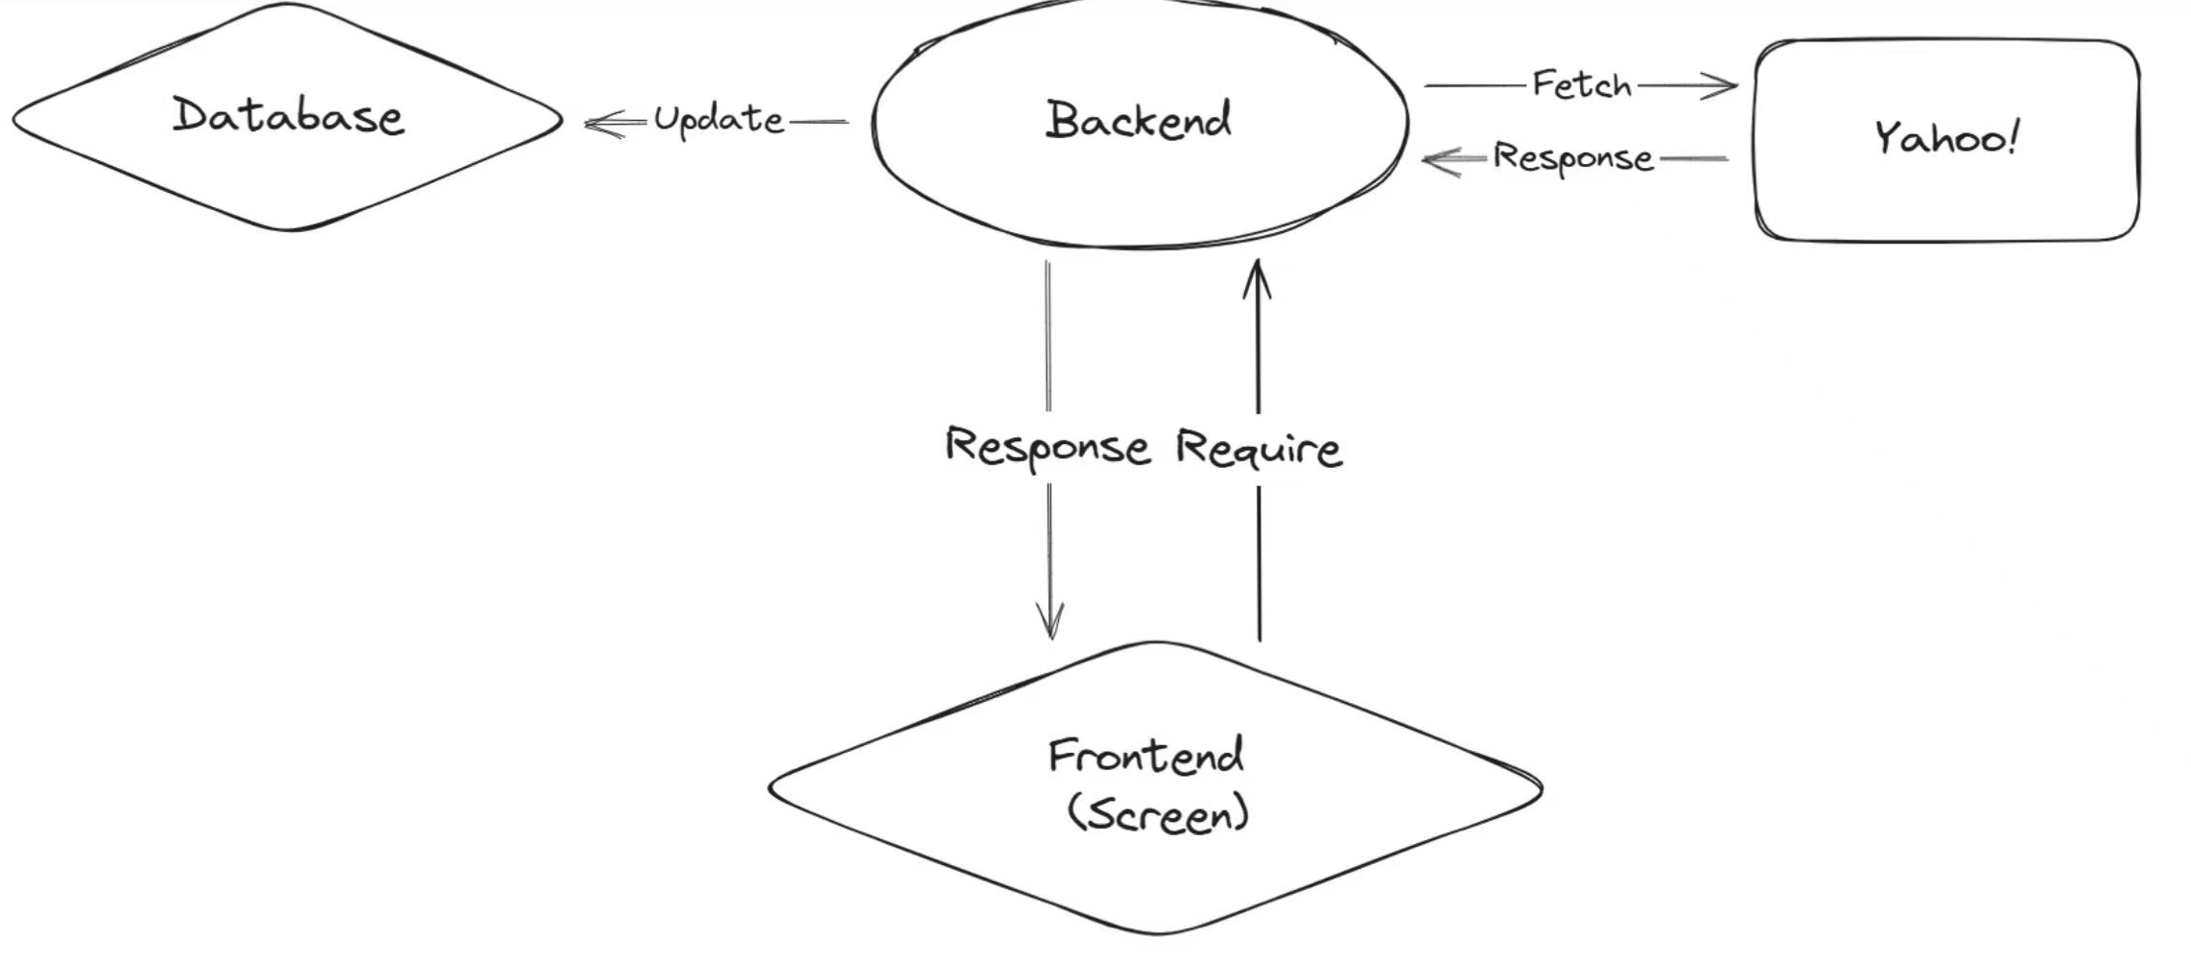
Call The External API
Yahoo Finance API
The Yahoo! API delivers global financial market data covering stocks, bonds, forex, and cryptocurrencies, including real-time quotes, historical data, and financial statements.

Slide 9

Live Demonstration

Slide 10
Conclusion & Next Steps
01
User authentication; multi-user environment.
Expand asset types (cryptocurrencies, ETFs).
02
03
Advanced analytics and reporting
04
Modernize UI/UX (React/Vue).

Slide 11
Thank you！

