Slide 1

PROBLEM STATEMENT
Digital Banking Account & Transaction Management System
Core Banking & Transaction Management Engine · Advanced JavaScript Backend Frameworks (Node.js & Express.js)
System Architecture & Engineering Foundation
Slide 1

Slide 2

01 — PROBLEM STATEMENT
Problem Statement & Challenges in Core Banking
Concurrency & Race Conditions CHALLENGE 01
Absence of Point-in-Time Auditability CHALLENGE 02
Inter-account fund transfers risk double-spending or dirty reads if dual-account mutations are not handled atomically.
Typical systems overwrite balance columns without preserving an immutable ledger with running historical balances.
Weak Governance & Role Segregation CHALLENGE 03
Unchecked Large Capital Outflows CHALLENGE 04
Mixing retail customer actions with compliance enforcement leads to security oversights and unauthorized status changes.
Lack of automated AML (Anti-Money Laundering) detection fails to flag rapid, high-value transfers for staff intervention.
A secure, double-entry style core banking backend engineered with atomic validation, strict account state machines, automated AML triggers, and multi-tier RBAC.
Architectural Problem & Engineering Solution
Slide 02

Slide 3


02 — OBJECTIVES & SCOPE
Objectives & System Scope
OBJECTIVE 01
OBJECTIVE 02
OBJECTIVE 03
Atomic Fund Transfer Engine
Double-Entry Ledger Accounting
Granular 3-Tier RBAC
Eliminate double-spending through rigorous balance and daily limit checks prior to dual balance mutation.
Maintain append-only transaction records storing running on every debit and credit.
Implement JWT bearer token authorization enforcing distinct boundaries
OBJECTIVE 04
OBJECTIVE 05
OBJECTIVE 06
Automated AML Monitoring
Operational Workflow Lifecycle
Interactive Executive Interface
Automatically intercept and flag transactions ≥ ₹50,000 for compliance review and audit escalation.
Provide bank staff with real-time approval queues, account freeze/unfreeze mechanisms, and audit logs.
Provide a responsive web portal styled in a bespoke Cream & Champagne Gold aesthetic with classic EB Garamond typography for viva evaluations.
System Functional Boundaries
Slide 03

Slide 4
03 — ARCHITECTURAL DESIGN
Architectural Design & Request Pipeline
PIPELINE SEQUENCE (MVC + LAYERED GUARDS) NODE.JS & EXPRESS.JS
PIPELINE SEQUENCE (MVC + LAYERED GUARDS) NODE.JS & EXPRESS.JS
Pattern Rationale
Model-View-Controller (MVC) architecture coupled with modular layered middleware keeps HTTP routing completely isolated from banking transaction business rules.
Uniform Response Envelope
Standardizes all outbound API payloads (sendSuccess and sendError), ensuring deterministic, highly reliable client contracts.
01. REQUEST ENTRY
HTTP Request initiated via Client Portal, Hoppscotch, or Postman client.
04. VALIDATION & SANITIZATION
middleware/validate.js Strict input validation serving as a 400 Bad Request error boundary.
02. BODY PARSING & LOGGING
CORS enablement, express.json() body parser, and Morgan HTTP request logging.
05. DOMAIN CONTROLLER
controllers/*.js Executes core business logic and state transition guards.
03. SECURE AUTHENTICATION GUARDS
JWT verification (auth.js) followed by RBAC role validation (Staff / Admin checks).
06. DATA PERSISTENCE & OUTPUT
Mongoose schema validation (models/*.js), MongoDB Atlas commit, and Uniform Response Envelope dispatch.
Layered Boundary Enforcement
Slide 04

Slide 5
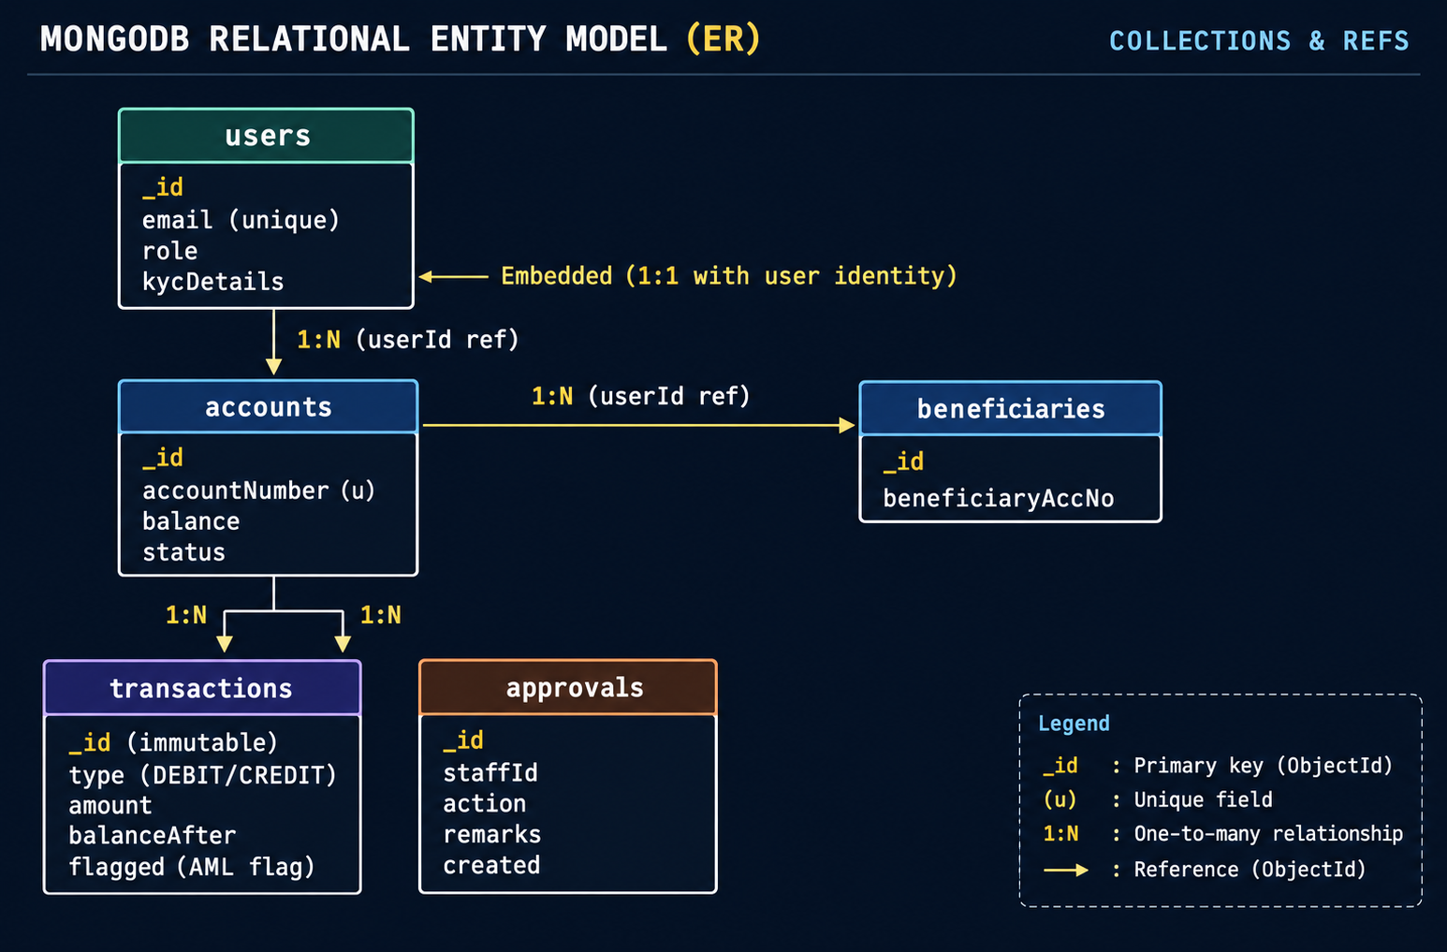


04 — DATABASE DESIGN
Database Design & Data Modeling Rationale (ER Model)
Embedded KYC Details
Tightly coupled to the user; avoids expensive multi-collection joins during everyday session authentication.
Referenced Accounts & Ledgers
Accommodates unbounded one-to-many scaling and circumvents MongoDB's strict 16MB single-document limit.
Document Architecture & Scale Trade-offs
Slide 05

Slide 6




05 — CUSTOMER WORKFLOWS
Core Modules — Customer Banking Workflows
MODULE 1
MODULE 3
MODULE 4
Customer Onboarding & KYC
Account Lifecycle Management
Beneficiary Management
Registration with bcrypt-hashed passwords and structured KYC capture (address, income).
Customers apply for Savings or Current accounts; system generates and assigns unique 10-digit account numbers.
Whitelist trusted recipients; compound unique index prevents duplicates.
MODULE 5
MODULE 6 & 7
MODULE 8
Fund Transfer Engine
Immutable Ledger & Statements
Balance & Limits Enforcement
Atomic transfers between accounts with simultaneous source debit and destination credit ledger mutations.
Running ledger and date-filtered statement exports with net turnover statistics.
Enforces minimum balance (Savings: ₹1,000 | Current: ₹5,000) and cumulative daily transfer limit (₹1,00,000).
Retail Banking Capabilities
Slide 06

Slide 7
06 — STAFF GOVERNANCE
Core Modules — Staff Operations & Governance
MODULE 2
MODULE 9
MODULE 10
Account Approval Workflow
AML & Suspicious Flagging
Account Freeze / Unfreeze
Staff reviews pending queue (), inspects KYC, and approves with initial deposit activation or rejects with mandatory remarks.
Automated threshold trigger on any transaction ≥ ₹50,000; flags transaction for compliance review and staff sign-off.
Security control transitioning accounts from to ; strictly blocks outgoing debits while preserving audit trails.
MODULE 11
MODULE 12
MODULE 13
Periodic Interest Accrual
Staff Monitoring Dashboard
Role-Based Access Control
Batch job calculating daily simple interest on active Savings accounts (4.0% per annum) with automated ledger accrual.
Bank-wide aggregated metrics: total deposits, pending queues, frozen accounts, and flagged counts across all branches.
JWT middleware enforcing strict access policies across , , and roles.
Administrative & Compliance Authority
Slide 07

Slide 8




07 — STATE MACHINES
State Transition Models & Validation Rules
FINITE STATE MACHINE (ACCOUNT LIFECYCLE)
[Customer Applies] ──► PENDING_APPROVAL ──(Staff Rejects)──► REJECTED (Terminated) │ (Staff Approves) ▼ ACTIVE ◄──────────────┐ │ │ (Staff Freezes) (Staff Unfreezes) ▼ │ FROZEN ───────────────┘ (Debits strictly blocked)
1. Source Check
2. Self-Transfer
3. Daily Guard
4. Min Balance
5. AML Policy
Must be (reject if or ).
Destination cannot equal source account.
Cumulative transfers cannot exceed ₹1,00,000.
Minimum Balance threshold.
If , set .
Deterministic Finite State Machine & Guard Hierarchy
Slide 08

Slide 9

08 — API VERIFICATION
API Demonstration & Negative Edge Case Assertions
DEMONSTRATED WORKFLOW | HTTP STATUS | RESPONSE / RESULT | CONTROL DEMONSTRATED
Happy Path Transfer | 200 OK | Dual ledger records + updated balanceAfter | POST /api/transactions/transfer with two account numbers and ₹2,500.
Minimum Balance Violation | 400 Bad Req | MINIMUM_BALANCE_VIOLATION | Transfer violating ₹1,00,0 threshold returns maximum transferable amount.
Frozen Account Transfer | 403 Forbidden | ACCOUNT_FROZEN | Outgoing debit blocked on non-active account.
RBAC Role Violation | 403 Forbidden | FORBIDDEN | Customer token rejected when accessing /api/staff/dashboard.
Missing Fields Validation | 400 Bad Req | Custom validator response | Malformed payload caught cleanly by custom validator without server crash.
Endpoint Testing & Verification Matrix
Slide 09

Slide 10

09 — WEB APPLICATION
Interactive Enterprise Web Application
SURFACE 01
SURFACE 02
SURFACE 03
Landing & Auth Portal
Customer Banking Console
Staff Operations Console
▪
Live role switchers (, , ).
▪
Live account summary cards with real-time balances.
▪
Pending KYC applications queue with single-click actions.
▪
Dynamic JWT issue modals for live demo testing.
▪
Quick-transfer modal with beneficiary dropdown list.
▪
Suspicious AML transaction queue with dismiss workflow.
▪
Encrypted session token storage with auto-refresh.
▪
Real-time immutable transaction ledger table.
▪
Administrative security freeze and unfreeze controls.
The interface is not decoration; it is the operational surface for the rules underneath.
CREAM & CHAMPAGNE GOLD · EB GARAMOND · GENEROUS WHITESPACE
Full-Stack Presentation Experience
Slide 10

Slide 11
10 — CHALLENGES & CONCLUSION
Key Learnings, Engineering Challenges & Conclusion
01 / TRANSACTION INTEGRITY
Atomic Balance Updates
Orchestrated independent balance updates across two separate MongoDB account documents with strict, state-aware pre-mutation validation.
02 / DATA ARCHITECTURE
Double-Entry Ledger Modeling
Solved point-in-time balance reconstruction by computing and storing balanceAfter on each individual ledger mutation.
03 / SECURITY GUARDS
State Guard Enforcement
Built strict pipeline middleware preventing unauthorized debit or credit operations on FROZEN or PENDING accounts.
Team 30 · Engineering Retro & Synthesis

