Slide 1
Security Issues with HTML5 Web Local Storage and Co-Hosting
Slides: TBD
Available via GitHub at:
TBD

Slide 2
Speaker Introduction
Richard Roda’s linked in profile:
  http://www.linkedin.com/in/richardroda
Over 15 years of IT experience.
Sr. Software Engineer for Hewlett Packard for the Army at Ft. Knox
Lead developer for common security framework used by multiple Java applications.
Headquarters Support Structure application Technical Lead.
Certifications: Security+, ITILv3 Foundation
BA Business with minor in Computer Science from Warren Wilson College

Slide 3
Security Changes
In the early 1970s analog phone system was controlled using tones.
A tone of 26kHz requested a trunk line. Trunk lines had operator privileges.
The only known instrument that could reproduce the tone was an organ. Sound reproduction equipment was not portable
What could go wrong…?

Slide 4

The Portable 2600hz Instrument

Slide 5
What is Local Storage?
It is a way for web applications to store and use data in the browser.
Allows data manipulation using browser side mobile code such as JavaScript.
Differs from cookies:
  Not sent to server with each request
  Cookies are primarily a product of http responses. HTML5 local storage is manipulated by browser side code.

Slide 6
Typical Local Storage Uses
Example: Email Application
  Offline Reading
  Offline Composition
  Offline Organization
Example: Caching
  A cached page may use local storage to display dynamic or per-user content.
  Eliminates the need to re-transmit content for each request.

Slide 7
How is Local Storage Bound?
“The localStorage object provides a Storage object for an origin.”… “If the Document's origin is not a scheme/host/port tuple, then throw a SecurityError exception and abort these steps.” (source: http://www.w3.org/TR/webstorage)
http://www.w3.org/TR/webstorage is a http/www.w3.org/80 tuple (port 80 is implied)
Notes:
The wc3 standard does not define what an origin is directly, but does define that an error should be thrown if it is not a scheme/host/port tuple. Since the only way to use local storage is to have it successfully initialized, this effectively defines an origin as a scheme/host/port tuple.

Slide 8
What Do We Mean By Security?
Security is commonly defined by the CIA triad as Confidentiality, Integrity, and Availability.
  Confidentiality – Only authorized users may access data and information.
  Integrity – Only authorized users may correctly change data. Damage is reversible.
  Accessibility – System and all authorized functions are available for authorized users.
Source, “The CIA Triad”, http://www.techrepublic.com/blog/security/the-cia-triad/488, pulled April 13, 2013.

Slide 9
Security Implications
An application may display data belonging to another application for which the user is not authorized, violating Confidentiality.
An application may alter data belonging to another application, violating Integrity.
An application that has its data altered may crash, violating Accessibility.

Slide 10
Demo: Single to Co-Hosting
This demo uses a virtual host configured with completely separate host names, and another virtual host configured for hostname “myappserver.mydomain.com.”

Slide 11
Co-hosting Good Practice
Each application* should have its own origin.
A separate network address for each application is not required, merely a different name.
DNS aliasing may be used to provide each application with its origin by making the host part of the scheme/host/port tuple unique.
A DNS wildcard (e.g. *.appserver.domain.com) may be used. It minimizes DNS administration and helps support Single Sign On.
*Or groups of applications designed to share data using local storage

Slide 12
Demo: Co-Hosting with subdomains
This demonstration uses a virtual host configured to handle requests for hosts within the domain “myappserver.mydomain.com”

Slide 13
Server Session Implications
By default, the browser binds cookies using the same protocol, host, port tuple as Local Storage.
Most application servers use cookies to bind sessions, with SSO (Single Sign On) being a form of shared session.
Changing applications on a server to use separate host name may effectively unbind any shared session state.

Slide 14
Demo: Subdomain co-hosting with domain SSO cookie.
This demo uses a virtual host configured with the domain fixedappserver.mydomain.com. This host creates a shared SSO cookie within the domain.

Slide 15
URL Rewriting Proxies
Or, we’re not out of the forest yet

Slide 16
Reverse Proxy Servers
A technique used to provide protected access to protected resources over an untrusted network using the https scheme.
Primary advantage: It works with a standard web browser. No need to deploy software.
Because they rewrite the URL to go through the proxy, they can map everything to a single origin. This effectively “flattens” the origin host namespace.

Slide 17
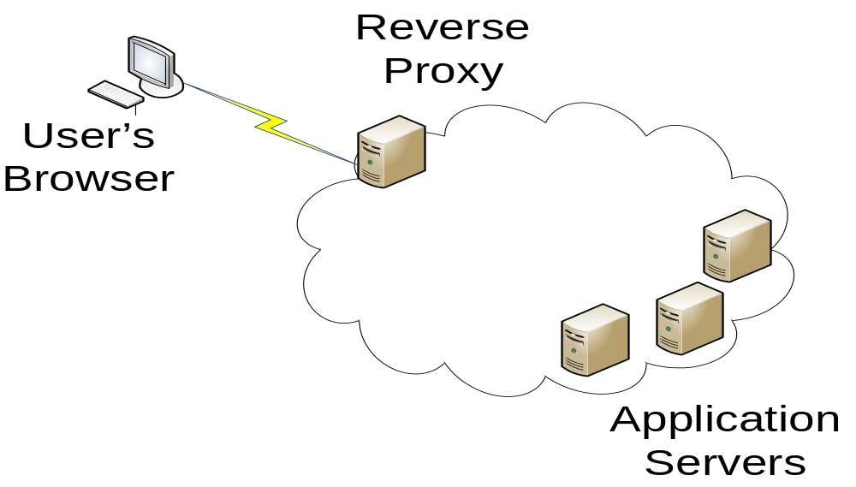
Reverse Proxy Configuration

Slide 18
Reverse Proxy Solution
Set up virtual hosts on the reverse proxy for each application, or a virtual host that allows for wildcard host names.
Set up Single Sign On (SSO) for all of the reverse proxy virtual hosts.
Set up a portal for the reverse proxy, or set up rules on the reverse proxy to redirect the browser to the correct host based on the application context requested.

Slide 19
LocalStorage Data Remains Vulnerable
DNS cache poisoning can direct to an impostor site that exfiltrates the data (similar to the co-hosting example).
A browser vulnerability may allow an escalation of privilege attack or code to escape the browser “sandbox”

Slide 20
Protect Sensitive Data
Such data should only come from an HTTPS page.
Encrypt the data and include a MAC code with it.
Message authentication codes (MAC) should be used instead of the keys.
The keys deserve protection because they can reveal clues about the data.

Slide 21
Co-Hosting Demo with Encryption
This demonstration will repeat the co-hosting demo, but with encryption and MAC codes.
The use of encryption limits the damage that a compromise may cause.
Two attacks remain: A deletion or corruption attack, and a replay attack.
These attacks must be mitigated (taken into consideration) when the app is designed.

Slide 22
Summary
HTML5 web local storage is a useful technology that has security implications.
Applications from the same origin share local storage, which can violate Confidentiality, Integrity, and Accessibility (CIA triad).
Avoid these risks by giving each application a unique host name, and encrypt any sensitive data.

Slide 23
Questions?
GitHub Location:
TBD

