Slide 1

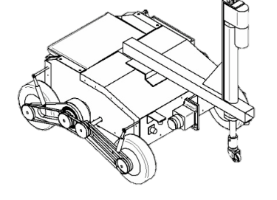
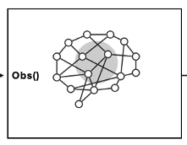
Curriculum
Seguimiento y Curriculum
Agente1900
Scen58, Reward_SystemA
Run_x860, 2000 eps
Checkpoint1900
(TD3)
Agente 500
Entrenamiento:
Scen58, Reward_SystemD
Run_x732, 1000eps
StdDev:0.2 StdDevmin:0.1
Scen58, Reward_SystemA
Run_x519, 1000eps
Checkpoint500
(TD3)
Agente 1000
Agente seleccionado
Checkpoint1000
(TD3)

Slide 2
Curriculum
Seguimiento y Curriculum
Agente1900
Scen58, Reward_SystemA
Run_x860, 2000 eps
Checkpoint1900
(TD3)
Agente 500
Agente 1000
Entrenamiento:
Scen58, Reward_SystemDE
Run_x853, 400eps
StdDev:0.2 StdDevmin:0.1
Scen58, Reward_SystemA
Run_x519, 1000eps
Checkpoint500
Scen58, Reward_SystemD
Run_x732, 1000eps
Checkpoint1000
(TD3)
(TD3)
Agente 400
Agente seleccionado
Checkpoint400
(TD3)

Slide 3
Curriculum
Seguimiento y Curriculum
Agente 1000
Scen58, Reward_SystemD
Run_x732, 1000eps
Checkpoint1000
(TD3)
Agente 400
Scen58, Reward_SystemDE
Run_x853, 400eps
Checkpoint4000
Entrenamiento:
Scen58, Reward_SystemF
Run_x569, 500eps
(TD3)
Agente 100
Agente seleccionado
Checkpoint100
(TD3)

Slide 4
Curriculum
Seguimiento y Curriculum
Agente 400
Scen58, Reward_SystemDE
Run_x853, 400eps
Checkpoint4000
(TD3)
Agente 100
Scen58, Reward_SystemF
Run_x569, 500eps
Checkpoint100
Entrenamiento:
Scen58, Reward_SystemD
Run_x303, 2000eps
(TD3)
Agente 1600
Agente seleccionado
Checkpoint1600
(TD3)

Slide 5
Curriculum
Seguimiento y Curriculum
Agente 100
Scen58, Reward_SystemF
Run_x569, 500eps
Checkpoint100
(TD3)
Agente 1600
Scen58, Reward_SystemF
Run_x303, 2000eps
Checkpoint1600
Entrenamiento:
Scen58, Reward_SystemD
Run_x681, 3000eps
(TD3)
Agente 600
Agente seleccionado
Checkpoint600
(TD3)

Slide 6
Curriculum
Seguimiento y Curriculum
Agente 1600
Scen58, Reward_SystemF
Run_x303, 2000eps
Checkpoint1600
(TD3)
Entrenamiento:
Scen58, Reward_SystemD
Run_x177, 1000eps
01ini: (-180,180) [° ]
O1sp: (-180,180) [° ]
Exploration,Smoothing
GlobalRandomInject:5%
BalancedCP
SubsectorSize15°
Checkpoint600
Scen58, Reward_SystemD
Run_x681, 3000eps
01ini: (-180,180) [° ]
O1sp: (-180,180) [° ]
do1ini:(-0,25,0.25)[rad/s]
GlobalRandomInject:5%
BalancedCP
SubsectorSize15°
Checkpoint600
Agente 600
(TD3)
Agente 100
Agente seleccionado
Checkpoint100
Breakpoint
(TD3)

Slide 7
Curriculum
Seguimiento y Curriculum
Agente 600
Scen58, Reward_SystemD
Run_x681, 3000eps
Checkpoint600
(TD3)
Agente 300
Agente 1000
Scen58, Reward_SystemD
Run_x863, 300eps
Checkpoint300
Scen58, Reward_SystemD
Run_x841, 1000eps
Checkpoint1000
Entrenamiento:
Scen58, Reward_SystemD
Run_x427, 1000eps
01ini: (-180,180) [° ]
Exploration,Smoothing
(TD3)
re-train
(TD3)
re-train
Agente 100
Agente 1000
Scen58, Reward_SystemD
Run_x177, 1000eps
Checkpoint100
Agente seleccionado
Checkpoint200
(TD3)
(TD3)
Breakpoint

