Slide 1
Steel Plates Dataset
Richard Szarka
Marko Stahovec

Slide 2
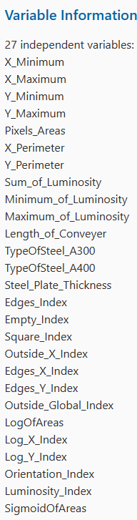
Dataset
No missing values
34 columns (7 of them for multiclass)
Last class can be used for binary classification
shape: (1941, 34)

Slide 3
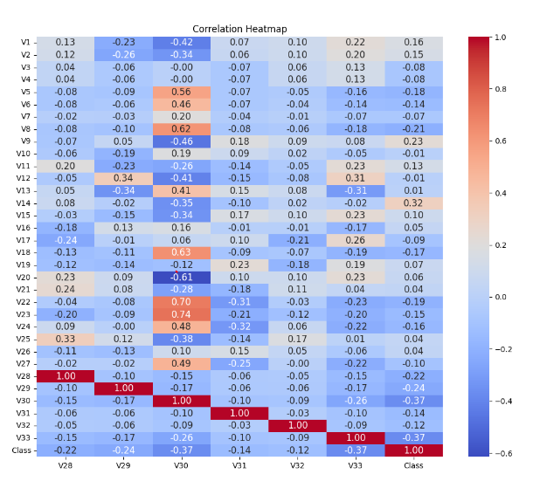
Dataset

Slide 4
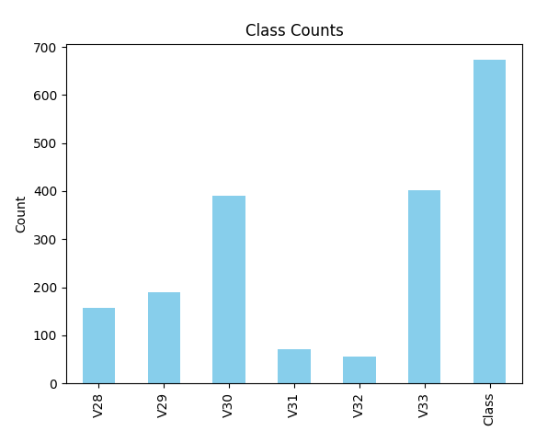
Dataset

Slide 5
Preprocess
Z – score normalization
Train valid split 80:20
Categorical parameters were only binary (transformation to 0 and 1)
Feature selection based on DecisionTree importance ( <= 0.05)

Slide 6
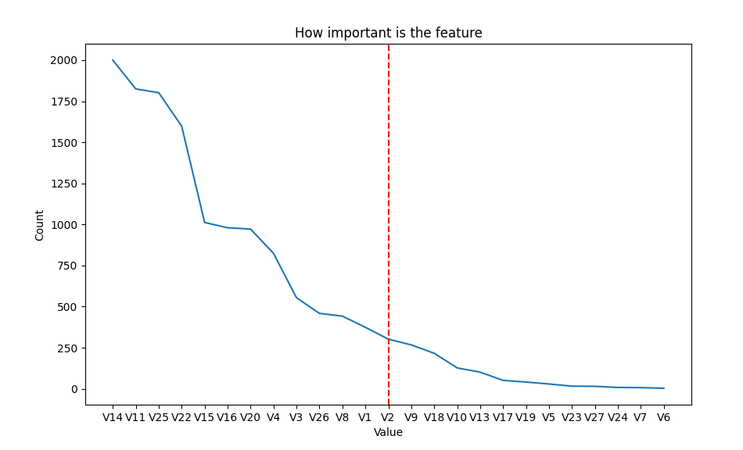
Feature Selection

Slide 7
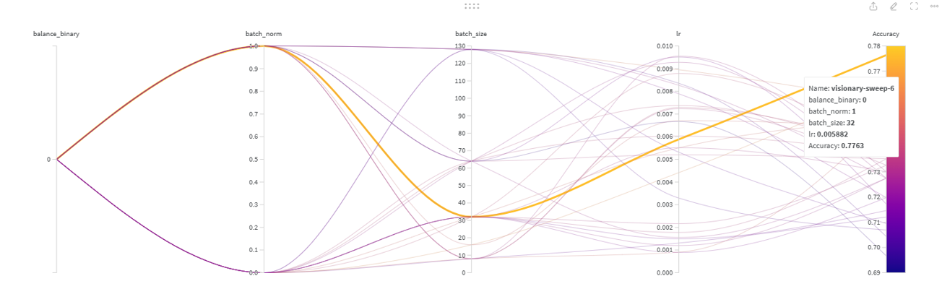
Hyperparameters
Batch size: 32
Learning rate: 0.006
Patience: 150 epochs
Optimizer: SGD - (so we can see the whole impact of batch norm)
Loss -> BCE for binary and CrossEntropy for multiclass

Slide 8
Architecture
Architecture:
Linear block - LB (linear -> batch norm -> ReLU)
Sigmoid (only for binary classification)
LB1
LB2
Input
LB3
Out

Slide 9
Architecture
Architecture:
Linear block - LB (linear -> batch norm -> ReLU)
Sigmoid (only for binary classification)
LB1
LB2
Input
LB3
Out

Slide 10
Experiments

Slide 11
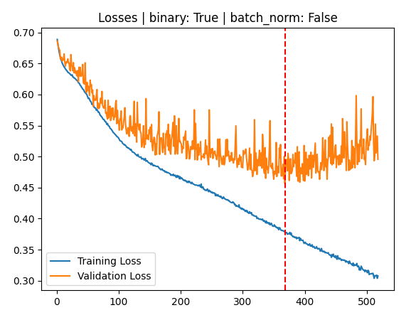
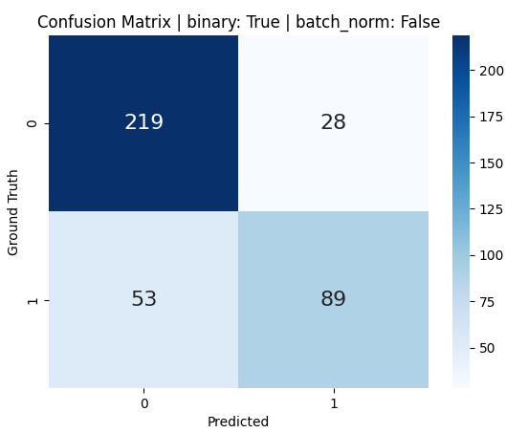
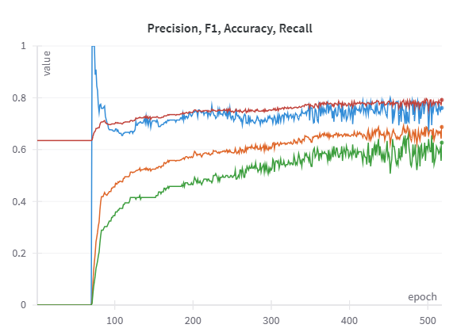
Binary classification
Accuracy: 0.7917737789203085
Precision: 0.7606837606837606
Recall: 0.6267605633802817

Slide 12
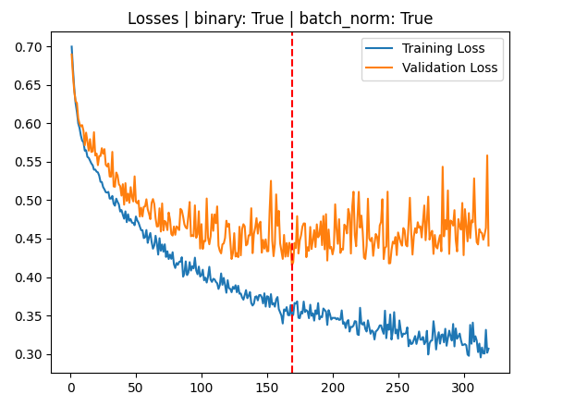
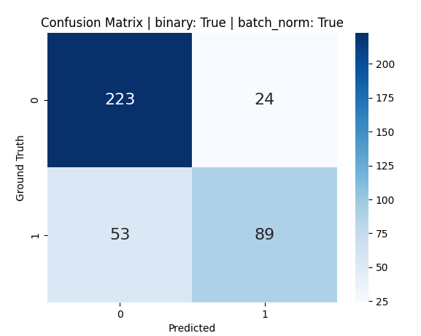
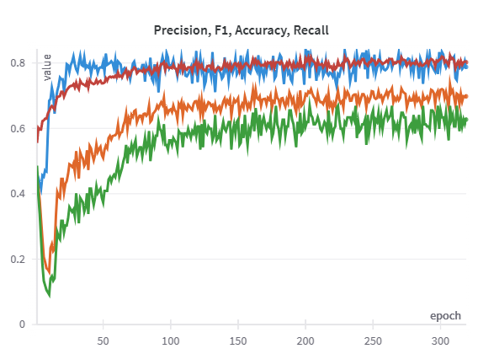
Binary classification – batch norm
Accuracy: 0.8020565552699229
Precision: 0.7876106194690266
Recall: 0.6267605633802817

Slide 13
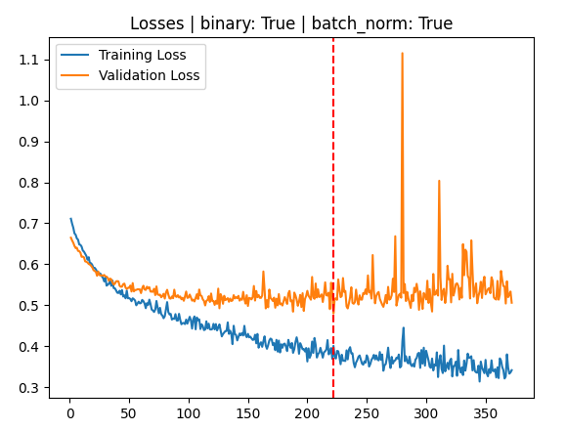
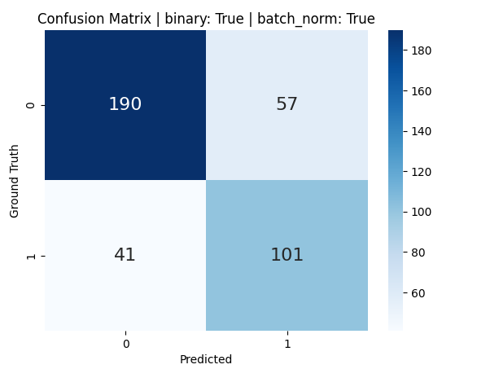
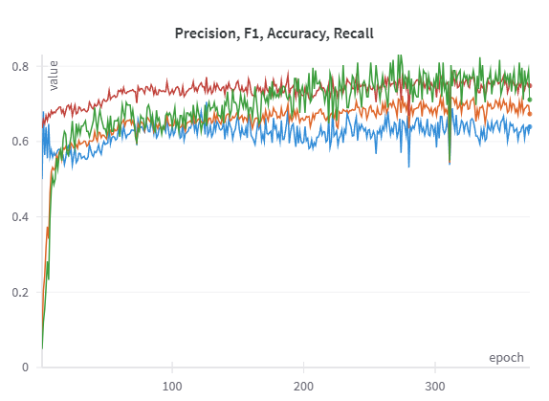
Balanced Binary classification – batch norm
Accuracy: 0.7480719794344473
Precision: 0.6392405063291139
Recall: 0.7112676056338029

Slide 14
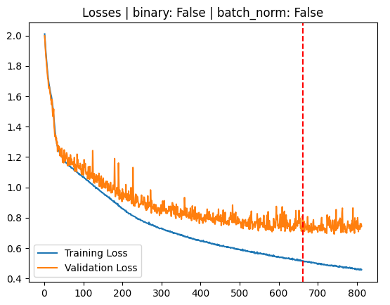
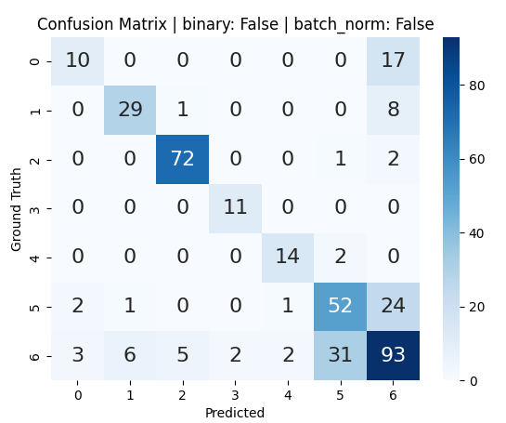
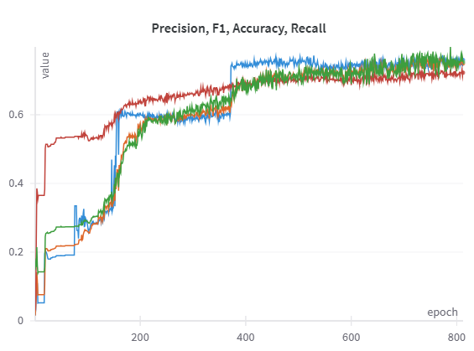
Multiclass classification
Accuracy: 0.7223650385604113
Precision: 0.7593524141916755
Recall: 0.7533511203674289

Slide 15
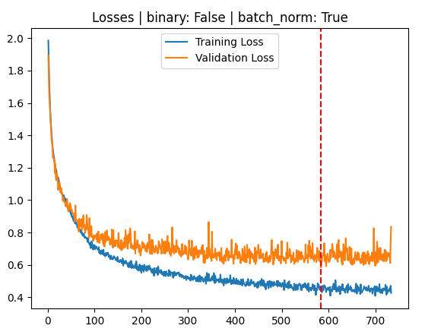
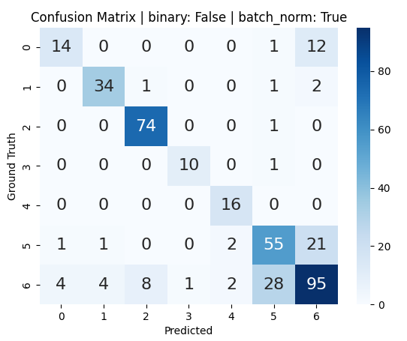
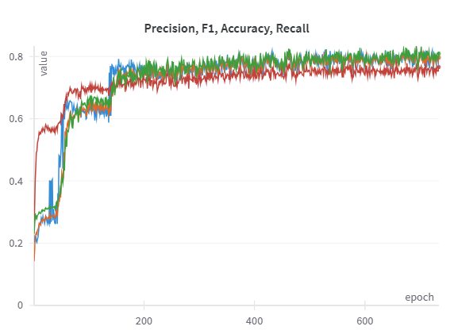
Multiclass classification – batch norm
Accuracy: 0.7660668380462725
Precision: 0.7960353271463412
Recall: 0.8093610029840571

Slide 16
Useful links to project
https://api.wandb.ai/links/r-szarka/q5gr5cww - sweep
https://api.wandb.ai/links/r-szarka/ou5z1ct2 - multiclass
https://api.wandb.ai/links/r-szarka/uoiclrgf - binary
https://github.com/RichardSzarka/NN_project_1 - github

