Slide 1
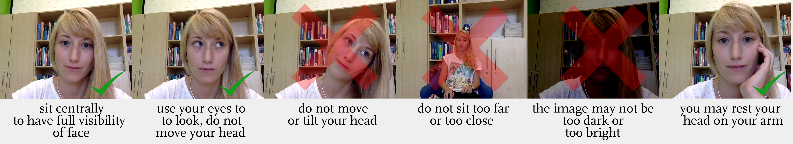
This experiment uses eye-tracking to keep track of where you are looking at on the computer screen throughout the experiment.
The eye-tracker is the little black bar that is attached at the bottom of your screen.
To make sure that it works correctly, it is important that you sit in a position where the eye tracker can easily keep track of your eyes.

Slide 2
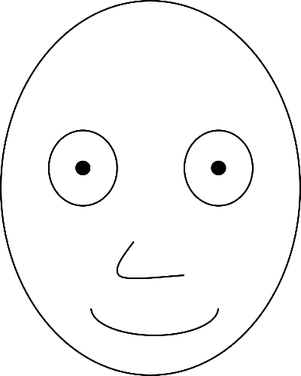
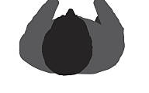
Before the study starts, it is important that the eye-tracker is calibrated to your eyes.
For this, you will see a procedure of three steps, that will be explained now.
Head position calibration.
In a first step, it is important that your head is in the right position.
To ensure this, you will see two face masks, like the one below, and your task will be to align the blue face with the black face as closely as possible.
First, position yourself to make sure that the blue face has the same size has the black face.
too close to screen
too far from screen
perfect distance

Slide 3
Before the study starts, it is important that the eye-tracker is calibrated to your eyes.
For this, you will see a procedure of three steps, that will be explained now.
Head position calibration.
In a first step, it is important that your head is in the right position.
To ensure this, you will see two face masks, like the one below, and your task will be to align the blue face with the black face as closely as possible.
Next, move your head left or right to adjust the horizontal position of the blue face until it matches the black face
too far left
too far right
perfect position

Slide 4
Before the study starts, it is important that the eye-tracker is calibrated to your eyes.
For this, you will see a procedure of three steps, that will be explained now.
Head position calibration.
In a first step, it is important that your head is in the right position.
To ensure this, you will see two face masks, like the one below, and your task will be to align the two masks as closely as possible.
Finally, adjust the height of your seat and seating position to bring the blue face to the same height as the black face.
too high
too low
perfect position

Slide 5

Before the study starts, it is important that the eye-tracker is calibrated to your eyes.
For this, you will see a procedure of three steps, that will be explained now.
Head position calibration.
Once the two masks are aligned well, the background of the screen will turn green to indicate that your head is in the right position. Once this is the case, keep your head in this position and press the SPACE bar to continue to the second step. Make sure to move your head as little as possible for the rest of the study.
2. Eye Movement calibration.
In the second step, the eye tracker will calibrate itself to your eye movements. You will see a grey dot on the screen that will move to different positions.
Keep your eyes fixated at the dot at all times.
2.
3.
1.

Slide 6
Before the study starts, it is important that the eye-tracker is calibrated to your eyes.
For this, you will see a procedure of three steps, that will be explained now.
Head position calibration.
Once the two masks are aligned well, the background of the screen will turn green to indicate that your head is in the right position. Once this is the case, keep your head in this position and press the SPACE bar to continue to the second step. Make sure to move your head as little as possible for the rest of the study.
2. Eye Movement calibration.
In the second step, the eye tracker will calibrate itself to your eye movements. You will see a grey dot on the screen that will move to different positions.
Keep your eyes fixated at the dot at all times.
3. Eye movement validation.
In a last step, the eye tracker will validate that it can track your eyes correctly.
For this, another green dot will appear, that you follow with your eyes, just like in step 2.
In the end, you will be told whether the calibration has succeeded or not.
In case the procedure has not succeeded for some reason, you will be asked to repeat the calibration.
Should the calibration fail again, you will be told to raise your hand to request assistance.
If these instructions are clear, you can start the calibration by pressing the SPACE bar. If anything is still unclear, please raise your hand to request assistance.

