Slide 1

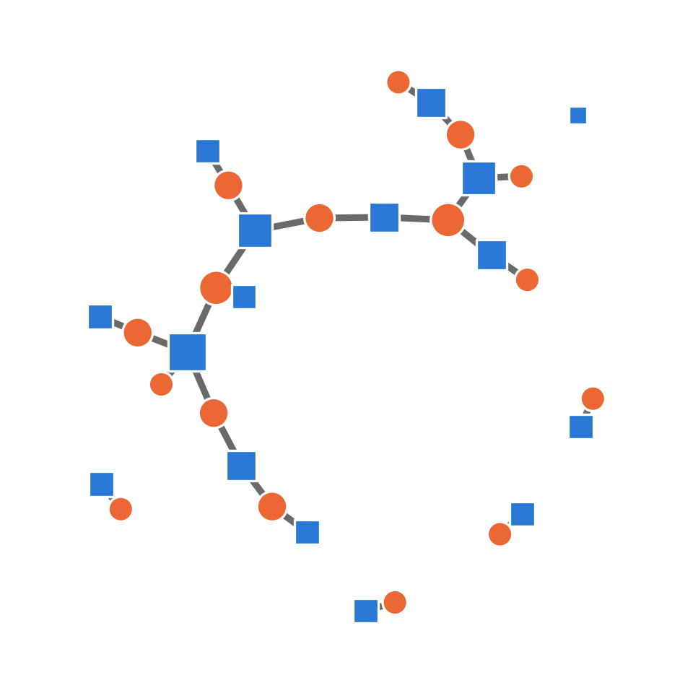
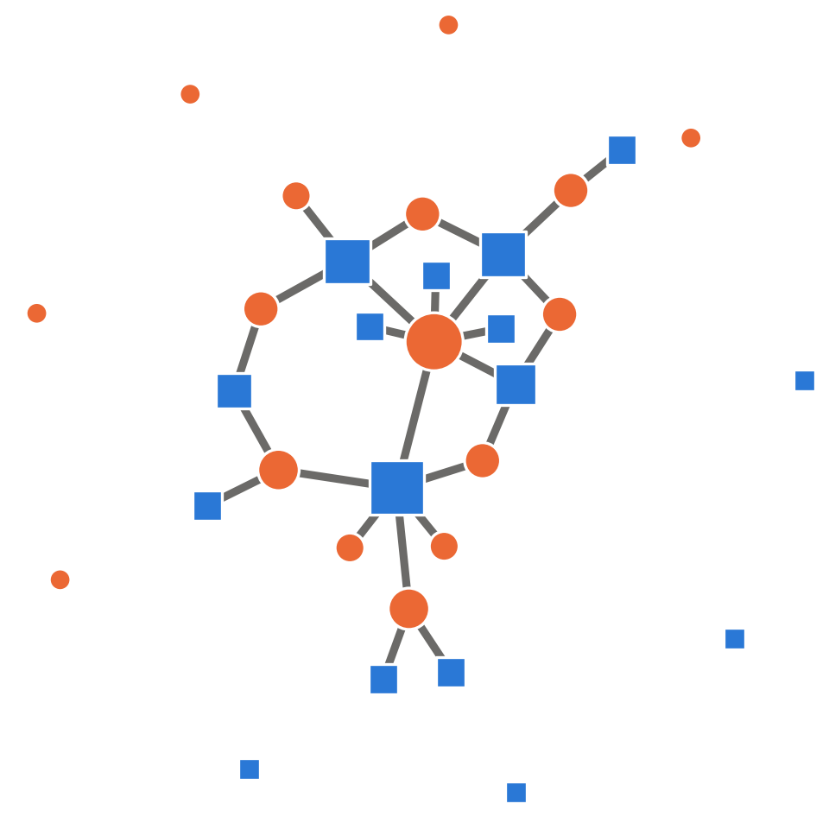
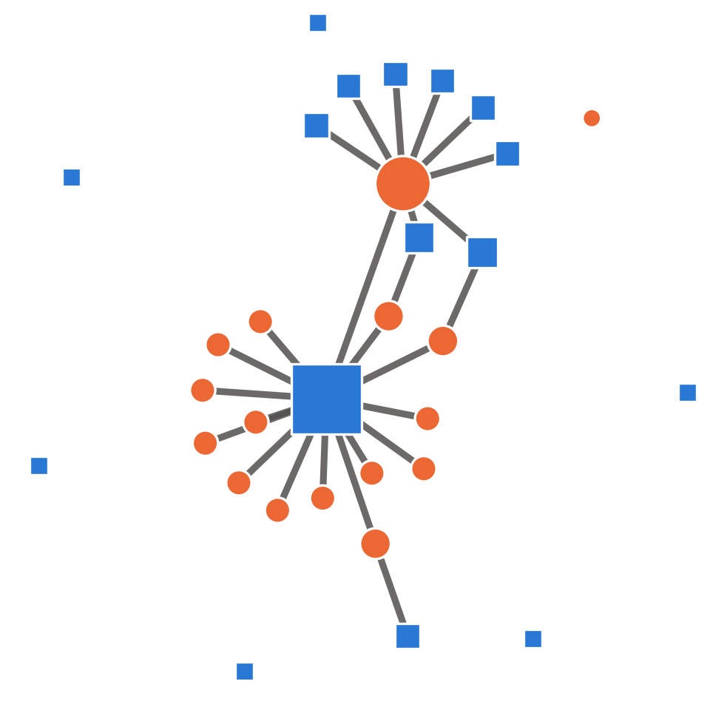
Importance of Network Structure in ABMs of STIs: an HPVsim Study
1 The problem
2 Our approach
3 What we found
HPVsim agent-based model (ABM) on three partnership networks
FINDING 1
Cervical cancer per 100,000 women, 2040
FINDING 2
Change vs default
+96%
Most STI models assume everyone has a similar number of partners.
Real behaviour (Natsal-3) is highly skewed: a few people have many partners, many have none.
Gamma
+30%
Default
Gamma
Power law
Power law
increasing heterogeneity
2040 medians, 50 runs
Same mean: 1.4 partners/year (Natsal-3)
● women ■ men size = no. of partners
Same average behaviour, up to 2× more cervical cancer projected on heterogeneous networks
Take-home: network structure, not just average partner numbers, shapes STI projections and intervention decisions.
Yu R, et al. · [Journal], [Year] · doi:[10.xxxx/xxxxx]
Notes:
DRAFT A: three panels, following the structure of Elsevier's own template (context -> method -> outcome), in the M4P poster colours.
Findings: draft values are setting B (mean degree 1.4) medians of 50 runs for cervical cancer incidence per 100,000 women in 2040: Default 6.9, Gamma (shape 2) 13.5 (+96%), Power law (alpha 3.5) 9.0 (+30%). Note the Gamma caveat in results_figures.tex (run 1900-2050, fitted differently). Chart: right-click > Edit Data. Update the stats card and any "2x" wording to match the final values.
Elsevier graphical abstract checklist (elsevier.com/en-gb/researcher/author/tools-and-resources/graphical-abstract):
- Minimum 1328 x 531 px (w x h), or proportionally more, keeping the 500 x 200 (2.5:1) ratio. This slide is 14 x 5.6 in, so even a default 96-dpi export is 1344 x 538 px.
- Preferred files: TIFF, EPS, PDF or MS Office. Safest: File > Export > Create PDF (vector), exporting only the chosen slide.
- Fonts: Times, Arial, Courier or Symbol, large enough to read when shrunk to 200 px high.
- Clear start and end, reading left to right or top to bottom. No "Graphical abstract" heading, no unnecessary white space, no extra text outside the image.
- Icons: Health Icons (healthicons.org), CC0, no credit required. Oxford logo: cropped from the Mathematical Institute logo on the M4P poster (212 px; swap in an official higher-resolution file if you have one). Network schematics: make_network_schematics.py (illustrations, not model output).

Slide 2
Importance of Network Structure in ABMs of STIs: an HPVsim Study
Methods
Same mean, different spread
Findings
HPVsim agent-based model (ABM) with 100,000 agents
FINDING 1
Cervical cancer per 100,000 women, 2040
FINDING 2
Change vs default
+96%
Partnership networks fitted to Natsal-3 (1.4 partners/year)
Gamma
Default
Gamma
Power law
similar for all
some hubs
a few big hubs
+30%
NHS cervical screening and HPV vaccination
increasing heterogeneity
Power law
● women ■ men node size = number of partners
2040 medians, 50 runs
Conclusion: STI models that assume homogeneous partnership networks can misjudge disease burden and intervention impact; fit network structure to behavioural data.
Yu R, et al. [Journal], [Year]
doi:[10.xxxx/xxxxx]
Notes:
DRAFT B: methods | network comparison | findings, with a title band and conclusion band (closest to the Kidney Medicine example on the Elsevier page), in the M4P poster colours.
Findings: draft values are setting B (mean degree 1.4) medians of 50 runs for cervical cancer incidence per 100,000 women in 2040: Default 6.9, Gamma (shape 2) 13.5 (+96%), Power law (alpha 3.5) 9.0 (+30%). Note the Gamma caveat in results_figures.tex (run 1900-2050, fitted differently). Chart: right-click > Edit Data. Update the stats card and any "2x" wording to match the final values.
Elsevier graphical abstract checklist (elsevier.com/en-gb/researcher/author/tools-and-resources/graphical-abstract):
- Minimum 1328 x 531 px (w x h), or proportionally more, keeping the 500 x 200 (2.5:1) ratio. This slide is 14 x 5.6 in, so even a default 96-dpi export is 1344 x 538 px.
- Preferred files: TIFF, EPS, PDF or MS Office. Safest: File > Export > Create PDF (vector), exporting only the chosen slide.
- Fonts: Times, Arial, Courier or Symbol, large enough to read when shrunk to 200 px high.
- Clear start and end, reading left to right or top to bottom. No "Graphical abstract" heading, no unnecessary white space, no extra text outside the image.
- Icons: Health Icons (healthicons.org), CC0, no credit required. Oxford logo: cropped from the Mathematical Institute logo on the M4P poster (212 px; swap in an official higher-resolution file if you have one). Network schematics: make_network_schematics.py (illustrations, not model output).

Slide 3
[Title: one line, Arial 24 pt]
1 Context
2 Method
3 Findings
[icon, network or diagram]
[icon, network or diagram]
[Finding 1: graphical comparison]
[Finding 2: key statistics]
[Introduce the context of your research]
[Showcase your methodology]
[One-line summary of the two findings]
Take-home: [one sentence]
[Authors] · [Journal], [Year] · doi:[...]
Notes:
BLANK: the Draft A frame with placeholders, including the two findings slots. Duplicate this slide to try other versions; delete unused slides before exporting.
Elsevier graphical abstract checklist (elsevier.com/en-gb/researcher/author/tools-and-resources/graphical-abstract):
- Minimum 1328 x 531 px (w x h), or proportionally more, keeping the 500 x 200 (2.5:1) ratio. This slide is 14 x 5.6 in, so even a default 96-dpi export is 1344 x 538 px.
- Preferred files: TIFF, EPS, PDF or MS Office. Safest: File > Export > Create PDF (vector), exporting only the chosen slide.
- Fonts: Times, Arial, Courier or Symbol, large enough to read when shrunk to 200 px high.
- Clear start and end, reading left to right or top to bottom. No "Graphical abstract" heading, no unnecessary white space, no extra text outside the image.
- Icons: Health Icons (healthicons.org), CC0, no credit required. Oxford logo: cropped from the Mathematical Institute logo on the M4P poster (212 px; swap in an official higher-resolution file if you have one). Network schematics: make_network_schematics.py (illustrations, not model output).

