Slide 1
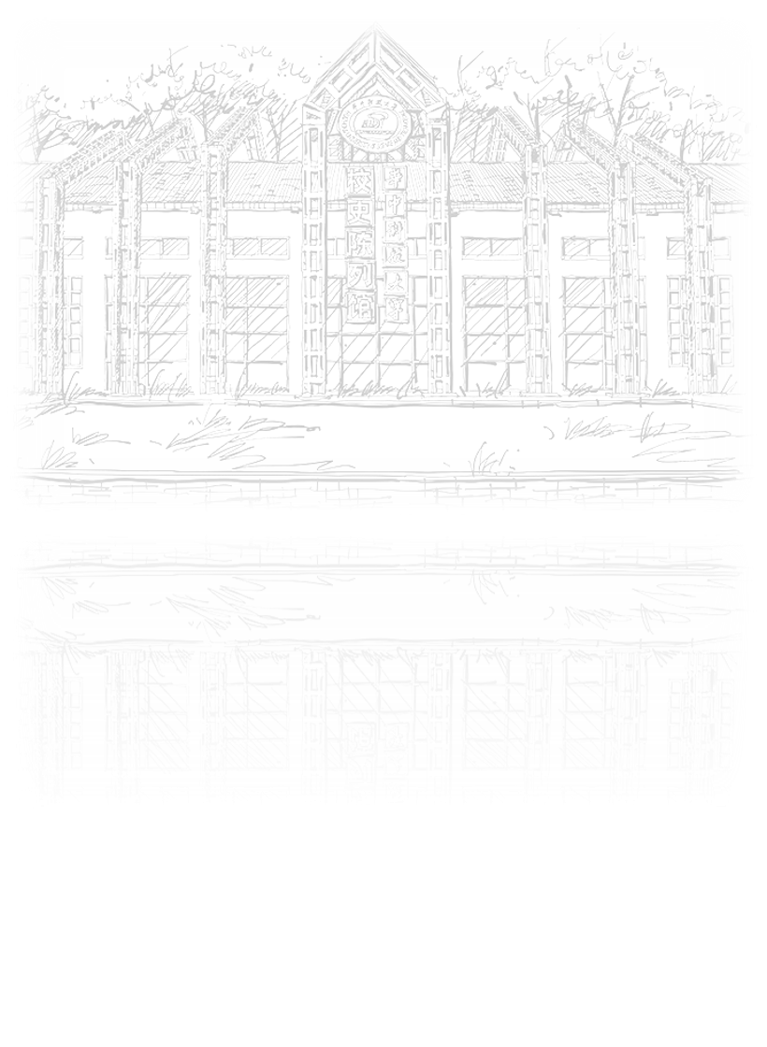
Gaze estimation
田博文

Slide 2
CONTENTS
01
02
03
Introduction
Dataset
Reference

Slide 3

1
Introduction

Slide 4
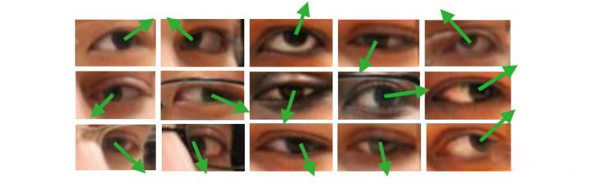
Gaze estimation
introduction
以眼睛图像或人脸图像为处理对象，估算人的视线方向或注视点位置

Slide 5
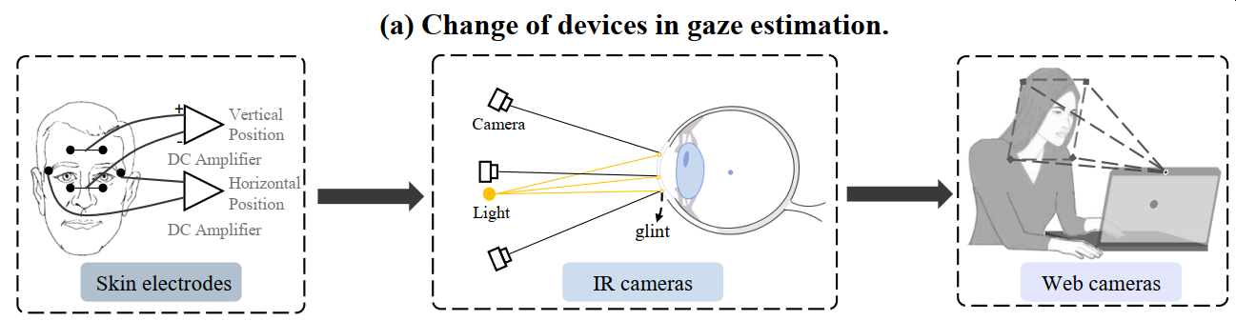
Gaze estimation
introduction

Slide 6
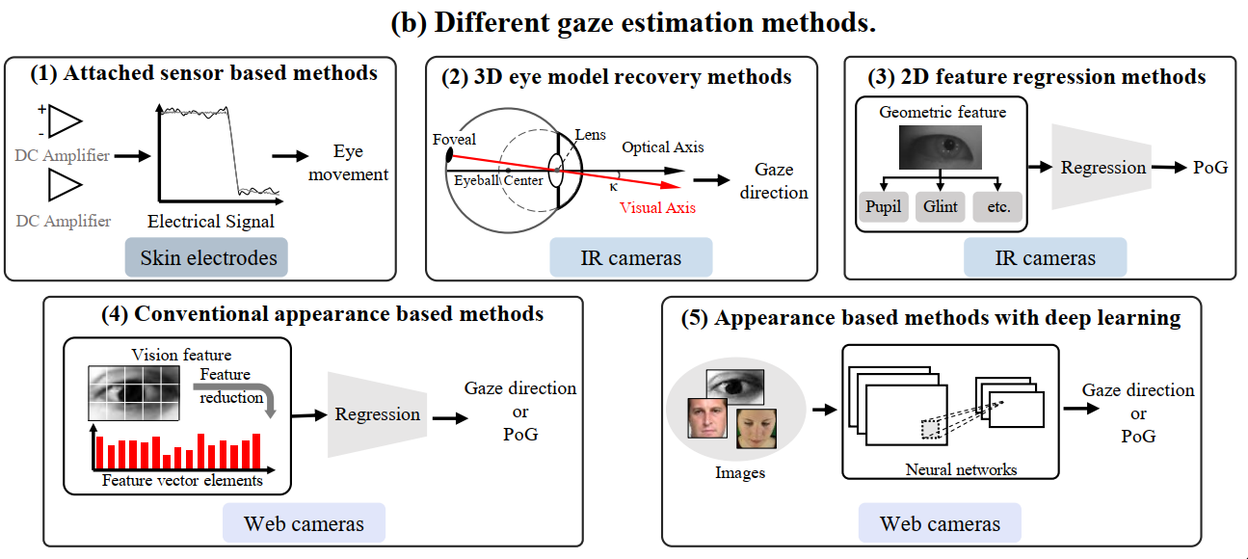
Gaze estimation
introduction

Slide 7
Gaze estimation
introduction
Why deep learning-based gaze estimation？
can extract high-level abstract gaze features
learns non-linear mapping function
tolerate head movement to some extent

Slide 8
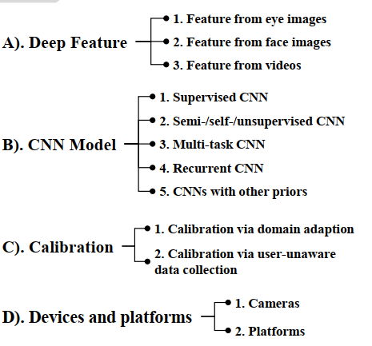
Gaze estimation
introduction

Slide 9
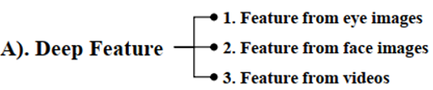
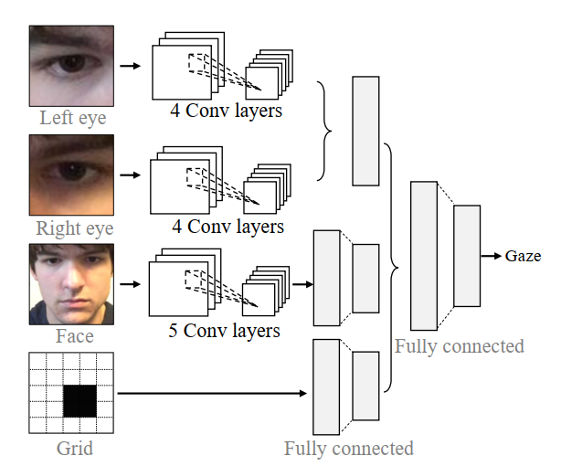
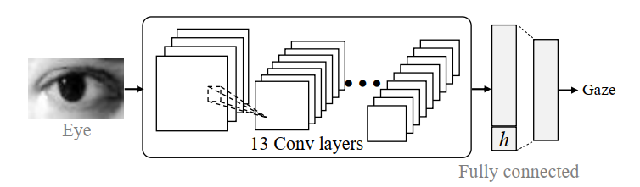
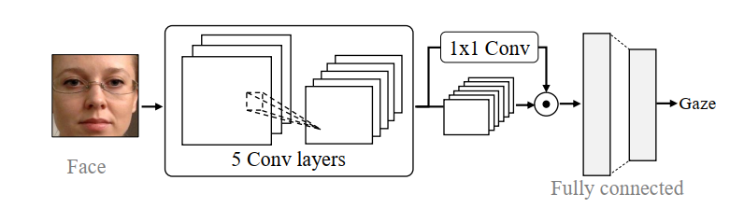
Gaze estimation
introduction
1.Gaze estimation with eye images
2.Gaze estimation with face images
3.Gaze estimation with face and eye images

Slide 10
Gaze estimation
introduction
苏黎世理工 AIT Lab----https://ait.ethz.ch/index.php
洛桑联邦理工学院Idiap----https://www.idiap.ch/en
马克思普朗克研究所----https://perceptualui.org/
北京航天航空大学陆峰----http://phi-ai.org/default.htm

