Slide 1
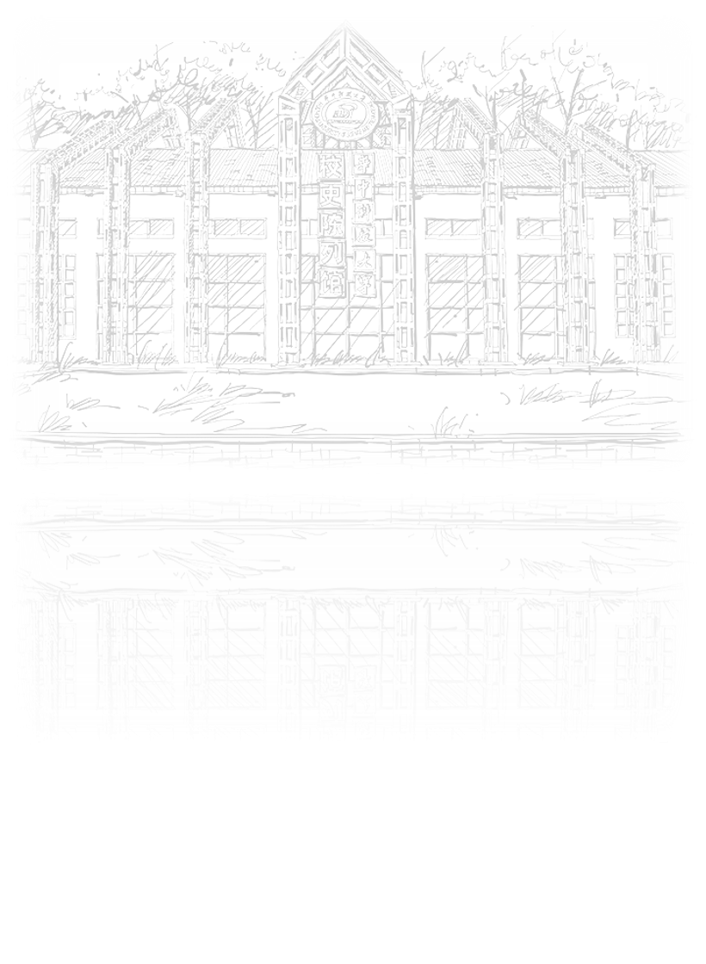
Gaze estimation
田博文

Slide 2
CONTENTS
01
02
03
Introduction
Dataset
Reference

Slide 3

1
Introduction

Slide 4
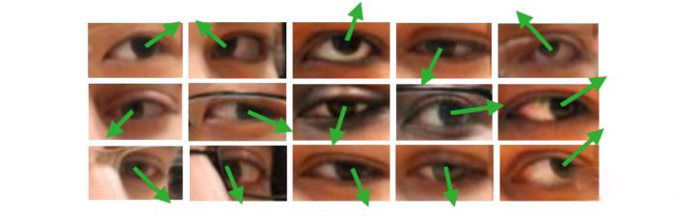
Gaze estimation
introduction
以眼睛图像或人脸图像为处理对象，估算人的视线方向或注视点位置

Slide 5
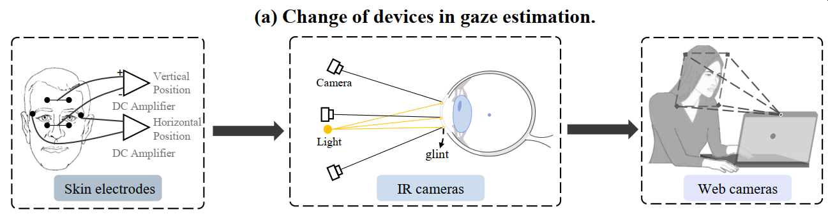
Gaze estimation
introduction

Slide 6
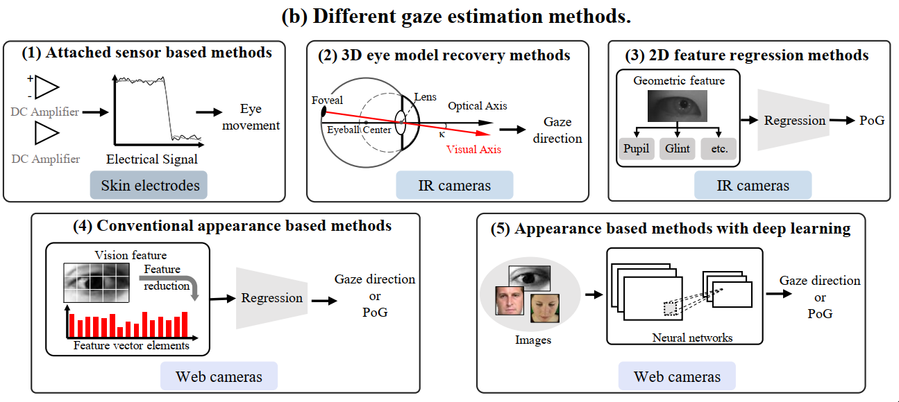
Gaze estimation
introduction

Slide 7
Gaze estimation
introduction
Why deep learning-based gaze estimation？
can extract high-level abstract gaze features
learns non-linear mapping function
tolerate head movement to some extent

Slide 8
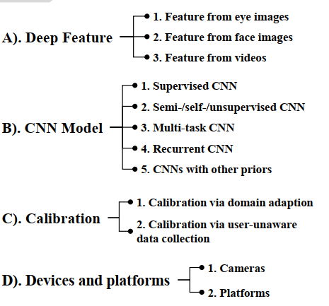
Gaze estimation
introduction

Slide 9
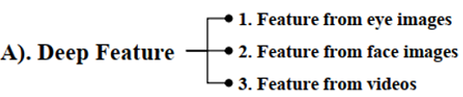
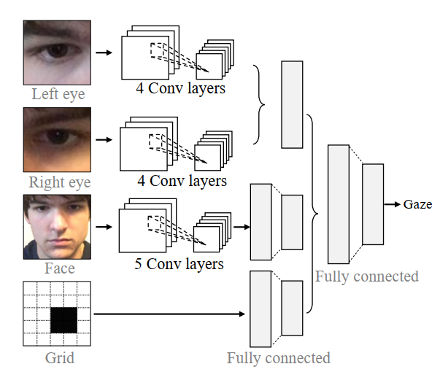
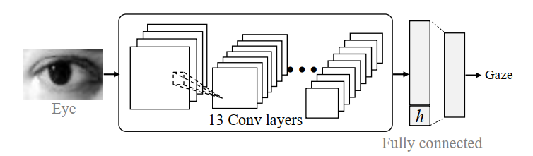
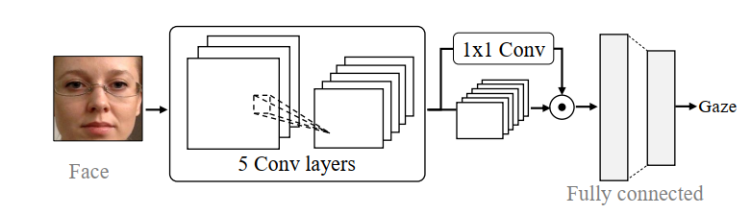
Gaze estimation
introduction
1.Gaze estimation with eye images
2.Gaze estimation with face images
3.Gaze estimation with face and eye images

Slide 10
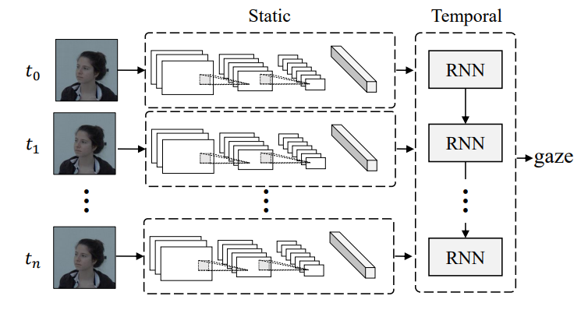
Gaze estimation
introduction
4.Gaze estimation with videos

Slide 11
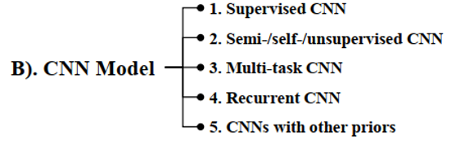
Gaze estimation
introduction

Slide 12
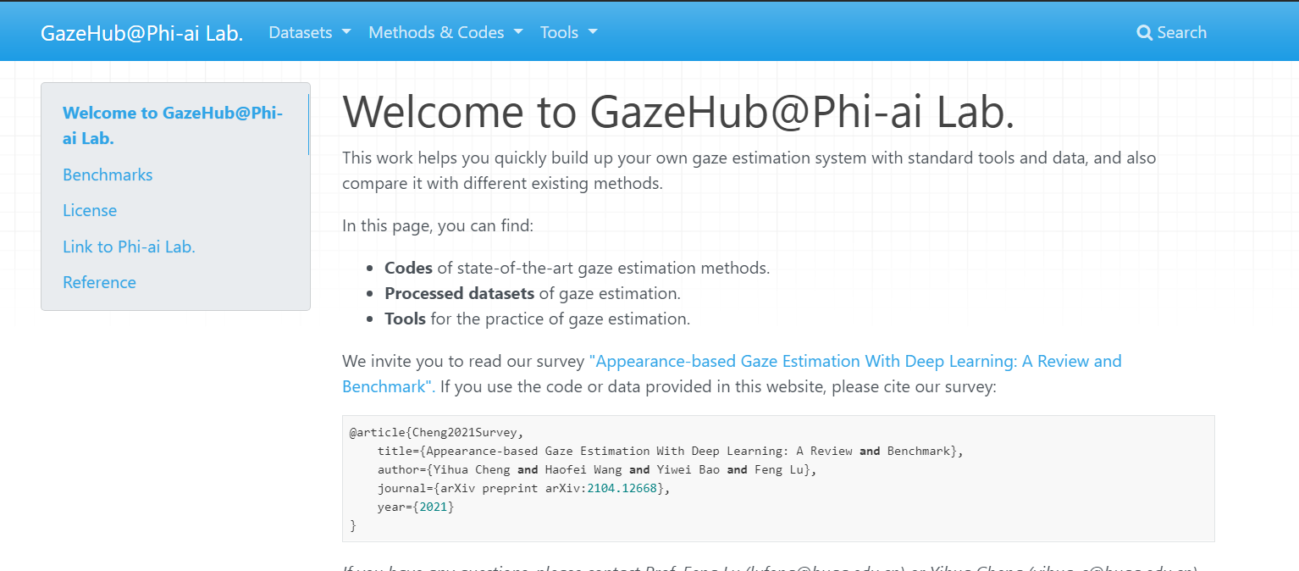
Gaze estimation
introduction
苏黎世理工 AIT Lab----https://ait.ethz.ch/index.php
洛桑联邦理工学院Idiap----https://www.idiap.ch/en
马克思普朗克研究所----https://perceptualui.org/
北京航天航空大学陆峰----http://phi-ai.org/default.htm
http://phi-ai.org/Gazehub/
https://github.com/RichardoMrMu/awesome-gaze-estimation-new
https://github.com/RichardoMrMu/gaze-estimation-paper

Slide 13

Gaze estimation
introduction
https://github.com/RichardoMrMu/awesome-gaze-estimation-new
https://github.com/RichardoMrMu/gaze-estimation-paper

Slide 14
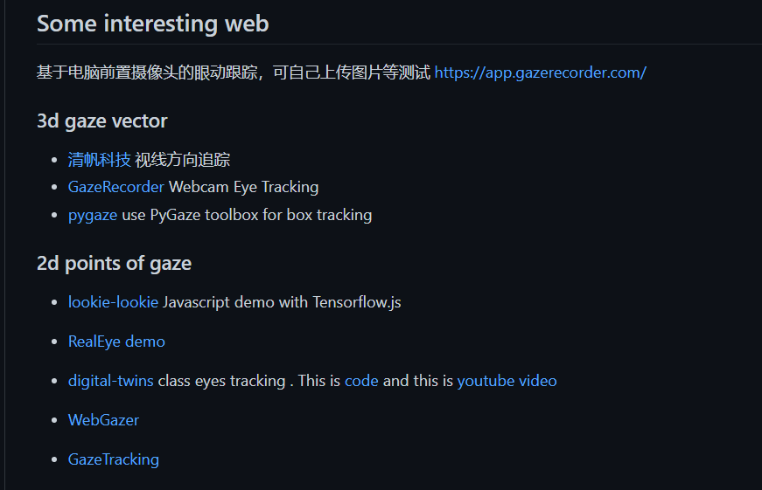
Gaze estimation
introduction
https://github.com/RichardoMrMu/awesome-gaze-estimation-new
https://github.com/RichardoMrMu/gaze-estimation-paper

Slide 15
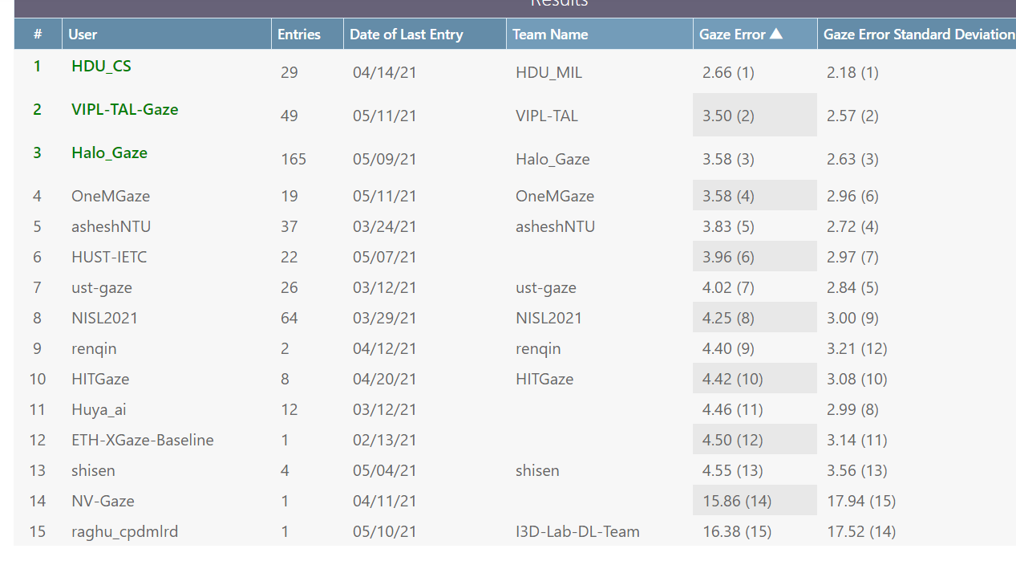
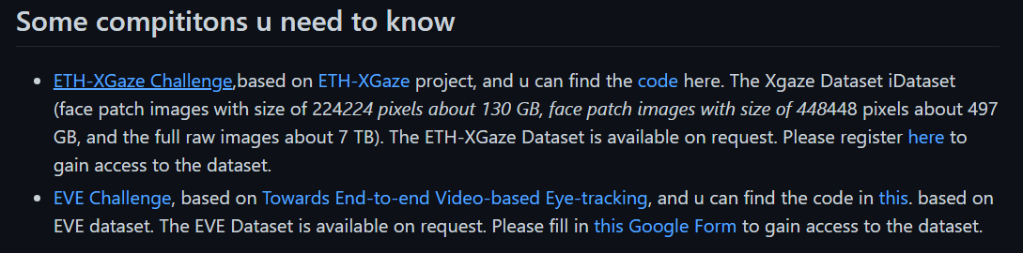
Gaze estimation
introduction
https://github.com/RichardoMrMu/awesome-gaze-estimation-new
https://github.com/RichardoMrMu/gaze-estimation-paper

Slide 16
