Slide 1
Journey To Below: A text adventure
RIchard Morrow| TLG | Apprenti| C# Console project

Slide 2
Rules
You are the captain of a drill machine assigned to dig to the center of the Earth.
You have a limited amount of health and repair kits that you have to use wisely.
If you blow up your machine or run out of crew people you lose.
You can dig at any time but you have a limited number of health and repair kits.

Slide 3
Demonstration

Slide 4
Challenges
WINS
Timing
Formatting
Color Limitations
Organization
Sounds
Character traits work
Colorful
Branching
Recursion practice
At least two people have smiled

Slide 5
Improvements
More traits/ more uses for existing traits
Reorganization of the event method
More scenarios/ and more user input during special events
Better sound design
Ability to fast forward text
Function that controls timing

Slide 6
Resources
Colorful Console
http://colorfulconsole.com/
SoundBible.com, Archive.org, and MovieSoundClips.net
NAudio
https://github.com/naudio/NAudio
James Morrow and HP Lovecraft for writing help
James Carriere for testing and feedback

Slide 7
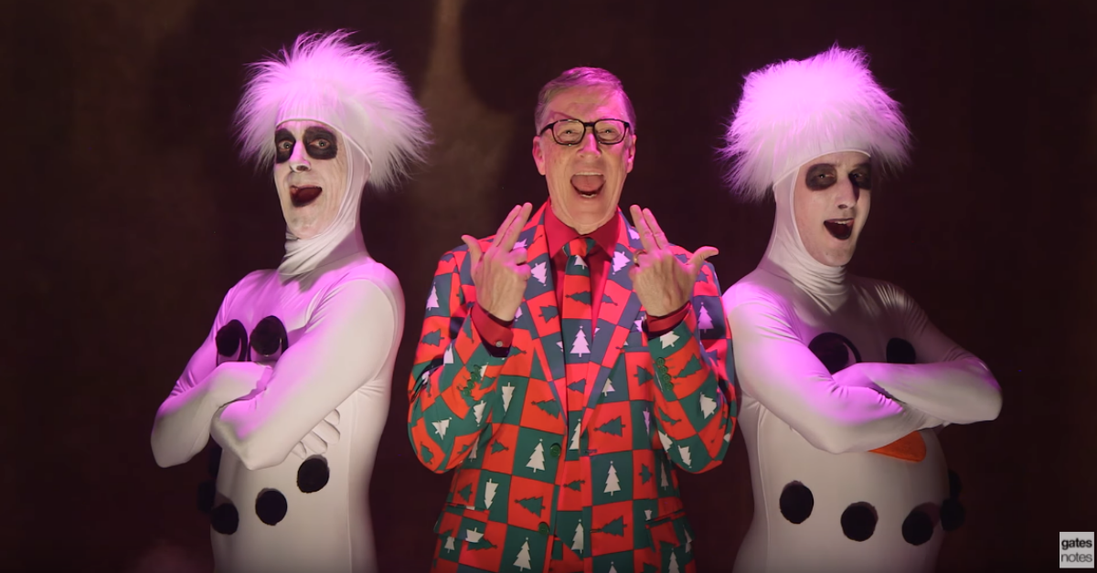
Any questions?

