Slide 1
r

Slide 2




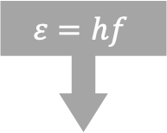

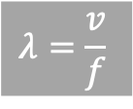

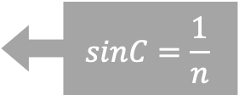






$$C_{1}<C_{2}$$
$$ε=hf$$
三棱镜分光结论
$$sinC=\frac{1}{n}$$
$ε_{1}>ε_{2}$
$$f_{1}>f_{2}$$
$$n_{1}>n_{2}$$
$$v_{1}<v_{2}$$
$$E_{k}=ε −w_{0}$$
$$λ=\frac{v}{f}$$
$$E_{k1}>E_{k2}$$
$$∆x_{1}<∆x_{2}$$
$$λ_{1}<λ_{2}$$
$$p_{1}>p_{2}$$
$$∆x=λ\frac{L}{d}$$
$$p=\frac{h}{λ}$$

Slide 3




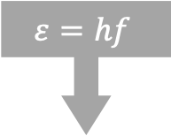

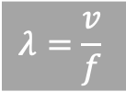

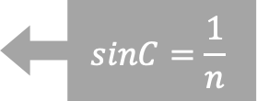






$$C_{1}<C_{2}$$
$$ε=hf$$
没有关联!
$$sinC=\frac{1}{n}$$
$ε_{1}=ε_{2}$
$$f_{1}=f_{2}$$
$$n_{1}>n_{2}$$
$$v_{1}<v_{2}$$
$$E_{k}=ε −w_{0}$$
$$λ=\frac{v}{f}$$
$$E_{k1}=E_{k2}$$
$$∆x_{1}<∆x_{2}$$
$$λ_{1}<λ_{2}$$
$$p_{1}>p_{2}$$
$$∆x=λ\frac{L}{d}$$
$$p=\frac{h}{λ}$$

Slide 4
$$C_{1}<C_{2}$$
$$ε=hf$$
没有关联!
$$sinC=\frac{1}{n}$$
$ε_{1}=ε_{2}$
$$f_{1}=f_{2}$$
$$n_{1}>n_{2}$$
$$v_{1}<v_{2}$$
$$E_{k}=ε −w_{0}$$
$$λ=\frac{v}{f}$$
$$E_{k1}=E_{k2}$$
$$∆x_{1}<∆x_{2}$$
$$λ_{1}<λ_{2}$$
$$p_{1}>p_{2}$$
$$∆x=λ\frac{L}{d}$$
$$p=\frac{h}{λ}$$

Slide 5




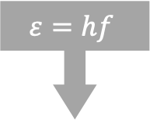
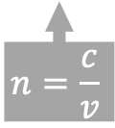

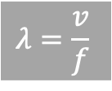

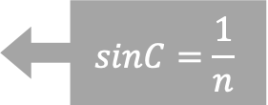






$$C_{1}<C_{2}$$
$$ε=hf$$
三棱镜分光结论
$$sinC=\frac{1}{n}$$
$ε_{1}>ε_{2}$
$$f_{1}>f_{2}$$
$$n_{1}>n_{2}$$
$$v_{1}<v_{2}$$
$$n=\frac{c}{v}$$
$$E_{k}=ε −w_{0}$$
$$λ=\frac{v}{f}$$
$$E_{k1}>E_{k2}$$
$$∆x_{1}<∆x_{2}$$
$$λ_{1}<λ_{2}$$
$$p_{1}>p_{2}$$
$$∆x=λ\frac{L}{d}$$
$$p=\frac{h}{λ}$$

Slide 6









$$末状态$$
$$初状态$$
$$（−）摔跤$$
$$（+）捡钱$$
$$外部事件$$
$$开心$$
$$难过$$
$$（−）受批$$
$$（+）进步$$

Slide 7

37$°$

Slide 8


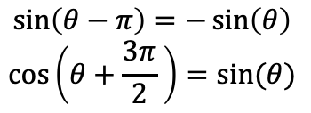
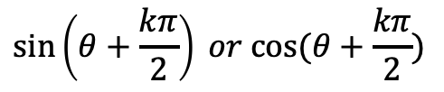

$$sin$$
$$\sin\left(θ+\frac{kπ}{2}\right) or cos⁡(θ+\frac{kπ}{2})$$
奇变偶不变;符号看象限
$$θ$$
$$cos$$
$$\sin\left(θ−π\right)=−\sin\left(θ\right)$$
$$\cos\left(θ+\frac{3π}{2} \right)=sin⁡(θ)$$

Slide 9


$$F$$
$$F$$
浸润层
不浸润层

Slide 11




$$E_{p}/F$$
$$r_{0}$$
10$r_{0}$
$$r$$

