Slide 1


Stone Sheet & Slicer

Slide 2
Hello!
We are Team Angus

Slide 3
Machine Learning
What’s so interesting?
What can we do to further our knowledge in the field?
What are some simple models that we can analyze?

Slide 4
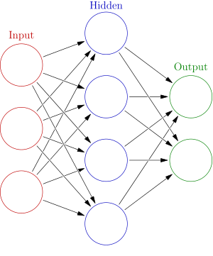
Neural Network
Why did we choose this algorithm?

Slide 5
What can we do?
Stone Sheets and Slicers
We attempted to use neural networks to create a self-improving RPS algorithm
Ended up implementing basic decision tree algorithm
Database Analysis - Titanic
Downloaded CSV database and utilized neural networks to analyze relationship between variables

Slide 6


How did we do it?
Languages:
HTML, CSS, JavaScript, node.js, C++
Software/Tools:
Notepad++, Powershell, Webstorm, Firebase

Slide 7
Our process
Start
4 hours
10 hours
16 hours
Learn JavaScript, CSS, HTML, and node.js
Learning how to implement Neural Networks
Shift towards Database Analysis
Reworking RPS algorithim and hosting sites on Firebase

Slide 8
Live Demo
Let’s show you what we’ve accomplished

Slide 9
Thanks!
Any questions?

