Slide 1
ToDo Tracker
By: Asmita Mahajan, Priyanka Nagarkar & Richa Sinha
mentor: Mrs. Anjali Singhal

Slide 2

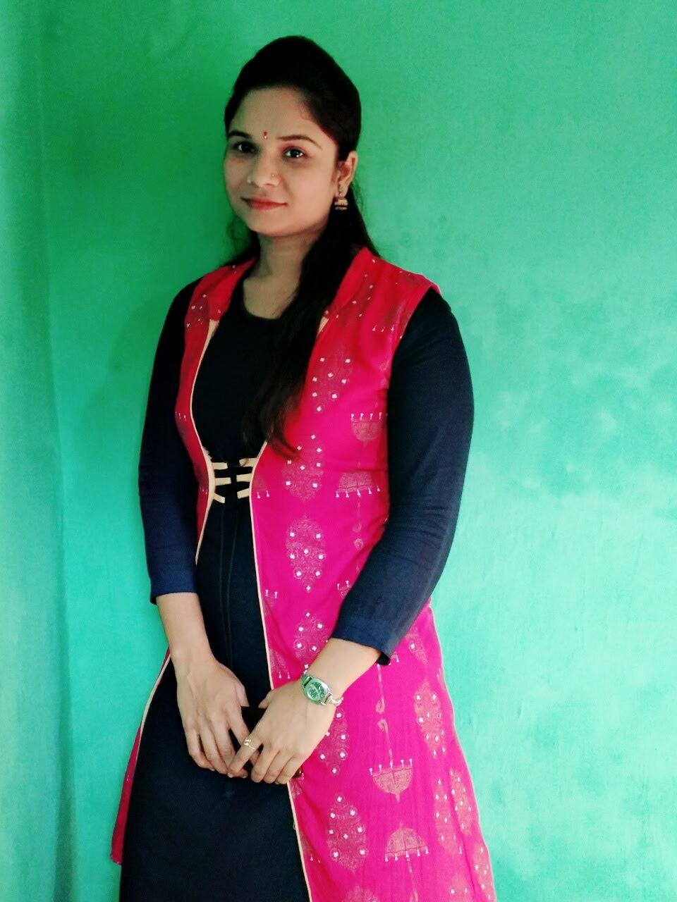

Our Team
Asmita Mahajan
Priyanka Nagarkar
Richa Sinha
mahajanasmita7@gmail.com Priyanka.nagarkar09@gmail.com richasinha0501@gmali.com

Slide 3
Contents
Introduction
Advantages of Tracker List
Characteristics
Microservice Architecture
Features of ToDo Tracker List
Technology Used
Project Demonstration
Ask Your Questions?

Slide 4
Introduction
Project is based on Worked as Team to develop a ToDoTracker Application and it is project management tool in which we can add the task and that task is completed or that task is in processing
Backend Technologies comprises of java and spring and spring Boot with My Sql and Mongo DB as a database, while Angular, HTML, CSS, JavaScript is used as frontend technology

Slide 5
Characteristics of ToDo Tracker
Get Organized: A task tracker forces you to get organized, planning out all the tasks and details for your project ahead of time before you get to work.
Improve Your Workflow: Task trackers require you to systematize your workflow, giving you a consistent and repeatable process you can fine-tune.
Plan for the Future: Task management software helps you plan for future projects, learning from experience and budgeting your time and resources.

Slide 6
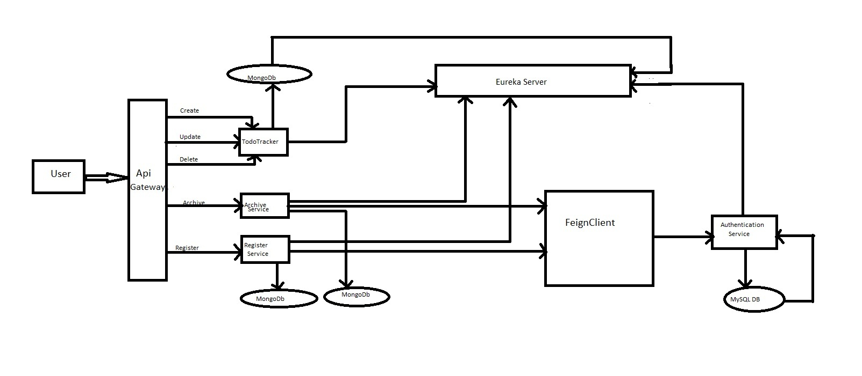
Microservices Architectural

Slide 7
Features of ToDo Tracker
Registration Service
Login Service
In our application user needs to register access the features of the application.
This service helps the user to register themselves with our application database.
Register user can login with their credentials and start using our application.
It is an circumstances, User forgot their password They can able to reset it with Forgot password link provide in the dialog box.

Slide 8
Features of ToDo Tracker
Add Task
Delete & Update Task
Login user can add the task to manage their work efficiently.
User can drag and drop the added task into specific column as per their requirements.
Login user are able to delete and update the tasks for their requirement available in the list.

Slide 9
Features of ToDo Tracker
Archive task
Priority
Every register user with an access to List task can archive the task.
If user want to see any archive task it will easily show in the list.
When Ever login user want to make a priority to task they are able to do that operations.. Like able to give 1st, 2nd or 3rd priority to any task. For their preferences.

Slide 10
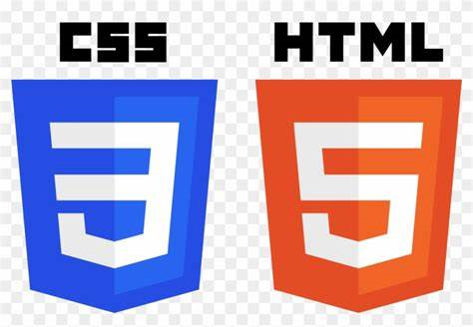

Technologies Used
The hyper text markup language or HTML is the standard markup language for documents designed to be displayed in a web browser.
It can be assigned by technologies such as Cascading Style sheets
(CSS) and scripting languages such as JavaScript.
Cascading Style Sheets [CSS] is a style sheet language used for describing the presentation of a document written in a markup language such as HTML or XML. CSS is a cornerstone technology
of the world wide web, alongside HTML and JavaScript.

Slide 11

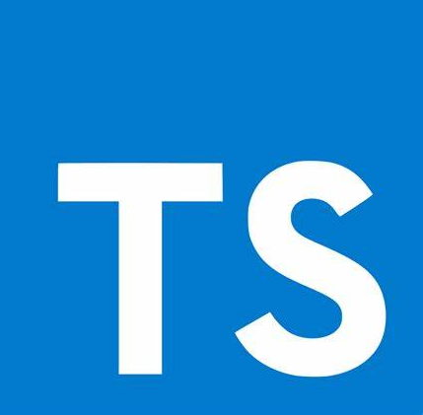
Technologies Used
Angular
Angular is a platform and framework for building single-page client applications using HTML and TypeScript. Angular is a Written in TypeScript. It implements core and optional functionality as a set of TypeScript libraries that you import into your applications.
TypeScript
TypeScript is a strongly typed, object oriented language. It was design by Anders Hejlsberg (designer of C#) at Microsoft. TypeScript is both a language and a set of tools. TypeScript is a typed superset of JavaScript compiled to JavaScript

Slide 12
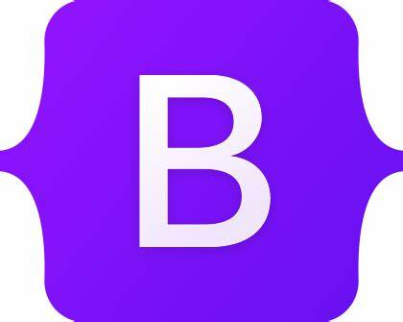

Technologies Used
Bootstrap
Bootstrap is the most popular CSS Framework for developing responsive and mobile-first websites.
Bootstrap 5 is the newest version of bootstrap.
Angular Material
Angular material is a User Interface (UI) component library that developers can use in their Angular projects to speed up the development of elegant and consistent user interfaces.

Slide 13


Technologies Used
Spring Boot
Spring Boot makes it easy to create stan-alone, production-grade Spring based applications that you can “just run”.
Most Spring Boot Applications need minimal Spring configuration.
Spring Framework
It was developed by Road Johnson in 2003. Spring Framework makes the easy development of java EE application. Spring is a fight weight framework. It can be thought of as a framework of frameworks because it provides support to various frameworks such as Struts, Hibernate, Tapestry, EJB,JSF, etc.

Slide 14
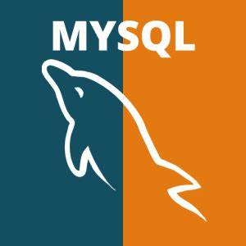

Technologies Used
MySQL
MySQL is relational database management system. It is open source. MySQL is compliant with the ANSI SQL standard. It was first released in 1995. MySQL is developed, distributed and supported by Oracle Corporation.
MongoDB
MongoDB is a source-available cross-platform document-oriented database program. Classified as a NoSQL database program, MongoDB uses JSON-like documents with optional schemas. MongoDB is developed by MongoDB In.

Slide 15


Technologies Used
The Feign Client is a declarative web service (HTTP client) developed by Netflix. Its is simplify the HTTP API clients. It is a Java to HTTP client binder. If you want to use Feign, create an interface, and annotate it. Feign Client will play an important role to consume data produced by Book service. Feign Client as a load balancer when used with Eureka. It is a library for creating REST API clients.
Eureka Server is an application that holds the information about all client-service applications.
Every Micro Service will register into the Eureka Server and Eureka server knows all the client applications running on each port and I P address. Eureka Server is also known as Discovery Server.
Eureka

Slide 16
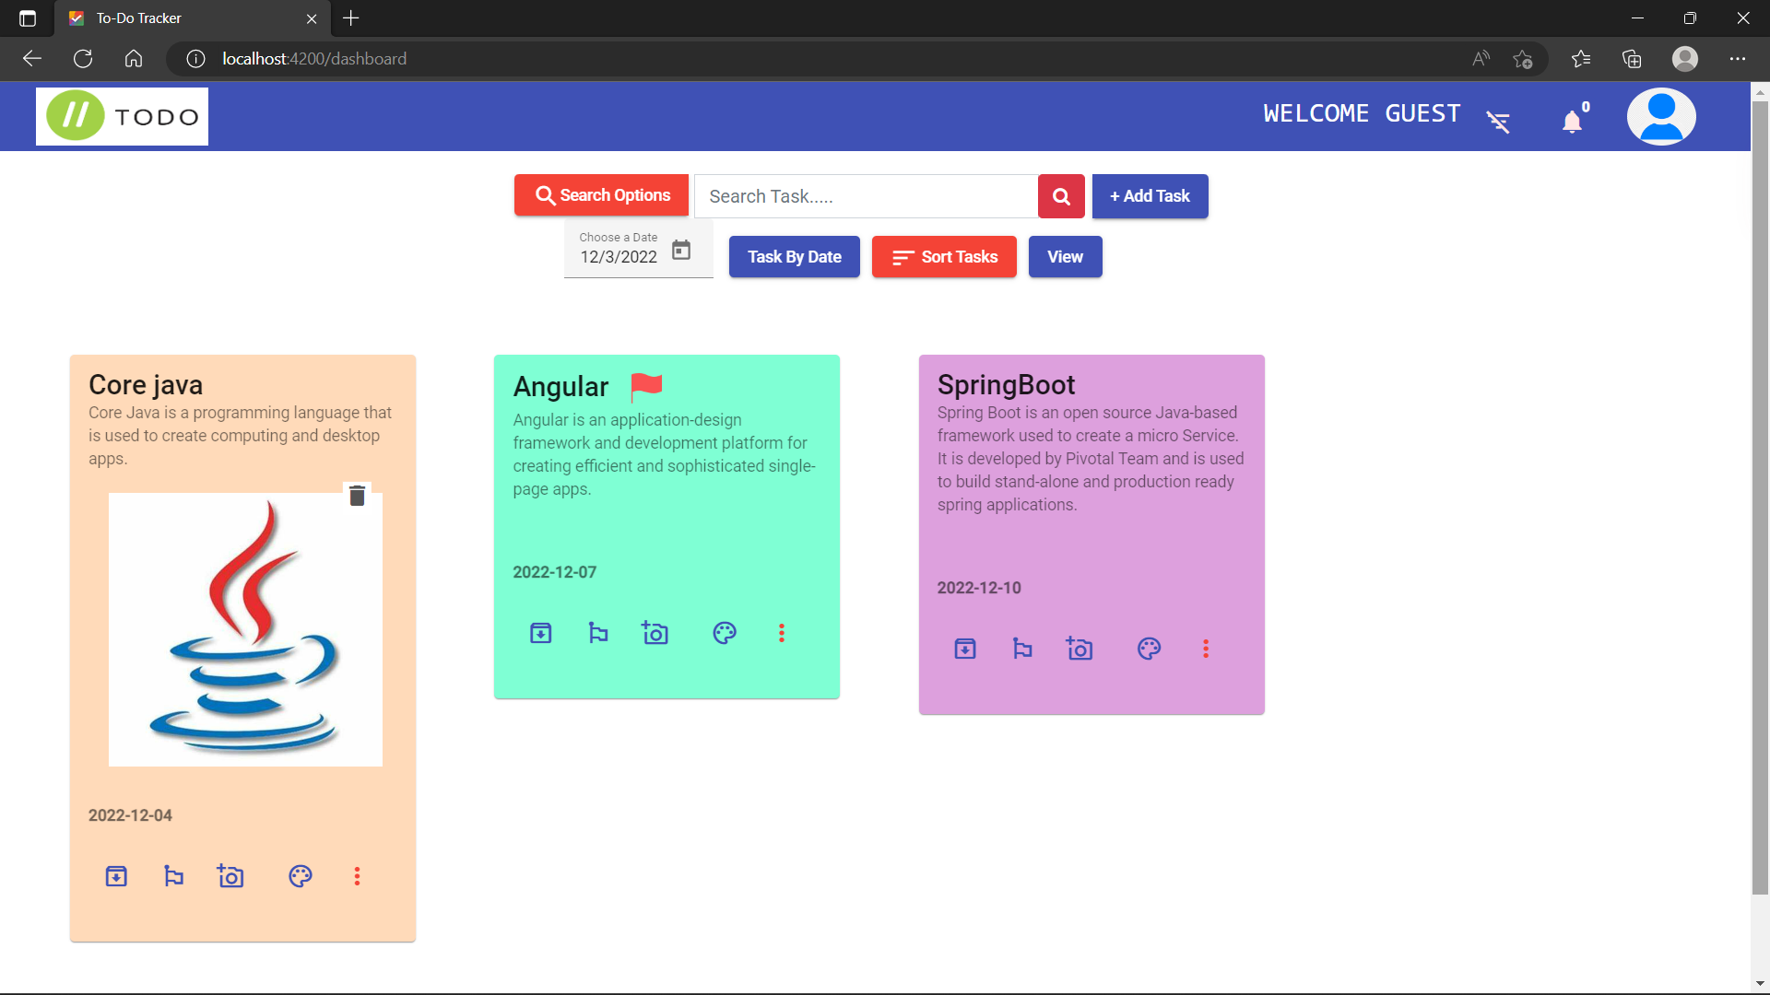
Demonstration of ToDo Tracker
Our Application Dashboard

Slide 17
Ask Your Questions?
We will be happy to answer your questions?

Slide 18

Thank You

