Slide 1
ToDo Tracker
By: Asmita Mahajan, Priyanka Nagarkar & Richa Sinha
mentor: Mrs. Anjali Singhal

Slide 2
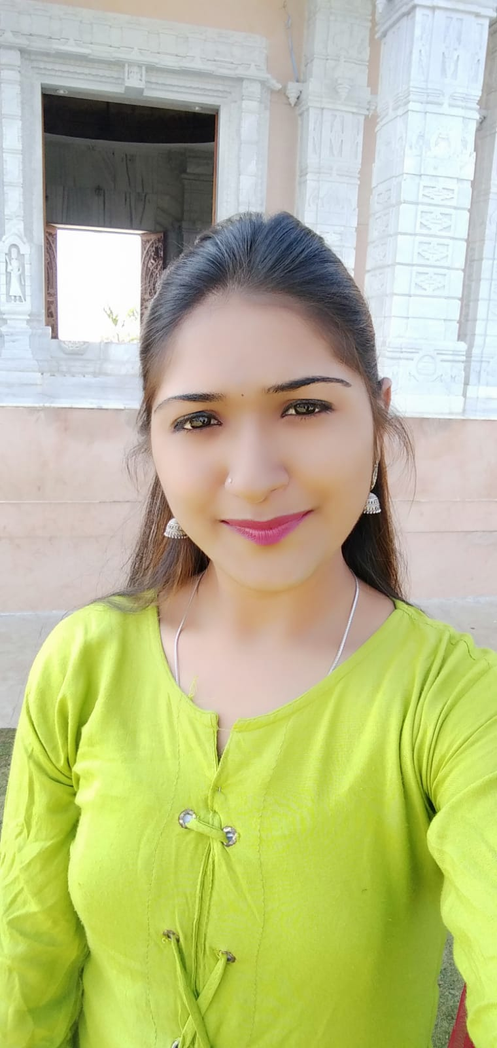
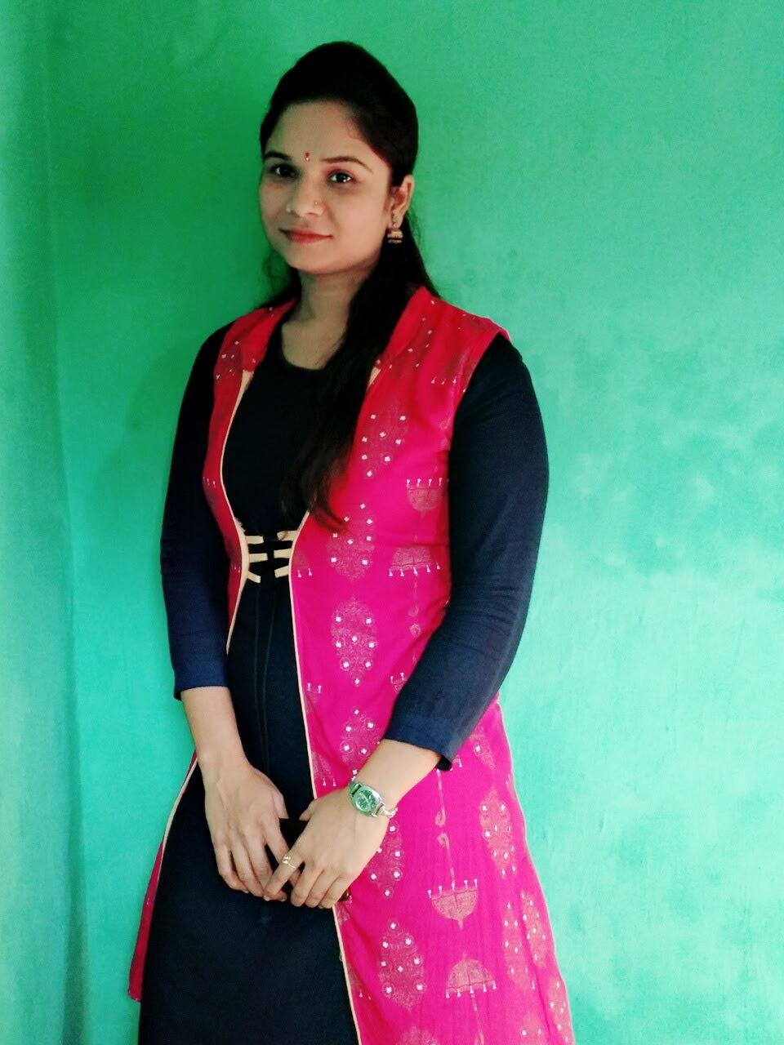

Our Team
Asmita Mahajan
Priyanka Nagarkar
Richa Sinha
mahajanasmita7@gmail.com Priyanka.nagarkar09@gmail.com richasinha0501@gmali.com

Slide 3
Contents
Introduction
Advantages of Tracker List
Characteristics
Microservice Architecture
Features of ToDo Tracker List
Technology Used
Database Used
Project Demonstration
Ask Your Questions?

Slide 4
Introduction
Project is based on Worked as Team to develop a ToDoTracker Application
It is project management tool in which we can add the task and that task is completed or that task is in processing

Slide 5
Characteristics of ToDo Tracker
Get Organized
Improve Your Workflow
Plan for the Future
Supports Work-Life Balance
Focus on the Important

Slide 6
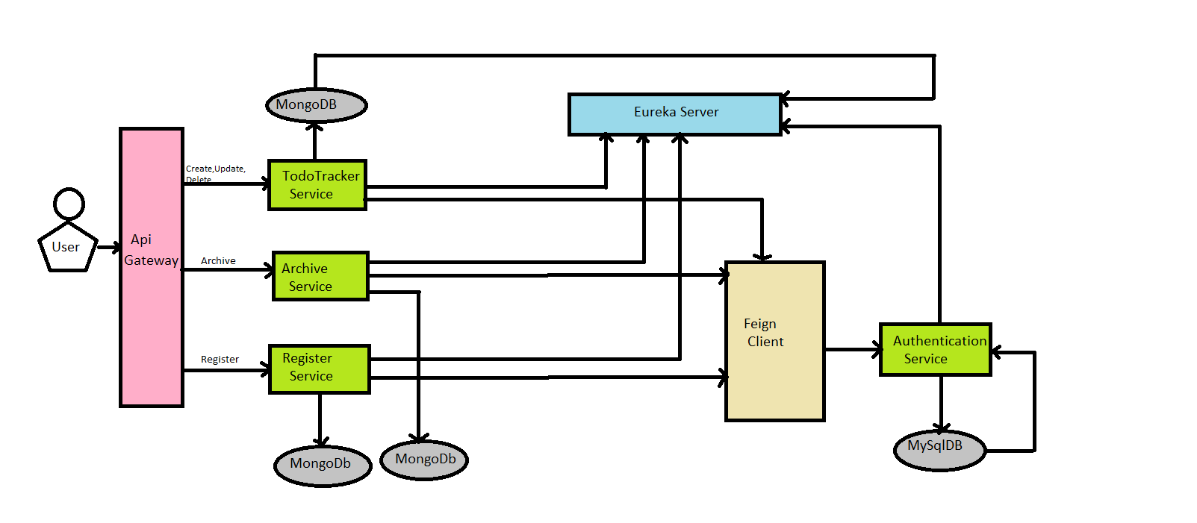
Microservices Architectural

Slide 7
Features of ToDo Tracker
Registration Service
Login Service
Add Task
In our application user needs to register access the features of the application.
Registered user can login with their credentials.
Login user can add the task to manage their work efficiently.

Slide 8
Features of ToDo Tracker
Archive task
Priority
Delete &Update Task
Every register user with an access to List task can archive the task.
When Ever login user want to make a priority to task they are
able to do that operations.
Login user are able to delete and update the tasks for their requirement available in the list.

Slide 9
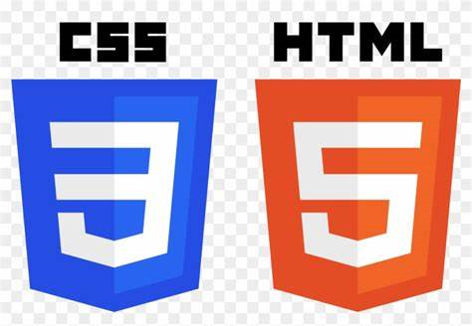


Technologies Used
The hyper text markup language or HTML is the standard markup language for documents designed to be displayed in a web browser.
Cascading Style Sheets [CSS] is a style sheet language used for describing the presentation of a document written in a markup language such as HTML or XML.
Angular is a platform and framework for building single-page client applications using HTML and TypeScript. Angular is a Written in TypeScript.

Slide 10
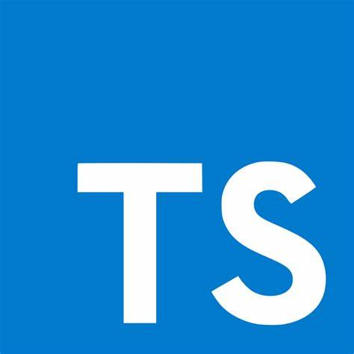
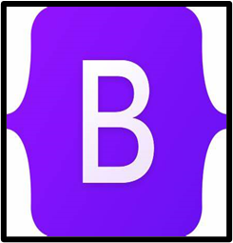

Technologies Used
TypeScript is a strongly typed, object oriented language. It was design by Anders Hejlsberg (designer of C#) at Microsoft.
Bootstrap is the most popular CSS Framework for developing responsive and mobile-first websites.
Angular material is a User Interface (UI) component library that developers can use in their Angular projects to speed up the development of elegant and consistent user interfaces.

Slide 11



Technologies Used
The Feign Client is a declarative web service (HTTP client) developed by Netflix. Its is simplify the HTTP API clients. It is a Java to HTTP client binder.
Spring Boot makes it easy to create stan-alone, production-grade Spring based applications that you can “just run”.
Eureka Server is an application that holds the information about all client-service applications.
Eureka

Slide 12
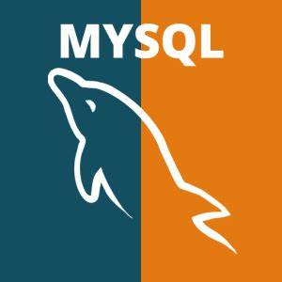

Database Used
MySQL
MySQL is relational database management system. It is open source. MySQL is distributed and supported by Oracle Corporation.
MongoDB
MongoDB is a source-available cross-platform document-oriented database program. Classified as a NoSQL database program.

Slide 13
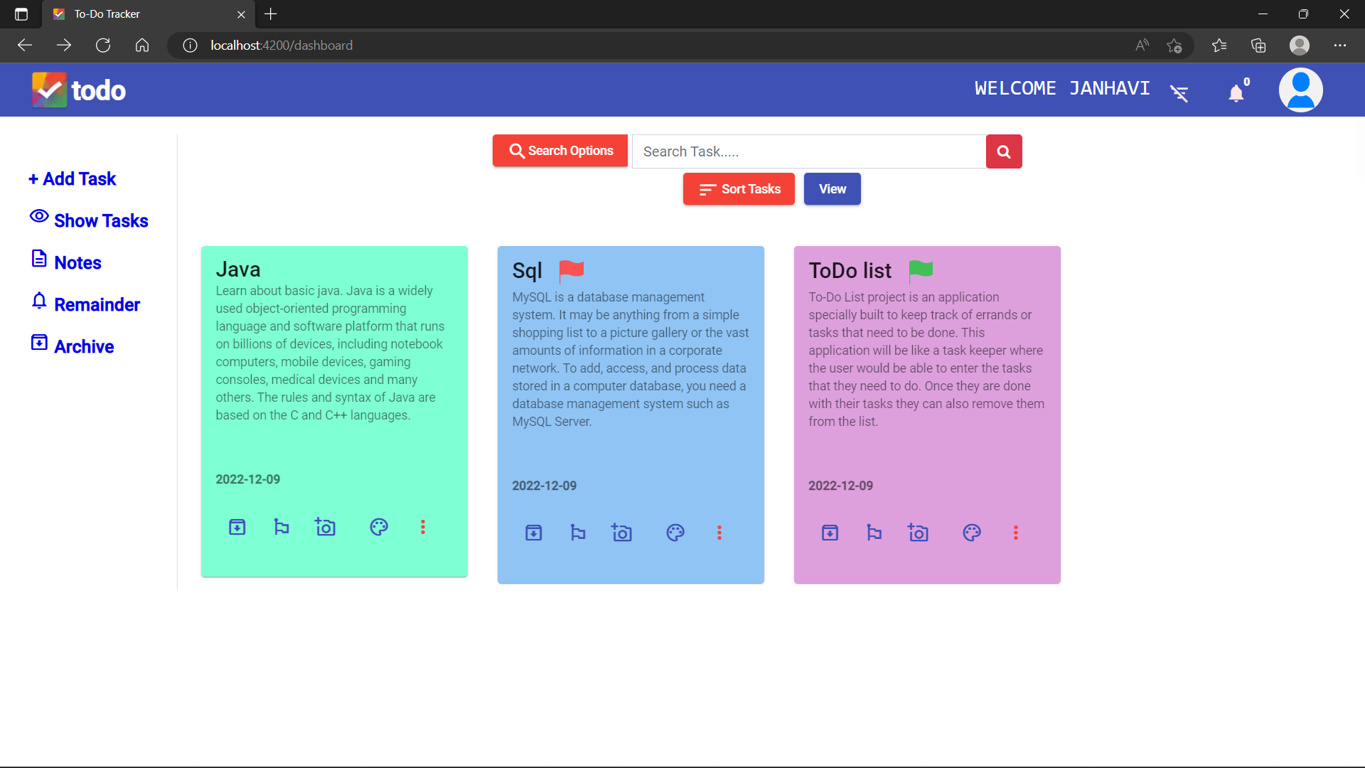
Demonstration of ToDo Tracker
Our Application Dashboard

Slide 14
Ask Your Questions?
We will be happy to answer your questions?

Slide 15

Thank You

