Slide 1
Prolog Project
Knowledge Based Systems WS23/24
Nonograms
Richard Hoang, Sebastian Windsperger, Julia Weißenbrunner

Slide 2
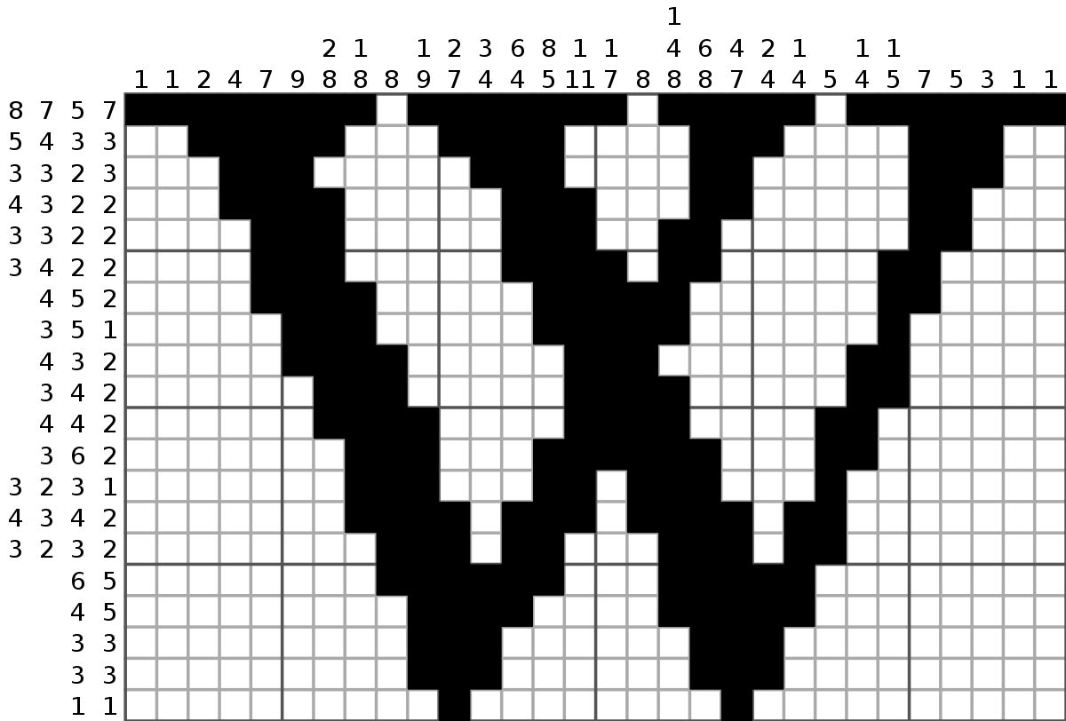
Motivation
Solving a japanese puzzle called nonogram with prolog
Nonogram contains a grid, where each row and column has a „hint“ for solving the puzzle
Source: https://en.wikipedia.org/wiki/Nonogram

Slide 3
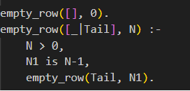
Programming Techniques
Pattern oriented Knowledge Representation

Slide 4
Our Knowledge Base
Supports Users playing Nonogram with feedback on correctness
Supports Automatic Nonogram solving
Five different complexity levels

Slide 5
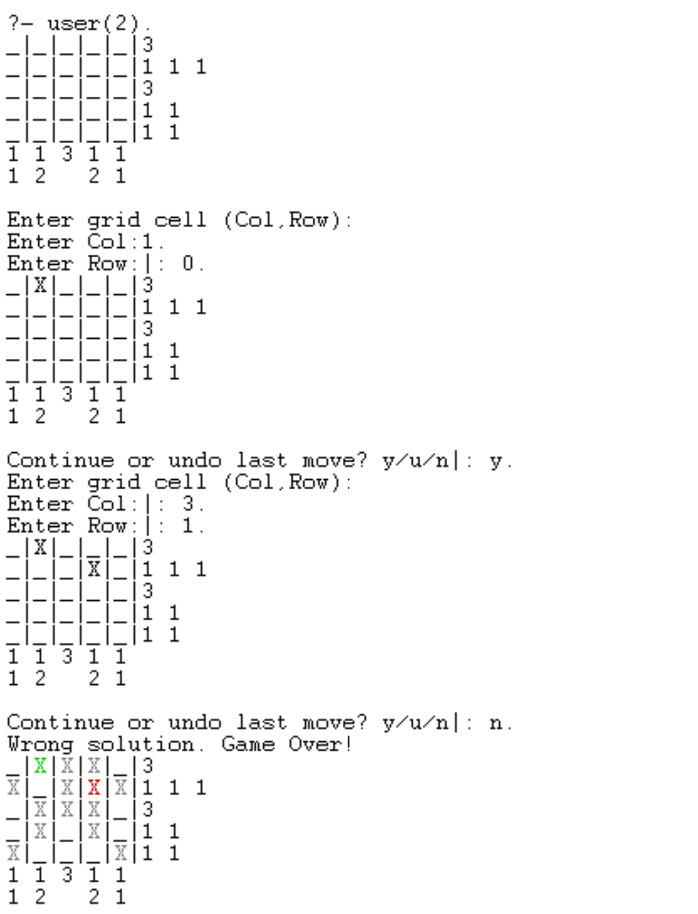
Nonogram User Play

Slide 6
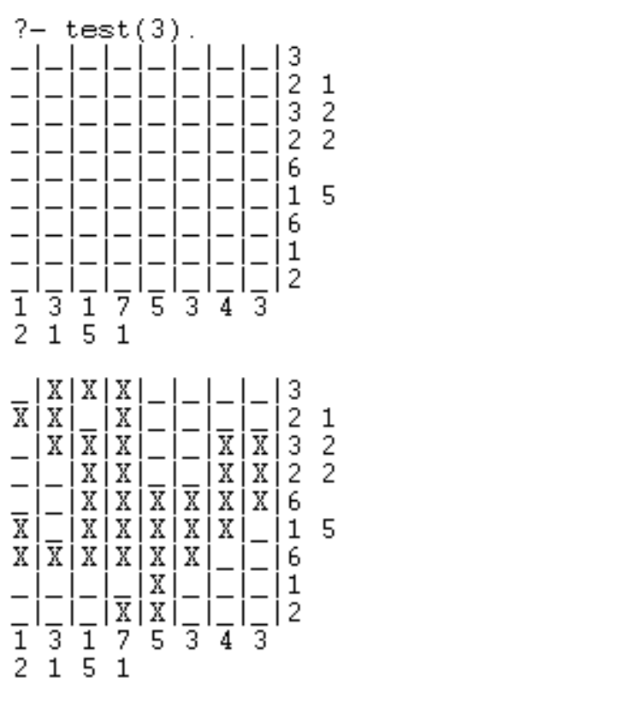
Automatic Nonogram Solver

