Slide 2
What The WLAN Experts Tend To Say About IPv6…

Slide 3

CiscoLive 2014 dualstack SSID config (high level)
Internet
North
User vlan 204
User vlan 4
South
Backup
Main

Slide 4
Configuration design goals
Must allow any distribution of access points between the two controllers
All access points on North, all access points on South, split between the two
L3 roaming of clients while between North and South, on IPv4 and IPv6
The client keeps their original link, the data is sent in/out the anchor controller
Minimize the amount of chatter – save batteries
Use RA Throttler on WLC with 30 minute timer.
Minimize the size of the neighbor caches on the devices
Very large link, many small devices
Allow for possible full reassociation vs of L3 roaming
Prefix does change but the connectivity must be recovered quickly

Slide 5
South SVI configuration
interface Vlan4
description !!! WIRELESS CLIENTS !!! CiscoLive2014 !!!
.. IPv4 configuration omitted ..
ipv6 address FE80::1 link-local
ipv6 address 2001:4D38:A:400::1/64
ipv6 nd reachable-time 1800000
ipv6 nd prefix default 86400 9000 off-link no-autoconfig
ipv6 nd prefix 2001:4D38:A:400::/64 604800 86400 off-link
ipv6 nd prefix 2001:4D38:A:6800::/64 604800 0 off-link
ipv6 nd router-preference High
ipv6 nd ra lifetime 9000
no ipv6 redirects
no ipv6 unreachables
ipv6 verify unicast source reachable-via rx
ipv6 ospf network point-to-point
ipv6 ospf flood-reduction
ipv6 ospf 1 area 0
End
ipv6 route 2001:4D38:A:400::/64 vlan4

Slide 6
North SVI configuration
interface Vlan204
description !!! WIRELESS CLIENTS !!! CiscoLive2014 !!! DO NOT USE VLAN4 on NORTH !!!
.. IPv4 configuration omitted ..
ipv6 address FE80::1 link-local
ipv6 address 2001:4D38:A:6800::1/64
ipv6 nd reachable-time 1800000
ipv6 nd prefix default 86400 9000 off-link no-autoconfig
ipv6 nd prefix 2001:4D38:A:400::/64 604800 0 off-link
ipv6 nd prefix 2001:4D38:A:6800::/64 604800 86400 off-link
ipv6 nd router-preference High
ipv6 nd ra lifetime 9000
no ipv6 redirects
no ipv6 unreachables
ipv6 verify unicast source reachable-via rx
ipv6 ospf network point-to-point
ipv6 ospf flood-reduction
ipv6 ospf 1 area 0
End
Ipv6 route 2001:4D38:A:6800::/64 Vlan204

Slide 7
IPV6ONLYEXP
First time CiscoLive-wide IPv6-only SSID with NAT64
On both 2.4Ghz + 5Ghz
Very conservative approach due to caveats
Blog entry with WPA2 PSK
search for “legacy ip ciscolive”
76 connected devices at peak, 62 using IPv6 w/global address
Successful use of AnyConnect over NAT64 to an IPv4-only VPN headend

Slide 8
WiFi troubleshooting exercise
Scenario:
The WLC is configured to throttle RAs down to 1 in 30 minutes.
Problem:
the wireless client saw an RA every few seconds between 6pm and 9am
The problem resolved “by itself”

Slide 9
The first dialogue
-What did you change ???
- Nothing !!!

Slide 10
Solution
RA Throttle
configured here
Spare WLC
1 of 2 NOC
AP joined here

Slide 11
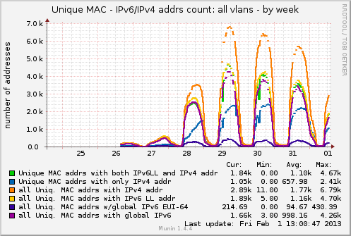
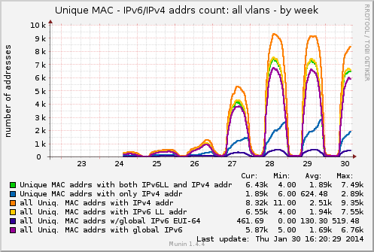
## of the devices
²⁰¹³
²⁰¹⁴

Slide 12
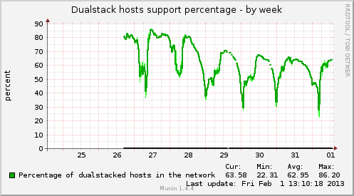
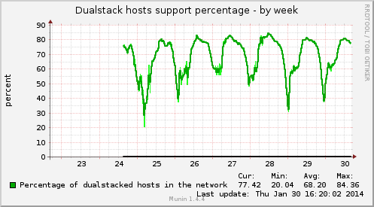
%% of clients
²⁰¹³
²⁰¹⁴

