Slide 1


SpaceNet
Turn-key datacenter
Richard Hartmann
richard.hartmann@space.net

Slide 2
About SpaceNet
Founded in 1993
  96 emails per hour in all of Germany
  Physical email dashboard with blinking lights
Shaped part of the Internet as we know it today
  Helped build what has become De-CIX, world‘s largest Internet Exchange
  Founding member of DENIC, the .de registry
  One of the first IPv6-enabled providers in Europe
  Single-handedly stopped Germany‘s unconstitutional data rentention laws
Long-term sustainabilty
  Stock not traded publically
  Founder is the CEO
  Weathered all bubbles and bursts

Slide 3
About SpaceNet
Full-service Internet provider
  Connectivity
  Co-location
  Cloud services
  Managed applications
  ..even webdesign
Three sites in Munich
  Vertiv is building the fourth site
Roughly 1200 customers

Slide 4

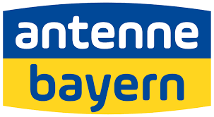
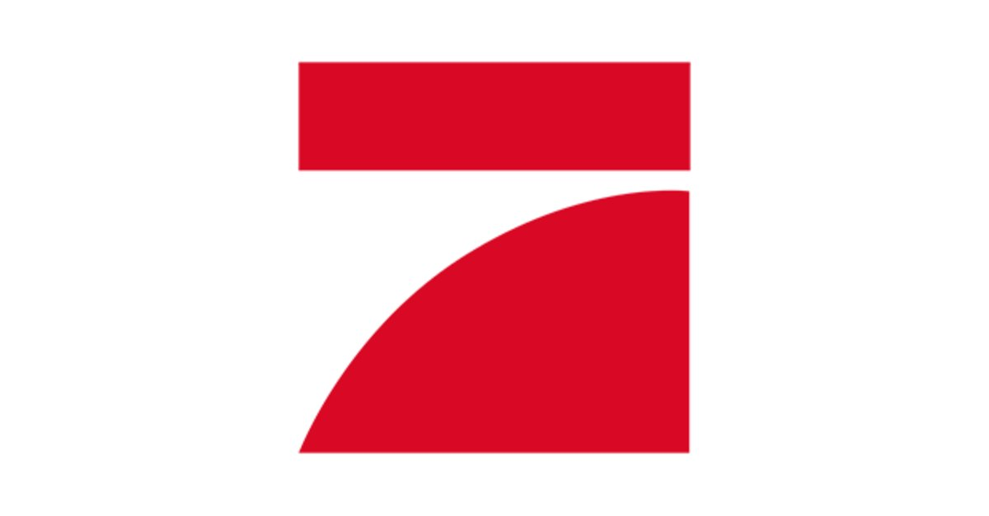
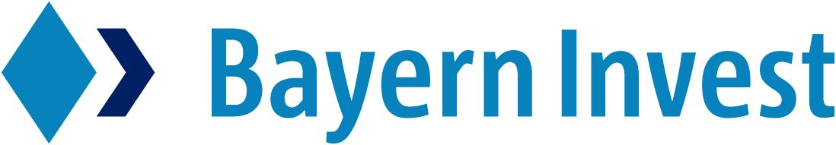

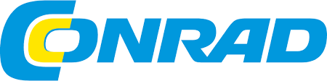
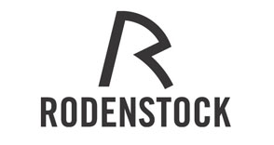

A few reference customers

Slide 5
By the way...
100% daughter of SpaceNet: SDC Datacenter
130 employees
~70% engineers
Visited production sites
Class 4
Contrary to popular belief, we‘re based in Germany, not Isreal

Slide 6
Why did we start this project
Obvious answer: growth
Full control over production stack
  From power & cooling up to multi-redundant services
No modern data-center for edge technologies in Munich, Germany‘s strongest city in tech
Market demand due to data security, espionage, and privacy
  State actors are becoming more and more aggressive
    PATRIOT act, FISA letters, etc apply to all US companies
  Health data is incredibly precious
  Family-run businesses need to preserve their legacy
  Innovation-driven companies need to protect against competitors
  This is a huge issue in Germany

Slide 7
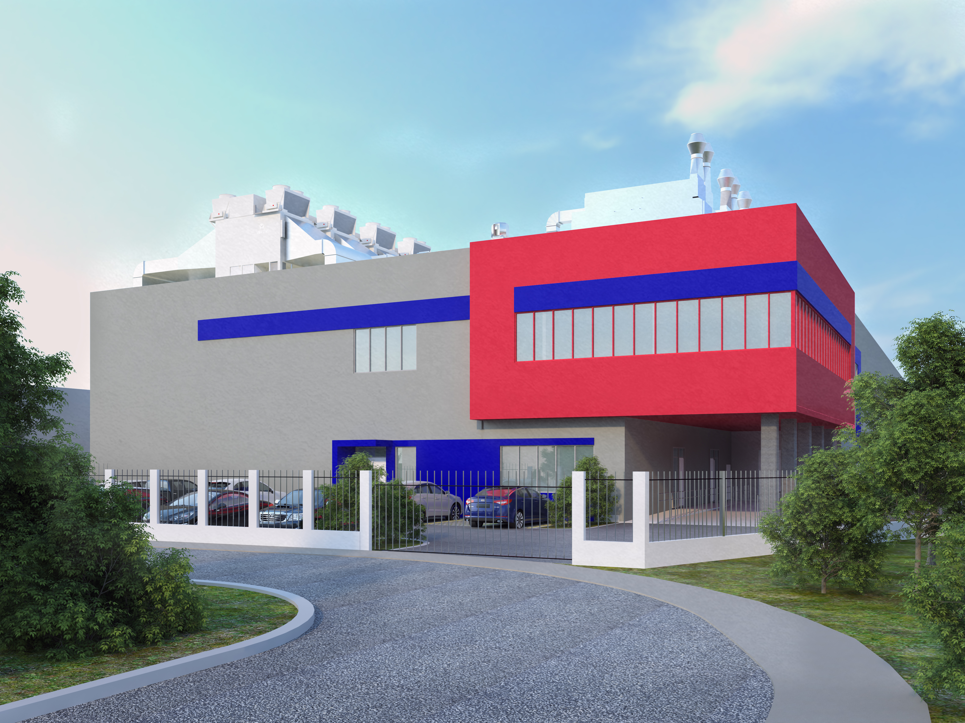
Our project
EN 50600, class 4
Hyperscale design
Green-field project
Concrete stick-build
Adiabatic indirect air-to-air cooling (EFC)
  100% DX backup
First phase 500kW IT load
  Phase scales up to 1.5MW
  2 * 500 m² per phase
Total of five phases
Operational in Q1 2019
A few concepts which are not public yet

Slide 8
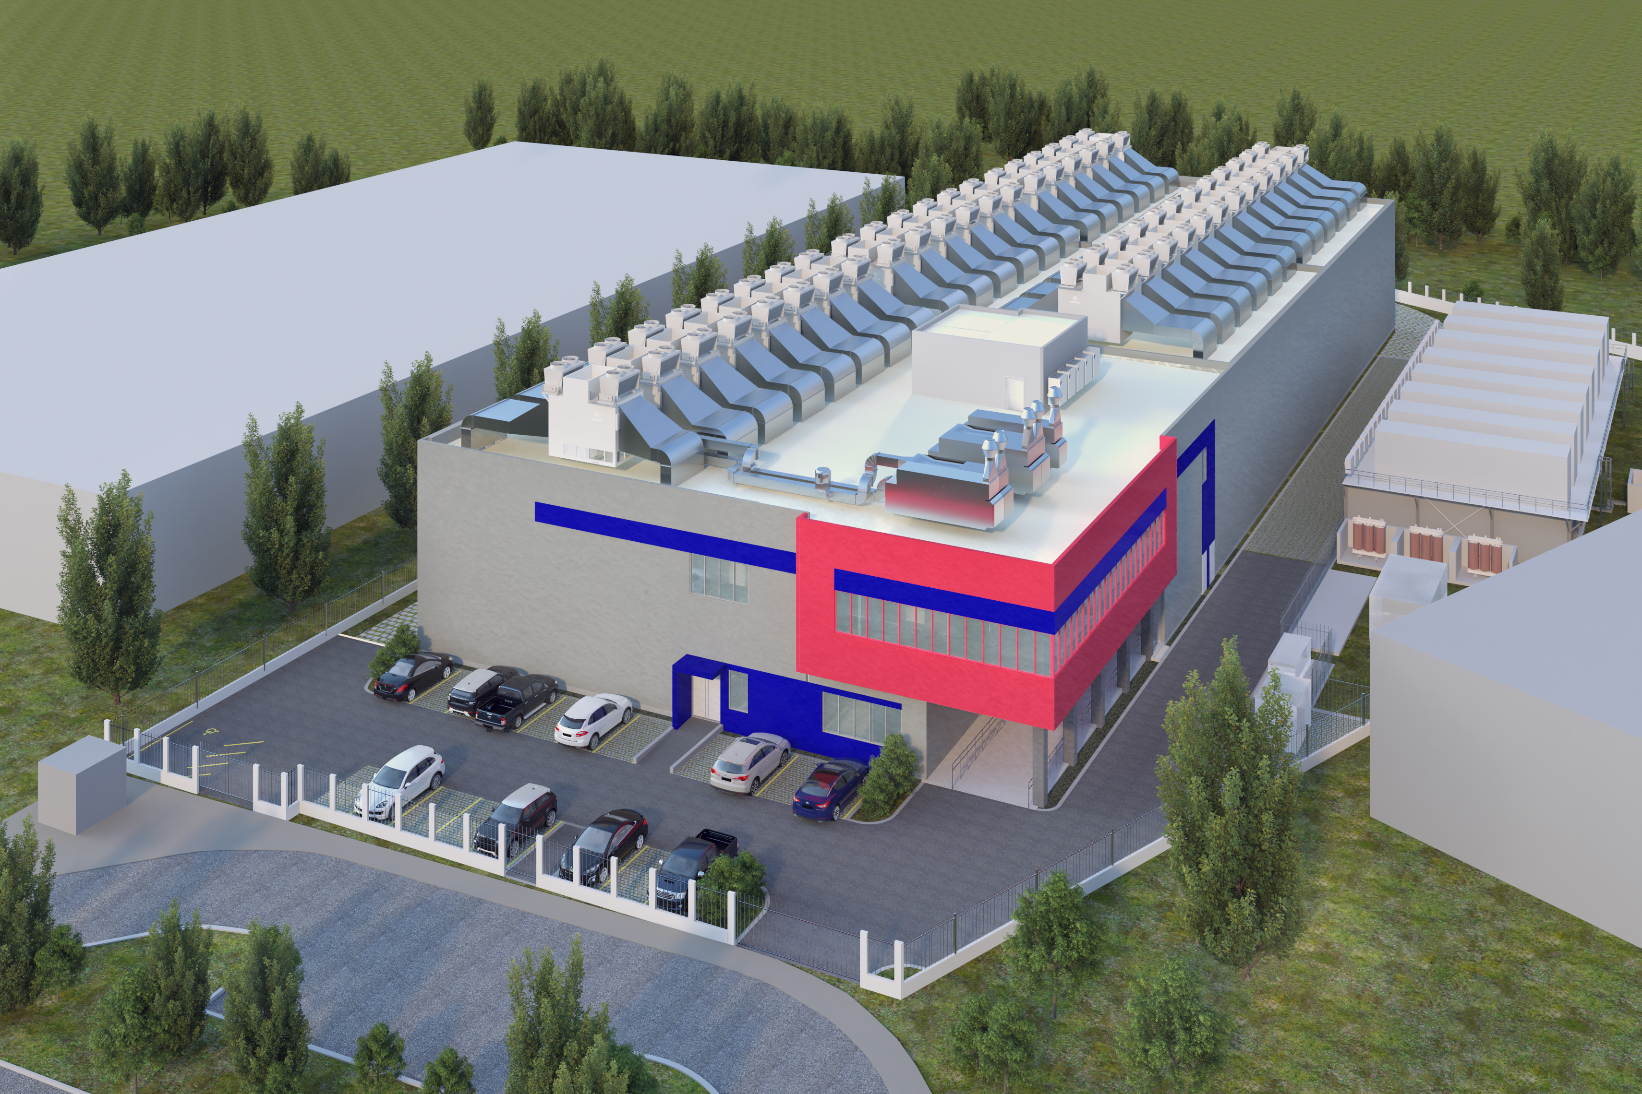

Slide 9
Design goals
Industry-leading power efficiency
Modular
  Pay as you grow
  Easier to adopt new technologies
Low TCO
Resilience and security in-depth
Relatively low average power due to more traditional co-lo customers
Using these as first principles helped streamlining the project

Slide 10
Buzzwords of our times
One of those buzzwords: „modular“
Everyone is currently pushing modular designs
  But it‘s not just about speed of execution
  We need to maintain the site as well
Together with Vertiv, we can adapt
  Size of modules
  Different cooling technologies
  Access-control (DC-in-a-DC)
  Mapping of which power modules deliver to which IT modules
    There's an obvious tie between power & cooling

Slide 11
What options did we look at
Everything
We looked at every option and talked to (almost?) every player in the relevant fields
  Build-it-yourself
  Contract planning agency
  Turn-key datacenter
  Datacenter-as-a-service
    Exclusive use
    Multi-tenant

Slide 12
Considerations: build-it-yourself
Pro
  Deepest possible control
  Direct contracts ensure good control over contractors
  Full cost visibility and hopefully control
Con
  Largest risk
  Need to contract lots of expertise

Slide 13
Considerations: Planning agency
Pro
    One-stop-shop for external expertise
    Less risk
    Direct contracts ensure good control over contractors
    Full cost visibility and hopefully control
  Con
    One more party to sync with
    Indirect access to planning

Slide 14
Considerations: Turn-key
Pro
  One central point of cont[r]act
  One-stop-shop for external expertise
Con
  Even less direct access to planning
  Loss of price visibility

Slide 15
Considerations: DC-as-a-service
Pro
  One central point of cont[r]act
  One-stop-shop for external expertise
Con
  Least access to planning
  Loss of price visibility
  When has leasing anything you use often ever been cheaper than buying outright?
  Special case of multi-tenant:
    De-facto loss of any planning access
    Loss of value-add

Slide 16
Sweet spot
Best trade-off between all considerations: turn-key
It‘s the first time we did this
Vertiv is also doing this at this depth for the first time
  Even responsible for groundworks, streets, everything
We see this as a growing trend in the future

Slide 17
Caveat: Vertiv is special
Vertiv‘s advantage:
  They are their own supplier for almost everything
  ..so they have extremely good control over the full DC
Vertiv‘s liabilty:
  They are their own supplier for almost everything
  ..so they won't easily suggest other market players for components
From the customer‘s PoV, this is important
  We have to rely on Vertiv always maintaining their leading position

Slide 18
Our path; sales phase
During sales phase, we all focused on technology
  Rough budget numbers so we knew we were not completely out of bounds
We got high quality input, but challenged again and again
The over-arching concept remained the same, but we changed a lot
Our longest in-person meeting took 18 hours, our longest telco took 11.5 hours
  and those were still productive and friendly
This builds trust

Slide 19
Using this trust
Shortly before signing, we hit a major roadblock
Issues around the gensets forced us to face a six-figure price increase; per phase
  This made a lot of people nervous
    ..but Vertiv assured us that they would compensate for those issues
    ..which, in turn, motivated us to work with them to lessen certain requirements
    ..we managed to work around this problem completely, while maintaining availability
  Text-book win-win; and it would not have happened without a baseline of trust

Slide 20
Our path; engineering phase
Vertiv employs a larger-than-average amount of intelligent and specialized people
Projects of this scale always cause lots of issues
Sometimes, Vertiv feels like a beehive
  To a complete stranger, it looks like utter chaos
  ..but intelligent and skilled people who agree on the Big Picture align automatically
  ..and the results are always on point
Vertiv engineers know they can rely on me to support wherever I can
Again, this builds common trust

Slide 21
Using this trust
Reminder: we are doing indirect air-to-air cooling
  ..so we need to move lots of air at a slow speed to be cost-effective
  ..which means huge air ducts
We realized that beams and underconstruction were in the way of some air ducts
We challenged Vertiv on this issue
  Vertiv changed the structure and statics of our building
This goes beyond what other companies would be willing to do

Slide 22
Would we choose Vertiv again?
I wouldn't be standing here if I would be about to say no
  ..and you wouldn't be here if you didn't expect me to say yes
I am not an easy customers and hard to please
  I convinced myself that we chose the best of the best
  Vertiv still outpaces my expectations
So: Yes

Slide 23
What would we do differently?
Overall, we are very happy with our path up to now
If we made one mistake, it was not to cull obviously non-fitting offers more aggressively
Turning this into a positive statement:
  Early and high-quality engagement with potential customers is key

Slide 24
Take-aways
Intentions

Slide 25
Take-aways
Trust

Slide 26
Take-aways
Partnership

