Slide 1

Cross-Site Scripting 101 Richie

Slide 2
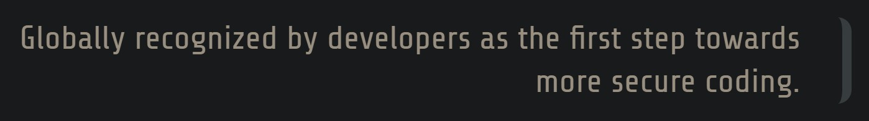
OWASP Top 10 Introduction
The OWASP Top 10 是一個，針對開發者以及web applications安全的標準公開文件。主要在於代表對於web applications最為嚴重的安全問題，來做一個廣泛共識。
公司應該要採用OWASP Top 10，並且在開始啟動標準程序確保web applications安全風險可以降至最低。
Notes:
The OWASP Top 10 is a standard awareness document for developers and web application security. It represents a broad consensus about the most critical security risks to web applications.
Companies should adopt this document and start the process of ensuring that their web applications minimize these risks. Using the OWASP Top 10 is perhaps the most effective first step towards changing the software development culture within your organization into one that produces more secure code.

Slide 3
What is OWASP Top 10?
1 | A1:2017-Injection | Injection flaws, such as SQL, NoSQL, OS, and LDAP injection
2 | A2:2017-Broken Authentication | Application functions related to authentication and session management are often implemented incorrectly, allowing attackers to compromise passwords
3 | A3:2017-Senstive Data Exposure | Many web applications and APIs do not properly protect sensitive data, such as financial, healthcare, and PII.
4 | A4:2017-XML External Entities (XXE)
5 | A5:2017-Broken Access Control
6 | A6:2017-Security Misconfiguration
7 | A7:2017-Cross-Site Scripting XSS
8 | A8:2017-Insecure Deserialization
9 | A9:2017-Using Components with Known Vulnerabilities
10 | A10:2017-Insufficient Logging & Monitoring
Notes:
Cross-site scripting (XSS) is a type of security vulnerability typically found in web applications. XSS attacks enable attackers to inject client-side scripts into web pages viewed by other users. A cross-site scripting vulnerability may be used by attackers to bypass access controls such as the same-origin policy. Cross-site scripting carried out on websites accounted for roughly 84% of all security vulnerabilities documented by Symantec up until 2007.[1] XSS effects vary in range from petty nuisance to significant security risk, depending on the sensitivity of the data handled by the vulnerable site and the nature of any security mitigation implemented by the site's owner network

Slide 4
What is OWASP Top 10?
Cross-site scripting (XSS) is a type of security vulnerability typically found in web applications. XSS attacks enable attackers to inject client-side scripts into web pages viewed by other users. A cross-site scripting vulnerability may be used by attackers to bypass access controls such as the same-origin policy. Cross-site scripting carried out on websites accounted for roughly 84% of all security vulnerabilities documented by Symantec up until 2007.[1] XSS effects vary in range from petty nuisance to significant security risk, depending on the sensitivity of the data handled by the vulnerable site and the nature of any security mitigation implemented by the site's owner network
Notes:
Cross-site scripting (XSS) is a type of security vulnerability typically found in web applications. XSS attacks enable attackers to inject client-side scripts into web pages viewed by other users. A cross-site scripting vulnerability may be used by attackers to bypass access controls such as the same-origin policy. Cross-site scripting carried out on websites accounted for roughly 84% of all security vulnerabilities documented by Symantec up until 2007.[1] XSS effects vary in range from petty nuisance to significant security risk, depending on the sensitivity of the data handled by the vulnerable site and the nature of any security mitigation implemented by the site's owner network

Slide 5
What Is Cross-Site Scripting?
XSS 可以主要可被分類為以下三種:
Reflected XSS
Stored XSS
DOM XS
但是XSS其實還有:
Self-XSS
Mutated XSS
Notes:
Cross-site scripting (XSS) is a type of security vulnerability typically found in web applications. XSS attacks enable attackers to inject client-side scripts into web pages viewed by other users. A cross-site scripting vulnerability may be used by attackers to bypass access controls such as the same-origin policy. Cross-site scripting carried out on websites accounted for roughly 84% of all security vulnerabilities documented by Symantec up until 2007.[1] XSS effects vary in range from petty nuisance to significant security risk, depending on the sensitivity of the data handled by the vulnerable site and the nature of any security mitigation implemented by the site's owner network

Slide 6
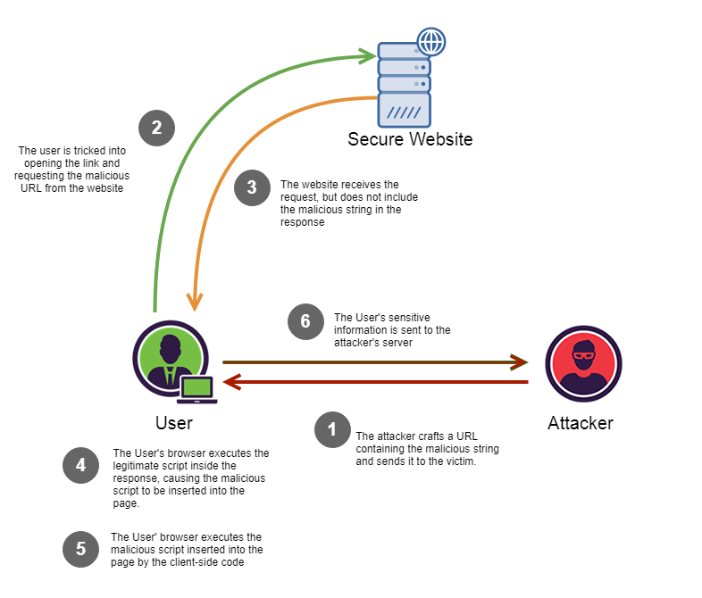
Reflected XSS
#1) Reflected XSS
為什麼叫做 Reflected XSS呢? 顧名思義就是網站會反應所輸入的 JavaScript。
因此，因為當駭客成功發現某個網站可以執行駭客預期的惡意程式碼時，駭客就可以把受害 (被植入 JavaScript)網站的 URL透過釣魚的方式或是郵件傳送給被害人。當被害人點擊該 URL時，就會看到且執行該 JavaScript。
Notes:
This occurs when the malicious results are being returned after entering the malicious code. Reflected XSS code is not being saved permanently. In this case, the malicious code is being reflected in any website result. The attack code can be included in the faked URL or HTTP parameters.

Slide 7
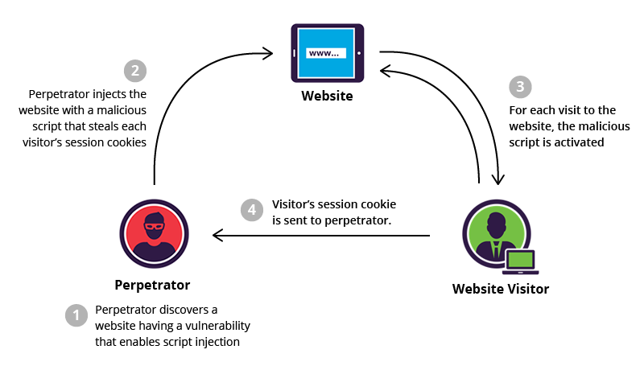
Stored XSS
#2) Stored XSS
Stored XSS 就是讓 JavaScript 可以儲存在網站資料庫中。
最常見的例子就是網頁伺服器的留言板或是備註訊息。由於留言欄位可以留的訊息通常有較鬆散的字數限制。因此駭客就可以把程式碼儲存在留言板中，每當其他使用者瀏覽該網頁，網頁伺服器就會把先前儲存的惡意腳本傳給瀏覽者的瀏覽器讀取。
Notes:
This attack can be considered riskier and it provides more damage.
In this type of attack, the malicious code or script is being saved on the web server (for example, in the database) and executed every time when the users will call the appropriate functionality. This way stored XSS attack can affect many users. Also as the script is being stored on the web server, it will affect the website for a longer time.
In order to perform stored XSS attack, the malicious script should be sent through the vulnerable input form (For Example, comment field or review field). This way the appropriate script will be saved in the database and executed on the page load or appropriate function calling.

Slide 8
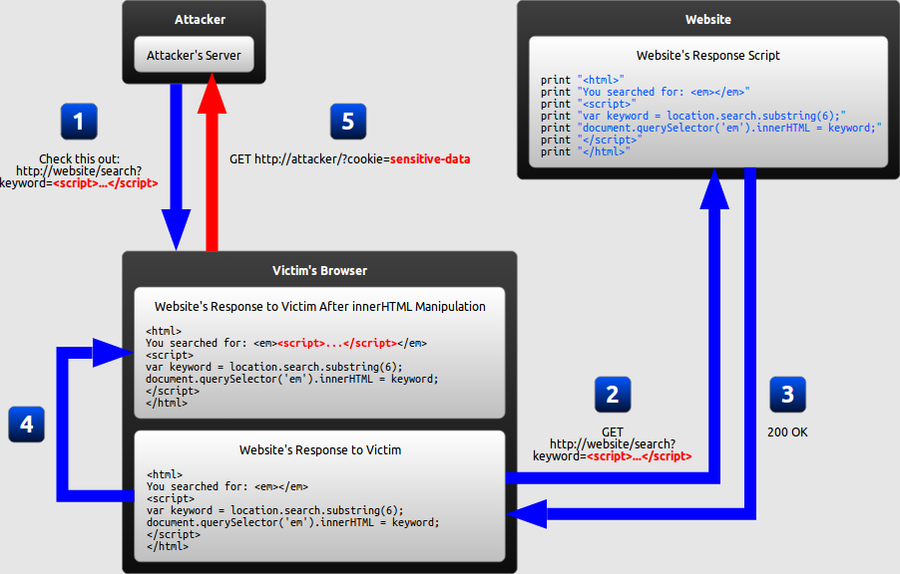
DOM XSS
#3) DOM XSS
DOM-XSS跟前兩者最大的不同在於 DOM-Based 的攻擊要防護必須做在用戶端。Reflected XSS與 Stored XXS 則是在伺服器端做防護與驗證。
一樣可以透過社交工程等等方式使被害人執行像是URL搜尋語法，當網頁伺服器因為URL搜尋關鍵字改變，回傳變動過後的HTML Page，搜尋語法因為夾帶執行外部腳本，導致可能從中竊取機敏資訊。
Notes:
This type of attack occurs when the DOM environment is being changed, but the client-side code does not change. When the DOM environment is being modified in the victim’s browser, then the client side code executes differently.
In order to get a better understanding of how XSS DOM attack is being performed let us analyze the following Example.
Consider, there is a webpage with URL http://testing.com/book.html?default=1. As we know, “default” is a parameter and “1” is its value. Therefore, in order to perform XSS DOM attack, we would send a script as the parameter.
容易遭受到 DOM攻擊的有：
document.url
document.cookie
window.location.search
history.replaceState
底下提供大家XSS測試網站，以及用來教育目的的HTML, JS語法:
http://www.insecurelabs.org/Task
1. <script>alert("test")</script>
2. <script>console.log("test")</script>
3. <script>window.open("https://www.sysage.com.tw")</script>
4. <img src="//external-content.duckduckgo.com/iu/?u=https%3A%2F%2Ftse1.mm.bing.net%2Fth%3Fid%3DOIP.VeaeqtAPfyJtw0_neF3TBQHaE8%26pid%3DApi&f=1" onclick=window.open("https://www.sysage.com.tw")></image>
5. <img src="//external-content.duckduckgo.com/iu/?u=https%3A%2F%2Ftse1.mm.bing.net%2Fth%3Fid%3DOIP.VeaeqtAPfyJtw0_neF3TBQHaE8%26pid%3DApi&f=1" onload=window.open("https://www.sysage.com.tw")></image>
6. <meta http-equiv="Refresh" content="0; url='https://www.sysage.com.tw" />
7. http://www.insecurelabs.org/Task/Rule1?query=<meta http-equiv="Refresh" content="0; url='https://www.sysage.com.tw" />
https://www.urlencoder.org/
8. http://www.insecurelabs.org/Task/Rule1?query=%3Cmeta%20http-equiv%3D%22Refresh%22%20content%3D%220%3B%20url%3D%27https%3A%2F%2Fwww.sysage.com.tw%22%20%2F%3E
9. http://www.insecurelabs.org/Task/Rule1?query=%3Cmeta%20http-equiv%3D%22Refresh%22%20content%3D%220%3B%20url%3D%27https%3A%2F%2Ffci.io%22%20%2F%3E
10. <script>$.ajax({url: "https://www.sysage.com.tw", success: function(result){ console.log(result); }});</script>

