Slide 1


EditNext Project
What are the innovative and emerging Gene Editing methods?

Slide 2
Context
      Sanofi is an innovative global healthcare company, driven by a single goal: to pursue the miracles of science to improve people's lives. With teams in over 100 countries, we are dedicated to transforming the practice of medicine by striving to turn the impossible into the possible. They provide life-changing therapeutic options and vital vaccine protection to millions of people around the world, while placing sustainable development and social responsibility at the heart of their ambitions.
      Today, Sanofi's R&D teams Sanofi integrates gene editing into its antigen design process to improve vaccine development. The focus is on engineering Gram-positive and Gram-negative bacterial genomes through precise mutations and gene deletions, to address challenges such as antibiotic resistance.
      However, the methods currently used by Sanofi are traditional methods for modifying exotic bacteria, a reliable but time-consuming process requiring 6 to 13 months on average. To increase efficiency, Sanofi wants to explore more recent tools such as CRISPR-Cas9 or other emerging technologies.
      This project therefore aims to identify the most promising solutions either for reducing development times while meeting their industrial needs or to solve the particular difficulties encountered with certain bacteria.

Slide 3

Objectives
Your objective: Find the appropriate new gene editing method that enable point mutations or the deletion of certain genes and start to
Alcimed will help you to reach this objective on 3 main pillars
Identification and characterization
Selection
Recommendations
Of the existing gene editing (or alternative )methods
Of the gene editing methods, the more useful for Sanofi to deploy its project
For an actionable plan for Sanofi to integrate gene editing method to design antigen

Slide 4
Our approach
Alcimed offers a 3-step approach :
STEP 0
STEP 1
STEP 2
STEP 3
Kick-Off
Analysis and selection of Gene Editing (or alternative) methods
Deep Dive on potential methods and partners for Sanofi
Recommandations

Slide 5
Pas nécessaire d’avoir les plans en double à chaque sous-partie !
General introduction
Engineering with Sequence-Specific Nucleases
Engineering at Transcriptional Level
Engineering at Translational Level
Comparisons & conclusions

Slide 6
General Introduction

Slide 7

Investigation carried out
Valoriser le travail de recherche bibliographique réalisé
  Exclusion of development stages:
  Inactive
  Filling rejected / Withdrawn
  Discontinued
Drugs identified – Jak1/Not Jak2 inhibitors
56
56
39
  4 Marketed drugs
  14 drugs in Phase III or Phase II
39
  21 drugs in Phase I or Preclinical or Pre-registration or IND/CTA Filled or Discovery
20
  First pre-selection of potential drugs of interest
20
  Including 26 drugs already identified by BI
  Including 13 drugs discovered by Alcimed
  Prioritization through the workshop of the 9th February 2024.
12
12

Slide 8
Investigation result
Overview du tableau excel récapitulatif

Slide 9
Overview of first selected methods
Plan :
Engineering with Sequence-Specific Nucleases
  Zinc-Finger Nucleases (ZFNs)
  …
Engineering at Transcriptional Level
Engineering at Translational Level

Slide 10
General introduction
Engineering with Sequence-Specific Nucleases
Engineering at Transcriptional Level
Engineering at Translational Level
Comparisons & conclusions

Slide 11
Engineering with Sequence-Specific Nucleases

Slide 12










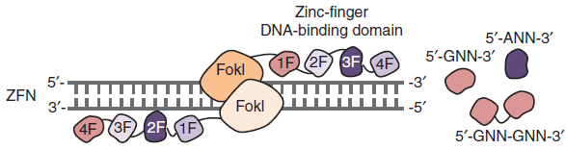
OK
Zinc-Finger Nucleases (ZFNs)
ZFNs are a versatile, effective and mature platform of genome editing but they also present important cytotoxicity and lack of specificity.
Applications’ areas
Characteristics
Cardiovascular diseases¹
Viral infections, such as HIV and HPV.² For HIV, in February 2022, a total of 9 clinical trials were conducted related to ZFNs.³
First generation of engineered nucleases, discovered in 1985.
A zinc-finger nuclease is a dimer, composed of two zinc-fingers, separated by a linker. Each zinc-finger counts 300 amino acids in total, distributed in 3 or 4 domains, each composed of 30 amino acids. Also, each monomer recognizes 9 to 18 base pairs of a specific “half site” sequence of DNA (FokI).
ZFNs are working via a double-strand break (DBS) at predefined genome loci.
They recognize triplets of base pairs.
Allows gene knockout and gene replacement.
Target Organisms
Yeast
Drosophila
Roundworms
Zebrafish
Nematode species
Humans
Plants (soybeans, thale cress)
Algae
Target sequence has to be rich in G bases.

Slide 13








OK
Zinc-Finger Nucleases (ZFNs)
Positive Points
They have proven to be the most versatile and effective class of targeting agents. Also, it’s a mature platform.
They are relatively easy to deliver as the small size of ZFN expression elements is suitable for a variety of viral vectors.
They tolerate a small number of positional mismatches.
Alcimed’s feeling
Specificity
Negative points
Wide applicability
The main problem with the use of ZFNs for genome editing is off-target mutations, leading to a lack of specificity and a high cytotoxicity.
With ZFNs, it’s difficult to target a non-G-rich region of DNA. Thus, they lack target flexibility.
They require a substantial protein engineering, hindering their used in non-specialized laboratories (in opposition with TALENs and CRISPR).
➔ Globally, ZFNs are difficult to design, costly and not specific enough.
Easy to implement
Main Sources
Improvement of the technology
NP : no directe application on bacteria host
1. Nishiga M. et al., Therapeutic genome editing in cardiovascular diseases, Adv Drug Deliv Rev, 168, 147-157 (2021)
2. Cui Z. et al., The comparison of ZFNs, TALENs and SpCas9 by GUIDE-seq in HPV-targeted gene therapy, Mol Ther Nucleic Acids, 26, 1466-1478 (2021)
3. ClinicalTrials.gov
Obligate heterodimeric ZFN architectures – enhances the specificity rely on charge–charge repulsion to prevent unwanted homodimerization of the FokI cleavage domain thereby minimizing the potential for ZFNs to dimerize at off-target sites.
OPEN (Oligomerized Pool Engineering) – increases the precision of the mutagenesis.
CoDA (context-dependant assembly) – simplifies creation’s process of ZFNs, enabling rapid alteration of genes in various organisms.

Slide 14
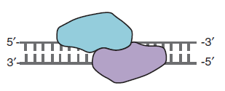
OK
Meganucleases (MNs)
MNs are very specific gene editing tools, with a wide variety of variants available; however, they are difficult to design, with limited therapeutical applications.
Characteristics
Meganucleases are a subclass of endonucleases.
They are composed of homing nucleases (HEs) and synthetic nucleases.
Homing nucleases are found in eukaryotic organisms such as plants, algae, fungi while synthetic nucleases are obtained by swapping or modifying domains from different HEs.
They are small molecules of 180 to 440 residues, with no repetition in their sequence.
They recognize long DNA target sites of 12 to 40 bp.
They are generally cleaving DNA as dimers.
They are unique platform in that their DNA binding and cleavage activities are integrated.
There are 6 families of meganucleases : LAGLIDADG, His-Cys box, GIY-YIG, HNH, PD(D/E)XK, EDxHD, with LAGLIDADG the most abondant one.
They have not been able to flourish due to development of newer techniques.
Discovered in 1990s, it was the first method used for plants genome editing.
Applications’ areas
Viral infections¹
Immunotherapy²
Allows targeted gene knockout and gene modification.
Target Organisms
Identification of a suitable target sequence within the genomic region of interest
Preparation of a wide library of variants to be tested
Bacteria
Fungi
Yeast
Plants
Algae
Archaea

Slide 15
OK
Meganucleases (MNs)
Positive Points
They are specific to long target sites.
These nucleases allow the modification of a user-defined target locus in the genome.
They make extensive sequence-specific contacts with their DNA substrate allowing an exquisite specificity.
These enzymes can be engineered to target specific DNA sequences.
They are easy to deliver as plasmids, mRNA or viral vectors.
They present no cytotoxicity and have a very low off-target activity.
Alcimed’s feeling
Specificity
Wide applicability
Negative points
Easy to implement
They are challenging to design and use since their binding domains on DNA are shared so the modification of a DNA-binding domain can affect the activity of the nuclease.
Custom meganucleases are not currently commercially available.
The naturally occurring meganucleases have limited clinical applications.
Unlike ZFNs and TALENs, their binding and cleavage domains are not modular.
Developing a new meganuclease variant that targets a new sequence requires a significant amount of protein engineering, mutant screening and selection, and optimisation procedures.
Their on-target efficiency is highly variable , dependent of the selected MN, cell type, target sequence, and use.
Main Sources
1. Yoon Y. et al., Streamlined ex vivo and in vivo genome editing in mouse embryos using recombinant adeno-associated viruses, Nat Commun, 9, 1-12 (2018)
2. Weber N.D. et al., DNA cleavage enzymes for treatment of persistent viral infections: recent advances and the pathway forward, Virology, 454–5, 353– 361 (2014)
3. Sather B.D. et al.,Efficient modification of CCR5 in primary human hematopoietic cells using a megaTAL nuclease and AAV donor template, Sc Transl Med, 7, 307ra156 (2015)
Improvement of the technology
MegaTALs, resulting from the fusion of a rare-cleaving MNs to a TALE-binding domain have been reported to induce highly specific gene modifications.
Recombinant adeno-associated viruses have been developed to transport the genetic tools in cells. Their applications are limited due to difficulty in preparing the engineered constructs, off-target activity, probable genome mutations and the reduced site specificity and integration.³

Slide 16
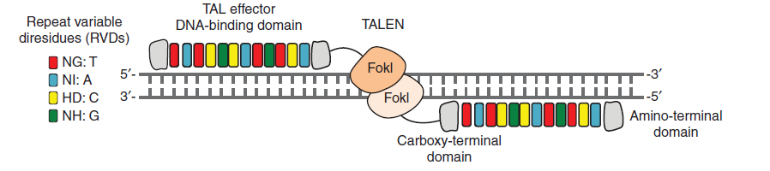
Transcription Activator-Like Effector Nucleases (TALENs)
TALENs are highly specific editing tools, with variety of techniques of preparation even though they are complex, long and costly to produce.
OK
Characteristics
Applications’ areas
TALENs were discovered in 2009 in bacteria.
They have the same kind of structure as ZFNs.
TALEs recognize between 14 and 20 bp of DNA per monomer, with more bases typically leading to higher genome-editing specificity.
The TALE binding domain consists of a series of repeat domains, each 34 residues in length. Each repeat contacts DNA via the amino acid residues at positions 12 and 13, known as the repeat variable diresidues (RVDs). This RVD is specific to one nucleotide base.
Each TALE repeat recognizes a single bp, with little to no target site overlap from adjacent domains.
In vivo investigation or reparation of DNA damages¹
Cancer treatment²
Cardiovascular diseases³
Allows mutagenesis and precise modification of nonprotein coding genes.
Target Organisms
A T base has to be present at each 5’ end of binding sites.
Roundworm
Fruit fly
Zebrafish
Pig
Rat
Frog

Slide 17
Transcription Activator-Like Effector Nucleases (TALENs)
OK
Positive Points
There exists a huge library of TALENs capable of modifying nearly any gene thanks to their modular structure.
TALEN repeats are less complex to design and assemble compared to the rigid ZF motifs used in ZFNs.
They are highly specific due to their structures, reducing unintended DNA cleavage at off-target sites.
No selection or directed evolution is necessary to engineer TALE arrays, reducing time to assemble a functional nuclease.
TALE DNA-binding domains can be constructed using a variety of methods : Golden Gate assembly. Gibson assembly, FLASH assembly, iterative capped assembly and ligation independent cloning.
Alcimed’s feeling
Specificity
Wide applicability
Easy to implement
Negative points
For any new genomic locus to target, TALENs require the repetition of the whole process of protein module design, cloning, and assembling. It’s time-consuming and impractical for widespread application.
TALENs are substantially larger than ZFNs, with highly repetitive structure, making their efficient delivery into cells challenging.
They require complex molecular cloning and module assembling methods.
Due to repetitive nature of the sequence, they are very prone to recombination within bacteria while cloning, making the process of vector construction difficult, which also significantly increases time and cost involved.
Each TALEN monomer require the targeting of a T at 5ʹ.
Main Sources
1. Moiani A. et al.,C., PreClinical Development of a Highly Efficient TALEN®-Based Correction of the β-Globin Gene in Patient-Derived Hematopoietic Stem and Progenitor Cells (HSPCs) to Treat Sickle Cell Disease, Blood, 138, 1856 (2021)
2. Qasim W. et al.,, Molecular remission of infant B-ALL after infusion of universal TALEN gene-edited CAR T cells, Sci Transl Med, 9, eaaj2013 (2017)
3. Nishiga M. et al., Therapeutic genome editing in cardiovascular diseases, Adv Drug Deliv Rev, 168, 147-157 (2021)
Improvement of the technology
Delivering problems car be solved by delivering TALENS as mRNA or protein. Also, adenoviral vectors have proven to be particularly useful for mediating TALENs delivery to hard-to-transfect cell types.

Slide 18
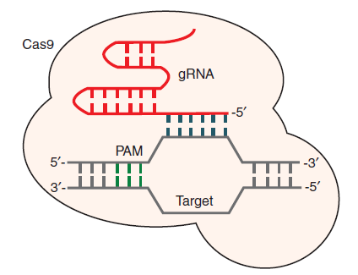
CRISPR/Cas9
CRISPR/Cas9 has emerged as the most flexible and user-friendly platform for genome editing even though its intracellular delivery is complex and it lacks specificity.
Characteristics
Applications’ areas
Discovered in 2005, Cas are the 3rd generation of sequence-specific endonucleases.
Cancer treatment: colorectal cancer,³ breast cancer,⁴ lung cancer⁵
Cardiovascular diseases⁶
Allows
CRISPR : Clustered Regularly Interspaced Palindromic Repeats
Cas : CRISPR-associated.
It derived from a bacterial adaptive immune defense system.
It targets DNA sequences of 22 to 26 bp, with 2 to 6 bp corresponding to PAM (Protospacer Adjacent Motif).
Target DNA sequence is recognized by a short single-guide RNA (sgRNA). This recognition has specific requirements : a PAM as an adjacent motif, followed by 19 target-specific nucleotides and a G at the end.
CRISPR/Cas9 : most commonly used tissue-specific system to mutate any gene by Cas9-mediated cutting.
Cas 9 recognition of PAM allows DNA cleavage.
-Targeted site must precede a PAM sequence.
Target Organisms

Slide 19
CRISPR/Cas9
Positive Points
Alcimed’s feeling
CRISPR/Cas 9 has emerged as the most flexible and user-friendly platform for genome editing, eliminating the need for engineering new proteins to recognize each new target site. One of the reason is the high specificity of the DNA targeting comes entirely from the short single-guide sgRNA, that is fully customizable, easy to design and assemble, allowing the creation of genome-wide libraries of sgRNAs able to target almost any gene.
In opposition to ZFNs and TALENs, Cas 9 generates a DSB without homodimerization.
The Cas9 nuclease and its sgRNA can be delivered into cells for genome editing on the same or separate plasmids.
It tolerates positional/multiple consecutive mismatches.
It requires standard cloning and oligo synthesis procedures.
Specificity
Wide applicability
Easy to implement
Negative points
Due to the large size of the commonly used Cas9, intracellular delivery is low, limiting clinical application of CRISPR. It may also cause packaging problems for viral vectors such as AAV, but smaller orthologs exist.
There is a high probability of off-target cleavage, leading to off-target mutations. It can be overcomed by using alternative reagents to Cas9 but also by generating sgRNA in silico to avoid sequence homology with the targeted genome.
It also suffers a poor repair efficiency and important immunogenic responses.
➔ There is a real need to enhance efficiency, flexibility and analytical power of CRISPR/Cas9.
Sources
Improvement of the technology
Off-target cleavage can be reduced by controlling the dosage of either Cas9 protein or sgRNA within the cells, or by using Cas9 variants configured to enable conditional genome editing.
Various delivery methods has been used with CRISPR technology but they faced numerous challenges such as mutations, carcinogenesis, immune response, time-consuming and labour intensive methodology.²
Notes:
2- Qasim W., Zhan H., Samarasinghe S., Adams S., Amrolia P., Stafford S., Butler K., Rivat C., Wright G., Somana K. and Ghorashian S., Molecular remission of infant B-ALL after infusion of universal TALEN gene-edited CAR T cells, Sci Transl Med, 9, eaaj2013 (2017)
3- Chang Y.Y., Yu L.C., Yu I.S., Jhuang Y.L., Huang W.J., Yang C.Y. and Jeng Y.M., Deletion of cadherin‐17 enhances intestinal permeability and susceptibility to intestinal tumour formation, J Pathol, 246, 289-299 (2018)
4- Ren Y., Qiu L., Lü F., Ru X., Li S., Xiang Y., Yu S. and Zhang Y., TALENs-directed knockout of the full-length transcription factor Nrf1α that represses malignant behaviour of human hepatocellular carcinoma (HepG2) cells, Sci Rep, 6, 1-32 (2016)
5- Lee J.W., Ryu Y.K., Ji Y.H., Kang J.H. and Moon E.Y., Hypoxia/reoxygenation-experienced cancer cell migration and metastasis are regulated by Rap1-and Rac1-GTPase activation via the expression of thymosin beta-4, Oncotarget, 6, 9820-9833 (2015)
6- Nishiga M., Qi L.S. and Wu J.C., Therapeutic genome editing in cardiovascular diseases, Adv Drug Deliv Rev, 168, 147-157 (2021

Slide 20
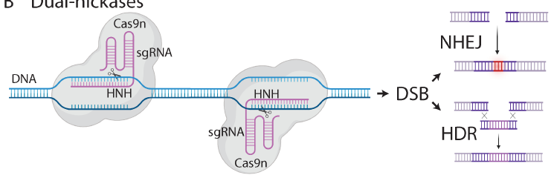
Dual Nickases
Key message
Characteristics
Applications’ areas
…
Hematologic disorders
Cardiac pathologies
Variety of livers’ diseases ( PKU, HT1…)
Retinal diseases
Hereditary hearing loss
Duchenne muscular dystrophy
Allows
Since Cas9 contains two nuclease domains, each cleaving one strand of DNA, point mutations have been introduced in the corresponding catalytic residues to convert Cas9 into a DNA nickase (Cas9n). Since Cas9n cuts only one strand, two offset sgRNAs in proximity and on opposite strands are needed to create a DSB, thereby extending the number of required matching nucleotides. As individual nicks are repaired with high fidelity, this approach has significantly reduced the possibility of off-target damage.
-
Target Organisms

Slide 21
Dual Nickases
Positive Points
Alcimed’s feeling
Considerable efforts have been devoted to improving the specificity of CRISPR/Cas9, including using paired Cas9 nickases, which increase gene-editing specificity by requiring the induction of two sequential and adjacent nicking events for DSB formation, or truncated sgRNA that are more sensitive to mismatches at the genomic target site than a full-length sgRNA.
Specificity
Wide applicability
Easy to implement
Negative points
Sources
Evolutions of the technology
Notes:
1-

Slide 22
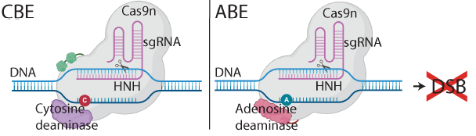
Base Editing (BE) of DNA
Key message
Applications’ areas
Base editing of DNA methods were first introduced in 2016.
Hematologic disorders
Cardiac pathologies
Variety of livers’ diseases ( PKU, HT1…)
Retinal diseases
Hereditary hearing loss
Duchenne muscular dystrophy
Characteristics
Allows direct and irreversible conversion of target C or A bases at a specific genomic locus.
- CBE depends on the single-stranded portion of DNAs’ R-loop.
- Creation of an ABE needs the generation of an adenosine deaminase acting on ssDNA.
CBE : Cytosine Base Editor, converting C•G to T•A
ABE : Adenosine Base Editor, converting A•T to G•C
Innovative approach in which Cas9n is fused to a deaminase enzyme responsible for the direct conversion of one DNA bp into another.
Target Organisms

Slide 23
Base Editing (BE) of DNA
Positive Points
Permanent introducion of mutations in living cells, with high efficiency.
Do not rely on double-stranded DNA breaks so it prevents unintended indels.
Designed to be highly specific.
Together, ABEs and CBEs are theoretically capable of correcting 63% of reported pathogenic single-nucleotide variants (SNVs).
CBEs and ABEs present fewer “gRNA-dependant off-targets” sites than wild-type Cas9.
Alcimed’s feeling
Specificity
Wide applicability
Negative points
Easy to implement
Deaminase enzymes often have a specific editing window or range of a few nucleotides. Consequently, it may also edit nearby bases within this window, leading to unintended mutations called “bystander” edits.
CBEs and ABEs present identical off-target sites as Cas9 but also unique ones.^{1,2}
BE is primarily focused on introducing single nucleotide changes, so it does not allow deletion or insertion of larger DNA fragments, which limits its utility for certain types of genomic modifications.
CBEs can lead to conversion of C•G into non-T•A unpredictably, in a locus dependent manner, reducing CBEs’ precision and blocking their uses for certain therapeutic areas.³
Sources
Nishida, K. et al. Targeted nucleotide editing using hybrid prokaryotic and vertebrate adaptive immune systems. Science 353, aaf8729 (2016).
Kim, D. et al. Genome-wide target specificities of CRISPR RNA-guided programmable deaminases. Nat. Biotechnol. 35, 475–480 (2017).
Hess, G. T. et al. Directed evolution using dCas9- targeted somatic hypermutation in mammalian cells. Nat. Methods 13, 1036–1042 (2016).
Mok, B. Y. et al. A bacterial cytidine deaminase toxin enables CRISPR-free mitochondrial base editing. Nature 583, 631–637 (2020).
Evolutions of the technology
A new base editor named DdCBE was created, combining a dsDNA-specific cytidine deaminase and TALENs. It enabled efficient mitochondrial genome editing for the first time.⁴
To combat gRNA-dependent off-targets, high-fidelity Cas9 variants have been incorporated into the classic CBE architecture to replace wild-type Cas9n.
Notes:
1-

Slide 24
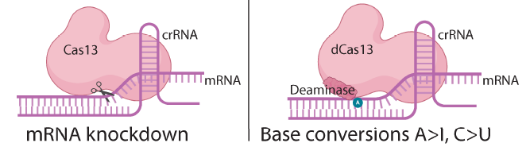
Base Editing (BE) of RNA
Key message
Applications’ areas
Base editing methods of RNA were first introduced in 1986.
Hematologic disorders
Cardiac pathologies
Variety of livers’ diseases ( PKU, HT1…)
Retinal diseases
Hereditary hearing loss
Duchenne muscular dystrophy
Characteristics
Allows reversible modifications to a cell’s genetic material or install epitranscriptomic modifications into RNA
-
A-to-I : Adenosine to Inosine
C-to-U : Cyotsine to Uracile.
Although RNA cytosine deaminase enzymes naturally exist, their high activity for any cytosine present in single-stranded RNA has precluded their use in the development of precise RNA base editors.
RESCUE (RNA Editing for Specific C-to-U Exchange) has been developed, starting with a A-to-I REPAIR system.
RESCUE maintains A-to-I activity, allowing for multiplexed adenine and cytosine RNA base editing.
Target Organisms

Slide 25
Base Editing (BE) of RNA
Positive Points
Alcimed’s feeling
RESCUE : to avoid unwanted A-to-I activity, gRNA can be designed to incorporate potential off-target adenines within AG mismatches.
Specificity
Wide applicability
Easy to implement
Negative points
High levels of unintended off-targets due to the introduction and overexpression of Adenosine Deaminase acting on RNA (ADAR).
Since mRNA is continuously transcribed from DNA and typically has a short life, the RNA editing machinery must be permanently expressed for a long-term effect, which may increase collateral bystander and genomic off-target edits.
Sources
Merkle, T. et al. Precise RNA editing by recruiting endogenous ADARs with antisense oligonucleotides. Nat. Biotechnol. 37, 133–138 (2019).
Qu, L. et al. Programmable RNA editing by recruiting endogenous ADAR using engineered RNAs. Nat. Biotechnol. 37, 1059–1069 (2019).
Cox, D. B. T. et al. RNA editing with CRISPR–Cas13. Science 358, 1019–1027 (2017).
Abudayyeh, O. O. et al. A cytosine deaminase for programmable single-base RNA editing. Science 365, 382–386 (2019).
Evolutions of the technology
RESTORE : Recruiting Endogenous ADAR to Specific Transcripts for Oligonucleotide-mediated RNA Editing¹
LEAPER : Leveraging Endogenous ADAR for Programmable Editing of RNA²
REPAIR : RNA Editing for Programmable A-to-I Replacement³
RESCUE-S - reduction of transcriptome-wide off-targets while maintaining on-target efficiencies.⁴
Notes:
1-

Slide 26
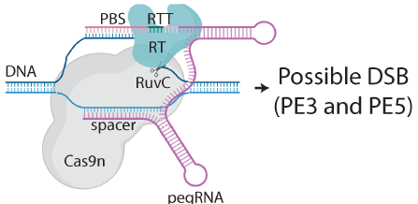
Prime editing (PE)
Key message
Characteristics
Applications’ areas
…
Allows
-
PE leverages an engineered reverse transcriptase (RT) fused to a Cas9n. This Cas9n-RT complex is guided to the target locus by a prime editing guide RNA (pegRNA) that includes a spacer sequence, which is complementary to the target DNA.
Target Organisms

Slide 27
Prime editing (PE)
Positive Points
Alcimed’s feeling
PE is a technique that offers high precision and fewer errors compared to Cas9 nuclease or BE and can make all possible small edits.
It generally does not cause DSBs or on-target indels, except for a few versions of PE.
It does not cause off-target indels or bystander mutations.
Specificity
Wide applicability
Easy to implement
Negative points
Length of the RTT (Reverse Transcription Template) and the PBS (Primer Binding Site) needs to be optimized for each target.
As for nuclease and BE, the DNA recognition domain of Cas9 is used for PE, so target sequences need to be adjacent to a PAM, which may represent a challenge if one is not available close to the target DNA locus.
Sources
Evolutions of the technology
PE2 is an improved version of the original PE system using an engineered RT to increase editing efficiency.
PE3 nicks the non-edited strand to further increase efficiency by stimulating the de novo synthesized 3′ flap to be used as a repair template instead of the original 5′ flap. However, PE3 sometimes generates unwanted indels since it may produce DSBs by simultaneously nicking both DNA strands.
PE4 and PE5 correspond to PE2 and PE3, respectively, with the additional expression of an engineered DNA mismatch repair (MMR)-inhibiting protein that increases editing efficiency.
PEmax was shown to improve editing rate in synergy with PE4, PE5, and engineered pegRNAs (epegRNAs).
Furthermore, PE6 emerged as shorter than PEmax by 0.5–0.8 kilobase (kb), with a 22-fold increased editing efficiency, following phage-assisted protein evolution experiments.
For larger insertion of DNA sequences, twin prime editing (twinPE) can be applied using a pair of pegRNAs located farther away from one another. TwinPE has demonstrated the ability to allow the insertion of a 113 bp sequence between the two pegRNA-directed nicks.
Notes:
1-

Slide 28
Sequence-Specific Nucleases summary
Tableau récapitulatif

Slide 29
Questionary
https://digistorm.app/c/2923247
MDP : m9ox3n
Outil digistorm pour gérer quizz intermédiaire et nuage de mot final pour la sélection

Slide 30
General introduction
Engineering with Sequence-Specific Nucleases
Engineering at Transcriptional Level
Engineering at Translational Level
Comparisons & conclusions

Slide 31
Engineering at Transcriptional Level

Slide 32
Epigenome editing
Key message
Characteristics
Applications’ areas
…
Combination of modified genome editing machinery with epigenetic modification enzymes.
There exists lots of epigenetic modifiers : histone acyltransferases, deacetylases, HMTs, demethylases… They can be fused with target-specific deactivated zinc fingers, TALEs or Cas9 proteins.
Epigenome editing involves precise modifications to epigenetic markers, such as DNA methylation and histone modifications, offering potential treatments for diseases influenced by epigenetic factors.
Allows
-
Target Organisms

Slide 33
Epigenome editing
Positive Points
Alcimed’s feeling
Main advantage of the system : flexibility in targeting the locus without undergoing alterations in the targeted sequence.
dCas9 repressor proteins targeted to distal regulatory elements have been found to facilitate chromatin remodeling and gene repression via epigenomic modification.
Specificity
Wide applicability
Easy to implement
Negative points
Sources
Improvement of the technology

Slide 34
Promoter Engineering
OK
Promoter Engineering allows a precise control on transcription, with a possible to condition gene expression, even thought promoters’ design is complexified by various actors.
Characteristics
Promoter Engineering started in the 1980s and 1990s.
There exists prokaryotic and eukaryotic promoters.
Prokaryotic promoters are short, with less than 150 bp. They contain key elements that can impact, individually or globally, transcriptional capacity of the promoter.
Eukaryotic promoters are larger, between 100 and 1000 bp, with more complex structures and conserved elements variating on a species-to-species basis. Their structure is composed of a core promoter region and upstream activating sequences.
Synthetic promoters can have reduced length and repeated sequences, stronger and/or graded compared to natural ones.
There are two broad strategies to develop new promoters. In one, promoters are diversified at the nucleotide level. In the other, called “hybrid promoter engineering”, core promoter and upstream activating sequence (UAS) are combined to form a new promoter.
Nucleotide Diversification Promoter Engineering leads to the creation of dozens to millions variations of a promoter scaffold.
Hybrid Promoter Engineering takes of advantage of the modularity of UAS elements to allow assembly of promoters with new properties, including enhanced strength or nonnative regulation (inducibility).
Applications’ areas
Increase crops yields, stress tolerance, and quality¹
Allows the control of transcription with properties not found in natural promoters.
Target Organisms
To build synthetic promoters, native promoters are needed, from one or several species.
Bacteria
Plants

Slide 35
Promoter Engineering
OK
Positive Points
One of the easiest method to control gene expression via the selection of the appropriate promoter.
Conditonnal gene expression is possible with inducible promoters that are responsive to cellular environment : temperature, oxygen availability, intracellular concentration of precise molecules… Inducible promoters are generally inexpensive, non-toxic, with high specificity.
The short length and relative simplicity of prokaryotic promoters make them usable to many engineering strategies
Current techniques for engineering new promoters can be broadly applicable.
Hybrid promoter design treat sequence promoter elements as “parts” which can be rearranged, swapped, or replicated, making it useful for maximizing promoter strength or establishing novel modes of transcriptional regulation.
Alcimed’s feeling
Specificity
Wide applicability
Easy to implement
Negative points
Method that requires characterization and selection of the promoter with desired properties, which is time consuming.
There exists numerous interactions between promoter and transcription factors, complexifying new promoter’s design.
For eukaryotic promoters, UAS elements are required to enhance the strength of core promoter to attain robust gene expression. Also, core promoter is the trickiest to work on since changes drastically impact promoter strength.
Nucleotide Diversification Promoter Engineering method creates variants in a pseudo-random manner.
Main Sources
1. Lu Shi, Jing Su, Myeong-Je Cho, Hao Song, Xiaoou Dong, Ying Liang, Zhiyong Zhang, Promoter editing for the genetic improvement of crops, Journal of Experimental Botany, Volume 74, Issue 15, 17 August 2023, Pages 4349–4366
Cazier AP, Blazeck J. Advances in promoter engineering: Novel applications and predefined transcriptional control. Biotechnol J. 2021 Oct;16(10):e2100239.
Improvement of the technology
Many of the advances in promoter engineering achieved in bacteria have focused on E. coli, efforts have been made to design promoters compatible across a broad spectrum of bacteria.
Prediction of promoter transcriptional strength has been shown to be amenable to machine learning techniques.

Slide 36
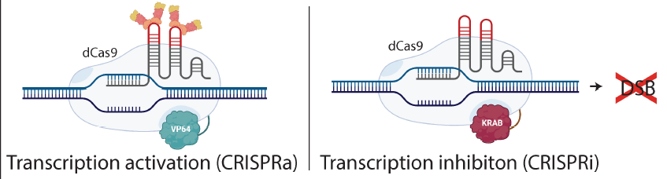
CRISPRi/CRISPRa
Key message
Characteristics
Applications’ areas
…
Allows
A mutation is done on Cas 9 to deactivate its nuclease activity.
CRISPR/ dCas9 becomes a novel tool to sterically hinder either the binding of RNA polymerase to the promoter region or their elongation through the exonic region.
CRIPSRi = CRISPR interference. It allows suppression of transcription. It can repress gene expression up to 99.9% in procaryotes.
CRISPRa = CRISPR activation. It allows activation of transcription.
Inducible promoters can be used. They can be natural or synthetic and induced in response to physical, biological or chemical cues → allows a conditional expression.
-
Target Organisms

Slide 37
CRISPRi/CRISPRa
Positive Points
Alcimed’s feeling
Specificity
Wide applicability
Easy to implement
Negative points
Sources
Improvement of the technology

Slide 38
General introduction
Engineering with Sequence-Specific Nucleases
Engineering at Transcriptional Level
Engineering at Translational Level
Comparisons & conclusions

Slide 39
Engineering at Translational Level

Slide 40
Riboswitches
Key message
Characteristics
Applications’ areas
…
Riboswitches are RNA sensors capable of controlling gene expression in response to a particular ligand or metabolite
Ligand binds on aptamer domain of the riboswitch → change in conformation → on/off → activation or répression of gene expression.
Allows
-
Target Organisms

Slide 41
Riboswitches
Positive Points
Alcimed’s feeling
Specificity
Wide applicability
Easy to implement
Negative points
Sources
Improvement of the technology

Slide 42
Compartmentalization
Key message
Characteristics
Applications’ areas
…
It consists into a targeted localization of transgene in a particular cellular compartment
engineering of intracellular transporters
dual targeting of the protein when required
planned targeting of the foreign protein into a particular organelle is an important point
availability of substrate molecule in specific compartment is to consider
Allows
-
Target Organisms

Slide 43
Compartmentalization
Positive Points
Alcimed’s feeling
Specificity
Wide applicability
Easy to implement
Negative points
Sources
Improvement of the technology

Slide 44
Polycistonic Expression Using 2A Peptides
Key message
Characteristics
Applications’ areas
…
It uses self-cleaving 2A peptides.
It can be used between protein encoding regions of two transgenic proteins.
The 2A peptide is 60 bp long (20 amino acids) and is cloned between the two genes of interest, resulting in the synthesis of single mRNA transcript under the control of a single promoter.
The cleavage occurs at the C-term during translation without enzyme
Allows more than 1 modification and the separation of two proteins.
-
Target Organisms

Slide 45
Polycistonic Expression Using 2A Peptides
Positive Points
Alcimed’s feeling
Specificity
Wide applicability
Easy to implement
Negative points
Sources
Improvement of the technology

Slide 46
General introduction
Engineering with Sequence-Specific Nucleases
Engineering at Transcriptional Level
Engineering at Translational Level
Comparisons & conclusions

Slide 47
Comparisons & Conclusions

Slide 48
Global overview
Tableau de l’ensemble des méthodes

Slide 49
Selection of Methods for In-Depth Analysis
AND Complementary info

Slide 50
Next steps

Slide 51
Glossary
Glossaire général

