Slide 1

PROJECT PRESENTATION Causes of Death Case study
Notes:
This template can be used as a starter file to give updates for project milestones.
Sections
Right-click on a slide to add sections. Sections can help to organize your slides or facilitate collaboration between multiple authors.
Notes
Use the Notes section for delivery notes or to provide additional details for the audience. View these notes in Presentation View during your presentation.
Keep in mind the font size (important for accessibility, visibility, videotaping, and online production)
Coordinated colors
Pay particular attention to the graphs, charts, and text boxes.
Consider that attendees will print in black and white or grayscale. Run a test print to make sure your colors work when printed in pure black and white and grayscale.
Graphics, tables, and graphs
Keep it simple: If possible, use consistent, non-distracting styles and colors.
Label all graphs and tables.

Slide 2
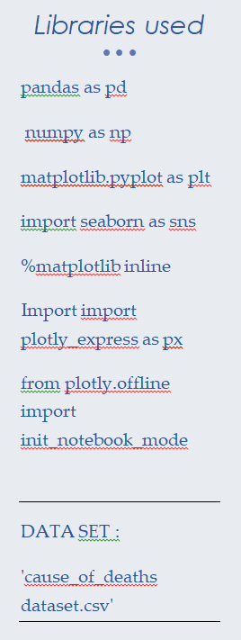
Project Overview
What is the project about?
Define the goal of this project
Data Collection
Notes:
What is the project about?
Define the goal of this project
Is it similar to projects in the past or is it a new effort?
Define the scope of this project
Is it an independent project or is it related to other projects?
* Note that this slide is not necessary for weekly status meetings

Slide 3
What is the project about?
A straightforward way to assess the health status of a population is to focus on mortality – or concepts like child mortality or life expectancy, which are based on mortality estimates. A focus on mortality, however, does not take into account that the burden of diseases is not only that they kill people, but that they cause suffering to people who live with them. Assessing health outcomes by both mortality and morbidity (the prevalent diseases) provides a more encompassing view on health outcomes. This is the topic of this entry. The sum of mortality and morbidity is referred to as the ‘burden of disease’ and can be measured by a metric called ‘Disability Adjusted Life Years‘ (DALYs). DALYs are measuring lost health and are a standardized metric that allow for direct comparisons of disease burdens of different diseases across countries, between different populations, and over time. Conceptually, one DALY is the equivalent of losing one year in good health because of either premature death or disease or disability. One DALY represents one lost year of healthy life. The first ‘Global Burden of Disease’ (GBD) was GBD 1990 and the DALY metric was prominently featured in the World Bank’s 1993 World Development Report. Today it is published by both the researchers at the Institute of Health Metrics and Evaluation (IHME) and the ‘Disease Burden Unit’ at the World Health Organization (WHO), which was created in 1998. The IHME continues the work that was started in the early 1990s and publishes the Global Burden of Disease study.

Slide 4
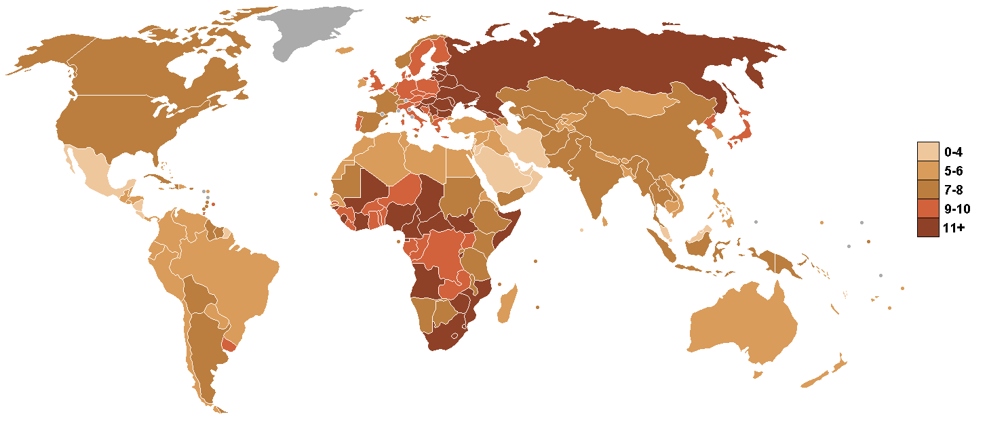
MAP OF THE WORLD
Notes:
@taken from *** https://upload.wikimedia.org/wikipedia/commons/d/d7/Death_rate_world_map.PNG****

Slide 5
CONTENT
In this Dataset, we have Historical Data of different cause of deaths for all ages around the World. The key features of this Dataset are: Meningitis, Alzheimer's Disease and Other Dementias, Parkinson's Disease, Nutritional Deficiencies, Malaria, Drowning, Interpersonal Violence, Maternal Disorders, HIV/AIDS, Drug Use Disorders, Tuberculosis, Cardiovascular Diseases, Lower Respiratory Infections, Neonatal Disorders, Alcohol Use Disorders, Self-harm, Exposure to Forces of Nature, Diarrheal Diseases, Environmental Heat and Cold Exposure, Neoplasms, Conflict and Terrorism, Diabetes Mellitus, Chronic Kidney Disease, Poisonings, Protein-Energy Malnutrition, Road Injuries, Chronic Respiratory Diseases, Cirrhosis and Other Chronic Liver Diseases, Digestive Diseases, Fire, Heat, and Hot Substances, Acute Hepatitis.

Slide 6
DATA COLLECTION
The Dataset is collected from all the countries based on the year and type of death cause
The data consists of 6120 rows & 34 columns
Col 1 to 3 has demographics specific feature
Col 4 to 34 has causes of death

Slide 7
Check the Names of the Columns
'Country/Territory', 'Code', 'Year',
'Meningitis', 'Alzheimer's Disease and Other Dementias', 'Parkinson's Disease',
'Nutritional Deficiencies', 'Malaria', 'Drowning',
'Interpersonal Violence', 'Maternal Disorders', 'HIV/AIDS',
'Drug Use Disorders', 'Tuberculosis', 'Cardiovascular Diseases',
'Lower Respiratory Infections', 'Neonatal Disorders',
'Alcohol Use Disorders', 'Self-harm', 'Exposure to Forces of Nature',
'Diarrheal Diseases', 'Environmental Heat and Cold Exposure',
'Neoplasms', 'Conflict and Terrorism', 'Diabetes Mellitus',
'Chronic Kidney Disease', 'Poisonings', 'Protein-Energy Malnutrition',
'Road Injuries', 'Chronic Respiratory Diseases',
'Cirrhosis and Other Chronic Liver Diseases', 'Digestive Diseases',
'Fire, Heat, and Hot Substances', 'Acute Hepatitis'
Notes:
* If any of these issues caused a schedule delay or need to be discussed further, include details in next slide.

Slide 8
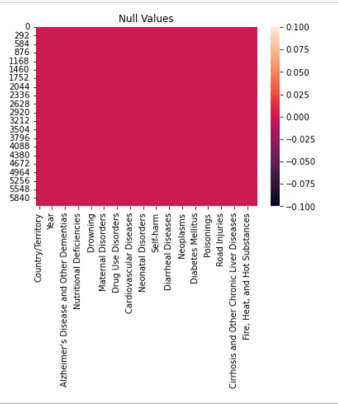
Checking for null values
As per the output from df.null.sum as well as ,info we see that there are 0 null’s
We see from the diagram as well that there are no null values

Slide 9
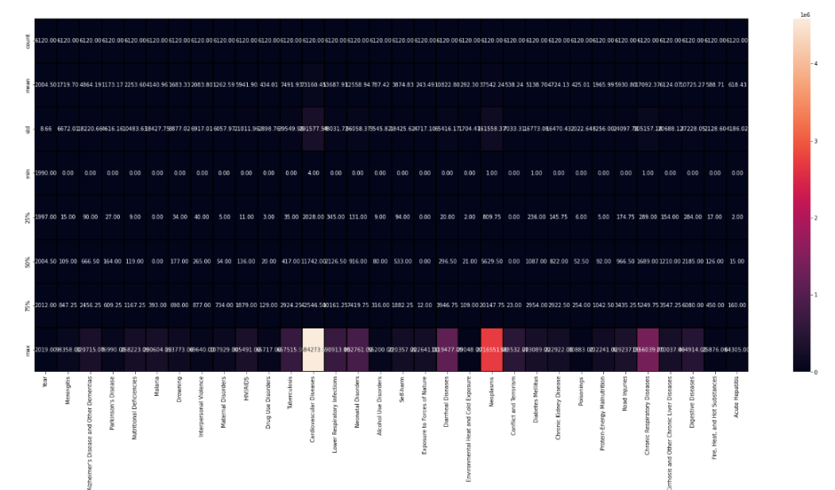
Using ‘Describe’ to show information of a numerical columns

Slide 10
Observations
We see that the values in the columns are very variated , we see that in ost the std number is much higher than the mean which is showing that there is no normal distribution in the columns.
we see that the max values in each are really higher than the 75% quantile and we can see that this data shows that over the years the rates have come down for many of the causes due to improvements in medical science
We see that the majority of the max values in all the columns as seen before are really outliers from the normal data , we see that the highest is cardiovascular diseases

Slide 11
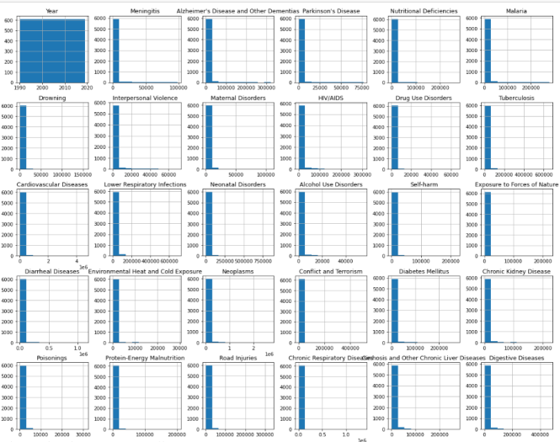
Visualization of the Data- As a Whole HISTPLOT
Notes:
We see similar kinds of data but we are not able to make out any difference or any trend , we see the data is all right skewed

Slide 12
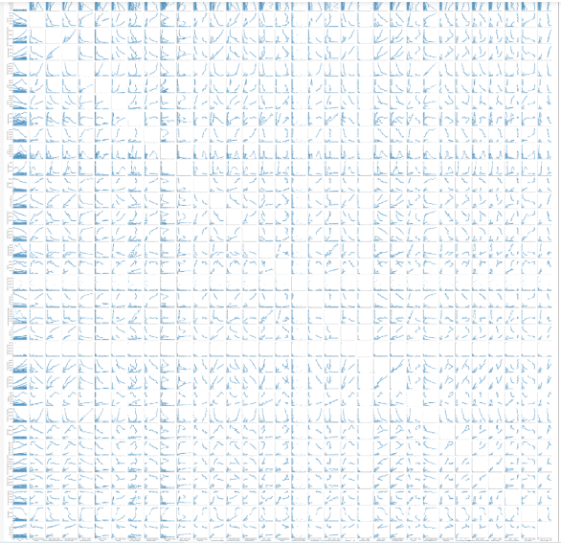
PAIRPLOT
Notes:
Same here we are not able to see the trend properly , need to analyze them individually

Slide 13
Checking the unique values in year & country year – 30 , Country/Territory - 204
Year - 1990, 1991, 1992, 1993, 1994, 1995, 1996, 1997, 1998, 1999, 2000, 2001, 2002, 2003, 2004, 2005, 2006, 2007, 2008, 2009, 2010, 2011, 2012, 2013, 2014, 2015, 2016, 2017, 2018, 2019]
Country - Afghanistan', 'Albania', 'Algeria', 'American Samoa', 'Andorra', 'Angola', 'Antigua and Barbuda', 'Argentina', 'Armenia', 'Australia', 'Austria', 'Azerbaijan', 'Bahamas', 'Bahrain', 'Bangladesh', 'Barbados', 'Belarus', 'Belgium', 'Belize', 'Benin', 'Bermuda', 'Bhutan', 'Bolivia', 'Bosnia and Herzegovina', 'Botswana', 'Brazil', 'Brunei', 'Bulgaria', 'Burkina Faso', 'Burundi', 'Cambodia', 'Cameroon', 'Canada', 'Cape Verde', 'Central African Republic', 'Chad', 'Chile', 'China', 'Colombia', 'Comoros', 'Congo', 'Cook Islands', 'Costa Rica', "Cote d'Ivoire", 'Croatia', 'Cuba', 'Cyprus', 'Czechia', 'Democratic Republic of Congo', 'Denmark', 'Djibouti', 'Dominica', 'Dominican Republic', 'Ecuador', 'Egypt', 'El Salvador', 'Equatorial Guinea', 'Eritrea', 'Estonia', 'Eswatini', 'Ethiopia', 'Fiji', 'Finland', 'France', 'Gabon', 'Gambia', 'Georgia', 'Germany', 'Ghana', 'Greece', 'Greenland', 'Grenada', 'Guam', 'Guatemala', 'Guinea', 'Guinea-Bissau', 'Guyana', 'Haiti', 'Honduras', 'Hungary', 'Iceland', 'India', 'Indonesia', 'Iran', 'Iraq', 'Ireland', 'Israel', 'Italy', 'Jamaica', 'Japan', 'Jordan', 'Kazakhstan', 'Kenya', 'Kiribati', 'Kuwait', 'Kyrgyzstan', 'Laos', 'Latvia', 'Lebanon', 'Lesotho', 'Liberia', 'Libya', 'Lithuania', 'Luxembourg', 'Madagascar', 'Malawi', 'Malaysia', 'Maldives', 'Mali', 'Malta', 'Marshall Islands', 'Mauritania', 'Mauritius', 'Mexico', 'Micronesia', 'Moldova', 'Monaco', 'Mongolia', 'Montenegro', 'Morocco', 'Mozambique', 'Myanmar', 'Namibia', 'Nauru', 'Nepal', 'Netherlands', 'New Zealand', 'Nicaragua', 'Niger', 'Nigeria', 'Niue', 'North Korea', 'North Macedonia', 'Northern Mariana Islands', 'Norway', 'Oman', 'Pakistan', 'Palau', 'Palestine', 'Panama', 'Papua New Guinea', 'Paraguay', 'Peru', 'Philippines', 'Poland', 'Portugal', 'Puerto Rico', 'Qatar', 'Romania', 'Russia', 'Rwanda', 'Saint Kitts and Nevis', 'Saint Lucia', 'Saint Vincent and the Grenadines', 'Samoa', 'San Marino', 'Sao Tome and Principe', 'Saudi Arabia', 'Senegal', 'Serbia', 'Seychelles', 'Sierra Leone', 'Singapore', 'Slovakia', 'Slovenia', 'Solomon Islands', 'Somalia', 'South Africa', 'South Korea', 'South Sudan', 'Spain', 'Sri Lanka', 'Sudan', 'Suriname', 'Sweden', 'Switzerland', 'Syria', 'Taiwan', 'Tajikistan', 'Tanzania', 'Thailand', 'Timor', 'Togo', 'Tokelau', 'Tonga', 'Trinidad and Tobago', 'Tunisia', 'Turkey', 'Turkmenistan', 'Tuvalu', 'Uganda', 'Ukraine', 'United Arab Emirates', 'United Kingdom', 'United States', 'United States Virgin Islands', 'Uruguay', 'Uzbekistan', 'Vanuatu', 'Venezuela', 'Vietnam', 'Yemen', 'Zambia', 'Zimbabwe'],

Slide 14
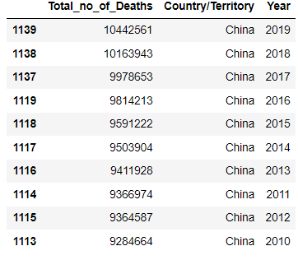
Top 10 Total_no_of_Deaths of all countries
We see that China is the only country in the top ten for most deaths in total for a given year . 2019 is the highest among years

Slide 15
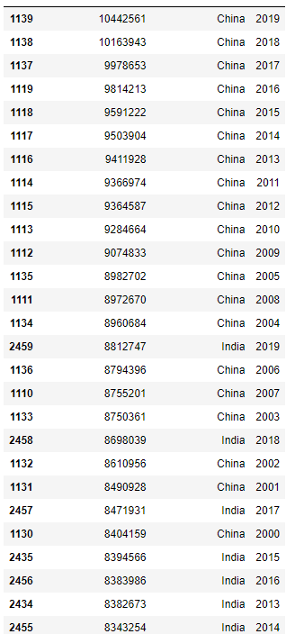
Top 60 Total_no_of_Deaths of all countries
We see that China and India are the only two countries in the top ten for most deaths in total for a given year . 2019 is the highest among years

Slide 16
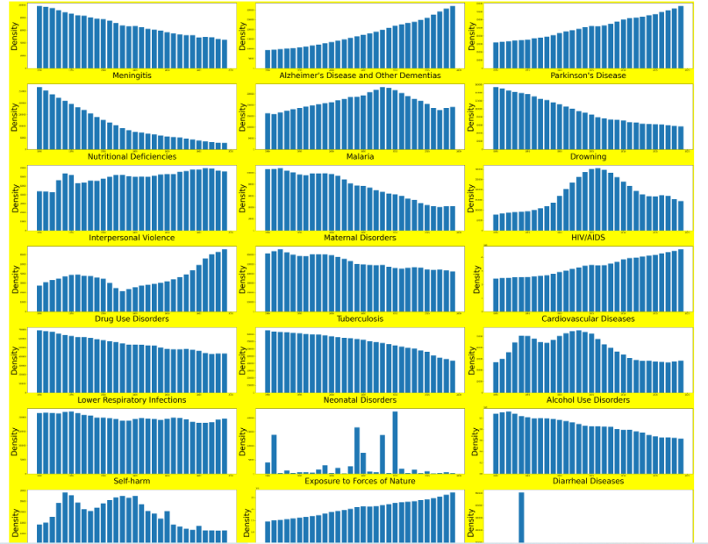
Visualizing Year and Causes of Disease

Slide 17
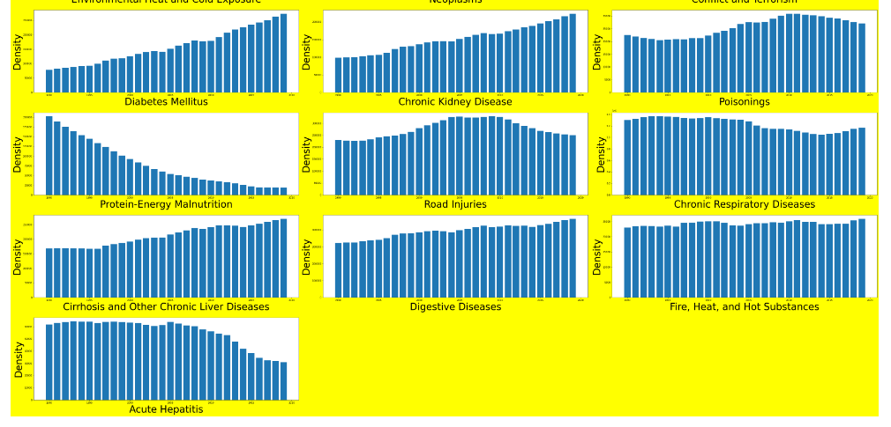
We see that the bar plot is the best in representing the trend , we see for the most part the level are uniform for all years , except for:
- Diabetes Mellitus,Neoplasm,Chronic Kidney Disease,Alzhelmers and Parkinson - increased
- Protein Malnutrition ,Tuberculosis ,maternal disorders, nutritional defeciancies & Drowning - decreased
- Conflict and terrorism ,Exposure to forces of nature are irregular as they are time or based on events which occurred during that year

Slide 18
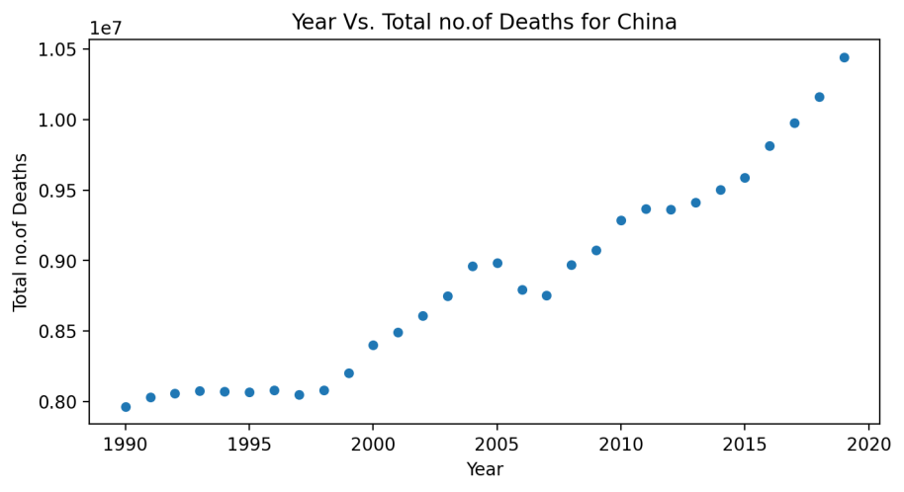
Studying the relationship between the causes and China as its having the most deaths compared to any other Country/Territory

Slide 19
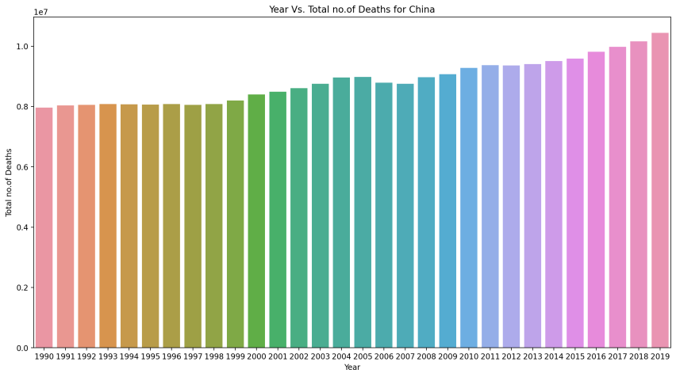
Rates are rising as the years

Slide 20
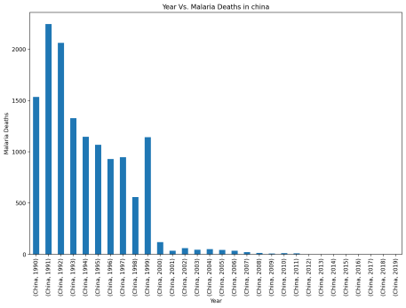
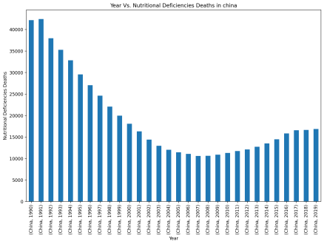
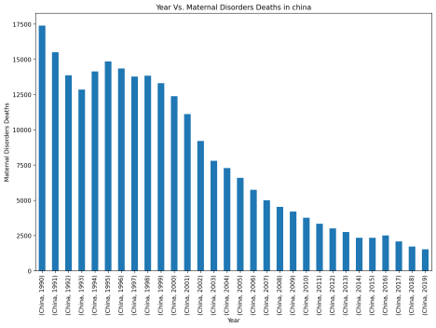
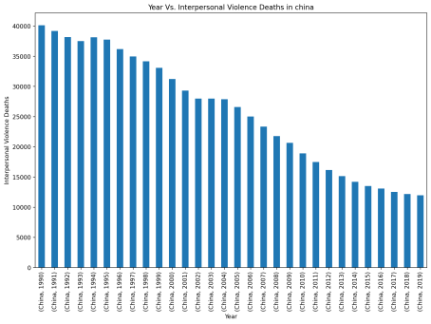

Slide 21
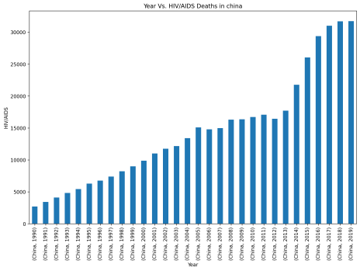
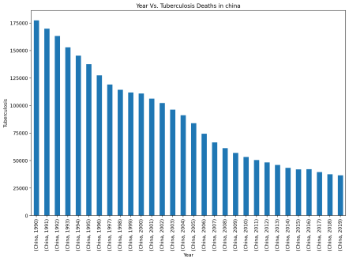
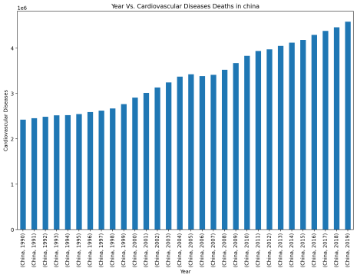
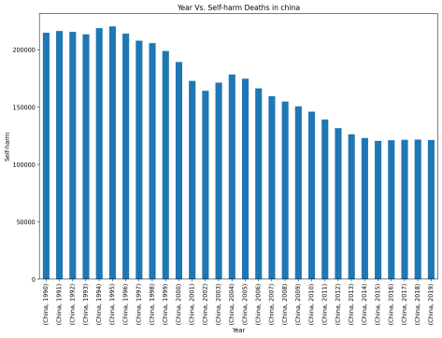

Slide 22
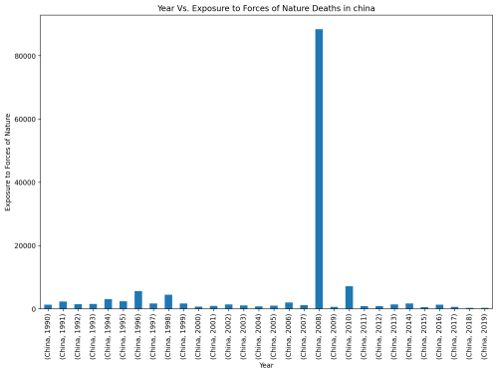
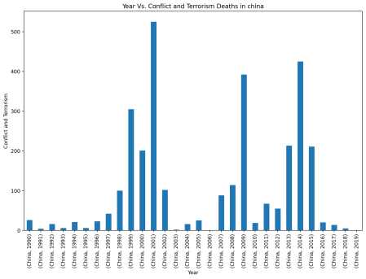
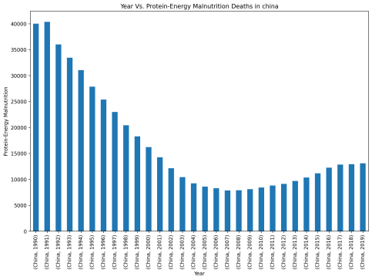
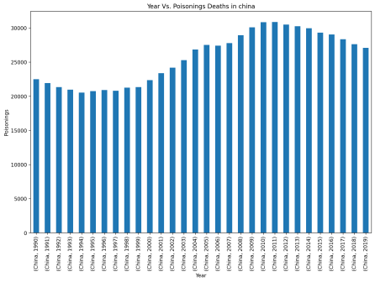

Slide 23
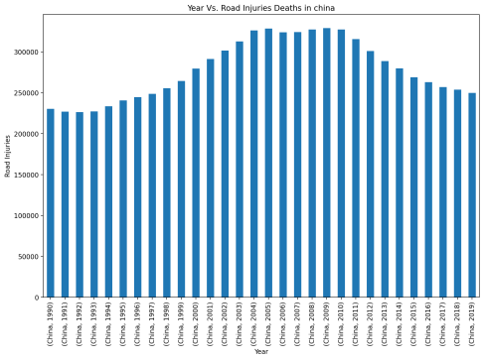
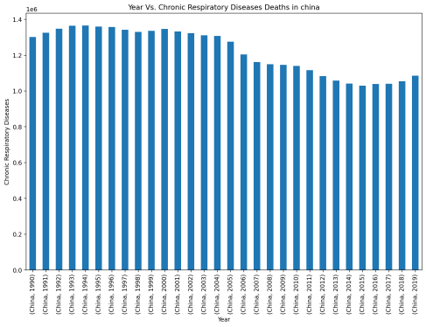

Slide 24
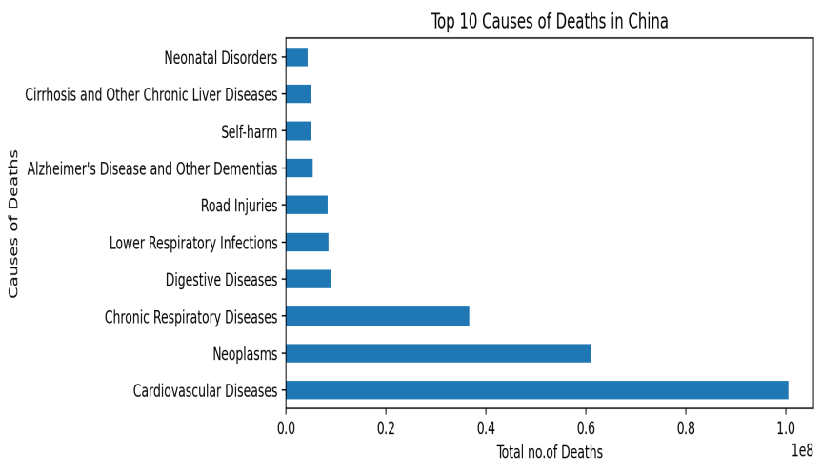

Slide 25
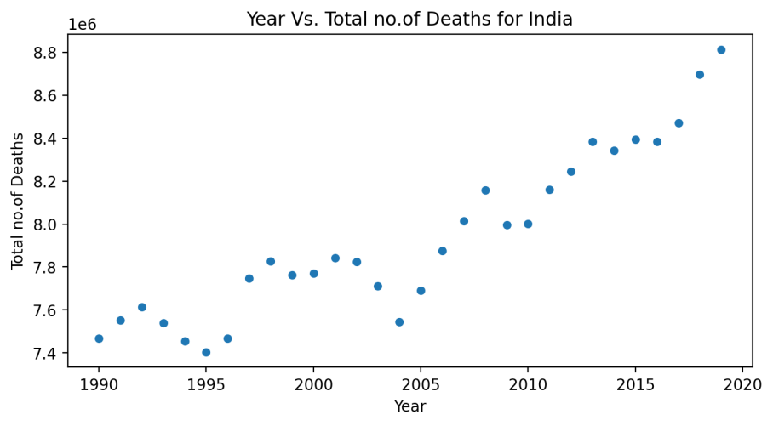
Studying the relationship between the causes and India as its having the most deaths compared to any other Country/Territory

Slide 26
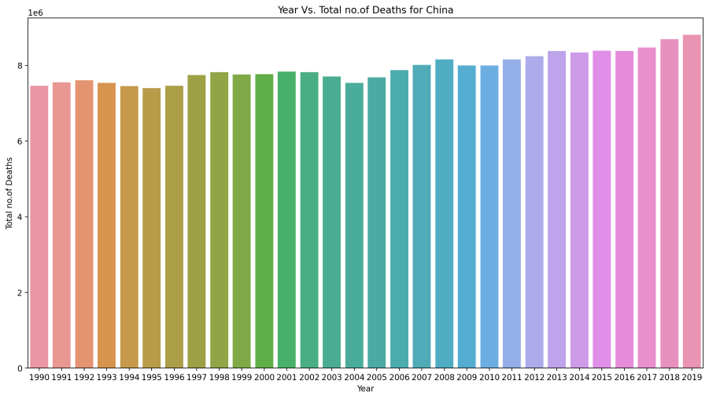
India as well we see the rates are increasing by the year

Slide 27
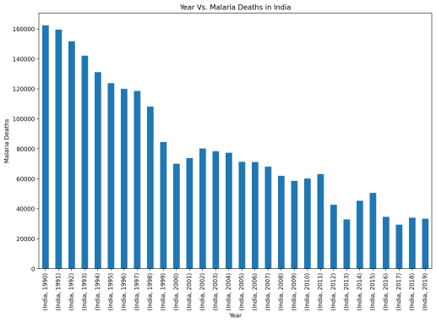
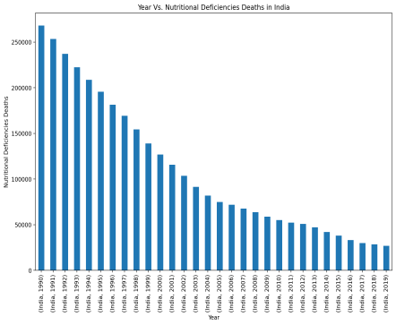
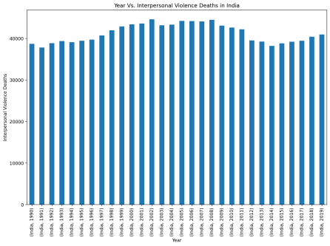
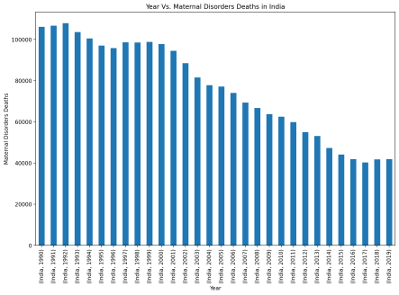

Slide 28
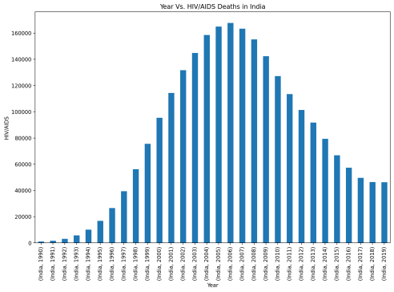
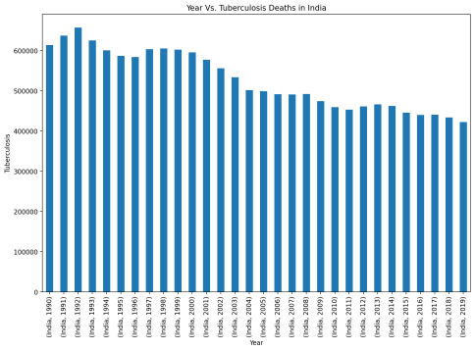
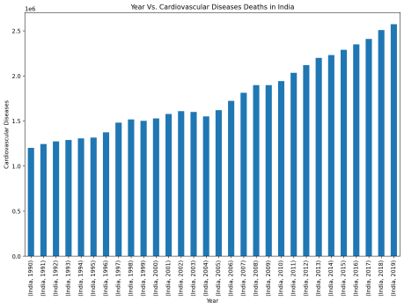
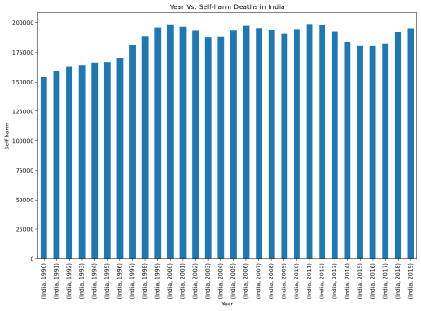

Slide 29
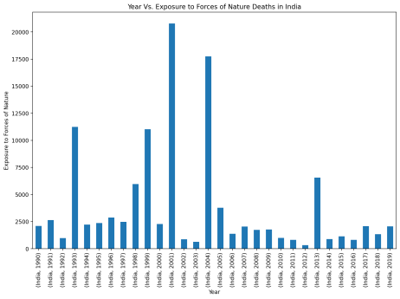
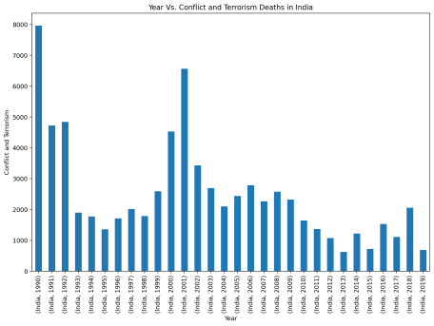
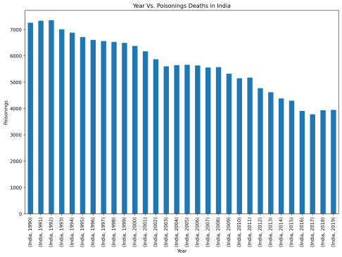
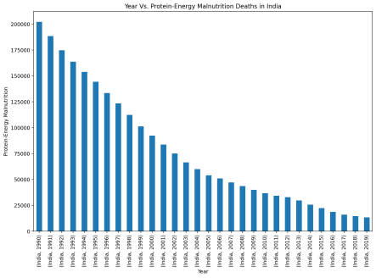

Slide 30
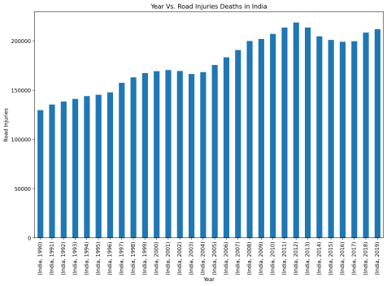
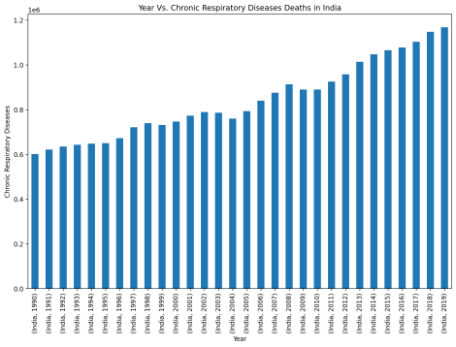

Slide 31
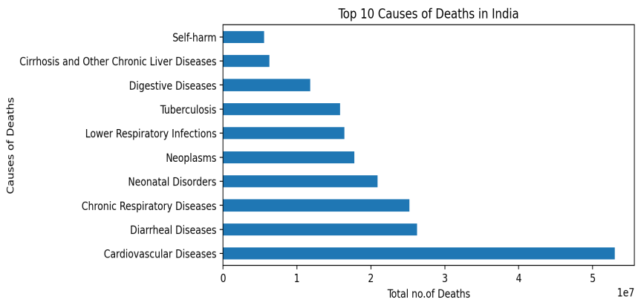

Slide 32
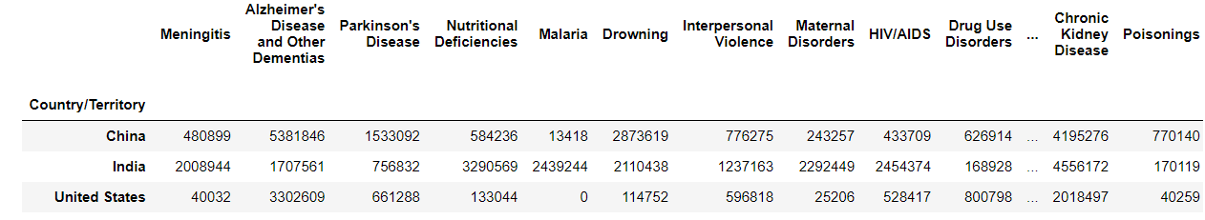
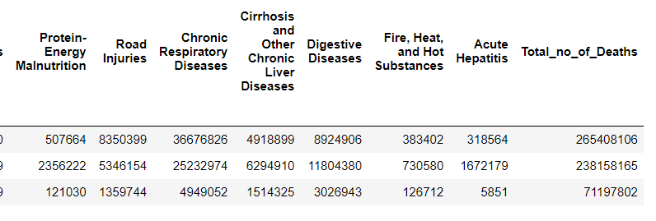
Top 3 Countries interms of "Total no.of Deaths" - For All the Years

Slide 33
We see that China tops the list and India and USA take 2nd and 3rd place
We see that the difference between deaths ain China and India are similar but the deaths in USA are less as compared to the 2
We also need to keep in mind that the 1st And 2nd Countries are the most populated countries in the world.

Slide 34
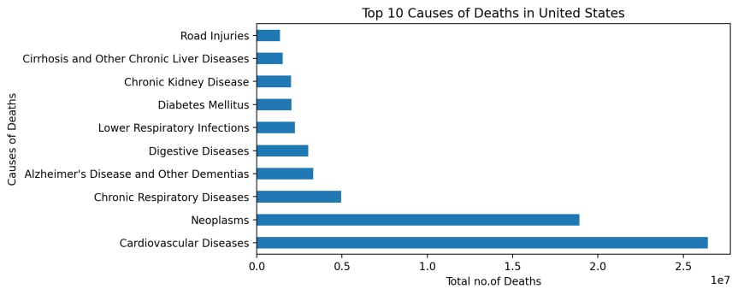
Top 10 Causes of Deaths in United States

Slide 35
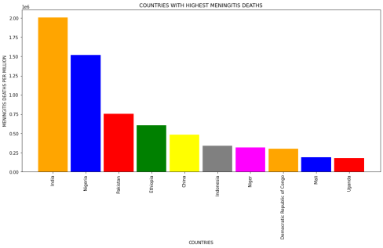
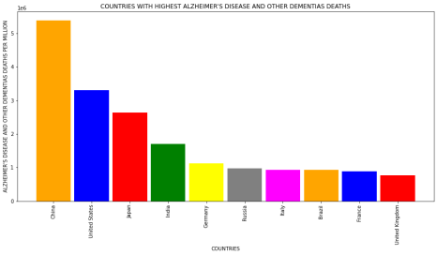
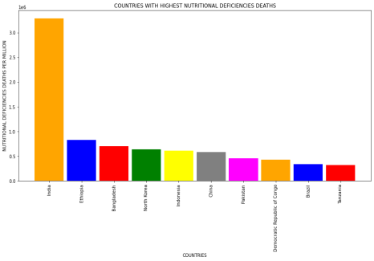

Disease SPECIFIC Country FATALITY FOR SPAN OF 30 YEARS

Slide 36





Slide 37





Slide 38





Slide 39





Slide 40





Slide 41





Slide 42




Slide 43

WHICH ARE THE COUNTRIES FACING OVERALL HIGHEST DEATHS DUE TO DISEASES

Slide 44

Highest deaths by disease overall

Slide 45


Slide 46
OBSERVATIONS
We see that cardiovascular diseases and neoplasms have 46% approx of all the deaths caused

Slide 47

Check Relationship of the features

Slide 48

Only relationship between the causes

Slide 49
Observations
We see protein energy malnutrition and nutritional deficiencies have 99% correlation which means the data is practically identical and that’s the highest correlation.
We see other causes have 90-98% correlation and most of them which have the same deaths year on year except for the others which are not related to medicinal causes have high multicollinearity and they have identical relationship with each other

Slide 50
Conclusion
Final Observations – China and India have historically had the most deaths and Cardiovascular is the cause of the highest death overall from 1990 to 2019

