Slide 1
ANNUAL DEATH RATES ANALYSIS BY AGE GROUP AND SEX
BY:
Trupthi Rajanna
Srinidhi Garlapati
Richitha Gutha
Sushmitha raj Banothu

Slide 2
ABSTRACT
In this project we are using a Kaggle dataset to analyze annual death rates across different age groups and by sex, focusing on uncovering demographic trends in mortality. By examining age-specific death rates for both males and females, the analysis seeks to highlight key differences in mortality across life stages and between sexes. Using Python's Pandas, Matplotlib and libraries, we conduct data cleaning, exploratory analysis, and create visualizations to present trends clearly. The findings offer valuable insights into age and sex-specific mortality patterns, which can inform healthcare resource allocation and targeted interventions for at-risk populations.

Slide 3
INTRODUCTION
Analyzing mortality rates by age group and sex provides crucial insights into public health trends, helping to identify vulnerable demographics and informing healthcare planning. Age and biological sex are key factors influencing mortality rates, with older age groups typically showing higher rates due to chronic illnesses, and notable differences between males and females attributable to various biological, social, and behavioral factors.
This project utilizes a Kaggle dataset on annual death rates segmented by age group and sex. Leveraging Python libraries such as Pandas for data processing and Matplotlib for visualization, the analysis aims to reveal patterns in mortality rates across demographic groups.
By examining these patterns, we can better understand demographic health dynamics and provide data-driven insights that can guide public health interventions and resource allocation.

Slide 4
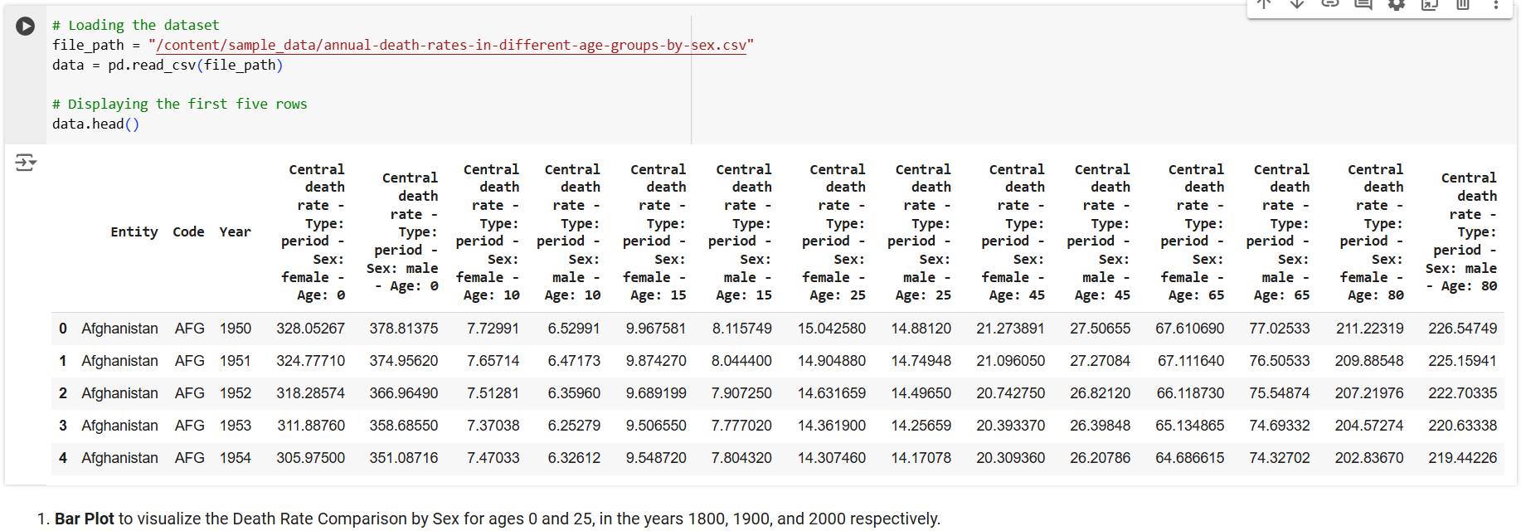
DATASET
ROWS:19923
COLUMNS:17
FIRST FIVE ROWS OF DATASET:

Slide 5
PREPROCESSING
Handling Missing Values:
Identifying Missing Data: If there were missing values in the "Death Rate" column, we filled them using the mean value of that column.
Data Type Conversion:
Year Conversion: The "Year" column was converted into a datetime format Encoding Categorical Variables
Sex Encoding: The "Sex" column, which had string values ('Female' and 'Male'), was converted into numerical values.This encoding is useful for certain statistical analyses and machine learning models.
Normalizing/Scaling Data:
Normalization: We applied the MinMaxScaler to the "Death Rate" column using scaling the values to a range between 0 and 1, which is especially useful when comparing data across different scales.
Saving the Cleaned Dataset:
After preprocessing, we saved the cleaned dataset to ensure the processed data is stored for further analysis or modeling.

Slide 6
LITERATURE REVIEW
S.NO | Author | Paper and Publication | Findings
1. | WHO (2022) | World Health Organization Global Health Data. World Health Organization | Found that older populations have significantly higher mortality rates due to chronic diseases such as heart disease, cancer, and respiratory illnesses.
2. | Lozano et al. (2013) | Global and Regional Mortality Patterns in the 21st Century. The Lancet | Identified that younger age groups in low- and middle-income countries face higher mortality from accidents and infectious diseases compared to high-income countries.
3. | Haghani & Borsboom (2021) | Using Python for Analyzing Demographic Mortality Data. Journal of Data Science and Analytics | Showed the effectiveness of Python-based analytics to study sex differences in mortality across different life stages. Emphasized the use of Python libraries like Pandas for data analysis.

Slide 7
METHODOLOGY/ARCHITECTURE
DATA COLLECTION
DATA PREPROCESSING
EXPLORATORY DATA ANALYSIS
DATA VISUALIZATION
ANALYSIS
REPORTING

Slide 8
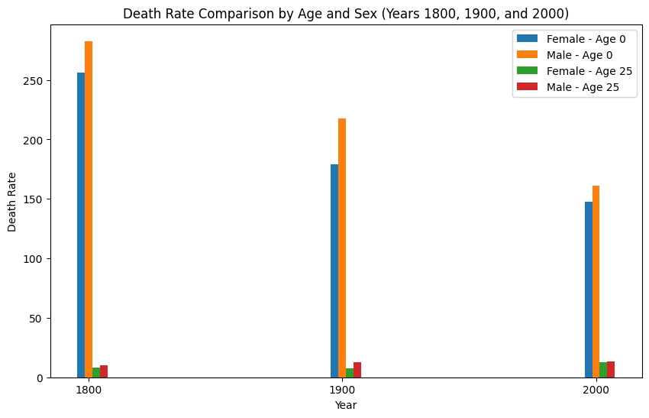
RESULTS

Slide 9
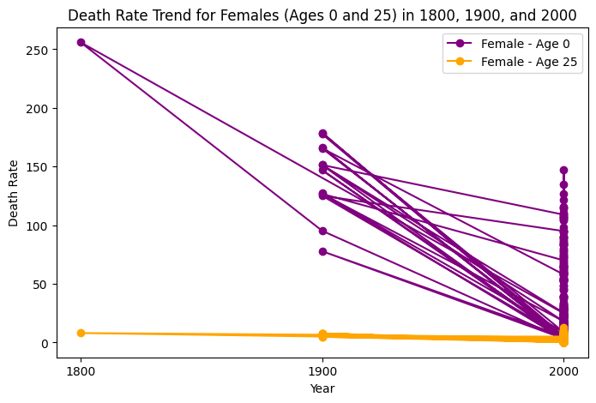

Slide 10
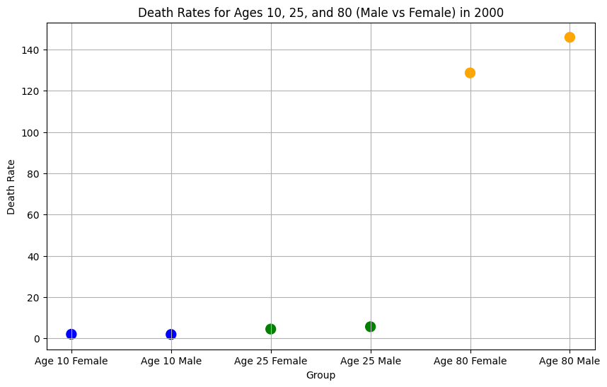

Slide 11
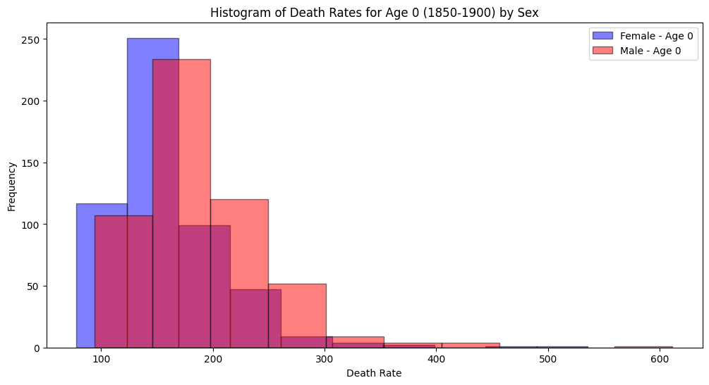

Slide 12
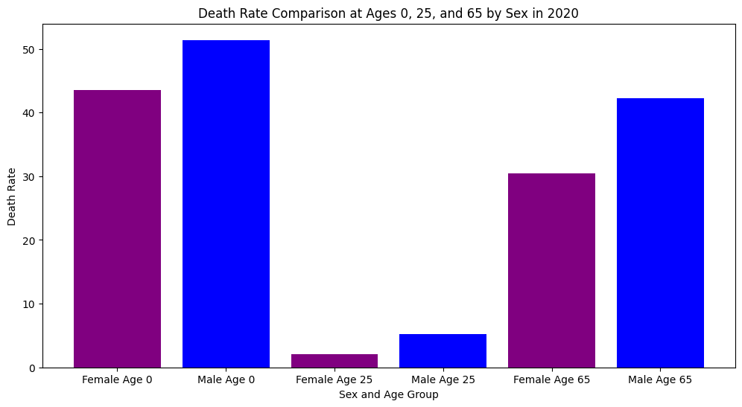

Slide 13
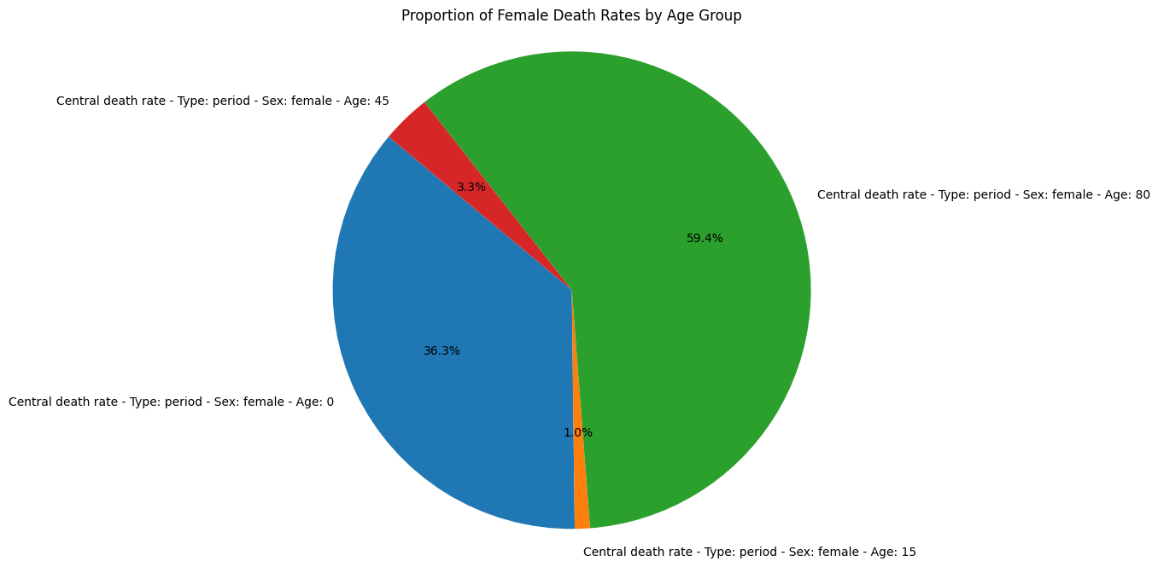

Slide 14
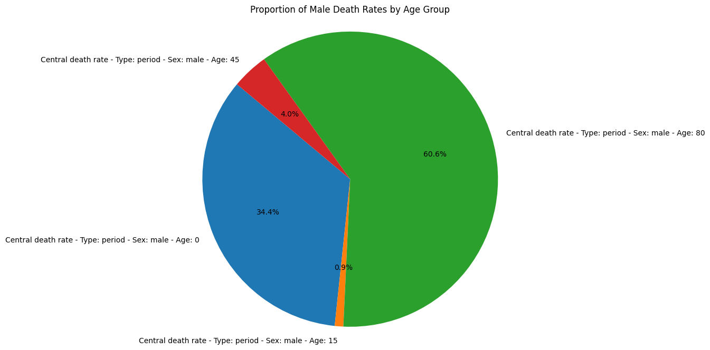

Slide 15
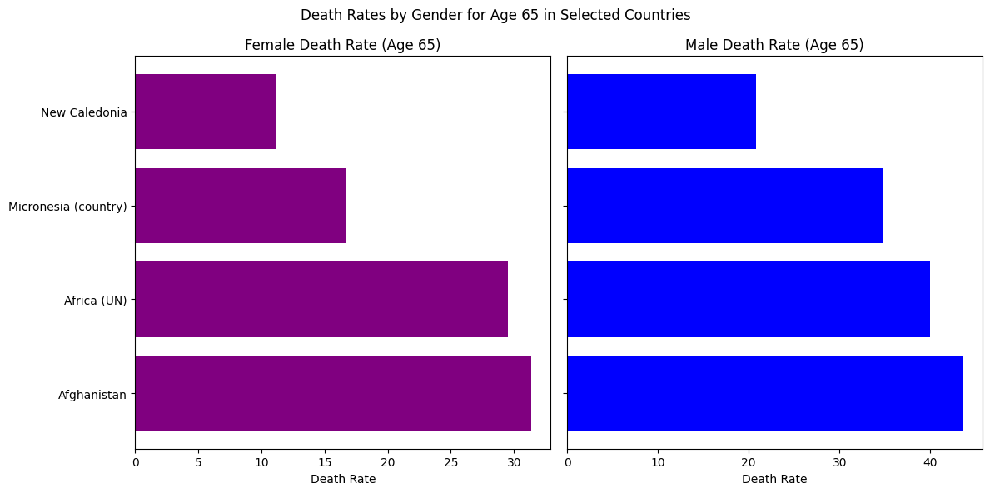

Slide 16
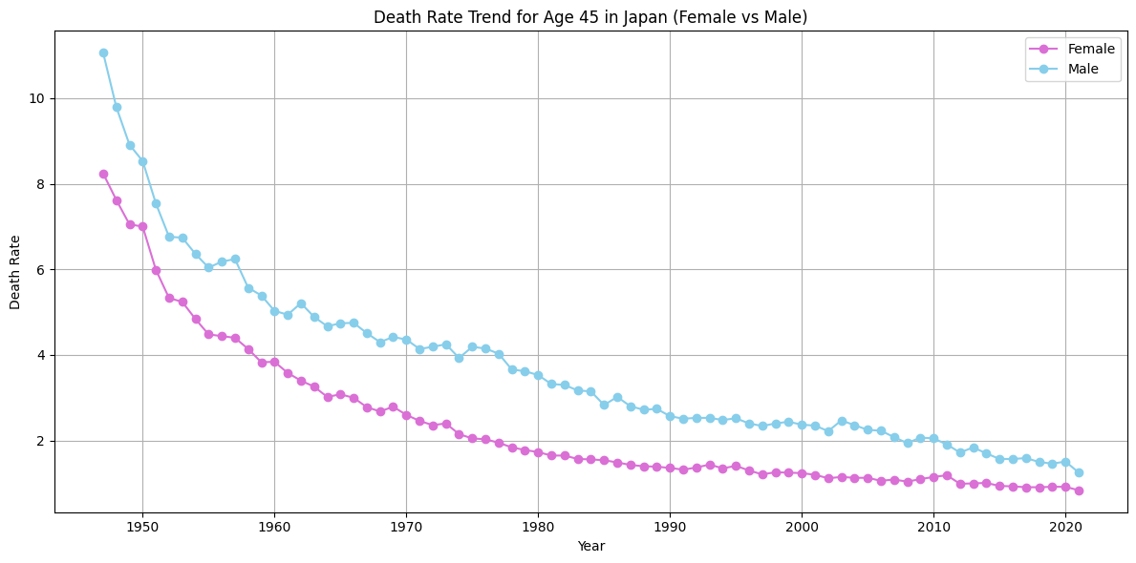

Slide 17
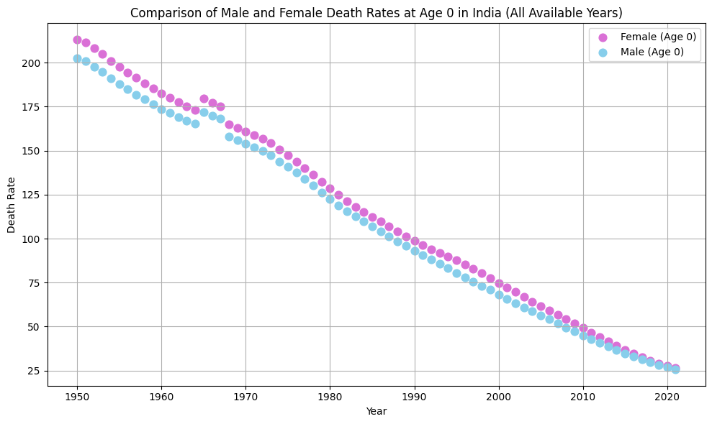

Slide 18
CONCLUSION
Our findings highlight that mortality rates tend to increase with age, especially in older populations, due to chronic health conditions such as heart disease and cancer. Additionally, the analysis reveals that males generally have higher mortality rates compared to females, which can be attributed to a combination of behavioral, environmental, and biological factors.
Visualizations such as bar charts, line graphs, histograms, pie-charts and scatter plots offered clear representations of these trends, making the data more accessible and interpretable. These insights are valuable for healthcare providers and policymakers in identifying at-risk demographic groups, allocating resources more effectively, and developing targeted public health interventions.
Overall, this project demonstrates the importance of data-driven analysis in understanding complex public health issues and provides a foundation for further research and policy planning aimed at reducing mortality disparities across different age groups and sexes.

Slide 19
REFERENCES
https://www.kaggle.com/datasets/mahdiehhajian/life-expectancy-around-the-world?resource=download
https://pypi.org/project/pandas/
https://matplotlib.org/stable/index.html

Slide 20
Github Repository Code
Github Repository link: https://github.com/RichithaGutha/Group5PythonProject
Github Code Link: https://github.com/RichithaGutha/Group5PythonProject/blob/main/MidTerm_Group5.ipynb
Dataset Link: https://github.com/RichithaGutha/Group5PythonProject/blob/main/annual-death-rates-in-different-age-groups-by-sex.csv

Slide 21
THANK YOU

