Slide 1
Breast Cancer Classification Using Machine Learning Techniques
By:
Richitha Gutha
Srinidhi Garlapati
Trupthi Rajanna
Sushmitha Raj Banothu

Slide 2
Abstract
This project uses machine learning to classify breast cancer cases as either malignant (cancerous) or benign (non-cancerous). Early and accurate diagnosis is important for starting treatment quickly, which can save lives. The study uses the Breast Cancer Wisconsin dataset with information on 569 patients and 33 features describing tumor characteristics like size and shape. Machine learning models, Decision Tree, Naïve Bayes, Logistic Regression and Random Forest were tested to see how well they can classify cases. Their performance was compared using three measures: Accuracy, Precision, and Recall. This shows how machine learning can help doctors make faster and more accurate diagnoses.

Slide 3
Introduction
By enabling automated analysis of medical data for diagnostic and treatment suggestions, machine learning is transforming the healthcare sector. Millions of new cases of breast cancer are identified worldwide each year, making it one of the most prevalent and fatal malignancies. By enabling prompt intervention and treatment, accurate and early diagnosis can save lives.
The goal of this study is to employ machine learning models to forecast, using patient data, whether a breast tumor is benign (non-cancerous) or malignant (cancerous). In particular, we assess how well the Decision Tree, Naïve Bayes, Logistic Regression and Random Forest models perform in the classification of instances of breast cancer. This research attempts to shed light on how machine learning might enhance conventional diagnostic methods and enhance results by utilizing medical datasets and sophisticated algorithms.

Slide 4
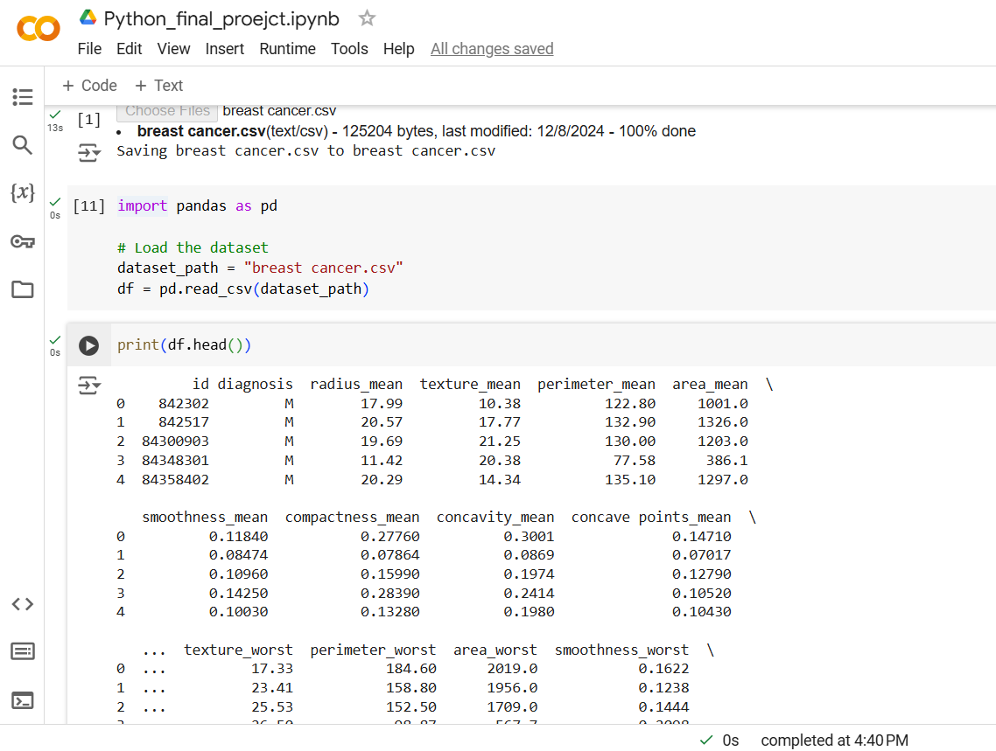
Dataset
Rows: 569, Columns: 33
First few rows of dataset:

Slide 5
Preprocessing
Dataset Exploration: Loaded the dataset to understand its structure and key attributes.
Data Cleaning: Removed Irrelevant Attributes: Eliminated columns that do not contribute to the analysis or prediction.
Encoding: Applied encoding to the diagnosis column to convert categorical data into numerical values.
Feature Engineering: Normalized or scaled numerical features to ensure consistency and improve model performance.
Handling Missing Values: Checked for missing values and applied strategies (e.g., imputation or removal).

Slide 6
Literature Review
S.No | Author | Paper and Publication | Findings
1. | W. Haijin, M. Tang, and H. Wang (2016) | "A Comparative Study of Machine Learning Algorithms for Breast Cancer Diagnosis" | Compared various classifiers (e.g., SVM, logistic regression) for breast cancer detection.
2. | M. Y. Tavassoli and L. J. Devilee (2003) | "Pathology and Genetics of Tumours of the Breast and Female Genital Organs" | Discussed the importance of using clinical data such as tumor size, grade, and lymph node status for classification models.
3. | A. F. Ozenne et al. (2019) | "The impact of machine learning in breast cancer diagnosis" | Explored the use of machine learning algorithms like decision trees, neural networks, and ensemble methods for breast cancer diagnosis.

Slide 7
Architecture/Methodology
Data Collection
Data Exploration
Preprocessing
Data Visualization
Model Selection
Training
Reporting
Analysis

Slide 8
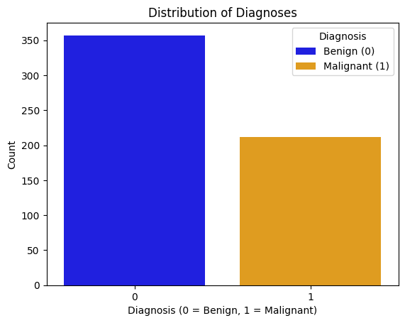
Results: Data visualization
Bar chart to show the proportion f Malignant M and benign B cases in dataset.

Slide 9
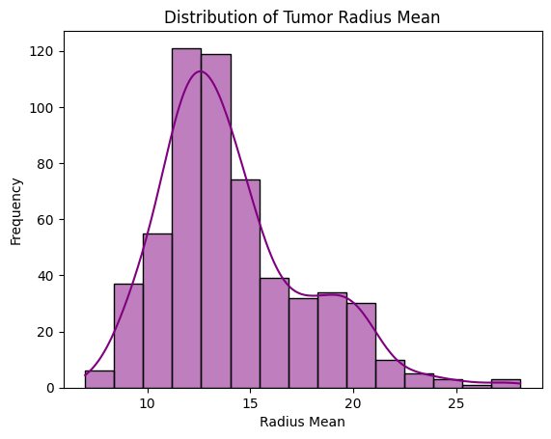
Histogram of key features.Visualizing the distribution of tumor radius

Slide 10
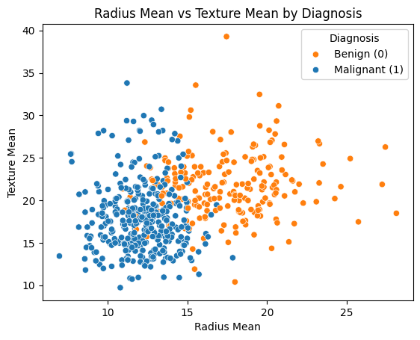
Scatterplot of two features scatter plot with diagnosis as the hue to see how features vary between classes

Slide 11
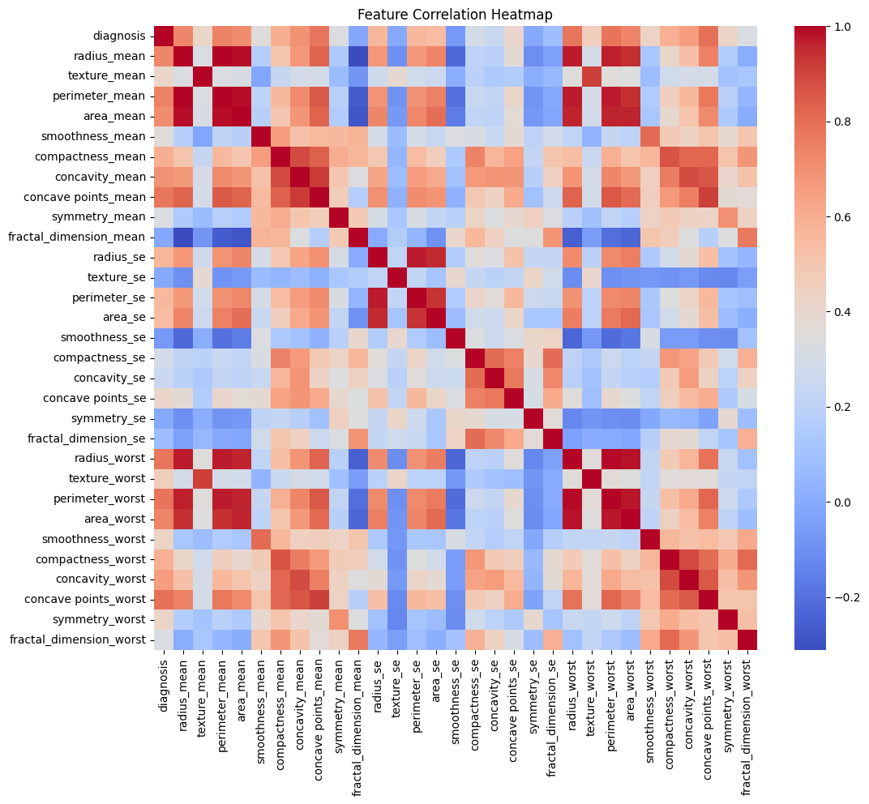
Heatmap of correlations to explore relationships between features. This helps identify highly correlated features

Slide 12
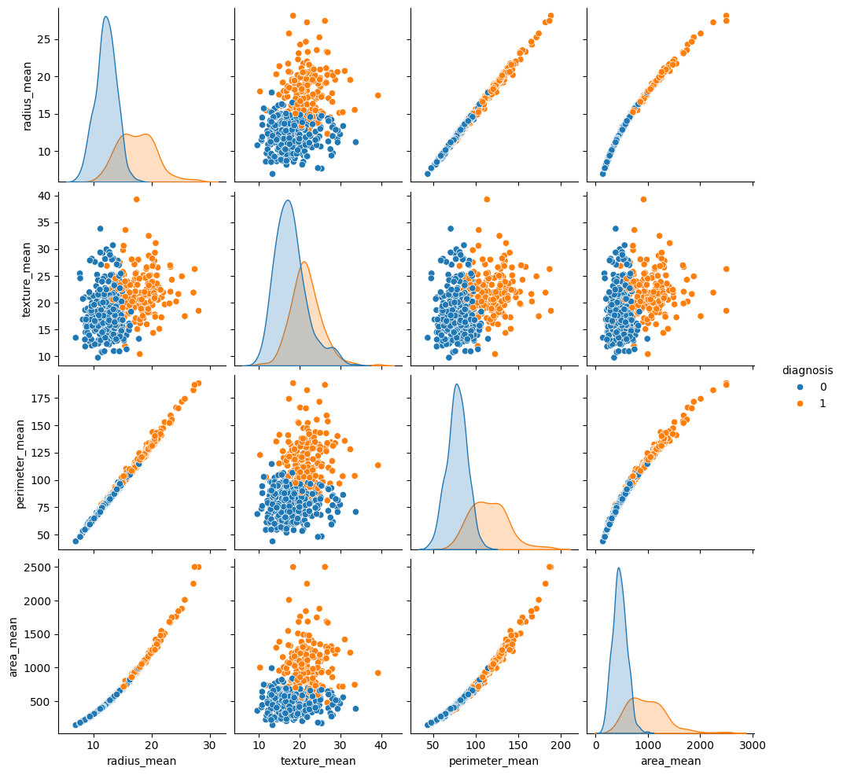
Pair Plot for selected features visualizing relationships between a few selected features

Slide 13
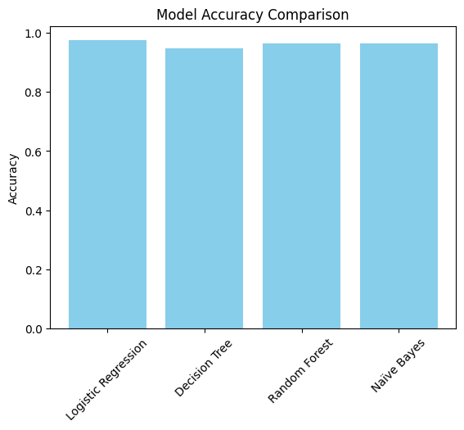
Results: Comparision of Models

Slide 14
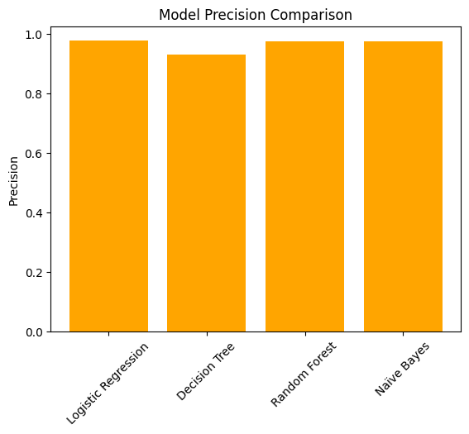

Slide 15
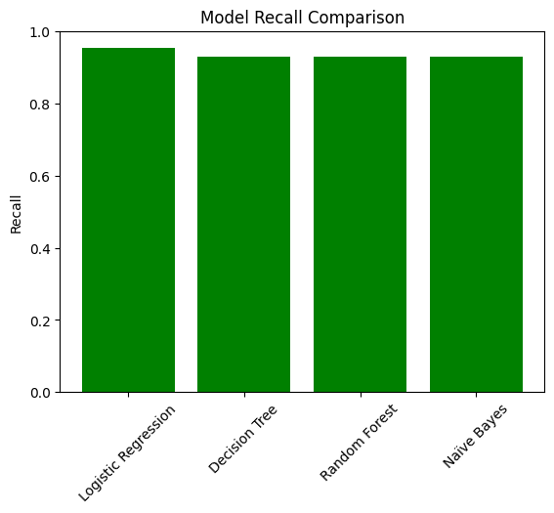

Slide 16
Conclusion
Logistic Regression emerged as the most reliable model, achieving the highest accuracy (97.37%), precision (97.62%), and recall (95.35%).Random Forest and Naïve Bayes also performed well, with identical precision and recall scores. Decision Tree, though interpretable, had slightly lower accuracy and precision compared to Random Forest.
For clinical applications where minimizing missed malignant cases is critical, Logistic Regression is the best choice.Random Forest is a close second and is suitable for robust and scalable implementations.

Slide 17
References
https://pypi.org/project/pandas/
https://matplotlib.org/stable/index.html
https://www.kaggle.com/datasets/uciml/breast-cancer-wisconsin-data

Slide 18
Github Repository Code
Github Repository Link: https://github.com/RichithaGutha/Python-Final_Project
Github Code link: https://github.com/RichithaGutha/Python-Final_Project/blob/main/Python_final_proejct%20_implementation.ipynb
Dataset Link: https://github.com/RichithaGutha/Python-Final_Project/blob/main/breast%20cancer.csv

Slide 19
THANK YOU

