Slide 1
Agent Memory
Engineering
AI DEV NEW YORK 2026 · WORKSHOP · DRAFT
Towards continual learning in token space.
Build an agent that gets better at its job between sessions, without touching the weights.
Richmond Alake · Director of AI Developer Experience, Oracle
01
Notes:
Welcome. Set expectations: seven short modules, one lab agent built in five steps, and an eval at the end that shows whether it actually improved.

Slide 2
Seven modules, one agent that learns between sessions
OPEN
01
02
03
Opening
Continual learning
The 4 Rs
Retain
Agents that start from zero, and what you leave with
Weights versus tokens, and the outer loop
Retain, reuse, refine and recall across sessions
Extracting memory from execution traces
04
05
06
07
Refine
Evolve
Recall and reuse
Observable learning
Consolidation, conflict resolution, forgetting without deleting
Workflows to skills, persona and entity memory over time
The right memory in context when it matters
Evals between sessions and the memory changelog
02
Notes:
Labs sit at the end of modules 02 to 07. Breaks: [after 03] and [after 05].

Slide 3
What you leave with
OPENING
01
02
03
04
A working agent
A mental model
Patterns
Observability
Measurably better across sessions, with no weight updates.
Continual learning in token space, and how it differs from fine-tuning.
Extraction, consolidation, decay and retrieval you can apply to your own stack.
What changed, why, and whether performance improved.
03
Notes:
Come back to this slide at the close and check each one off.

Slide 4












The same agent, one session later
THE AGENT LOOP · WITHOUT MEMORY
User
Application
Agent harness
Context window
LLM
Tool
SESSION 1 · THE AGENT ANSWERS
“Book Rosa’s for two, Friday 7pm.”
Chat UI sends the message to the agent
Builds the prompt and runs the loop
System prompt, tools, this message
Plans: check availability, then book
book_table: Rosa’s, Fri 19:00, 2
Answer: “Booked. Friday 7pm, table for two.”
Session ends. The context window is cleared.
SESSION 2 · THE AGENT CANNOT CONTINUE
“Move it to Saturday.”
New session, new thread, nothing carried over
Builds the prompt from scratch
Prompt, tools, this message. No booking.
“It”? Which booking? Which venue?
Nothing to call
Answer: “Sorry, I have no record of a booking.”
04
Notes:
Build the system first: user, application, agent harness, context window, LLM, tool. Click: session 1 runs left to right and works, because everything the agent needs is in the request. Click: the session ends and the context window is cleared; it was the only state the system had. Click: session 2. The user refers back to the booking and every component downstream of the window has nothing to work with. No model upgrade fixes this; it is a memory problem, and the next slide adds the memory.

Slide 5





Memory feeds the window and learns from each answer
THE AGENT LOOP · WITH MEMORY
User · next session
Context window
Reason · LLM
Act · tool
Answer
Query plus recalled booking
“It” is booking #8812 at Rosa’s
Calls update_booking for #8812
Moved to Saturday, 7pm.
Move it to Saturday.
recall
#8812
write path:
trace + answer
MEMORY PROCESS · REFINEMENT
Database · memory store
Consolidate
Deduplicate
Extract · LLM
Bookings, preferences, past turns, versions
Merge with what exists; keep a version
Drop facts already stored
Pull durable facts from the turn
Iteration 2 now works: “move it to Saturday” resolves to booking #8812 at Rosa’s, 7pm.
05
Notes:
Same loop, two additions. The read path: the database feeds the context window before the model reasons. The write path: the output goes through extraction, deduplication and consolidation before it lands in the store. Skip the refinement and the store fills with duplicates and contradictions, which is how memory gets worse over time.

Slide 6
MODULE 01
Continual learning
in token space
Improve the agent by engineering what it remembers, not what it weighs.
06
Notes:
Most agents today start every session from zero. This module sets up the alternative to retraining.

Slide 7
What continual learning asks of an agent
01 · CONTINUAL LEARNING
LEARN
KEEP
REPEAT
From its own experience
What it already does well
Session after session
Each run leaves something behind that makes the next run better.
New lessons do not overwrite old competence.
One update is not continual learning. It has to keep happening.
07
Notes:
Traditional continual learning means updating weights: slow, expensive and hard to audit. Hold these three requirements up against both routes on the next slides.

Slide 8


Memory engineering has two ends and two bridges
01 · CONTINUAL LEARNING
FRONT END · TOKEN SPACE
BACK END · WEIGHT SPACE
Front-end memory engineering
Back-end memory engineering
Changes what the model sees: memory in databases and files, stored, retrieved, refined and augmented
Data path
Changes what the model is: supervised fine-tuning, LoRA and QLoRA, RL post-training
Traces and memory records become curated training sets
Who works here
Activation path
Who works here
Database engineers, information retrieval and search, agent engineers
The KV cache: prefix caching, trained caches
Machine learning engineers and evaluation specialists
A single fine-tuning run is not continual learning. Continual learning repeats on new experience and must keep what it learned last time.
08
Notes:
Front-end and back-end memory engineer are roles I expect to see on job specs in 2027. Most teams are at the front end today; the back end is where they get pushed once traces pile up and the model still has not changed. LangSmith shipped trace-to-fine-tuning in its fine-tuning feature this autumn: the data path is now a product.

Slide 9
Two routes to an agent that improves
01 · CONTINUAL LEARNING
WEIGHT SPACE
TOKEN SPACE
What changes
The model's parameters
What the agent retains and recalls into context
Time to update
A training run
The next session
Cost
GPUs, curated data, evaluation runs
Storage and extraction calls
Auditability
Opaque
Every memory links to its source trace
Rollback
Redeploy an older checkpoint
Supersede or restore a record
Scope
One model for everyone
Per user, team or agent
Main risk
Catastrophic forgetting
Stale or poisoned memories
09
Notes:
This workshop takes the right-hand column. The two are not exclusive: memory records and traces become the dataset if you later fine-tune.

Slide 10
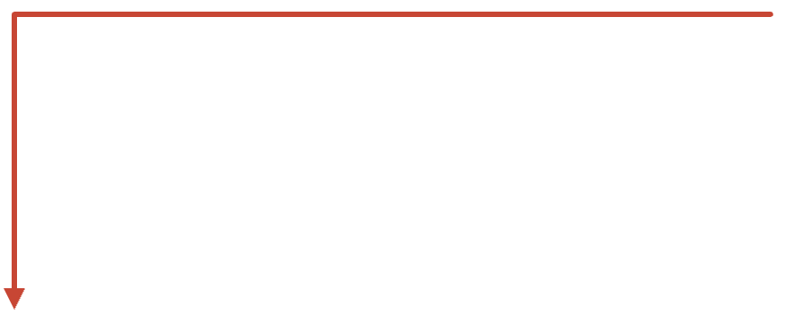
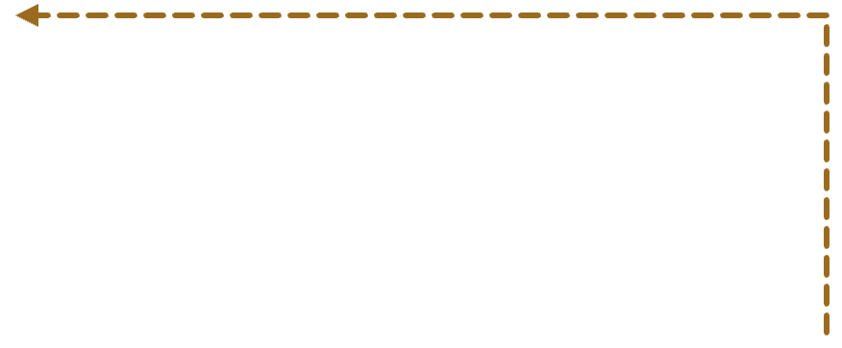

An inner loop that acts, an outer loop that learns
01 · CONTINUAL LEARNING
Inner loop · the agent
repeat on new experience
Perceive, reason, act, per task
1 Capture traces
2 Extract lessons
3 Change something
4 Evaluate
Every run, every tool call, every outcome
Distil what worked and what failed
Memory, the harness, or the model
Did performance improve?
The intelligence plane
Makes the loop observable: what changed, why, and whether it helped
10
Notes:
The outer loop is the framing Harrison Chase uses: capture traces, extract learnings, change something, measure. My addition: every step is a read or a write against memory, so the store and the plane that makes changes observable are learning infrastructure, not plumbing.

Slide 11
MODULE 02
The 4 Rs
Retain, reuse, refine and recall: the operating vocabulary for the rest of the workshop.
11
Notes:
Quick module. The 4 Rs, then how they line up across a session boundary.

Slide 12
The 4 Rs of memory engineering
02 · THE 4 RS
R1
R2
R3
R4
Retain
Reuse
Refine
Recall
Decide what is worth writing, and write it before the window clears.
Serve the same knowledge again instead of paying to re-derive it.
Consolidate, correct and promote as evidence arrives. Forget, don’t delete.
Bring back the right memory at the right moment, ranked by relevance and recency.
12
Notes:
The 4 Rs are the operating vocabulary for the rest of the session. Modules 03 to 06 take them in turn.

Slide 13

The 4 Rs across a session boundary
02 · THE 4 RS
SESSION N
R1 · IN SESSION
R3 · BETWEEN SESSIONS
R4 · SESSION N+1
R2 · SESSION N+1
Agent runs
The trace is captured.
Retain
Refine
Recall
Reuse
Extract from the trace and write to the store.
Consolidate, resolve conflicts, decay.
Bring the right memory back into context.
Skip re-deriving what is already known.
Retain and recall run inside the loop. Refine runs between sessions. Reuse is where the improvement shows up.
13
Notes:
Draw the boundary between sessions on the whiteboard. Everything that makes session N+1 better than session N has to cross it through memory.

Slide 14
One agent, built in five steps
02 · LAB
STEP 1
Run the agent across three sessions with no memory and score it
Baseline
STEP 2
Extract memories from execution traces into the substrate
Retain
STEP 3
Add a consolidation, conflict and decay pass between sessions
Refine
STEP 4
Wire retrieval into context assembly
Recall
STEP 5
Rerun the eval suite and read the memory changelog
Measure
Lab repo: [link] · Memory substrate: [name] · Example agent: a returns support agent
14
Notes:
The baseline matters: without it there is nothing to show improvement against.

Slide 15
MODULE 03
Retain
Turning execution traces into memory.
15
Notes:
The trace is the raw experience. Retain decides what is worth keeping from it.

Slide 16
What an execution trace gives you to keep
03 · RETAIN
TRACE SIGNAL
BECOMES
MEMORY TYPE
A tool sequence that succeeded
Workflow memory
Procedural
A failed call, then the fix
A lesson or guideline
Procedural
A user correction
A preference or rule
Semantic
People, organisations, things
Entity facts
Semantic
The run as a whole
An episode summary
Episodic
16
Notes:
Conversation is one source; the trace is the richer one. Errors and retries are the most underused signal: they are where the agent learns what not to do.

Slide 17

One exchange in, six typed memories out
03 · RETAIN · WORKED EXAMPLE
THREAD t_2041 · TRAVEL AGENT · TURNS 1 TO 3
preference
Vegetarian; prefers an aisle seat
Semantic
Entity memory
user: u_314 · turn 1
user
Book me for Web Summit in Lisbon, 9 to 12 November. Hotel near the venue, under €200 a night. I’m vegetarian and I like an aisle seat.
trip
Lisbon trip; hotel near venue, under €200
Semantic
Entity memory
trip: lis-nov · 9 to 12 Nov
assistant
extract
fact
Ana, a teammate, joins on 11 November
On it. Any timing preferences for the flights?
Semantic
Entity memory
entity: ana · trip: lis-nov
user
rule
Never book flights before 9am
Nothing before 9am, the 6am flight last time was a disaster. Ana from my team joins on the 11th. Use the company card ending 4417.
Procedural
Workflow memory
user: u_314 · turn 3
episode
The 6am flight on the last trip went badly
Episodic
Summary memory
ttl: 180 days · turn 3
DROPPED, NOT STORED
rule
Bill work travel to the company card
The card number and the pleasantries. Payment details never become memory.
Procedural
Workflow memory
org policy · no card number
17
Notes:
Extract in action, on a travel agent. Left: three turns. Click: extraction runs with your rules. Click: six typed memories come out. Read the badges: the memory type, semantic, episodic or procedural, and the implementation it is written to, entity, workflow or summary memory. Preferences and trip facts are semantic and land in entity memory; the no-flights-before-9am rule and the company card policy are procedural, so they go to workflow memory and shape how the agent books; the bad 6am flight is an episode with a 180-day TTL, and it is the evidence behind the rule. Click: what was dropped. The card number never becomes memory, which is a write-path rule, not a hope. Every row carries a scope and the turn it came from, which is what makes forget, don't delete possible.

Slide 18
Every record carries its provenance
03 · RETAIN
Type and scope
Source trace
Confidence
What kind of memory, and who it belongs to.
The run and step it came from.
How much evidence supports it.
Validity
Status
Usage
valid_from and valid_to, not overwrite.
Active, decayed, superseded or archived.
When it was last recalled, and how often.
18
Notes:
These fields are what make refine, forgetting and evals possible later. Skip them at write time and you cannot add them back.

Slide 19
MODULE 04
Refine
Consolidate, resolve conflicts, forget without deleting.
19
Notes:
Without refine the store fills with duplicates and contradictions, and memory makes the agent worse over time.

Slide 20
Consolidation: three operations
04 · REFINE
01
02
03
Merge
Abstract
Promote
Duplicates and near-duplicates become one record with combined evidence.
Many similar episodes become one rule or procedure.
Memory with enough evidence moves up a tier.
20
Notes:
Run consolidation between sessions, not in the hot path. Abstract is where episodic memory turns into procedural memory.

Slide 21
Every new memory gets a decision
04 · REFINE
ADD
UPDATE
SUPERSEDE
IGNORE
New
More detail
Contradiction
Already known
Nothing overlaps. Write it.
Same fact, richer. Merge in.
Close the old record with valid_to and open the new one.
Or below the confidence threshold. Log it, do not write it.
Example: refunds over £50 need approval → superseded by the £100 threshold from 1 November
21
Notes:
Decide on recency, source authority and confidence. Notice no branch deletes anything.

Slide 22

Forget, don’t delete
04 · REFINE
STATUS
STATUS
STATUS
Active
Decayed
Archived
Eligible for recall.
Age, low recall, low importance. Out of recall, still stored.
Kept for audit, rollback and evals.
Recall reads active records. Audit, rollback and evals read everything. Use reinforces a memory; neglect lets it fade.
22
Notes:
Superseded records sit alongside archived ones with a pointer to what replaced them. Deleting would destroy the evidence of what the agent learned and when.

Slide 23
MODULE 05
Evolve
Memory that changes shape as the agent works: workflows to skills, persona and entity memory over time.
23
Notes:
Refine keeps the store clean. Evolve is where the store changes what the agent is and knows.

Slide 24
Continual learning without touching the weights
05 · EVOLVE · WORKFLOWS TO SKILLS
01
02
03
04
05
Workflow memory
Score
Distil and validate
Skillbox
Monitor and demote
Frequency × success × recency, over canonical trajectories.
Promoted skills load before planning, above raw workflows.
Every run stored with steps, outcome and lesson.
An LLM drafts a skill; a gate checks tools exist and rules hold.
Drift or failures send a skill back down.
Workflow memory that proves itself becomes a skill. That is learning in token space, and it produces the dataset the back end needs later.
This is the promotion design in MemoRizz: workflow memory feeds a skillbox, with a validation gate and a demotion path.
24
Notes:
Frequency alone is not enough: a common path can be a common failure. Score on success and recency too, and always keep a demotion path.

Slide 25
Persona memory evolves with interaction
05 · EVOLVE
V1 · CONFIGURED
SIGNAL
V2 · PROPOSED, VALIDATED
SIGNAL
V3
Users ask for shorter replies
Escalations follow unclear policy
New standing rule
Tier 1 support agent
Repeated across sessions.
Tone: concise, warm
State the refund policy before options.
Tone formal. Never promise refunds.
Seen in traces.
Rules unchanged.
Proposed from interaction, validated by the harness, versioned. The previous version stays.
25
Notes:
Persona is the agent's role, tone and standing rules. Interaction proposes changes; a validation gate approves them; each version is kept, so you can see how the agent's behaviour drifted and roll back.

Slide 26
Entity memory evolves as the world changes
05 · EVOLVE
ENTITY
FACT
VALID_FROM
VALID_TO
SOURCE
STATUS
Acme Ltd
plan = pro
2026-03-02
2026-08-31
ticket #0871
superseded
Acme Ltd
plan = enterprise
2026-09-01
null
ticket #1042
active
Acme Ltd
contact = [name]
2026-10-14
null
trace t_207
active
Current values for recall, full history for audit and evals.
26
Notes:
Entity facts change. Update the fact, close the old version, keep both. The agent answers with current values and can explain the history when asked.

Slide 27
MODULE 06
Recall and reuse
The right memory, in context, when it matters.
27
Notes:
Everything so far is wasted if the wrong memories reach the window.

Slide 28
From task to context window
06 · RECALL
01
02
03
04
05
Filter
Retrieve
Rerank
Budget
Assemble
Scope and active status.
Vector plus keyword.
Relevance, recency, strength.
Fit the token allowance.
Stable first, volatile last.
28
Notes:
Stable memories such as persona and skills go in the cached prefix; per-task recall goes last.

Slide 29
What changes on the next attempt
06 · REUSE
SESSION 1
SESSION N
Policy
Re-derives it from documents
Recalls the guideline
Tools
Trial and error on arguments
Loads the promoted skill
User
Asks again
Knows the preference
Errors
Repeats last week's mistake
Applies the lesson
29
Notes:
Reuse is where improvement becomes measurable: fewer steps, fewer tokens, fewer corrections.

Slide 30
MODULE 07
Observable learning
What changed, why, and whether it helped.
30
Notes:
Learning you cannot see is learning you cannot trust or ship.

Slide 31
Evals between sessions
07 · OBSERVABLE LEARNING
01
Freeze
A task suite that does not change
MEASURE
Five numbers
02
Snapshot
Memory after every session
Task success
Steps and tool calls
03
Replay
The suite against each snapshot
Tokens per task
User corrections
Regressions on earlier tasks
04
Compare
Against the no-memory baseline
31
Notes:
The regression column is the forgetting check: improving on new tasks while getting worse on old ones is not learning.

Slide 32
The memory changelog
07 · OBSERVABLE LEARNING
SESSION
OP
RECORD
WHY
EVAL Δ
2
add
check order ID format first
trace t_118: fail, then fix
[__]
3
supersede
refund threshold £50 → £100
policy update in t_207
[__]
3
promote
returns workflow → skill
[n] successful runs
[__]
4
persona v3
state policy before options
escalation pattern
[__]
5
decay
old courier cut-off time
not recalled in [n] sessions
[__]
32
Notes:
Every change answers three questions: what changed, why, and did the eval move. Fill the eval column from the lab run.

Slide 33
Take it to your stack
CLOSE
01
02
03
Start with your traces
Add a refine pass
Put evals between sessions
You are probably logging them already. That is the raw experience.
Consolidate, resolve and decay between sessions.
Baseline first, then measure every memory change.
[Repo link] · [Contact]
33
Notes:
Close by going back to the leave-with slide.

