Slide 1
Side Channel Attacks Analysis for Secure ISA and Architecture
Presentation
Abishek Barve
Richmond Johnson David Bhaskaran
Tanushree Tanushree

Slide 2
Aim and Motivation – shortfalls in current mapping techniques in many-core mapping algorithms
Novel algorithms for application mapping in many core architectures tend to focus on improving performance and efficiency by assigning specific functionalities to localized nodal clusters
Although it may achieve its designated goals in terms of speed, one cannot deny that it leverages predictable patterns of the system behavior, and this when exploited by an external/internal attacker can lead to a blueprint of the internal mapping architecture being exposed
The attacker (depending on his type – either a memory or cache or even a processor blocking attacker) may then choose to attack a particular cluster set
For example, there may be a particular cluster dedicated to performing only memory (either L2, L3 or Main Memory) transactions and therefore accessing the cache contents of this cluster may expose the data exchanges being performed by the system as a whole
In another case, even if the memory access is evenly distributed across the clusters, an attacker manages to read the cache contents is able to know what data is being processed/exchanged by each individual clusters

Slide 3
Aim and Motivation – shortfalls in cache vulnerabilities in multi-nodal clusters
Therefore from the above points, it can be definitively concluded that an insight into the cache is equivalent to exposing the system behavior as a whole up to the level of instruction level data exchanges
Even if the mapping algorithms are perfect such that functionalities are distributed evenly across clusters, an attack on the cache still exposes the system
It becomes necessary to protect the cache contents as it is the entry point for a number of attacks
In this project, we explore the cache related attacks in multi-nodal multi core systems and make best efforts to provide safety against such attacks

Slide 4
Algorithm – Attacker Emulation
Step 1. Fill entire L2 and L1 cache with cache blocks using attacker program and note access time of each individual cache line
Step 2. Flush the entire L2 and L1 cache using clflush instruction
Step 3. Run Victim program and fill cache blocks used by victim in L2 cache
Step 4. Again run Attacker program to load cache blocks in L2 cache and note down access time of each individual cache line
Step 5. Is access time of all blocks same?
Yes
No
Step 6. No cache blocks were accessed by victim program
Step 6. Blocks with less access time as compared to other are used by victim program

Slide 5
Cache Model Algorithm Explanation
x
 | x
x
Victim Program L1(From LLVM)
Attacker Program L1
Main Memory
x | x+y | x+y | x+y
x+y | x | x+y | x+y
x | x+y | x+y | x+y
x+y | x+y | x+y | x+y
x+y | x+y | x+y | x+y
x+y | x+y | x+y | x+y
x -> access time for a block which is present in L2 cache
Y -> access time of block not present in L2 cache and needs to be accessed from main memory
Shared L2 Cache

Slide 6
Program Flow
Attacker_trace
Victim_trace generated from LLVM
Run Attacker trace on Cache Model
Note Old Access time for each Block
Flush L2 Cache
Run Victim trace on Cache Model
Again Run Attacker trace on Cache Model
Save Block Address , Old Access time and New Access time in Result file and analyze the result in graphs
Note New Access time for each Block
Steps to find access time in Cache
Search Block in L1 -> If found, already present in L2
If not found in L1 -> Search Block in L2 cache
If found in L2 -> access time will be equal L1 miss latency
If not found in L2 -> access time will be equal to L2 miss latency

Slide 7
Implemented Code
Pseudocode to search a cache block in L1 and L2 cache by attacker and calculate the time taken to search initially
i=0
While (line in attacker file):
time_start = time()
search = L1_attacker.search(line)
If(!search):
search_l2 = L2.search(line)
If(!search_l2):
L2.install(line)
L1_attacker.install(line)
time_end = time()
time_block_old[i] = time_start - time_end
i++
Pseudocode to search a cache block in L1 and L2 cache by victim
While (line in victim file):
search = L1_victim.search(line)
If(!search):
search_l2 = L2.search(line)
If(!search_l2):
L2.install(line)
L1_victim.install(line)

Slide 8
Implemented Code
Pseudocode to search a cache block in L1 and L2 cache by attacker and calculate the time taken to search second time
i=0
While (line in attacker file):
time_start = time()
search = L1_attacker.search(line)
If(!search):
search_l2 = L2.search(line)
If(!search_l2):
L2.install(line)
L1_attacker.install(line)
time_end = time()
time_block_new[i] = time_start - time_end
i++
Compare time-analysis to find if cache block accessed by Victim
for(i in time_block_new):
if(time_block_new[i]!=time_block_old[i]):
printf "Accessed block i by victim"
Else:
Printf "not accessed"

Slide 9
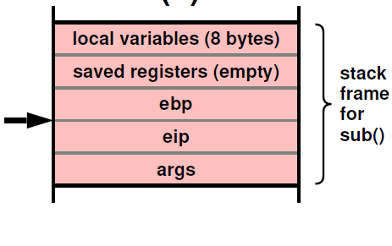
What is memory footprint ?
The addresses accessed by a particular program during its execution
Addresses in this context corresponds to the variables used by the program
Due to principle of locality, many programs have their variables placed nearby in their stack frames and by extension, in memory (both main memory and caches)
# of
accesses
addresses
main

Slide 10
Why is this vulnerable?
Just like in a game of battleships, if an attacker finds one relevant address of the victim program, he can deduce the other addresses because it is definitely going to be the nearby ones
# of
accesses
addresses
main

Slide 11
Naïve solution
So, to tackle this, can we distribute the variables in random inside the address space ?
Then that would come at a terrible performance
In fact, it would beat the purpose of high speed caches and would violate a ton of Operating system concepts and program mapping into memory
# of
accesses
addresses

Slide 12
Improvised solution
What if we give an impression that the victim program is working on a ton of variables, when in fact it is working on a few
Then the attacker has to browse through many variables and he will never be able to settle in on the exact variables
# of
accesses
addresses

Slide 13
Improvised solution
Lets assume that we present an illusion that we are working with 100 variables, when in actuality we are working with only 10
In the original (vulnerable) scenario, the attacker will definitely know that 10 variables are being used by the victim and he will always find those 10 variables – Probability of successful attack = 100%
In the improvised scenario, now the attacker has to guess among 100 variables !
Even if he knew that the victim uses only 10 critical variables, now he has to guess 10/100 locations Probability of successful attack ~ 0 to 100%
# of
accesses
addresses

Slide 14
Inspiration for the solution
This technique is already used in Digital Communication Systems as Frequency Hopped Spread Spectrum Modulation – from World War 2
Instead of settling at one critical frequency (fc) which is easily deducible by an attacker, what if the sender and receiver are tuned to send/receive from a range of frequencies fc1 to fc2
Then the attacker will never be able to settle in on the frequency at which they communicate as it is bound to change after a time slice
Likewise, by not allowing the attacker to settle in on one memory address, we are ensuring safety to some degree
Simple Basis : If you cannot convince them, then confuse them
Gain
# of
accesses
fc1
fc2
Frequency
addresses
Frequency Hopped Spread Spectrum modulation
Security through address space widening

Slide 15
How to achieve this ?
Compiler Based Solutions
Include Dummy Variables
What if we can provide this as a background solution without asking the user to include 100’s of fake variables ?
Break a long iterator or array into interleaved sections
Without considerable reduction in performance
A combination of solutions to produce a unified framework ?
Etc..
Hardware Based Solutions
What if one thread is dedicated to loading dummy addresses
without loss in performance
Use of a mathematical function
Opens up an entire arena of Hardware based randomization

Slide 16
Our Approach
We decided to go for the dummy variable approach as proof of concept
Concerns
Dummy Variables must not blow up the stack
Dummy Variables must not interfere with regular working of program
Dummy Variables must be included in background
Dummy variables must not cause measurable loss in performance
Must be a solution to be applicable to all languages and architectures
The security framework must be a plugin and should provide seamless integration to any existing compilation framework
These are the necessary components to our PoC
An LLVM toolchain and clang based environment that would convert any front-end program into an IR representation
A script that converts the IR to assembly format
A script that analyzes the assembly file to identify suitable spots and include dummy variables
A script that gets the objdump and populates the necessary inputs for a cache emulator that runs attacker and victim programs
A script that provides the output graph solution for visual representation
To note: the security feature (including dummy vars) is a configurable feature that can be turned ON/OFF

Slide 17
Our Approach
.c file
.ll file
.S file
exe file
objdump
Pre – compiled Attacker and its trace files
If secure execution is turned ON
Victim trace file
Modified .s file
Cache Emulator
Identify all variables in the address space
Include Dummy Variables
Output .csv files
Emulation of CONTECH Tool
Graph Template
Output Graphs

Slide 18
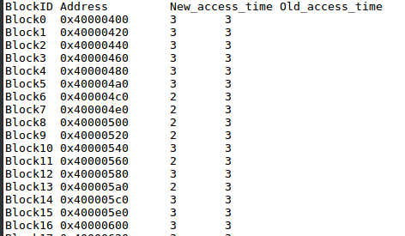
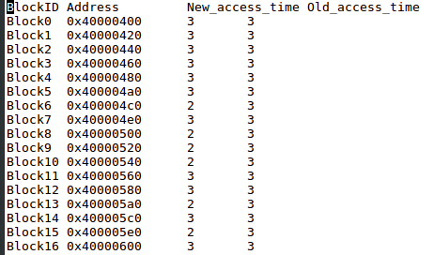
Result From Cache Algorithm
Results when secure algorithm off
Results when secure algorithm on
With Security, attacker is able to find 100% of the actual victim used addresses for a program
With Security, attacker is able to find 66.66% of the actual victim used addresses for a program

Slide 19
Future Scope
As new approaches are discovered, all the solutions – both compiler based and hardware based can be compiled into a framework
This opens a new arena in Hardware Security
Hardware Based Hardware Security
Software Based Hardware Security
Collaboration from a number of Engineers in the
Computer Architecture Division
Compilers Division
Operating Systems Division
Hardware Division
System Software Division
Firmware Division
To Provide a unified solution that can tackle Hardware Security as Side Channel Attacks – SCA are emerging threats !

Slide 20
Thank You

