Slide 1


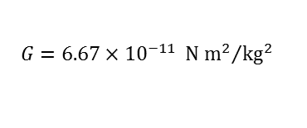



unit vector
${\hat{r}}_{12}$
$${\vec{F}}_{1 on 2}=−G\frac{m_{1}m_{2}}{r^{2}}{\hat{r}}_{12}$$
$m_{2}$
$r_{12}$
$$G=6.67×{10}^{−11} {\text{N} {\text{m}}^{2}}/{{\text{kg}}^{2}}$$
$m_{1}$

