Slide 1


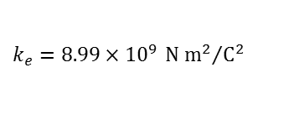



unit vector
${\hat{r}}_{12}$
$${\vec{F}}_{1 on 2}=k_{e}\frac{q_{1}q_{2}}{r^{2}}{\hat{r}}_{12}$$
$q_{2}$
$r_{12}$
$$k_{e}=8.99×{10}^{9} {\text{N} {\text{m}}^{2}}/{{\text{C}}^{2}}$$
$q_{1}$

