Slide 1


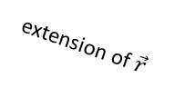
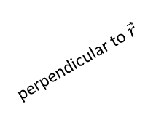

$\vec{τ}$ skewer
styrofoam connector
perpendicular to $\vec{r}$
$\vec{F}$ skewer
$\vec{r}$ skewer
extension of $\vec{r}$

