Slide 1
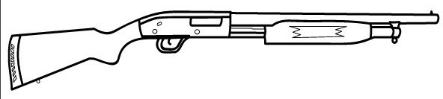


object 1
object 2
$$m_{1}$$
$$m_{2}$$

