Slide 1


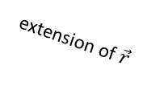
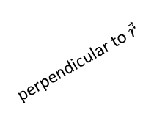

$$\vec{τ}$$
perpendicular to $\vec{r}$
$$\vec{r}$$
$$\vec{F}$$
extension of $\vec{r}$

