Slide 1
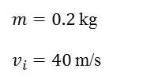

$m=0.2$ kg
$v_{i}=40$ m/s
mass of moon: $7.4×{10}^{22}$ kg

