Slide 1
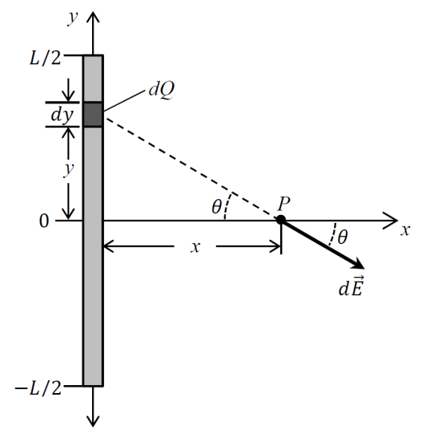
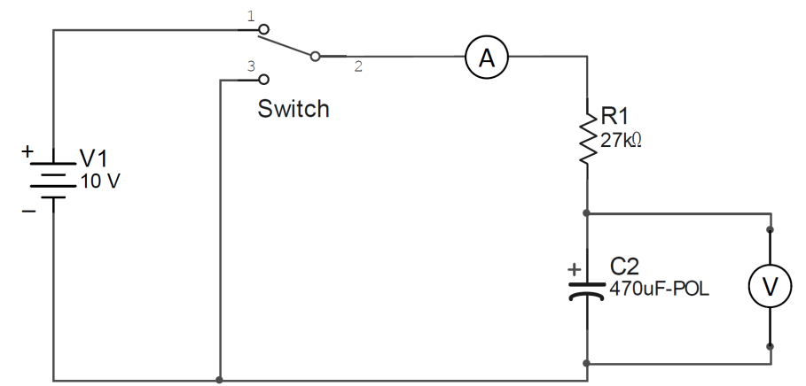
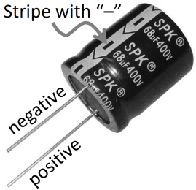
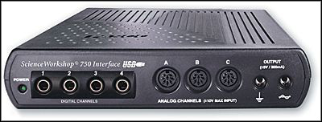


























$$y$$
$$v$$
$$\vec{E}\left(x\right)$$
$$\vec{E}\left(x+Δx\right)$$
$$𝓁$$
$$v_{S}$$
$$λ^{′}$$
$$v_{o}$$
+
$$z$$
$$\vec{B}$$
$$Δx$$
$$x$$
Physics For Doing!
Part 1: Activities for Physics 131
Detector
Assembly
light
sensor
turn wheel
Laser
beam
1
10
100
GAIN
ROTARY MOTION
SENSOR
bit o’ volume: $dV$
$$R$$
aperture wheel
gain
switch
rail
$$r$$
$$h$$
$$ρ=Cr$$
I
time
$$+$$
$$−$$
Area $A$
$$I$$
$$+$$
$$\vec{E}$$
$$−$$
P
b
$$+$$
$$−$$
$$+$$
$$−$$
c
$$+Q$$
$$−Q$$
1 atm
a
1800 K
d
300 K
1 liter
V

