Slide 1

Matter & Interactions I
Modern Mechanics
Ruth Chabay & Bruce Sherwood
Department of Physics
North Carolina State University
This project was funded in part by the National Science Foundation (grants DUE 95-54843 and 99-72420). Opinions expressed are those of the authors, and not necessarily those of the foundation.

Slide 2
Note
This presentation is normally accompanied by oral clarifications. However, it may be useful as it stands to give an overview of the nature of Volume I of Matter & Interactions.
Homework problems displayed in this presentation are copyright John Wiley & Sons.

Slide 3
Outline of Presentation
Goals
The momentum principle
Predicting effects of instruction
More on physical modeling
Potential energy is absolute
The point-particle system
Computer modeling

Slide 4
What should we teach?
Physics education research: a large investment by teachers and students is required for effective learning.
What is important enough to be worth a large investment on the part of students and teachers?
Need clear goals on which to base decisions.

Slide 5
Goals
Involve students in the contemporary physics enterprise:
Emphasize a small number of fundamental principles
(unification of mechanics & thermal physics; electrostatics & circuits)
Engage students in physical modeling
(idealization, approximation, assumptions, estimation)
Integrate 20th century physics
(atomic viewpoint; connections to biology, chemistry, mat. sci.)
(And, avoid simple repetition of high school physics)

Slide 6


Supporting materials:
Matter & Interactions I:
Modern Mechanics
mechanics;
integrated thermal physics
Matter & Interactions II:
Electric & Magnetic
Interactions
modern E&M; physical optics
John Wiley & Sons, 2002
http://www4.ncsu.edu/~rwchabay/mi

Slide 7
Components of Modern Mechanics
(Volume I)
Small number of fundamental principles
Physical and computer modeling
Atomic nature of matter: macro/micro
Unification of mechanics and thermal physics (statistical mechanics)
Visualization / simulation software

Slide 8
Fundamental Principles
The momentum principle
The energy principle
The angular momentum principle
The fundamental assumption of statistical mechanics
Instructional issue: How to make these appear fundamental to the student

Slide 9
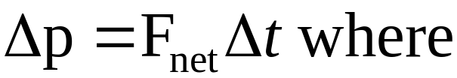
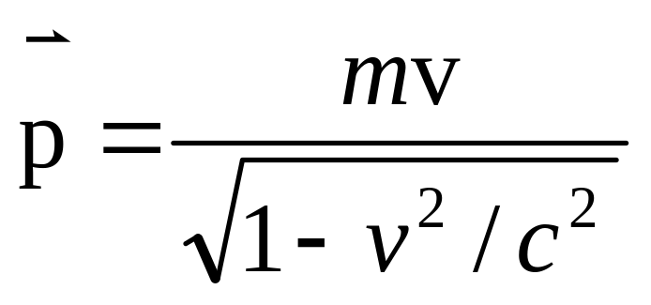
The Momentum Principle
Not central in traditional curriculum; comes very late in course
In M&I, start with
Momentum central to the entire course
Clear separation from KE and L

Slide 10
The Momentum Principle: Making Approximations
When can we approximate p ≈ mv?
For many students this is the first example of approximations in physics; gets them thinking about the issue
One of the aspects of building physical models of phenomena

Slide 11
The Momentum Principle:
The Newtonian Synthesis
Given a force law and initial conditions, iteratively update momentum and position; time-evolution character
Students do paper problems with one or a few steps
Students write programs for a variety of situations (orbits, oscillator, scattering)
De-emphasize problems where known motion is used to deduce forces

Slide 12
The Momentum Principle:
Paper Homework Problems Involving Modeling
Running students collide; estimate force
Hockey stick breaks; estimate collision time
NEAR spacecraft deflected by the Mathilde asteroid (see next slide)

Slide 13
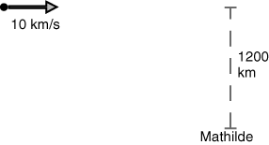
In 1997 the NEAR spacecraft passed within 1200 km of the asteroid Mathilde at a speed of 10 km/s relative to the asteroid (http://near.jhuapl.edu). Photos transmitted by the spacecraft show Mathilde’s dimensions to be about 70 km by 50 km by 50 km. It is presumably composed of rock; rock on Earth has an average density of about 3000 kg/m³. The mass of the NEAR spacecraft is 805 kg.
A) Sketch qualitatively the path of the spacecraft:
B) Make a rough estimate of the change in momentum of the spacecraft resulting from the encounter. Explain how you made your estimate.
C) Estimate the deflection (in meters) of the spacecraft’s trajectory from its original straight-line path, one day after the encounter.
D) From actual observations of the position of the spacecraft one day after encountering Mathilde, scientists concluded that Mathilde is a loose arrangement of rocks, with lots of empty space inside. What about the observations must have led them to this conclusion?
(week 2)

Slide 14
The Momentum Principle: Atomic Nature of Matter
Ball-and-spring model of solid
Apply momentum principle to model propagation of sound in a solid; determine speed of sound
Macro-micro connection to Young’s modulus (leads later to quantum stat mech of Einstein solid)

Slide 15
Confusion:
Momentum and Kinetic Energy
Students in traditional courses frequently confuse momentum and kinetic energy. Why?
Both concepts introduced late in first semester course, in close succession (interference) (Typical text: KE Ch 7, p Ch 9)
Similar formulas (both involve m and v)
Both concepts rarely used in one problem

Slide 16

Prediction: Matter & Interactions
M&I students should not confuse momentum and kinetic energy because:
Momentum introduced on day 1 and used extensively throughout course (primacy)
Kinetic energy introduced after 3 weeks work with momentum
KE often written as
Both concepts often used in a problem (energy check on momentum computations; scattering problems)

Slide 17
Test of Prediction
Two problems developed by U. of Washington researchers to probe students’ understanding of work-energy and impulse-momentum theorems.

Slide 18

Problem 1
The diagram depicts two pucks on a frictionless table. Puck 2 is four times as massive as puck 1. Starting from rest, the pucks are pushed across the table by two equal forces. Which puck has the greater kinetic energy after one second? Briefly explain your reasoning.
T. O’Brien Pride, S. Vokos, and L. C. McDermott, “The challenge of matching learning assessments to teaching goals: An example from the work-energy and impulse-momentum theorems,” Am. J. Phys. 66, 147-157 (1998)

Slide 19
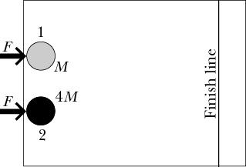
Problem 2
The diagram depicts two pucks on a frictionless table. Puck 2 is four times as massive as puck 1. Starting from rest, the pucks are pushed across the table by two equal forces. Which puck has the greater kinetic energy upon reaching the finish line? Briefly explain your reason-ing.
R. A. Lawson and L. C. McDermott, “Student understanding of the work-energy and impulse-momentum theorems,” Am. J. Phys. 55, 811-817 (1987).

Slide 20
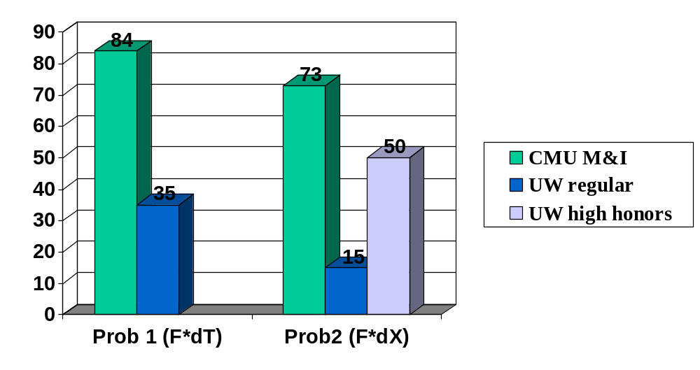
Correct answer and correct reasoning:

Slide 21
Momentum & Angular Momentum
When momentum and angular momentum were introduced late in the course (and near each other in time), we saw students on homework and exams write p_{ix}+L_{ix} = p_{fx}+L_{fx} .
This mistake disappeared once momentum had primacy.

Slide 22
More about Modeling
Physical Systems
Explain / predict a real physical phenomenon
Decide how to model a system
Make assumptions and approximations
Estimate quantities
Start from fundamental principles

Slide 23
Modeling in Homework & Exams
Explain, predict, understand messy real-world phenomena
Analyze a small number of phenomena, not a large number of textbook problems
Possible with a supportive curriculum that helps students learn to do this kind of analysis

Slide 24
A hot bar of iron glows a dull red. Using our simple model of a solid, answer the following questions. The mass of one mole of iron is 56 g.
(a) What is the energy of the lowest-energy spectral emission line? (Give a numerical value).
(b) What is the approximate energy of the highest-energy spectral emission line?
(c) What is the quantum number of the highest-energy occupied state?
(d) Predict the energies of two other lines in the emission spectrum of the glowing iron bar.
(Note: the actual spectrum is more complex than this, and a more complex model is required to explain it in detail.)
(week 7)

Slide 25
In 1988 telescopes viewed Pluto as it crossed in front of a distant star. As the star emerged from behind the planet, light from the star was slightly dimmed as it went through Pluto’s atmosphere. The observations indicated that the atmospheric density at a height of 50 km above the surface of Pluto is about one-third the density at the surface. The mass of Pluto is known to be about 1.5×10²² kg, and its radius is about 1200 km. Spectroscopic data indicate that the atmosphere is mostly nitrogen (N₂). Estimate the temperature of Pluto’s atmosphere. State what approximations and/or simplifying assumptions you made.
(week 12)

Slide 26
Modeling of Real Matter
Properties of matter not normally a major part of the introductory course
In M&I it makes a difference whether an object is made of lead or aluminum
Lots of homework problems deal with solids, molecules, atoms, nuclei, subnuclear particles, often involving experimental data
Quantized energy and angular momentum; photon emission and absorption

Slide 27
Supporting Student
Modeling Activities
Start immediately
p≈ mv
Do it consistently, all the time
Every homework and exam
Ask explicitly about simplifying assumptions, approx.
Group work
Talk to students as adults
This is what science is about!

Slide 28
Issues with Modeling Problems
Appropriate modeling problems are hard to find and hard to invent
Must repeat some particularly good problems in successive semesters
Issue of student copying from files: start work in class, put modeling problems on exams (but see first point above!)

Slide 29
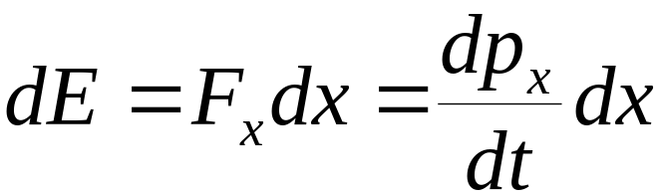
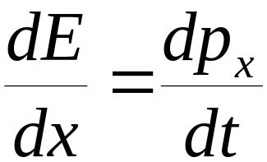
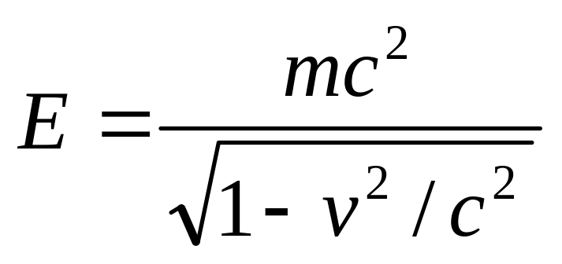
The Energy Principle
Start with
One dimension:
implies
It follows that

Slide 30
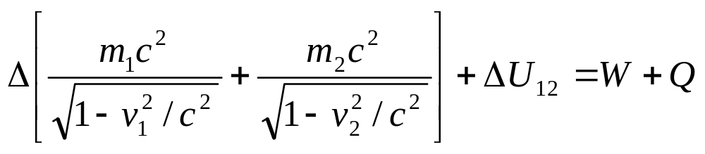
The Energy Principle:
Two interacting particles
(low speed so U is meaningful)

Slide 31
The Energy Principle:
Homework Problem
Positron and electron released
from rest very far from each other.
(a) Graph the various energies involved in this process, as a function of separation...

Slide 32

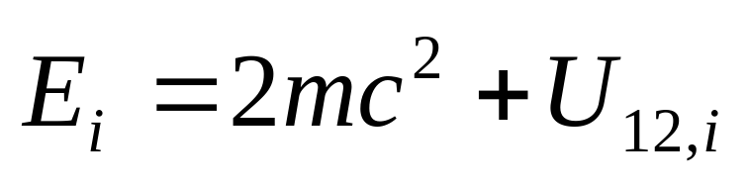
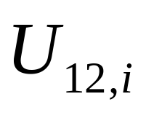
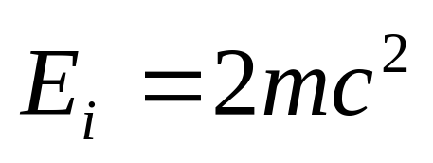

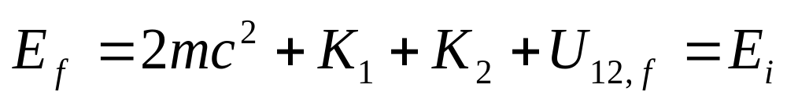
must be zero because
Therefore, U does not have an arbitrary additive constant.

Slide 33
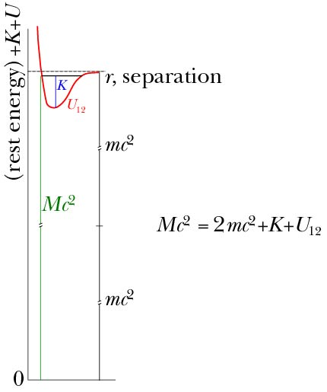
Oxygen
molecule
(U greatly exaggerated)

Slide 34
The Energy Principle:
Pedagogical Consequences
U must go to zero at large separation in a relativistic framework
Total energy never negative, so less discomfort with negative U
Grounding in absolute energy provides a firmer foundation for understanding energy changes

Slide 35
Energy and Entropy Absolute
Fred Reif points out that the absolute nature of energy is similar to the situation with entropy. Pre-quantum it had an arbitrary additive constant. Post-quantum, entropy has an absolute value.

Slide 36
Acknowledgements
Gregg Franklin
Curtis Meyer
(Carnegie Mellon)

Slide 37
The Energy Principle:
Multiparticle Systems
Illustrate the power and generality of fundamental principles, applicable to a wide range of phenomena
Treat counterintuitive phenomena, which are uncommon in mechanics

Slide 38
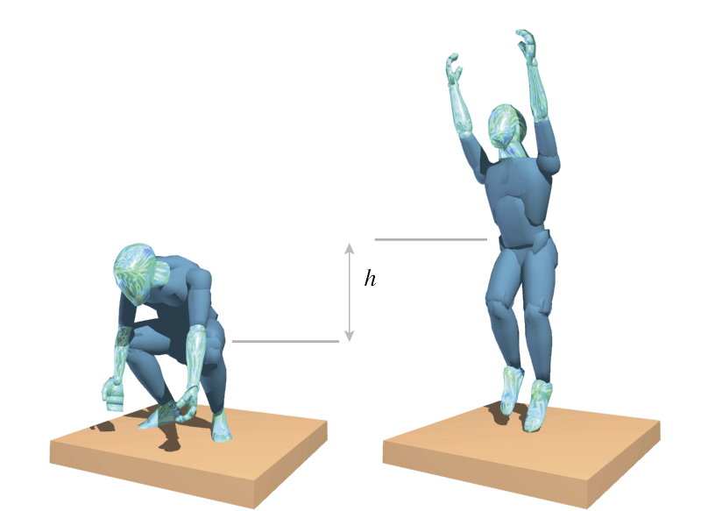
Energy in Multiparticle Systems:
Jumping Up
Pseudowork-energy equation
ΔK_{trans} = (N–Mg)h
True energy equation
ΔK_{trans} + ΔK_{rel} + ΔE_{therm} + ΔE_{chem} = –Mgh

Slide 39
New Approach:
The Point-Particle System
Consider a point particle:
• has total mass of real system
• located at C.M. of real system
• subjected to same forces as real system, acting at C.M.
N
F_{net} = N–Mg
Real system
ΔK_{trans} = (N–Mg)h
M
Mg
This is also ΔK_{trans} for real system

Slide 40
Advantages of
Point-Particle System
Distinguishing between the pseudowork-energy equation and the true energy equation is subtle, algebraic, and difficult for students
Distinguishing between the real system and the point-particle system is visual and much easier, and one uses just one equation (the real energy equation) for both systems

Slide 41

A chain (mass M) of metal links is coiled up in a tight ball on a frictionless table. You pull on a link at one end of the chain with a constant force F. Eventually the chain straightens out to its full length L, and you keep pulling until you have pulled your end of the chain a total distance d.
(a) What is the speed of the chain at this instant?
(b) In straightening out, the links of the chain bang against each other, and their temperature rises. Calculate the increase in thermal energy of the chain, assuming that the process is so fast that there is insufficient time for the chain to lose much thermal energy to the table. (Also, ignore the small amount of energy radiated away as sound produced in the collisions among the links.)
(week 9)

Slide 42
I’m surprised that most physics courses avoid the topics covered in this chapter (nonrigid systems and the energy analysis of systems involving friction) when they can be dealt with as straightforwardly as they are here. Typically friction is described as a “nonconservative force” and left at that.
I’ve always realized that most physics courses operate in a dream world of frictionless pulleys and massless springs because many real-world effects can’t easily be calculated analytically. This, however, is the first time I’ve seen a topic which can be dealt with using basic principles and simple algebra (meaning no iterative calculations) but which isn’t covered in physics textbooks (at least not in my high school physics textbook).
(Student D.S. responding to a “reflection” question)

Slide 43
Other Important Features
Separation of KE and L into translational parts plus parts relative to CM
Quantum statistical mechanics of Einstein solid; makes the entropy concept very concrete
Boltzmann factor governs thermal behavior

Slide 44
An Example of High Performance: Quiz (week 14)
A microscopic system consists of 9 quantized harmonic oscillators. The energy spacing for each oscillator is 5×10^{–21} J. When the internal energy of the system above the ground state is 20×10^{–21} J, what is the approximate temperature? Show your work clearly.
Given: Ω = (q+N–1)!/[q!(N–1)!] S = klnΩ
1/T = ∂S/∂E k = 1.4×10^{–23} J/K
70% of students had perfect scores (38/55, fall’99).
9% had poor scores.

Slide 45
Programs Written by Students
(in VPython)
Binary star
Damped oscillator
Energy in Moon voyage
Rutherford scattering
Angular momentum in planetary orbits
Heat capacity vs. T for Einstein solid

Slide 46
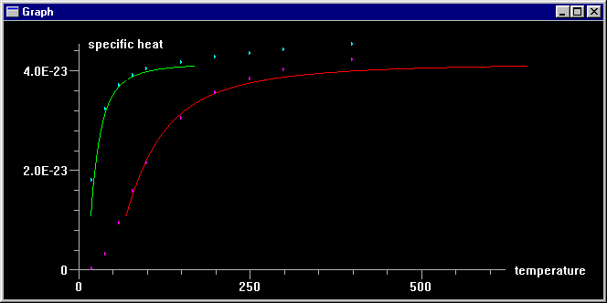
Week 14: Using ball and spring model of a solid (Einstein model: independent quantized oscillators), students write a computer program to calculate the heat capacity of a solid as a function of temperature.
Students fit curves to actual data for Pb and Al, with one parameter, the interatomic spring constant k_{s}. Values obtained are consistent with results obtained from Young’s modulus in Week 3.
Students measure heat capacity of water in a microwave oven.
heat capacity

Slide 47
Instructor Programs
Speed of sound
Potential energy well
Rutherford scattering distribution
Path of an atom in a gas
Carnot engine
etc.
Downloadable from M&I web site

Slide 48
More Homework Examples
The following slides show additional examples of homework problems that engage the student in physical modeling

Slide 49
In an earlier problem we found the effective spring constant corresponding to the interatomic force for aluminum and lead. Let’s assume for the moment that, very roughly, other atoms have similar values.
(a) What is the (very) approximate frequency f for the vibration of H₂, a hydrogen molecule?
(b) What is the (very) approximate frequency f for the vibration of O₂, an oxygen molecule?
(c) What is the approximate vibration frequency f of D₂, a molecule both of whose atoms are deuterium atoms (that is, each nucleus has one proton and one neutron)?
(d) Why is the ratio of the deuterium frequency to the hydrogen frequency quite accurate, even though the effective spring constant is normally expected to be significantly different for different atoms? (Hint: what interaction is modeled by the effective “spring”?)
(week 3)

Slide 50
In my opinion, the central idea in this chapter was to learn that atoms bonded to each other can be through of as two balls connected to one another with a spring. Once we understood this concept, we could apply the models of springs from the macroscopic world to the atomic level, which gave us a general idea of how things work at the atomic level. Understanding that gave us the ability to predict vibrational frequencies of diatomic molecules and sound propagation in a solid.
It is absolutely amazing how we can use very simple concepts and ideas such as momentum and spring motion to derive all kinds of stuff from it. I truly like that about this course.
(Student S.H. responding to a “reflection” question in week 3)

Slide 51
(a) Below about 80 K the specific heat at constant volume for hydrogen gas (H₂) is 1.5k per molecule, but at higher temperatures the specific heat increases to 2.5k per molecule due to contributions from rotational energy states. Use these observations to estimate the distance between the hydrogen nuclei in an H₂ molecule.
(b) At about 2000 K the specific heat at constant volume for hydrogen gas (H₂) increases to 3.5k per molecule due to contributions from vibrational energy states. Use these observations to estimate the stiffness of the “spring” that approximately represents the interatomic force.
(week 12)

Slide 52
At sufficiently high temperatures, the thermal speeds of gas molecules may be high enough that collisions may ionize a molecule (that is, remove an outer electron). An ionized gas in which each molecule has lost an electron is called a “plasma.” Determine approximately the temperature at which air becomes a plasma.
(week 12)

Slide 53
Matter & Interactions I:
Modern Mechanics
modern mechanics; integrated thermal physics
Matter & Interactions II:
Electric & Magnetic Interactions
modern E&M; physical optics
Ruth Chabay & Bruce Sherwood
John Wiley & Sons, 2002
http://www4.ncsu.edu/~rwchabay/mi

