Slide 1
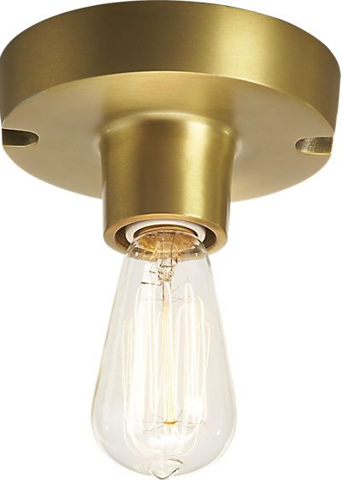





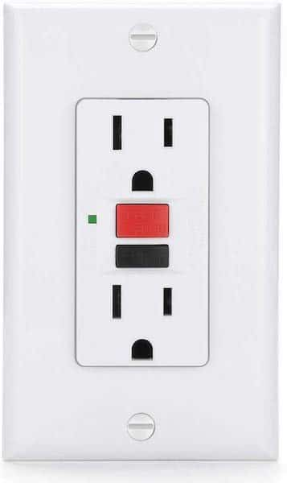
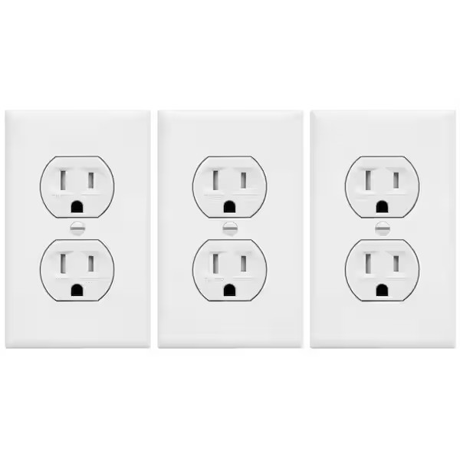
Today’s Lab
6
This light from that switch
Three-way switches controlling that light
4
5
NOT protected
by GFCI
3
1
2
Switched
Unswitched
protected
by GFCI
top outlet switched here
GFCI
GFCI on left protects light #6 and all three receptacles

Slide 2
Today’s Lab
6
This light from that switch
Three-way switches controlling that light
4
5
NOT protected
by GFCI
3
1
2
Switched
Unswitched
protected
by GFCI
top outlet switched here
GFCI
GFCI on left protects light #6 and all three receptacles

Slide 3
Today’s Lab
6
This light from that switch
Three-way switches controlling that light
4
5
NOT protected
by GFCI
3
1
2
Switched
Unswitched
protected
by GFCI
top outlet switched here
GFCI
GFCI on left protects light #6 and all three receptacles

Slide 4
Today’s Lab
6
This light from that switch
Three-way switches controlling that light
4
5
NOT protected
by GFCI
3
1
2
Switched
Unswitched
protected
by GFCI
top outlet switched here
GFCI
GFCI on left protects light #6 and all three receptacles

Slide 5
Today’s Lab
6
This light from that switch
Three-way switches controlling that light
4
5
NOT protected
by GFCI
3
1
2
Switched
Unswitched
protected
by GFCI
top outlet switched here
GFCI
GFCI on left protects light #6 and all three receptacles

