Slide 1
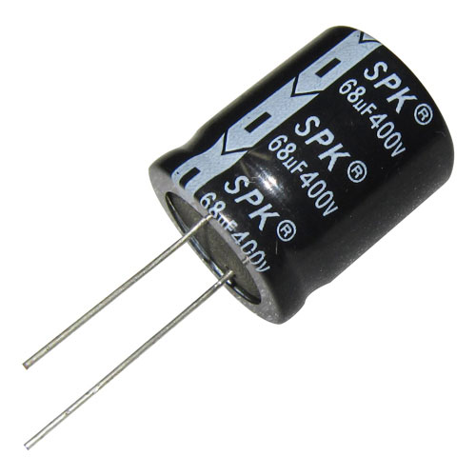
Stripe with “–”
negative
positive

