Slide 1






















$x^{′}=γ_{v}\left(x−vt\right)$
$t^{′}=γ_{v}\left(t−\frac{v}{c^{2}}x\right)$
$y^{′}=y$
$z^{′}=z$
$γ_{v}=\frac{1}{\sqrt{1−\left({v^{2}}/{c^{2}}\right)}}$
${}_{55}^{137}{\text{Cs}}$ (30.08 years)
$β^{−}$ (0.512 MeV)
m
${}_{56}^{137 }{\text{Ba}}$ (2.552 minutes)
$γ$ (0.662 MeV)
Relativity For Doing!
${}_{56}^{137}{\text{Ba}}$ (stable)
1st front emitted
Source
Activities for Space, Time, and Relativity
Detector
Assembly
$t=0$:
Spring 2024
2nd front emitted
light
sensor
turn wheel
…source and first front both move forward…
Source
1st front, traveled forward
Receiver
$t=T$:
$$u=+0.8c$$
1
10
100
GAIN
ROTARY MOTION
SENSOR
$$vΔt$$
$$λ_{R}$$
aperture wheel
gain
switch
rail
$$cΔt$$
Frame $S$
Frame $S′$
$$ct$$
$$ct′$$
$$a=g$$
$$2$$
Lorentz
$$=9.8 \text{m}\text{/}\text{s}$$
$$x$$
$$x′$$
$$v$$
*
ListPlot[{lorentz[1, 2, v], lorentz[1, 5, v]}, ...]
ListPlot[{galilean[1, 2, v], galilean[1, 5, v]}, ...]
Laser
beam

Slide 2




$$H$$
$$a=g$$
$$2$$
$$=9.8 \text{m}\text{/}\text{s}$$

Slide 4

$$u=+0.8c$$

Slide 5





${}_{55}^{137}{\text{Cs}}$ (30.08 years)
$β^{−}$ (0.512 MeV)
${}_{56}^{137\text{m}}{\text{Ba}}$ (2.552 minutes)
$γ$ (0.662 MeV)
${}_{56}^{137}{\text{Ba}}$ (stable)
Laser
beam

Slide 6

shorter wavelength λ
shorter period T
higher frequency f
“blue-shifted”
longer wavelength λ
longer period T
lower frequency f
“red-shifted”
same speed $c$

Slide 7




Source
$t=0$:
1st front emitted
…source and first front both move forward…
2nd front emitted
Source
1st front, traveled forward
Receiver
$t=T$:
$$vΔt$$
$$λ_{R}$$
$$cΔt$$

Slide 8
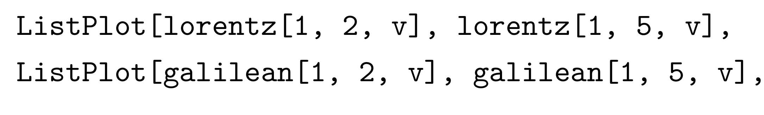

Anna
Bob
$$v$$
*
ListPlot[{lorentz[1, 2, v], lorentz[1, 5, v]}, ...]
ListPlot[{galilean[1, 2, v], galilean[1, 5, v]}, ...]

Slide 9
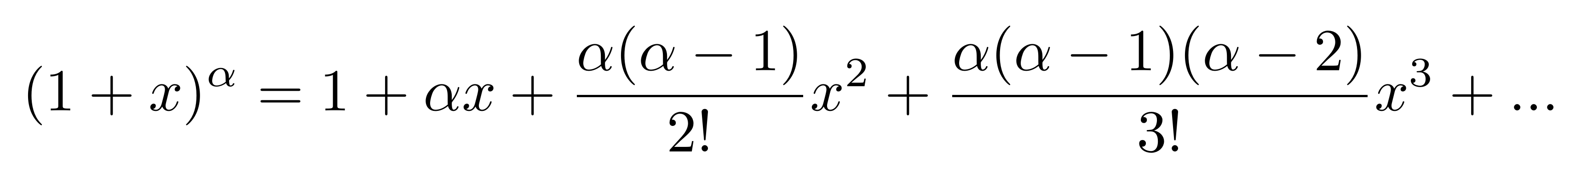
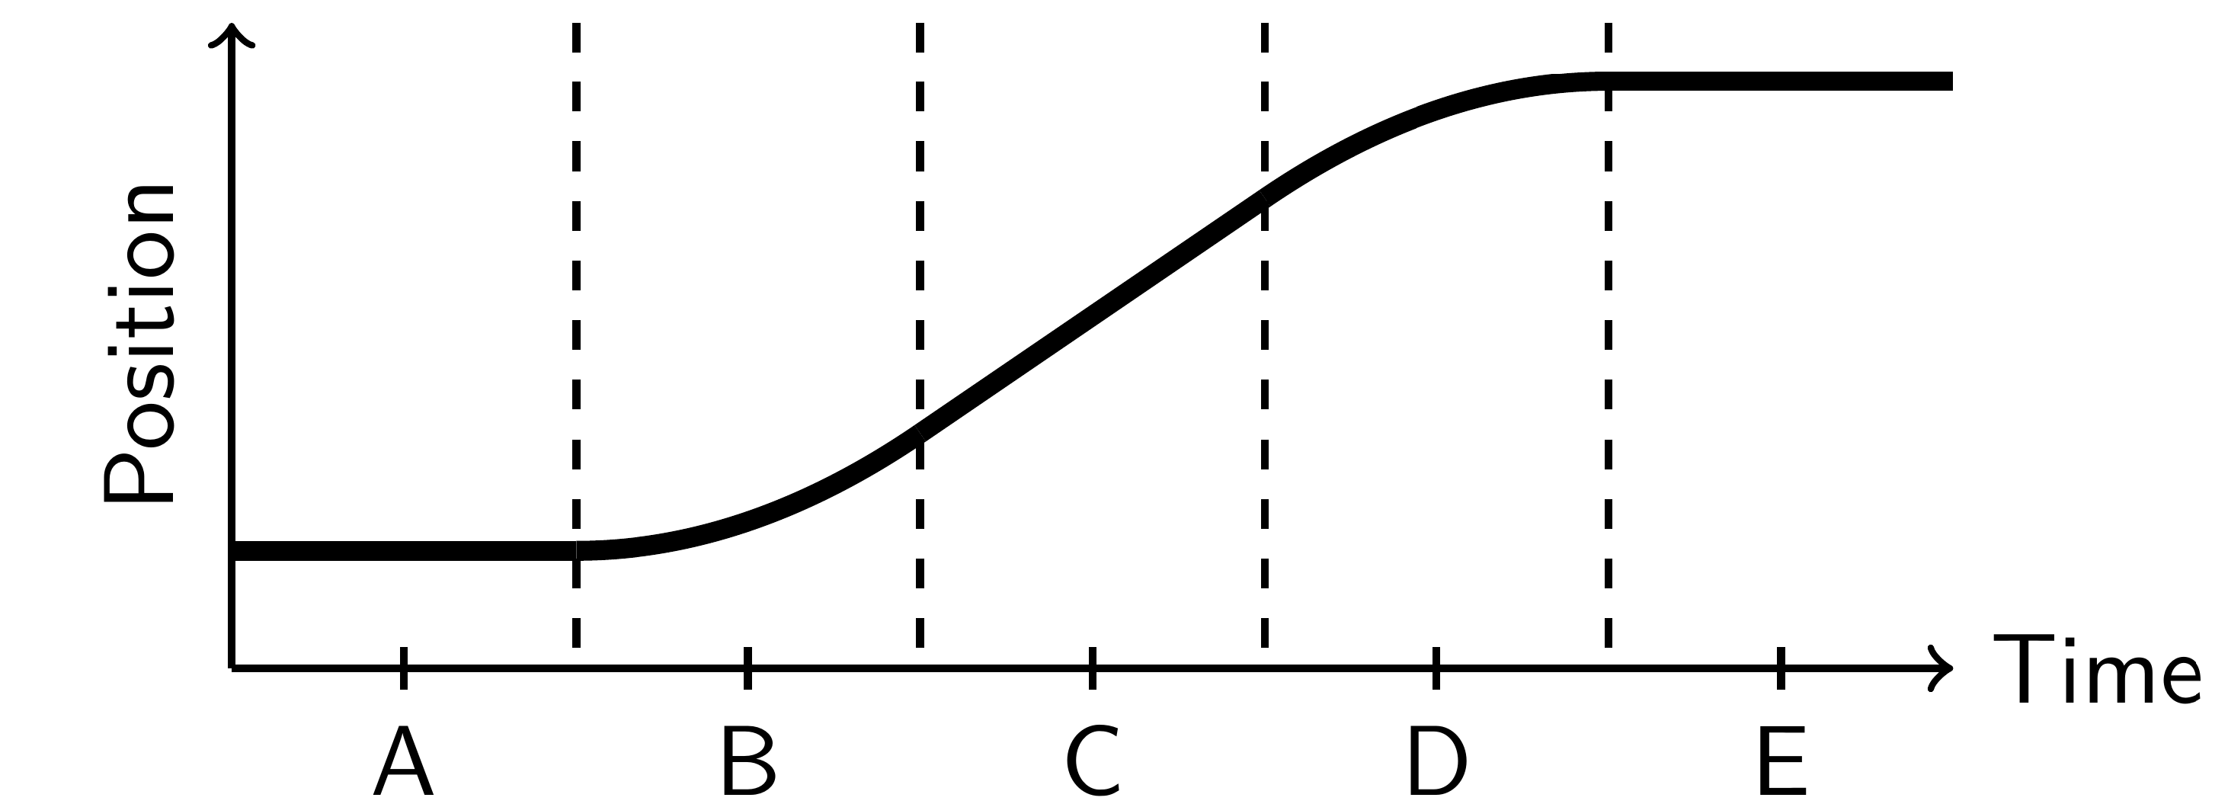

Slide 10
Anna
Bob
$$v$$
*
ListPlot[{lorentz[1, 2, v], lorentz[1, 5, v]}, ...]
ListPlot[{galilean[1, 2, v], galilean[1, 5, v]}, ...]

Slide 11
Bob
Anna

Slide 12




Frame $S$
Frame $S′$
$$ct$$
$$ct′$$
Lorentz
$$x$$
$$x′$$

