Slide 1
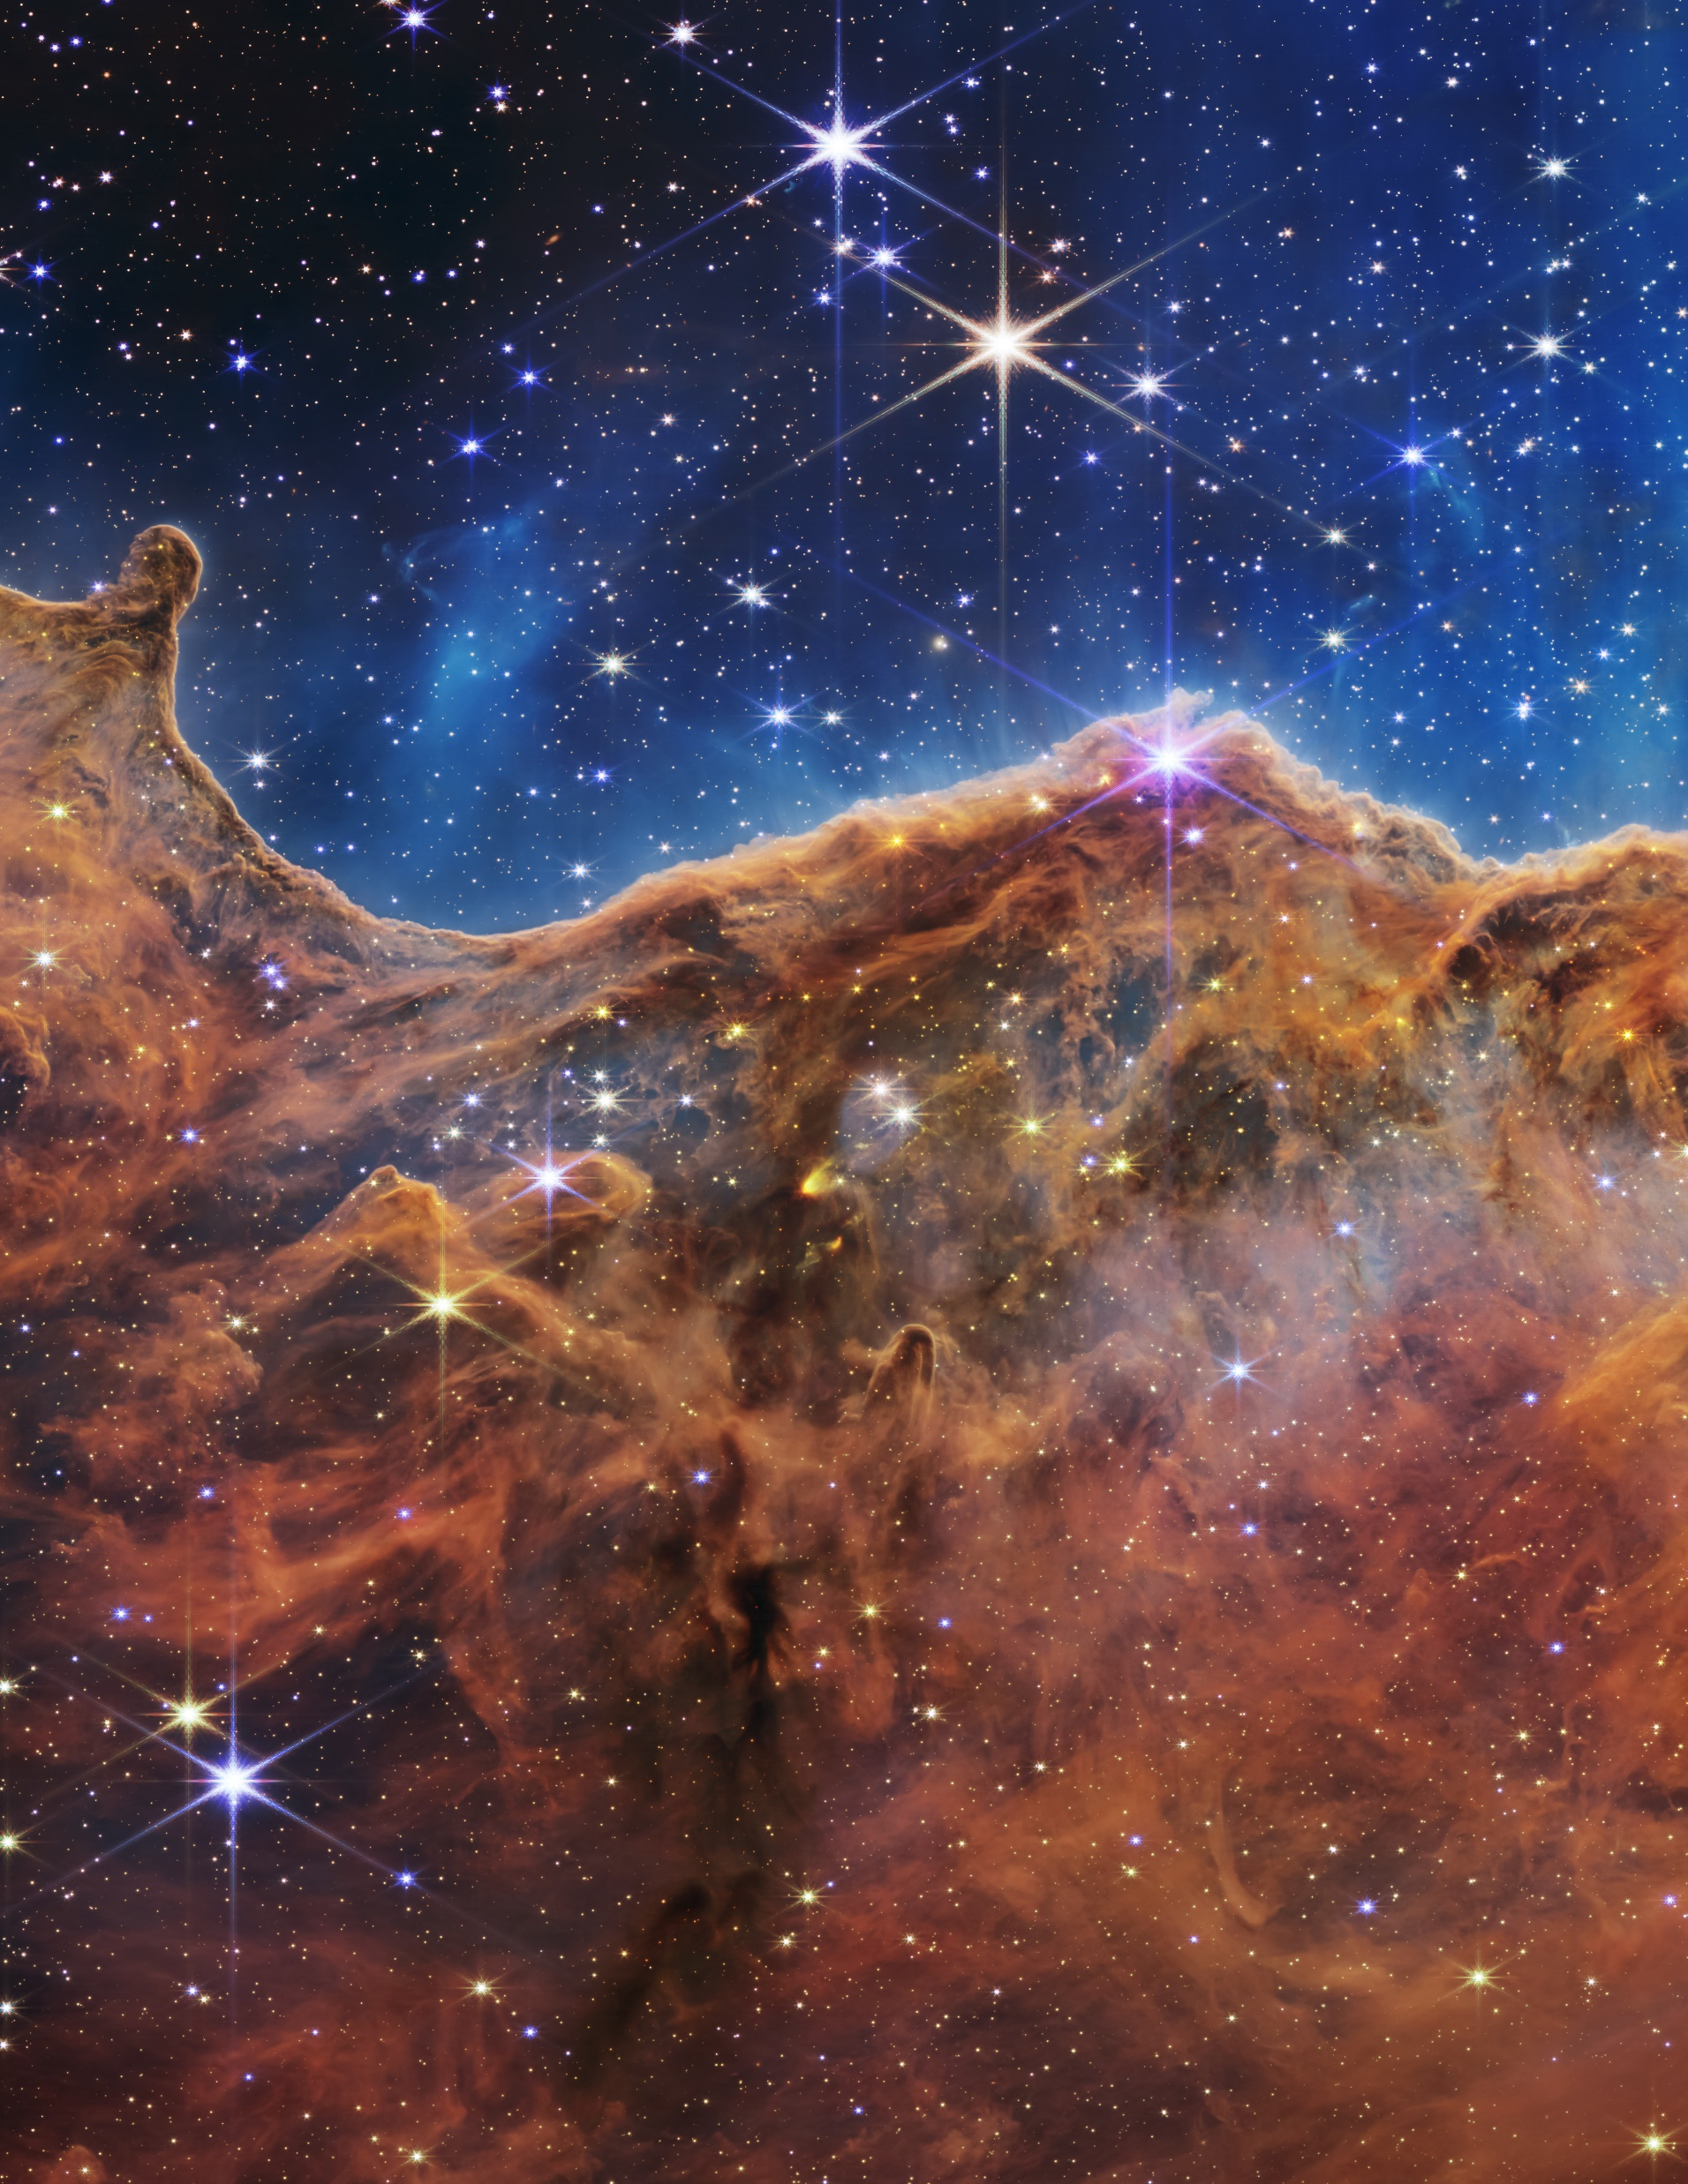
Astronomy For Doing!
Laboratory Exercises for Physics 121

