Slide 1
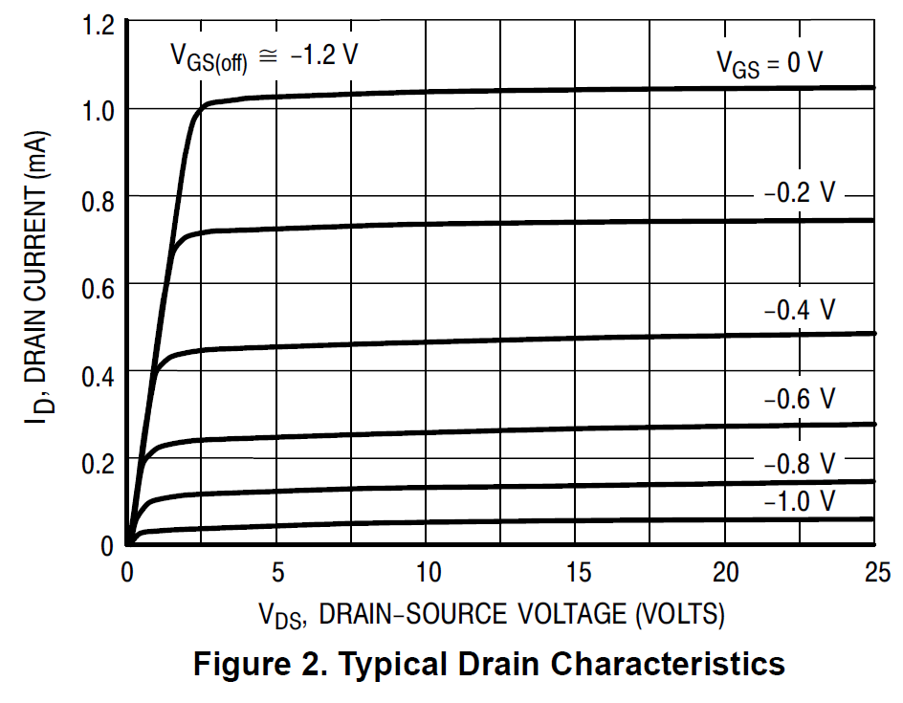
JFET properties (2N5457 modified)
Ohmic region
0.6
0.5
0.4
0.3
0.2
0.1
0
“Active” or “Saturation” region
Pinch-off voltage
Notes:
Generically, note resistor. “BIG” resistor means reduces current even more.

