Slide 1
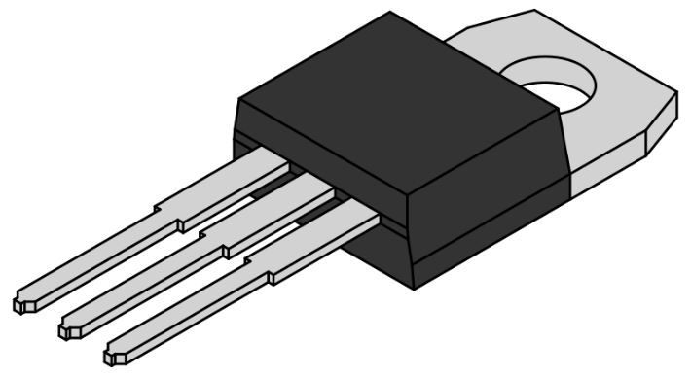
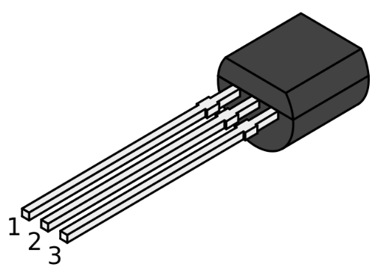
1
1
2
2
3
3
TO-220 package
TO-92 package

