Slide 1
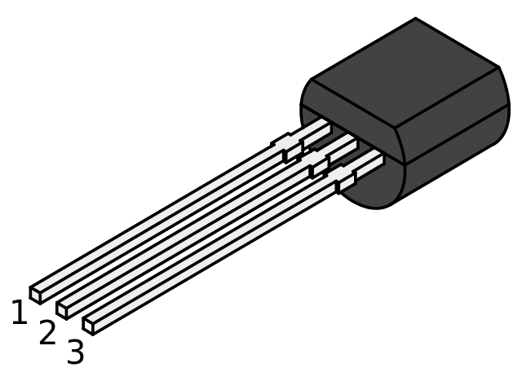
1
2
3
TO-92 package

