Slide 1
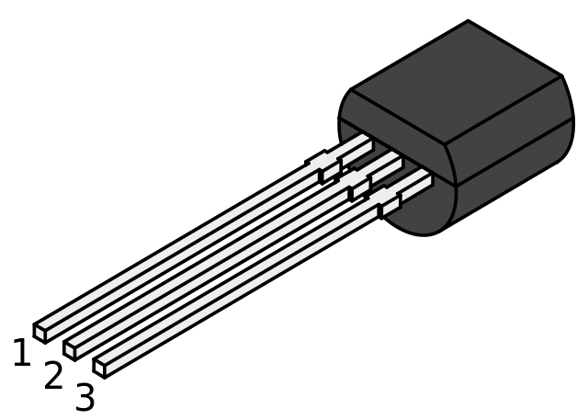
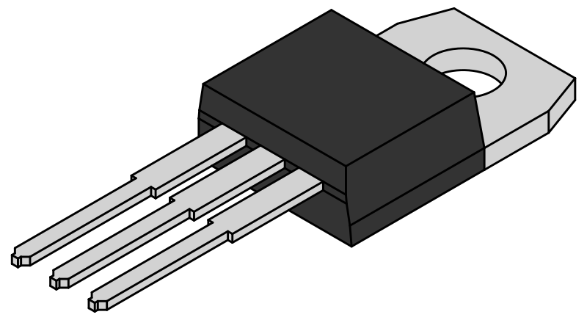
1
2
1
3
2
3
TO-92 package
TO-220 package

