Slide 1
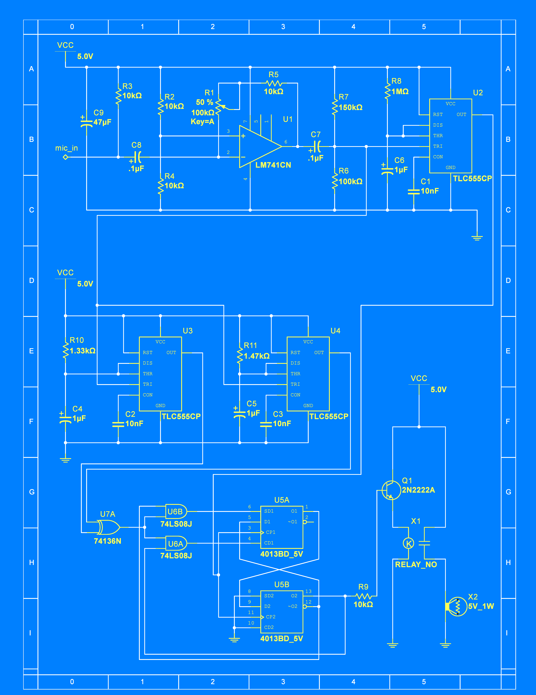
Electronics For Doing!
Laboratory Exercises for Physics 216

