Slide 1
ProCp - Project Core phase Rural Cultivation and Atmospheric Emulation Application
Richard Dyer Khan, Al-Mohaiminul IslaM
Tsanko Hadzhiev Khan, Raima
Zisis Damianidis Mihail Hadzhinikolov

Slide 2
Presentation Contents
Project overview
Project Purposes
Project Steps
Project roles
demo explanation and test cases

Slide 3
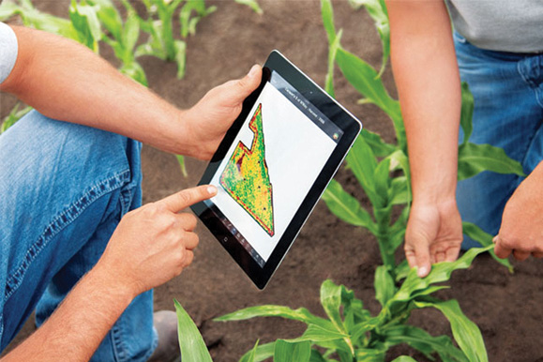
Project Overview

Slide 4
Project Purposes
to simulate cultivating specific crop(s) in an area of land during a certain length of time
to use RCAEA in order to determine when, where, and what crops to place in a specified piece of land

Slide 5
Project Steps
Phase I: Project plan
Phase II: User requirement specifications
Phase III: Test plan and test cases
Phase IV: Design document
Phase V: Programming/Testing

Slide 6
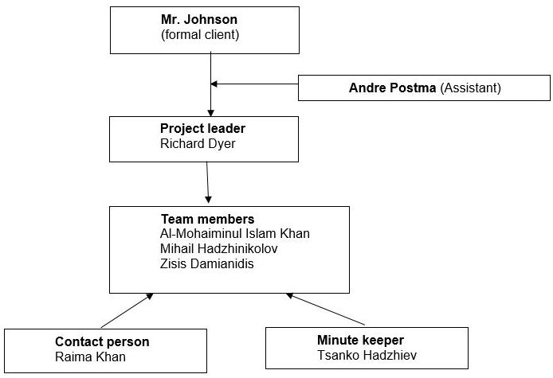
Project Roles

Slide 7


Slide 8

Enjoy RCAEA Demo!!!

Slide 9

Any Questions?

Slide 10

Thank you

