Slide 1
Hack-the-Pool 2026
“Cause of Death: Franz Ferdinand”
History remembers the hunter. We follow the hunted.
Rebeka Erdő, Lisa Gollner, Leander Gussmann, Vasyl Holovachko, Simon Mayer, Caroline McKinley, Anna Puhr, Henje Richter

Slide 2
Main Steps of Data Creation
→ our basis: Oxygen Vault, Digitised Diary of Franz Ferdinand, Website about the Voyage (www.franzferdinandsworld.at)
→ Narrative: Archduke Franz Ferdindands Voyage and Hunting trip 1892-93 on the ship “Kaiserin Elisabeth”, with a focus on the animals
Data normalization and enrichment
→ VS Code/Command Line + Claude Code
→ using existing patterns for the creation of the categories (people, places, institutions)
→ features that connect the information within the vault and the diary with the voyage and the hunting trips (vault, digitised diary and ranking lists and website)
Result: 84 people, 137 places on 94 distinct coordinate points, 17 animals/animal groups that were sent back to vienna

Slide 3
Data Flow Diagram

Slide 4
Interface Workflow + Diagram

Slide 5
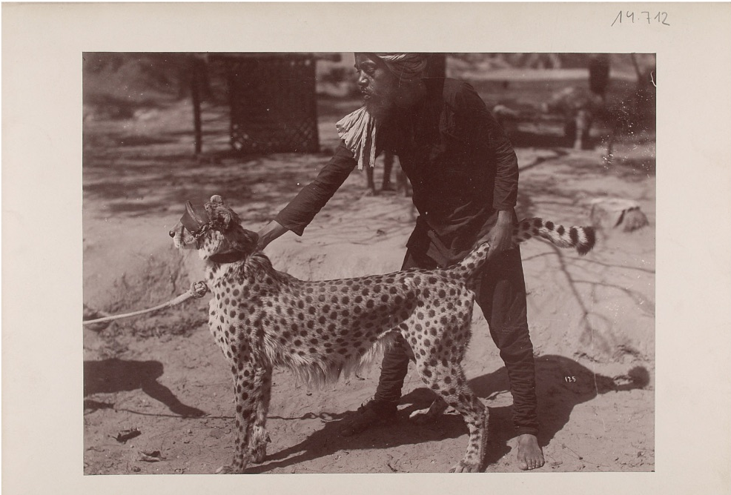
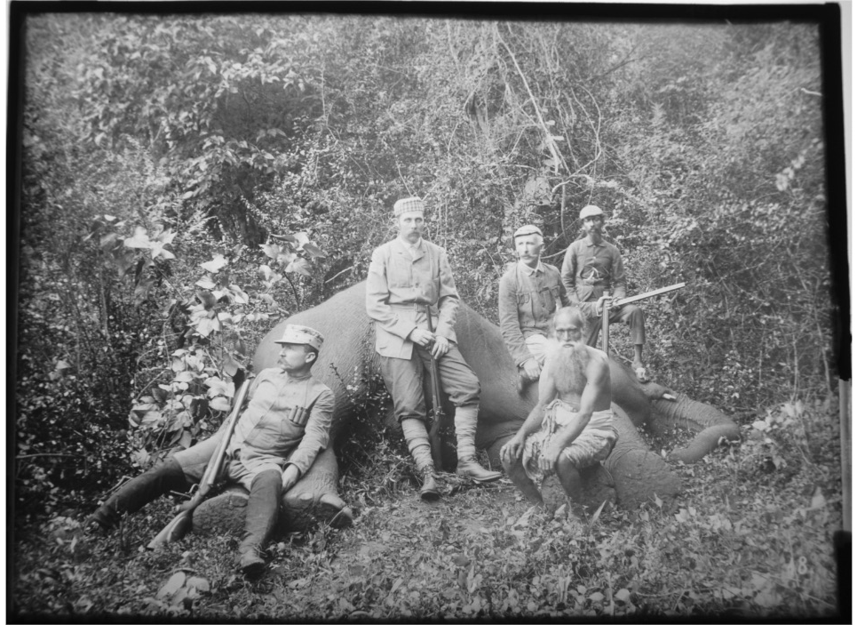
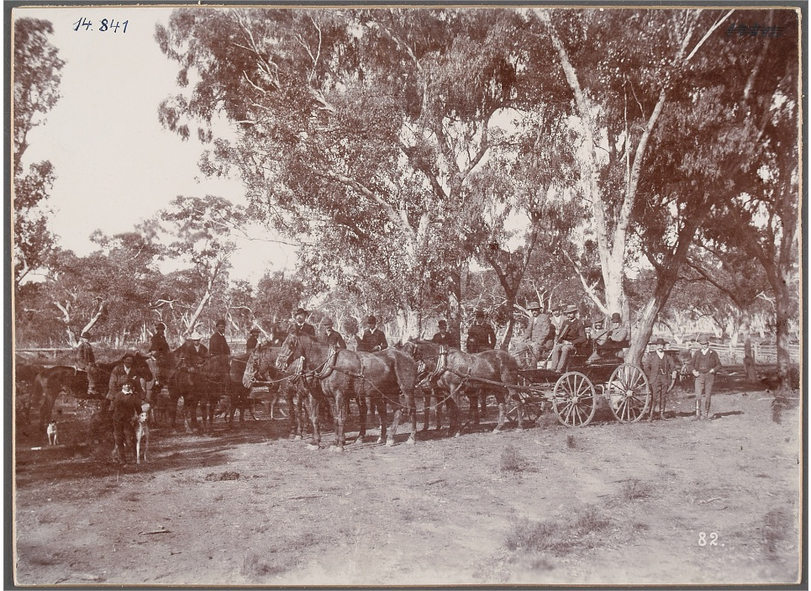
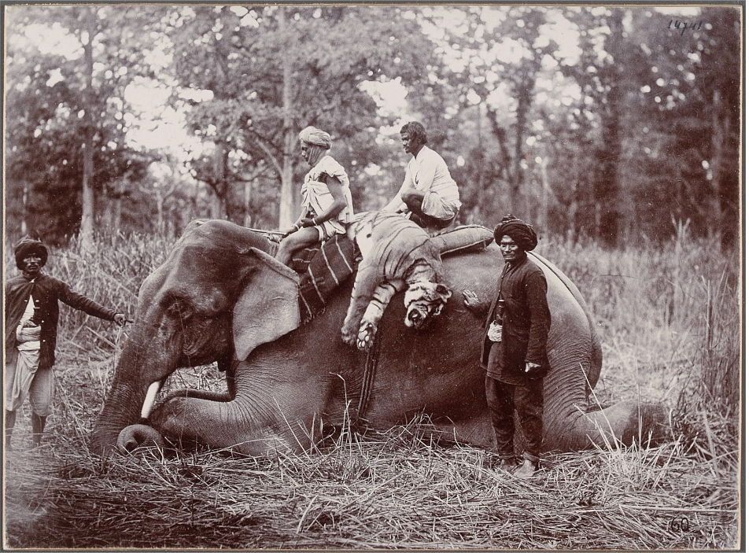
Storyline
Between 1892 and 1893, Archduke Franz Ferdinand shipped around the world. Hunting was a defining part of his voyage, with thousands of animals reportedly killed along the way.
Among them was Siriska, the tiger recorded as his first tiger kill on the expedition.
With her story as a starting point, we offer a different way into the journey: not through the hunter’s achievements, but through the animals that became part of his archive.

Slide 6
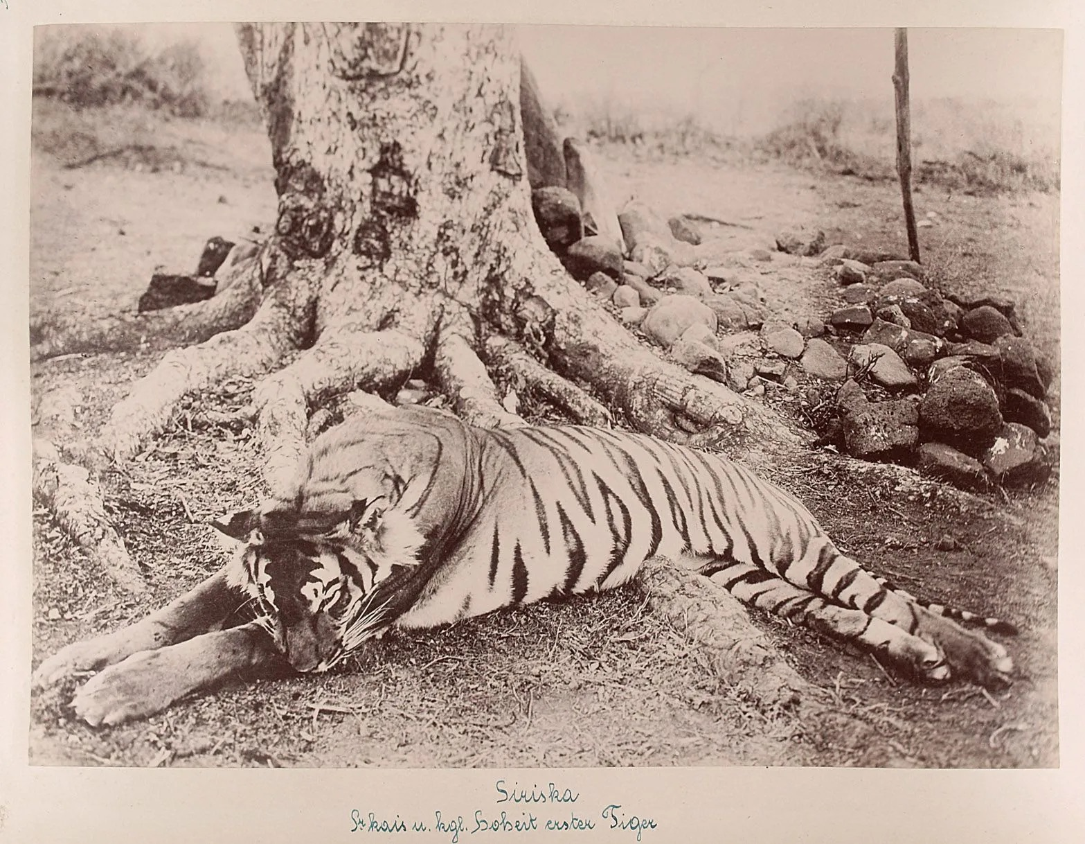
Storyline + Link to Live Demo
Siriska’s story does not end with the hunt.
By connecting diary entries with photographs, newspaper reports, and collection records, you can investigate how these hunts were recorded, perceived, and remembered.
“The piles of dead animals the prince so proudly posed in front of were eventually to be mirrored in the millions of lives lost to the Great War: on June 28, 1914, 19-year-old Gavrilo Princip stepped up in front of the Archduke and shot him in the neck.”
https://nepalitimes.com/nepali-kukur-franz-praises-nepalis-shoots-their-animals

